Slide 1
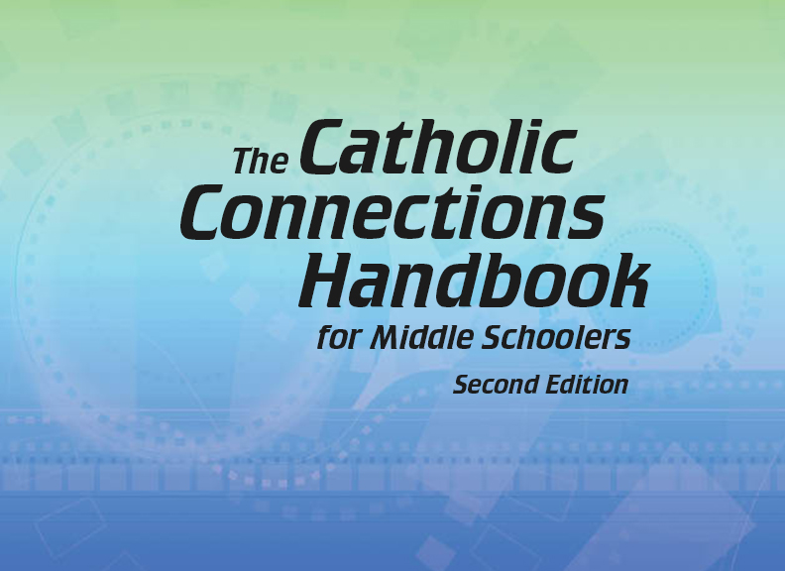

Document #: TX005820

Slide 2
Liturgy
and Sacraments
Chapter 33
The Sacrament of Baptism

Slide 3
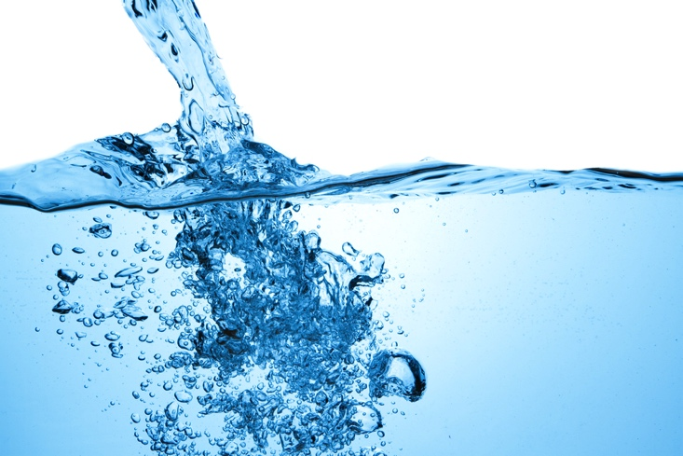
Chapter Summary
In this chapter, we will consider the power of the Rite of Baptism and the importance of Baptism in our own lives.
© kubais/Shutterstock.com
We will discover that Baptism cleanses us from Original Sin as it welcomes us into the faith. We also will examine God’s universal plan for the salvation of all people.

Slide 4
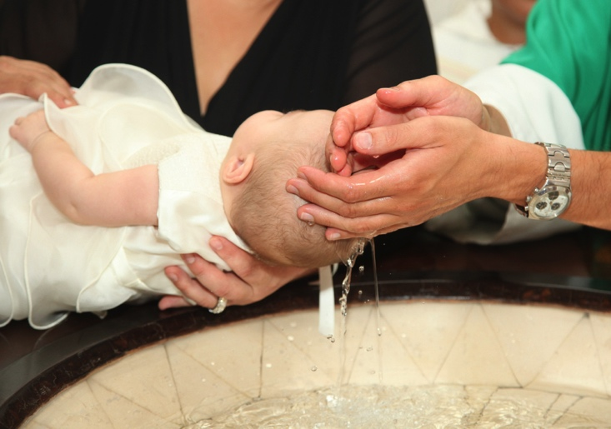
Introduction and “The Birth of a Catholic” (Handbook, pages 352‒354)
Through the Sacrament of Baptism, we are born of water and the Spirit into new life in Christ.
© AntonioGravante/Shutterstock.com

Slide 5
Journal It!
What do you know about your own Baptism?
What have you seen in pictures of this day?
What do you remember from other Baptisms that you have been to?
© Carmen2011/Shutterstock.com

Slide 6
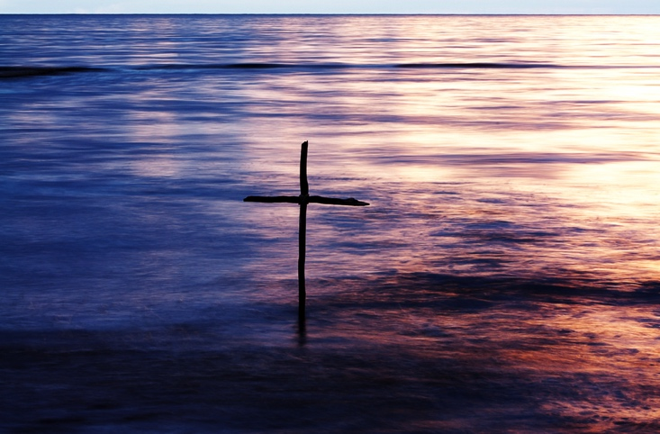
“The Waters of Baptism”
(Handbook, pages 354‒355)
The waters of Baptism wash away Original Sin, changing us forever to be children of God.
© Mycteria/Shutterstock.com

Slide 7
Review It!
Fill in the blank:
The waters of Baptism wash away _________ ____.
© Blackspring/Shutterstock.com
Notes:
Answer: Original Sin

Slide 8
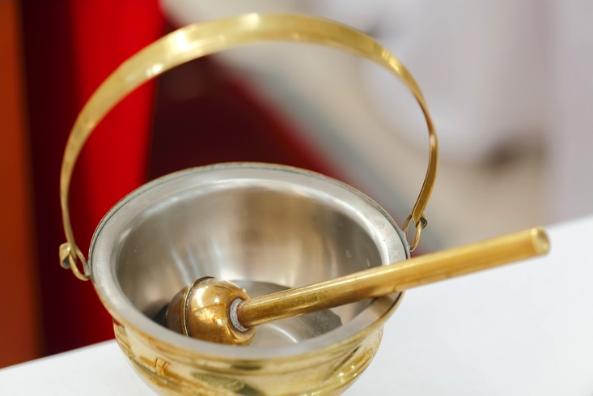
“Rite of Baptism”
(Handbook, pages 356‒361)
The Rite of Baptism is our entrance into the Body of Christ through action and symbol.
© Bofo/Shutterstock.com

Slide 9
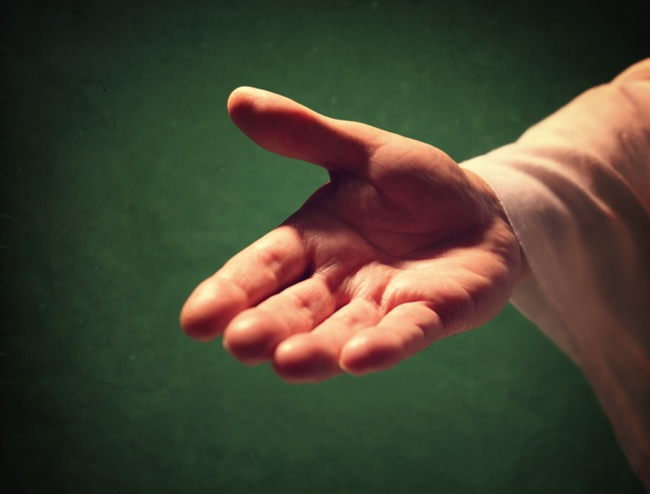
“Salvation without Baptism”
(Handbook, pages 361‒362)
God can do all things and has a plan for salvation that includes all people.
© BrianAJackson/Shutterstock.com

Slide 10
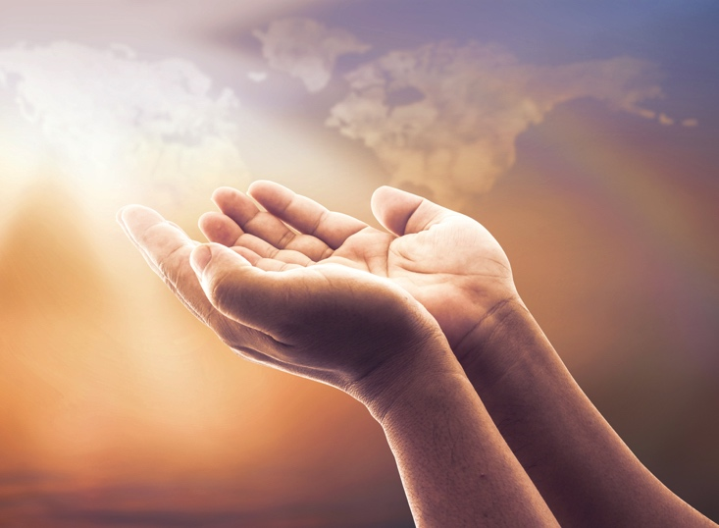
Review It!
True or False:
Baptism is essential for salvation. Discuss with a neighbor.
© CHOATphotographer/Shutterstock.com
Notes:
Explain that Baptism is essential for salvation, yet a person who has lived an extraordinary life but didn’t get to be baptized can still be saved.

