Slide 1


Document #: TX005848

Slide 2
The Prophets,
Jesus Christ, and the Holy Spirit
Chapter G
Women of the New Testament

Slide 3
Chapter Summary
This chapter will take a look at significant women of the New Testament and their contributions to God’s plan of salvation.
These women supported the mission and ministry of Jesus, and the mission and ministry of the Church.
The women include Mary of Nazareth, Mary Magdalene, women Jesus healed, and women in the New Testament Letters.
These women were active in the life of Christ and the early work of the Church and provide role models for us today.

Slide 4
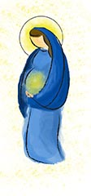
Mary of Nazareth
(Luke 1:26–56, 2:1–52; John 2:1–12)
What do you know about
Mary, the Mother of God?
What do you think Mary
was like when she was
your age?
Do you think Mary was
ever afraid?
© Thoom/Shutterstock.com

Slide 5
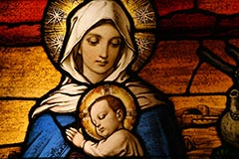
Mother of God
When asked to give birth
to the Son of God, Mary
responded that she was a
servant of God and would
do God’s will.
God worked through Mary to
bring about the salvation of
the world.
At Mary’s request Jesus performed his first public miracle by changing water into wine.
© Thoom/Shutterstock.com

Slide 6
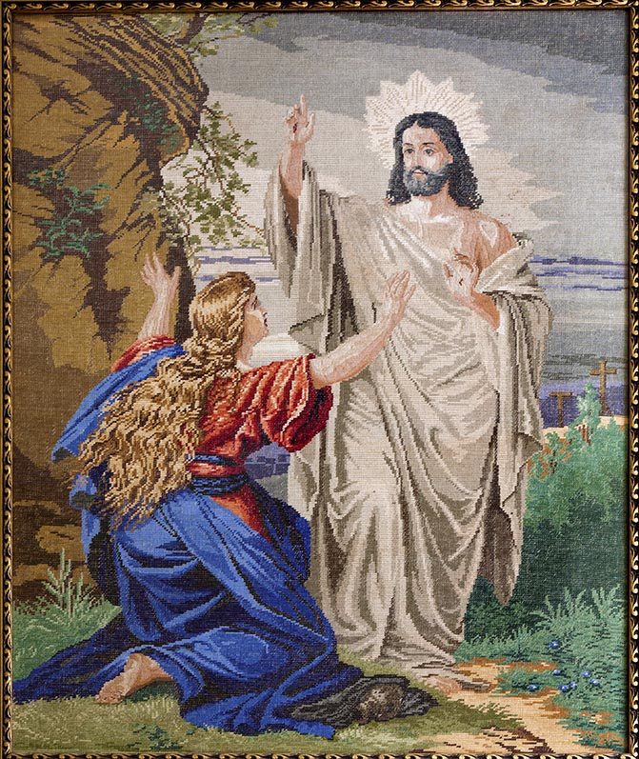
Mary Magdalene, Disciple of Jesus
(Luke 8:1–3; Matthew 27:55–61; John 20:1–18)
Mary Magdalene first met Jesus when he healed her from being possessed by seven demons.
As Jesus traveled through towns and villages, Mary Magdalene and many other women used their own resources to help Jesus and his disciples.
Mary and other women followed Jesus from Galilee and witnessed his Crucifixion. They remained with him while his body was placed in the tomb.
Mary Magdalene was the first to discover the empty tomb and witness the risen Christ. It is Mary Magdalene who told the other disciples about the Resurrection.
© Renata Sedmakova / Shutterstock.com

Slide 7
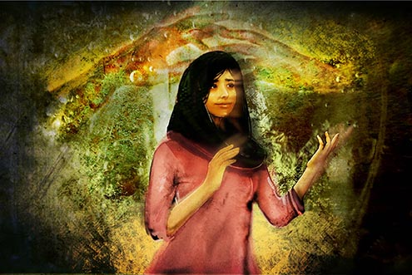
Interview with the Magdalene
Pick one person to be Mary Magdalene.
Take turns asking this person questions about her life. The person must answer
as she or he thinks Mary would answer.
Some questions might be:
  What was it like to be possessed by
  demons?
  What leadership qualities did you use to
  lead the women who followed Jesus?
After the person answers several questions, pick another person to be
Mary and interview her or him.
© Odessa Sawyer / Saint Mary's Press

Slide 8
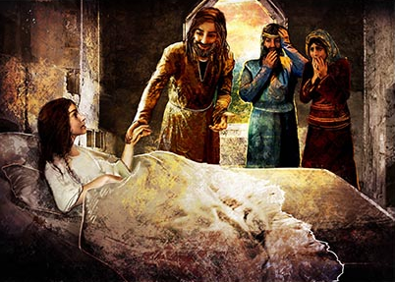
Women Who Were Healed
(Matthew 15:21–28 and Mark 5:25–34)
Discussion Questions:
How many stories do you
know about Jesus healing
people?
What were some of the
things that Jesus healed
people from?
© Odessa Sawyer / Saint Mary's Press

Slide 9
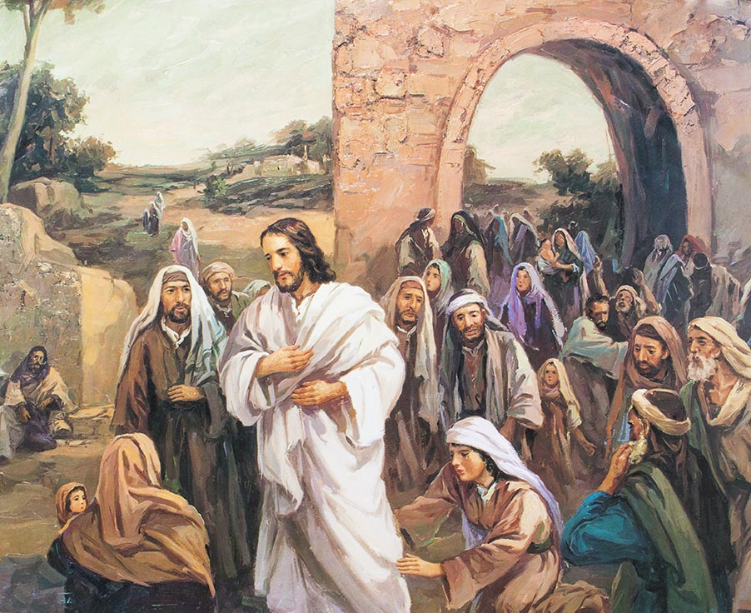
Healed by Faith
A Canaanite woman asked
Jesus to heal her daughter.
She was persistent, even
after Jesus objected, and
Jesus healed her daughter.
A woman who suffered from
severe bleeding was healed
simply by touching Jesus’ cloak.
For these women, their faith in
Jesus brought them healing.
They are models of prayer and discipleship for us today.
© Freedom Studio / Shutterstock.com

Slide 10

Lydia, a Purple Cloth Dealer
(Acts 16:11–15)
Paul encountered Lydia, a
dealer in purple cloth, on his
visit to Philippi.
Lydia heard Paul preach and
became a Christian. She and
everyone in her house were baptized.
Lydia invited Paul
and his companions to stay with her.
Purple dye was expensive, and it is likely that Lydia was quite wealthy. She used her wealth to support Paul on his mission to spread the Good News of Jesus Christ.
© homydesign/Shutterstock.com

Slide 11

Share It!
Imagine that you have just won one million dollars. What are the first three things you would do with the money?
Name a wealthy person who has used his or her money or fame to do good for others.
How could people use their wealth and influence to help spread the Gospel?
© givaga/Shutterstock.com

