Slide 1
God Our Father
The Catholic Faith Handbook for Youth, Third Edition
Chapter 5
Document #: TX003136
Notes:
Use this presentation to introduce or review the key points in chapter 5 of the student handbook.

Slide 2

Does God Exist?
It is reasonable to believe in God.
Copyright: Kenneth Sponsler / www.shutterstock.com
We cannot prove there is a God in a scientific way.
If we trust in another person, it becomes easier to love him or her without holding back. We know about God because he has chosen to reveal himself to us.
God remains a mystery beyond words.
Notes:
Explain that the proofs for the existence of God, on page 58 of the student handbook, are not scientific proofs, but arguments based on reasoning. Ask the students which of these arguments seems convincing to them. Ask too if they can provide a different argument supporting God’s existence.

Slide 3
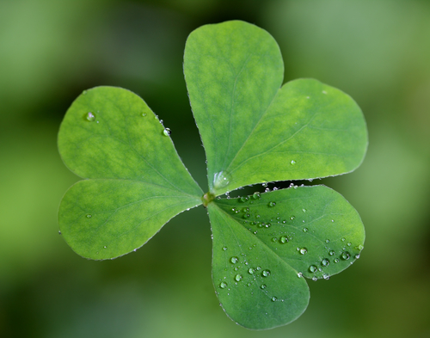
The Trinity: One God, Three Persons
The Trinity is the foundational image of God for Christians.
Christians alone use this image and term.
Jesus’ life and words revealed the Trinity.
Copyright: Brandon Alms / www.shutterstock.com
Notes:
To illustrate the last statement, share one or more New Testament accounts that reveal the Trinity, such as Matthew 3:13–17 (the Spirit descending at Jesus’ Baptism) and John 16:5–14 (Jesus asking his Father to send the Holy Spirit). Explain that the doctrine of the Trinity is a mystery of faith, a revealed truth we believe by faith but cannot fully grasp with human reason.

Slide 4
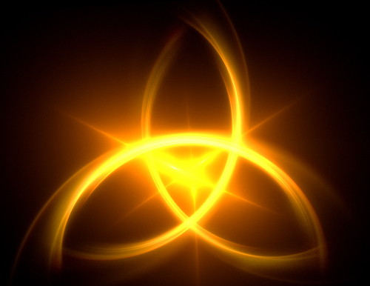
The Trinity: One God, Three Persons
God is Father, Son, and Holy Spirit.
God exists as a communion of Persons.
The Father, Son, and Holy Spirit are not three Gods, but one God, yet the three are also distinct from one another.
Copyright: Matt Antonino / www.shutterstock.com
Notes:
Ask the students to recall the opening words of the revised Creed: “I believe in one God, the Father almighty, maker of heaven and earth, of all things visible and invisible.” Explain that the remaining slides will explain each of the terms in that opening sentence.

Slide 5
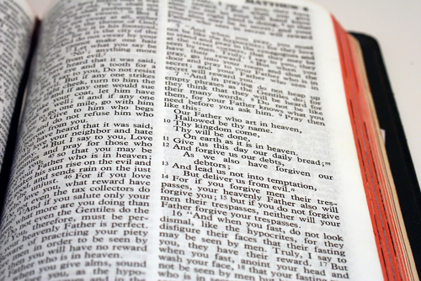
God, the Father
Copyright: Karl R. Martin / www.shutterstock.com
Jesus used “Father” to describe his own unique relationship with God.
In the Bible accounts, Jesus called God “Abba,” an Aramaic word for “father” that implies an intimate and loving relationship.
When we call God “Father,” we address a loving parent who transcends human distinctions.
Notes:
Invite the students to think of someone who represents for them a truly caring father. Ask them to share some descriptive words that come to mind when they think of that person at his most loving.

Slide 6
God, the Almighty
No creature, power, or force is more powerful than God.
God is omnipotent (all-powerful), omnipresent (present everywhere), and omniscient (all-knowing).
God is an awesome, powerful force worthy of our praise and worship.
Copyright: SFerdon / www.shutterstock.com
Notes:
Consider sharing with the students a time when you felt compelled to praise God for his greatness, suggesting that they may have experienced similar moments in their own lives.

Slide 7
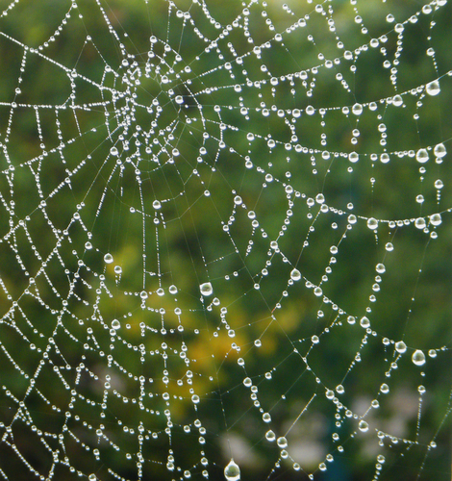
God, Creator of Heaven and Earth
God freely chose to create everything that is.
God created the world out of nothing.
God created all creatures to be in loving union with him.
For those who see the world with the eyes of faith, creation gives witness to God’s love and wisdom.
Copyright: Stephen Clarke / www.shutterstock.com
Notes:
Explain that the image of the Garden of Eden represents God’s plan for a perfect world where all creatures are in harmony with one another and with God.

Slide 8
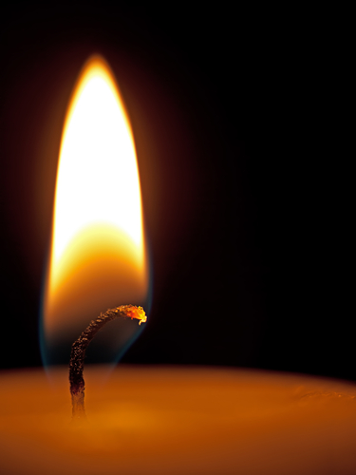
Did God Create Evil?
God created humans with free will, so they could freely choose to love him.
Our first parents chose to reject God’s love.
Adam and Eve’s Original Sin disrupted God’s plan for the created world.
Copyright: sarah2 / www.shutterstock.com
Evil cannot overpower God’s plan: that we should spend eternity in union with him.
Notes:
Decide what level of discussion on this topic is appropriate for your class. Consider spending more time on this topic apart from this presentation. You may want to use the “Catholic Wisdom” sidebar, on page 59 of the student handbook, for classroom discussion.

Slide 9
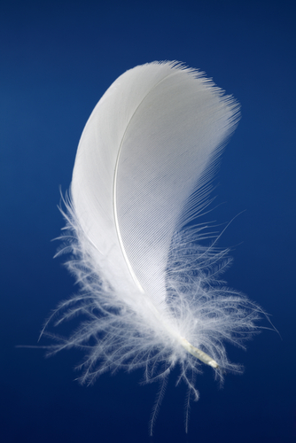
All Things Visible and Invisible
God created all that we see, taste, smell, touch, and hear.
God also created some things beyond the reach of our senses.
Angels are beings of spirit, not matter.
Angels’ purpose is to be God’s servants and messengers and to glorify God without ceasing.
Copyright: Brian A Jackson / www.shutterstock.com
Notes:
Ask the students to describe what angels look like. Remind them that they are describing images we use to represent beings that are not material. Explore what some of the symbols, such as wings and halos, might represent. (Wings could refer to their role as messengers; halos may mean that they are devoted to God; harps could represent their eternal praise; and so on.)

Slide 10
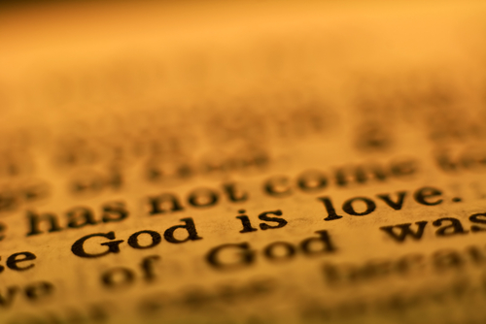
God Is Truth and Love
God revealed his name to Moses, “I AM WHO I AM.”
The Bible describes God as faithful and loving.
The Bible reveals that God is perfect love. God loves us more than we could possibly imagine.
Copyright: maigi / www.shutterstock.com
Notes:
Explore with the students the image of God as light with no darkness, which is from the First Letter of John 1:5. (Light reveals things that we could not see otherwise; light calls to mind goodness, truth, hope. Darkness can frighten us because it may hide evil things; darkness calls to mind evil, deception, destruction, despair.)

