Slide 1


Document #: TX005816

Slide 2
Liturgy
and Sacraments
Chapter 29
The Eucharist: The Heart of All Liturgy

Slide 3
Chapter Summary
In this chapter, we will consider the nature of liturgy as a moment of anamnesis and transformation that begins with Christ and requires a response. By virtue of our Baptism, all have the right and duty to play a role and engage fully, consciously, and actively in the Eucharistic celebration.
© mtkang/Shutterstock.com

Slide 4
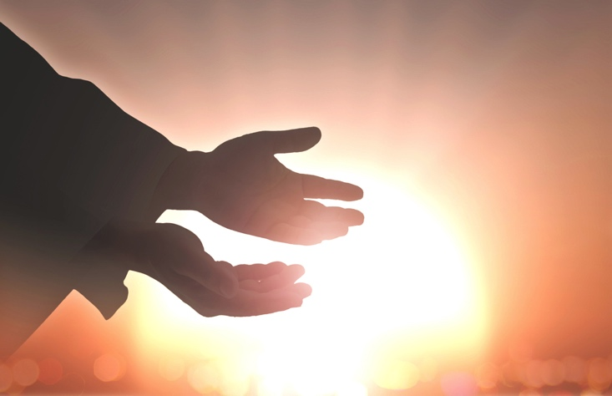
Introduction and
“Making the Past Present”
(Handbook, pages 308–310)
Eucharist, or giving thanks,
is a celebration in which we remember (anamnesis) what Christ has done as well as his saving actions today.
© CHOATphotographer/Shutterstock.com

Slide 5
Journal It!
Journal about the following questions:
What are some holidays that we celebrate to remember something that happened in the past?
How do you celebrate these holidays?
How do you think these celebrations of remembrance you listed relate to the Mass?
© Peterfactors/Shutterstock.com

Slide 6
“You Are What You Eat”
and “Call and Response”
(Handbook, pages 310–313)
Communion transforms us into the Mystical Body of Christ through the proclamation of Scripture and our response of thanksgiving.
© Daisybee/Shutterstock.com

Slide 7

Search It!
Find a partner.
Look up the word communion in a dictionary or online.
Together with your partner, make a list of synonyms and antonyms for the word communion.
© LulianDragomir/Shutterstock.com

Slide 8
“Who Celebrates the Eucharist?”
(Handbook, pages 313–315)
Even though the priest or bishop acts in the person of Christ during the Eucharist, each person is called to actively participate by joining with Christ.
© SeamartiniGraphics/Shutterstock.com

Slide 9

Search It!
Write in your journal the various ways in which you actively participate in the Mass.
How do you do this?
How can you be more connected?
© Rawpixel.com/Shutterstock.com

Slide 10
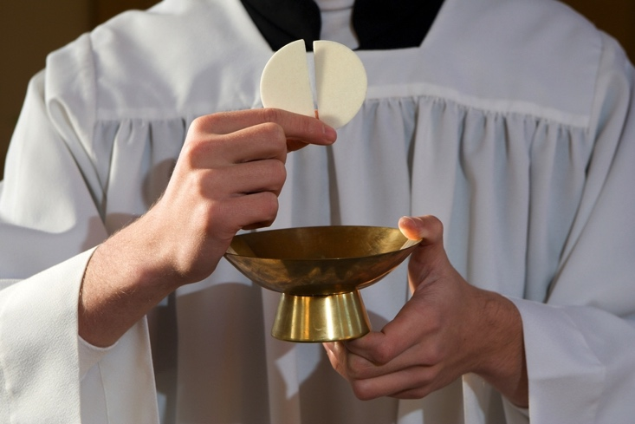
“The Role of the Assembly”
(Handbook, pages 315–317)
Full, conscious, and active participation in the Eucharist is the right and duty of the faithful by virtue of their Baptism.
© MartinPodzorny/Shutterstock.com

Slide 11
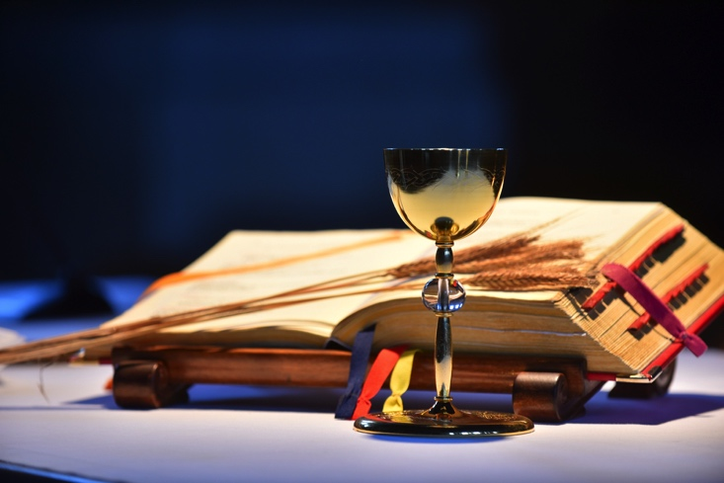
Share It!
What is the best liturgy that you’ve ever participated in? What made it so good?
Share with the person next to you!
© TatjanaSplichal/Shutterstock.com

