Slide 1


Document #: TX005821

Slide 2
and Sacraments
Liturgy
and Sacraments
Chapter 34
The Sacrament of Confirmation

Slide 3
Chapter Summary
In this chapter, we will explore all aspects of the Sacrament of Confirmation. We will discover its liturgical symbols and sacramentals, differences in practice between East and West, and the Rite itself.
© Solomnikov/Shutterstock.com
We will also challenge some incorrect assumptions regarding this important Sacrament of Initiation.

Slide 4
Introduction, “Water and Oil,” and “Sealed for Life” (Handbook, pages 364‒366)
In the Sacrament of Confirmation, Sacred Chrism seals the Gift of the Holy Spirit, deepening and confirming our baptismal call.
© Thoom/Shutterstock.com

Slide 5

Journal It!
What do you know about Confirmation?
Have you ever been to a Confirmation?
What did it look like?
What did you witness?
© Thoom / Shutterstock.com

Slide 6

“East and West”
(Handbook, pages 366‒368)
As the Church grew and bishops could no longer be at every Baptism, different understandings and practices developed in the East and the West. These focus on two things: Apostolic Succession and the use of oil.
© Zentilia/Shutterstock.com

Slide 7
“Age and Confirmation”
(Handbook, pages 368‒369)
A person does not celebrate Confirmation until they have reached the age of reason, when they are able to know the difference between right and wrong.
© MimaCZ/Shutterstock.com

Slide 8
Share It!
How would you define age of reason? Compare definitions with a partner. What age do you think the age of reason should be?
© x9626/Shutterstock.com

Slide 9
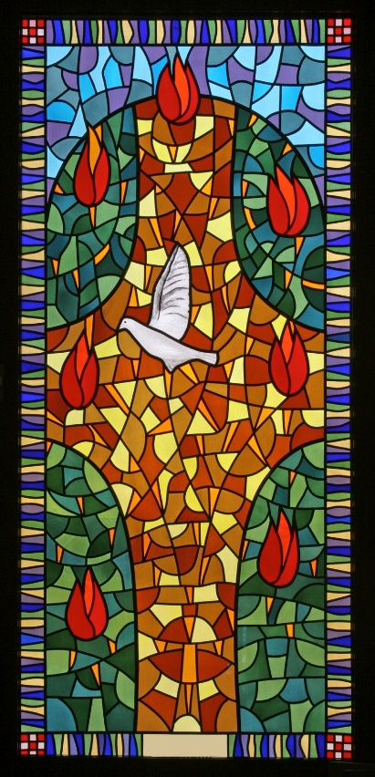
“Order of Confirmation” and “Who’s Who at Confirmation”
(Handbook, pages 370‒375)
People celebrate Confirmation when they are ready and willing. Through the laying on of hands and anointing with Sacred Chrism, the bishop seals in each person the gift of the Holy Spirit given at Baptism.
© ZvonimirAtletic/Shutterstock.com

Slide 10

Review It!
List the three components of the Order of Confirmation.
© MilenaMoiola /Shutterstock.com
Notes:
Answers: Renewal of Baptismal Promises, Laying on of Hands, Anointing with Sacred Chrism

