Slide 1
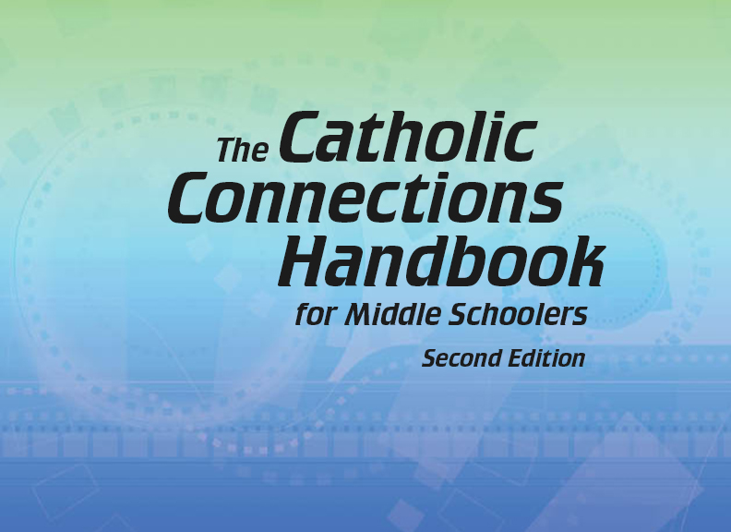


Slide 2
The New Testament
and the Church
Chapter C
The Bible: The Early Letters of Paul

Slide 3
Chapter Summary
The Bible: The Early Letters of Paul
This chapter will explore some of Saint Paul’s earlier letters.
Paul established churches in communities throughout his missionary travels. Then he wrote letters to guide them on a variety of issues, both practical and complex.
Building on themes we have previously explored, this chapter will further consider Paul’s teaching that salvation comes through faith in Jesus alone.
We will continue to examine Paul’s struggle through conflicts that threatened to divide the Church, and we will rejoice with him through the suffering he shared with Christ.

Slide 4
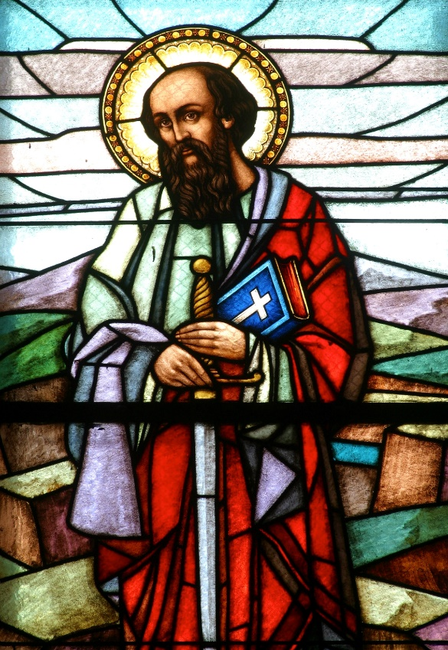
“Anxiety and Empathy”
(1 Thessalonians 4:13—5:4 and 2 Corinthians 12:1–10)
Paul founded churches in his missionary travels, then wrote letters to guide and encourage these communities.
The Letter to the Thessalonians addresses the future and the second coming of Christ, while the Second Letter to the Corinthians encourages resilience and faith in the face of challenges.
©Zvonimir Atletic/www.shutterstock.com

Slide 5
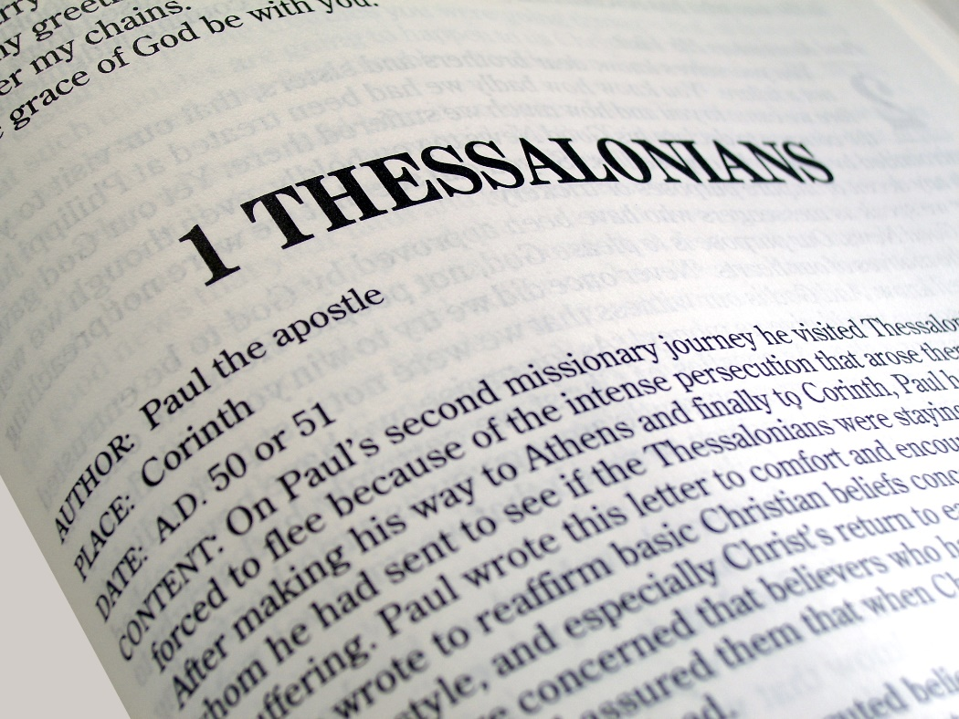
“Anxiety and Empathy”
(1 Thessalonians 4:13—5:4 and 2 Corinthians 12:1–10)
Paul’s letters addressed many concerns, including anxiety about when Jesus would come again.
Paul reassures the Thessalonians that all the faithful, living and dead, will be joined with Jesus when he comes again.
©Matthew T Tourtellott/www.shutterstock.com

Slide 6
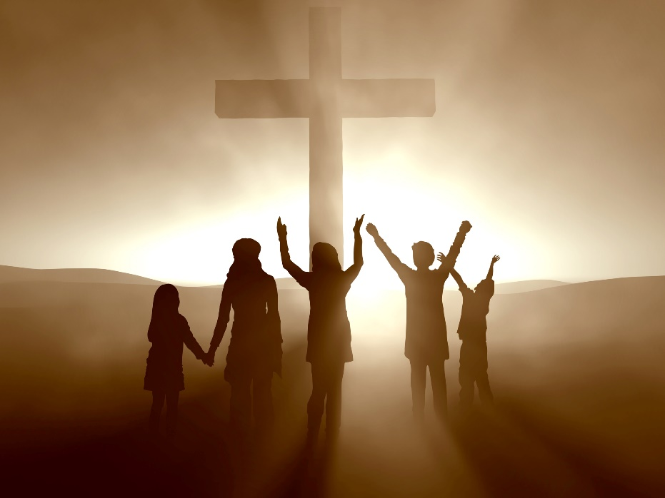
“Anxiety and Empathy”
(1 Thessalonians 4:13—5:4 and 2 Corinthians 12:1–10)
Activity
Read 1 Thessalonians 4:14–17.
What is the problem Paul is addressing?
How does Paul ease the Thessalonians’ anxiety?
When does Paul believe that Jesus will come again?
Read 1 Thessalonians 5:1–4.
Does Paul know for sure when Jesus will come again?
So what should believers do?
©Dream Perfection/www.shutterstock.com

Slide 7
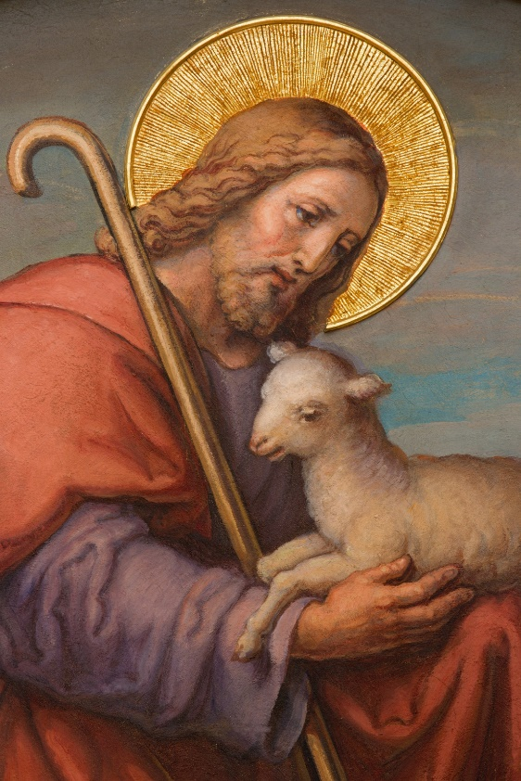
“From Conflict to Community”
(Galatians 2:15—3:5, 1 Corinthians 3:1–9)
Paul’s letters resolve conflicts that emerge as people debate what is essential to faith.
Paul tells the Galatians and the Corinthians that the Laws of Moses or individual preachers do not bring salvation. Only faith in Christ Jesus saves.
© sedmak/www.istockphoto.com

Slide 8
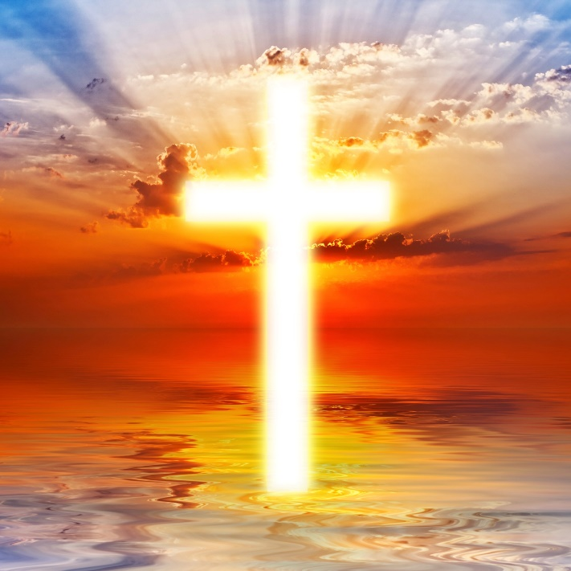
“From Conflict to Community”
(Galatians 2:15—3:5, 1 Corinthians 3:1–9)
Paul’s letters resolve
conflicts that emerge as
people debate what is
essential to faith.
One such conflict involved
whether Gentiles needed to
follow the same laws as the
Jews who had become
Christian.
Paul reminds the Galatians, and us, that we are made right with God not by obeying religious laws but by believing in Jesus.
©Merydolla/www.shutterstock.com

Slide 9

“From Conflict to Community”
(Galatians 2:15—3:5, 1 Corinthians 3:1–9)
Activity
Read Galatians 2:15—3:5.
What problem is Paul addressing?
What is Paul’s answer to this question?
What brings a person life?
Why does Paul say the Galatians are being foolish?
©Olivier Le Moal/www.shutterstock.com

Slide 10
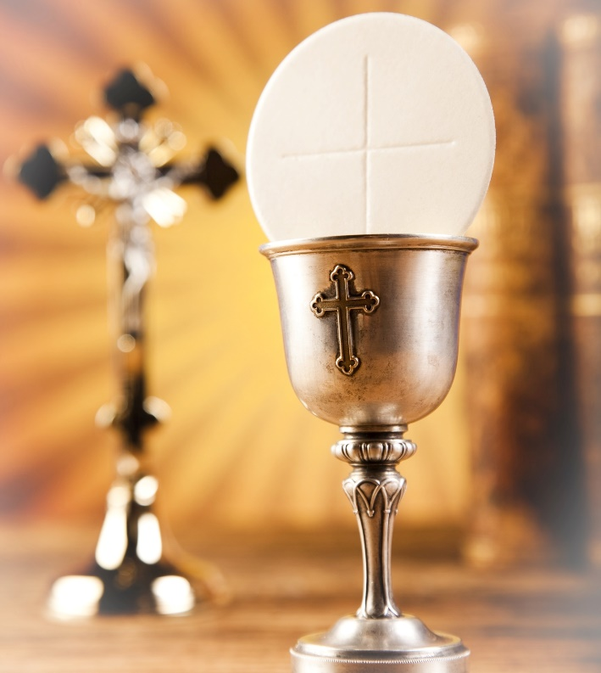
“Body of Christ”
(1 Corinthians 12:4–31)
Paul addresses divisions and arguments with calls for unity, reminding people of their common gifts, given by God for service to his Church, “the Body of Christ.”
The way the people of Corinth were celebrating the Eucharist was dividing the Church there. Paul wrote to remind them what the Eucharist is meant to be.
©Sebastian Duda/www.shutterstock.com

Slide 11
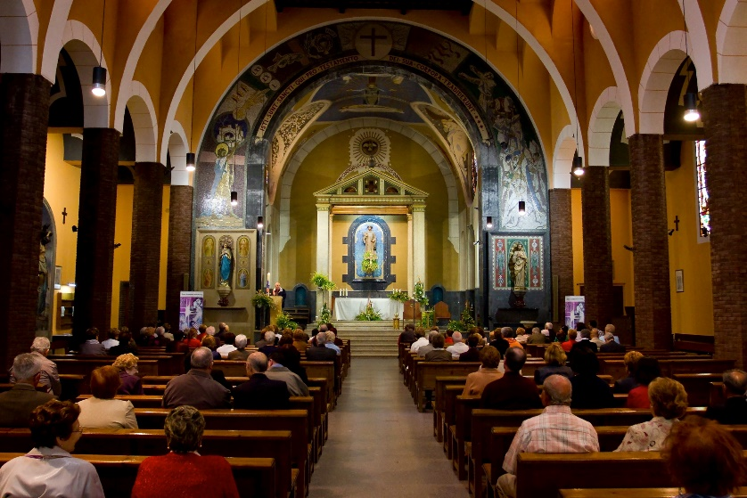
“Body of Christ”
(1 Corinthians 12:4–31)
Paul emphasizes that
each part of the body has an
important role to play.
Like a human body, the
Body of Christ needs all of its
parts to function. No part is
more important than another.
Together, the weak and strong
parts help each other, making the Body of Christ its best self.
Discussion Questions
What are some of the gifts and talents God has given you?
How can you use your talents to serve the Church?
©Natursports/www.shutterstock.com

Slide 12

“Encouraging Words”
(Romans 8:28–39, Philippians 4:4–9)
In the face of hardships, conflicts, division, and despair, Paul instructs the communities in Rome and Philippi to be joyful, for nothing can keep them from the love of God.
Paul teaches that although we may not always do the right thing, God wants a relationship with us through Jesus.
Paul’s Letter to the Romans provides a litany of obstacles to that relationship.
Paul concludes that nothing can separate us from the love of Jesus.
©Rido/www.shutterstock.com

Slide 13

“Encouraging Words”
(Romans 8:28–39, Philippians 4:4–9)
Activity
            First, we’ll read 1 Corinthians 13:4–7 out loud together.
            We say these words with a unified voice. But love doesn’t work if we don’t live it ourselves. Can you see yourself in these verses?
            Let’s pray these words again together. But instead of saying “love” or “it,” say your own name.
©Suat Gursozlu/www.shutterstock.com

