Slide 1
The Last Supper (Matthew 26:20–30)
The Paschal Mystery Course
Document # TX001325
Notes:
(Notes: The slides in this presentation are an adaptation of Matthew’s account of the Last Supper, New American Bible translation, for use as a dramatic reading. Assign five student readers: the narrator, Jesus, voice 1, voice 2, and Judas.)

Slide 2
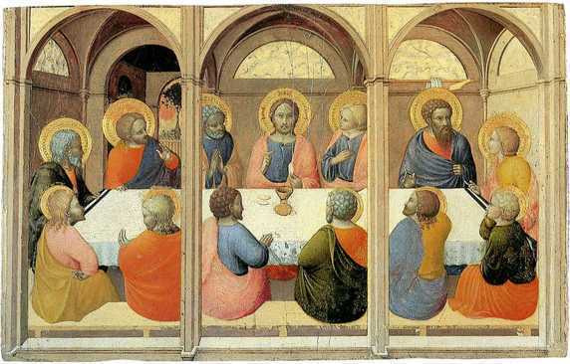
Narrator:
When it was evening, Jesus reclined at table with the Twelve.
Jesus:
Amen, I say to you, one of you will betray me.
Image in public domain

Slide 3
Narrator:
They were deeply distressed at this.
Voice 1:
Surely it is not I, Lord?
Voice 2:
Surely it is not I?

Slide 4
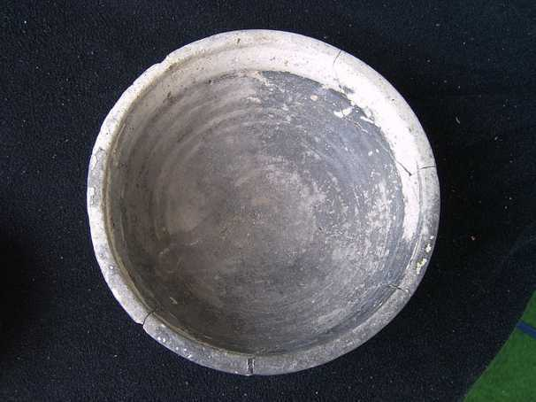
Jesus:
He who has dipped his hand into the dish with me is the one who will betray me.
Image in public domain

Slide 5
Jesus:
The Son of Man indeed goes, as it is written of him, but woe to that man by whom the Son of Man is betrayed. It would be better for that man if he had never been born.

Slide 6
Judas:
Surely it is not I, Rabbi?
Jesus:
You have said so.

Slide 7
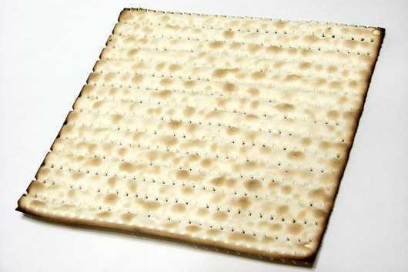
Narrator:
While they were eating, Jesus took bread, said the blessing, broke it, and gave it to his disciples.
Jesus:
Take and eat; this is my body.
Image in public domain

Slide 8
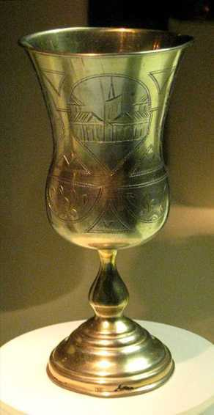
Narrator:
Then he took a cup, gave thanks, and gave it to them.
Jesus:
Drink from it, all of you, for this is my blood of the covenant, which will be shed on behalf of many for the forgiveness of sins.
Image in public domain

Slide 9
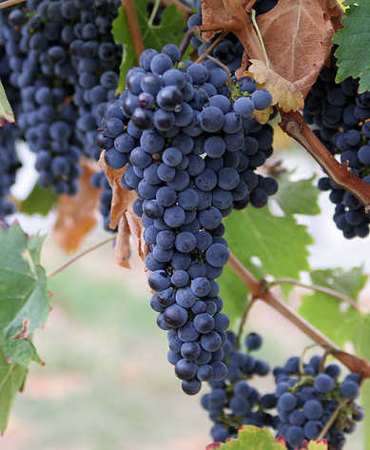
Jesus:
I tell you, from now on I shall not drink this fruit of the vine until the day when I drink it with you new in the kingdom of my Father.
Image in public domain

Slide 10
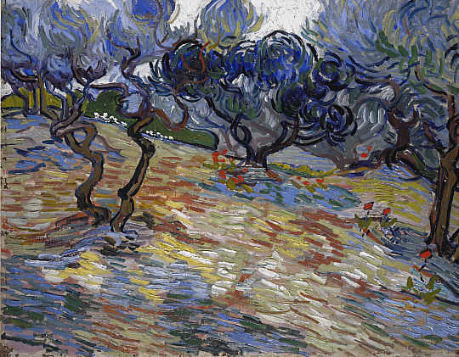
Narrator:
Then, after singing a hymn, they went out to the Mount of Olives.
Image in public domain

