Slide 1
The Liturgy of the Word and the Lectionary
Document #: TX004715
Notes:
Notes: This PowerPoint is designed for teachers who would like to provide additional information for their students regarding the Liturgy of the Word and the Lectionary for Mass, in conjunction with learning experience 3.

Slide 2
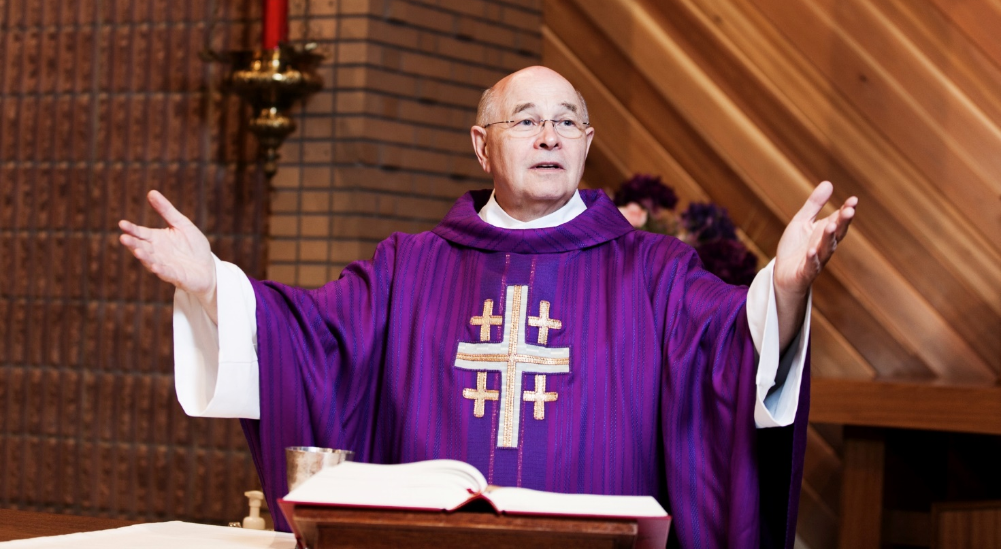
The Liturgy of the Word
What do you know about the readings proclaimed during the Liturgy of the Word?
© Cody Wheeler / Shutterstock.com
Notes:
Notes: Invite the students to brainstorm answers to this question before proceeding to the subsequent slides. For example, ask if they know how many readings are proclaimed, from what section of Sacred Scripture those readings are taken, where we find these readings collected, and/or how these readings were selected.

Slide 3
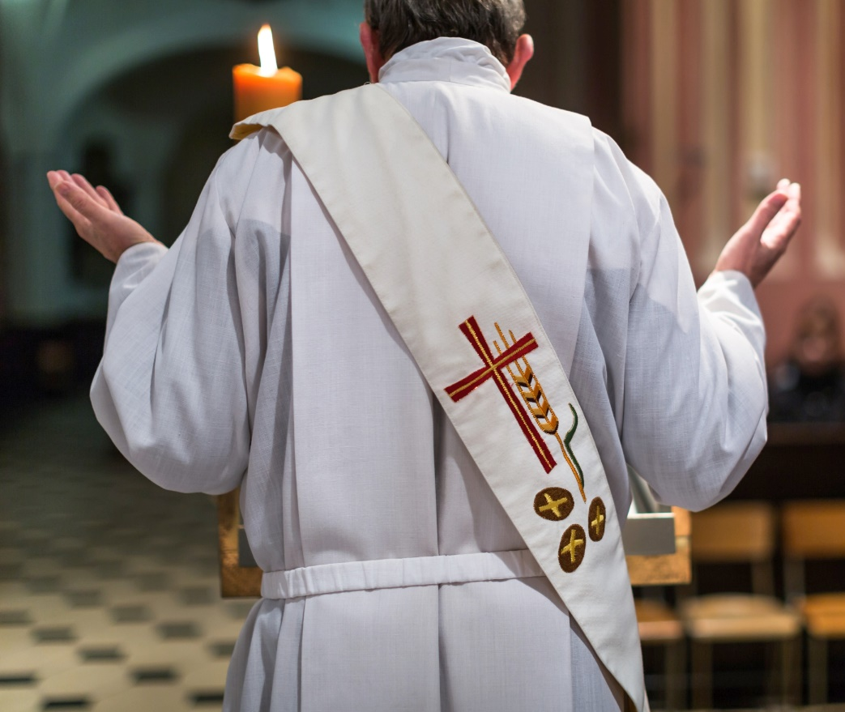
The Lectionary
During a Sunday liturgy, a solemnity, or a major feast, four readings from Sacred Scripture are proclaimed.
At a weekday liturgy, three readings are proclaimed.
These readings are organized and collected into a book called a Lectionary.
© l i g h t p o e t / Shutterstock.com
Notes:
Notes: If you have a Lectionary in your classroom, pass it around for the students to examine.

Slide 4
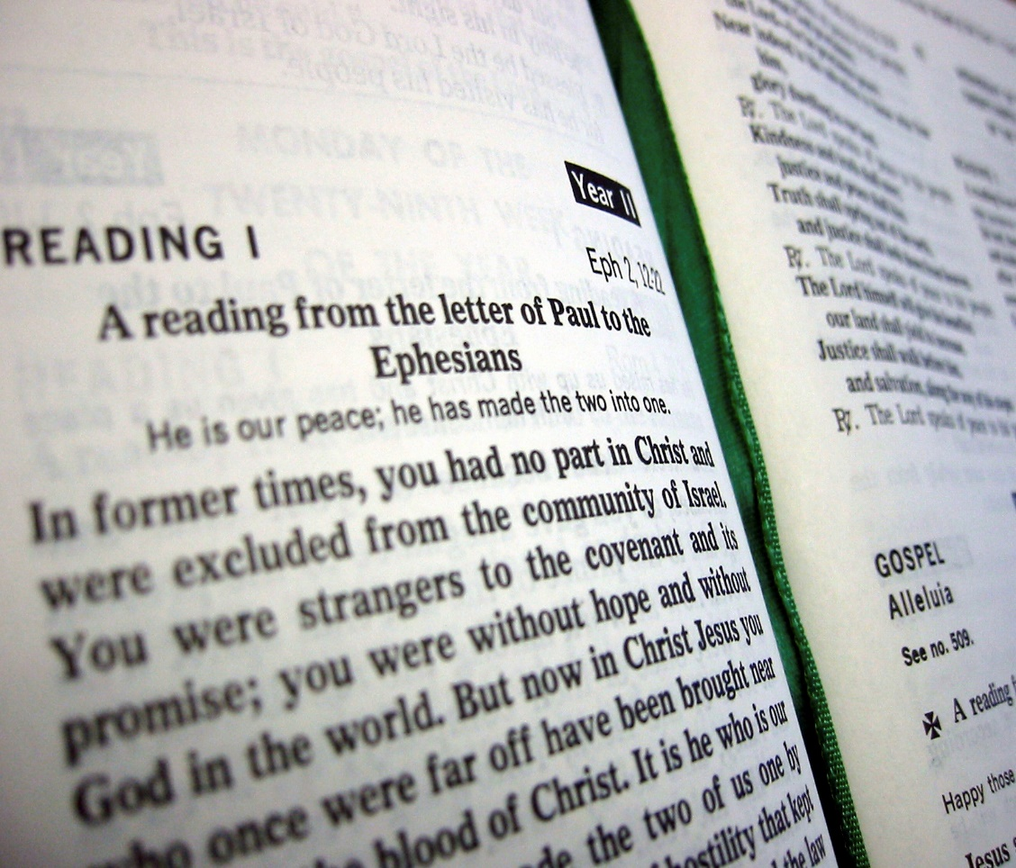
Facts about the Lectionary
The Lectionary is not the Bible.
The Lectionary is the collection of Scripture readings assigned to the Eucharistic liturgy for each day of the year.
You will hear the same readings anywhere in the world.
© iStock.com/stevehong
Notes:
Notes: Provide further clarification of the Bible/Lectionary distinction, if needed.

Slide 5
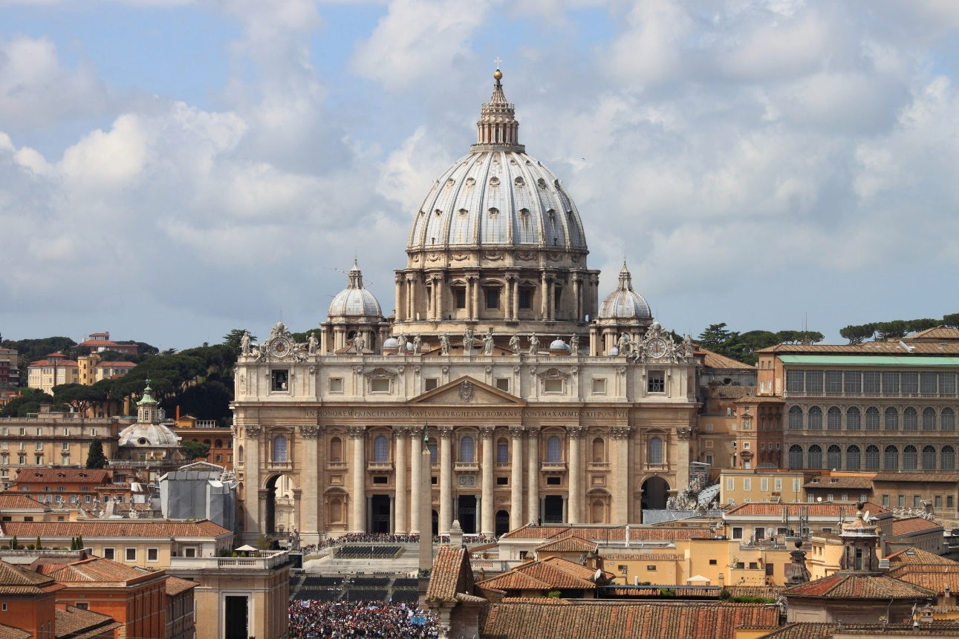
Changes since Vatican II
The bishops gathered at the Second Vatican Council asked for a comprehensive Lectionary.
Before Vatican II, there was a Lectionary, but it offered only a very limited selection of Scripture readings.
© alessandro0770 / Shutterstock.com
Notes:
Notes: If necessary, clarify that Vatican II was the event that brought many changes to the Church, most noticeably in the liturgy.

Slide 6
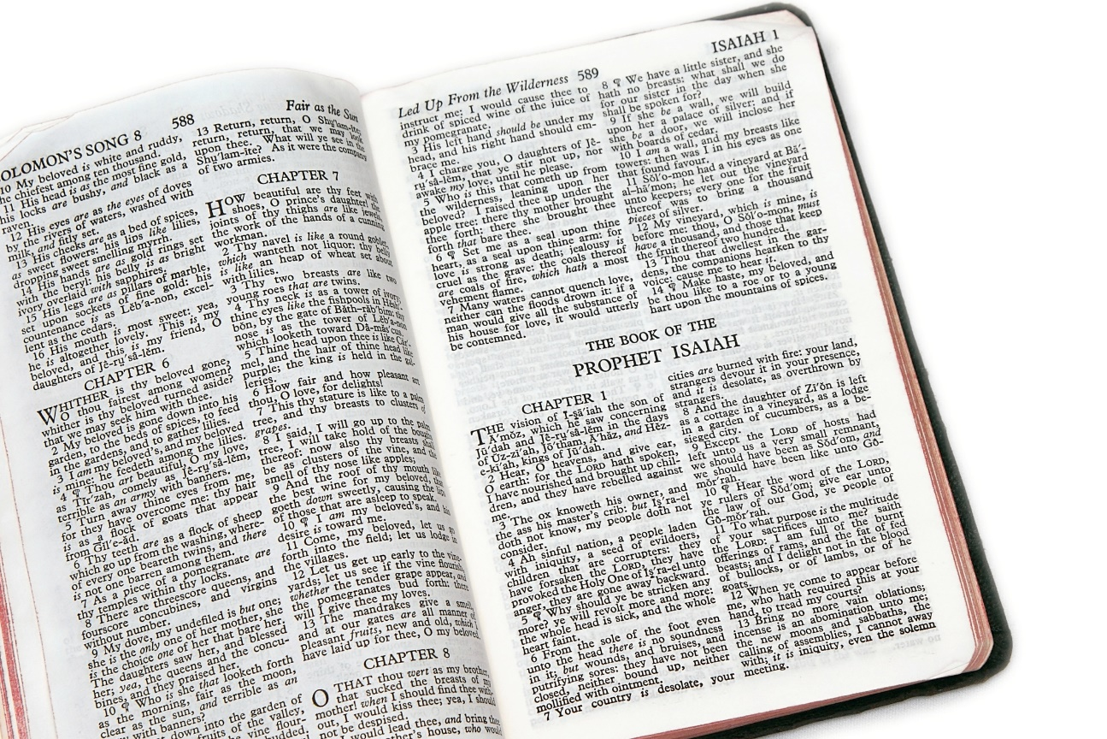
The Liturgy of the Word Today
The First Reading is generally taken from the Hebrew Scriptures.
The First Reading is based upon its connection to the Gospel reading.
First Reading
Psalm
Second Reading
Gospel
© Stephen Orsillo/Shutterstock
Notes:
Notes: Explain to the students that the first reading is taken from the Hebrew Scriptures except during the Easter season, when the first reading is taken from the Acts of the Apostles. In the development of the Lectionary, the Gospel readings were selected first, and then Old Testament readings were selected to correspond with the Gospel readings based on a similarity in theme, teachings, or events.

Slide 7
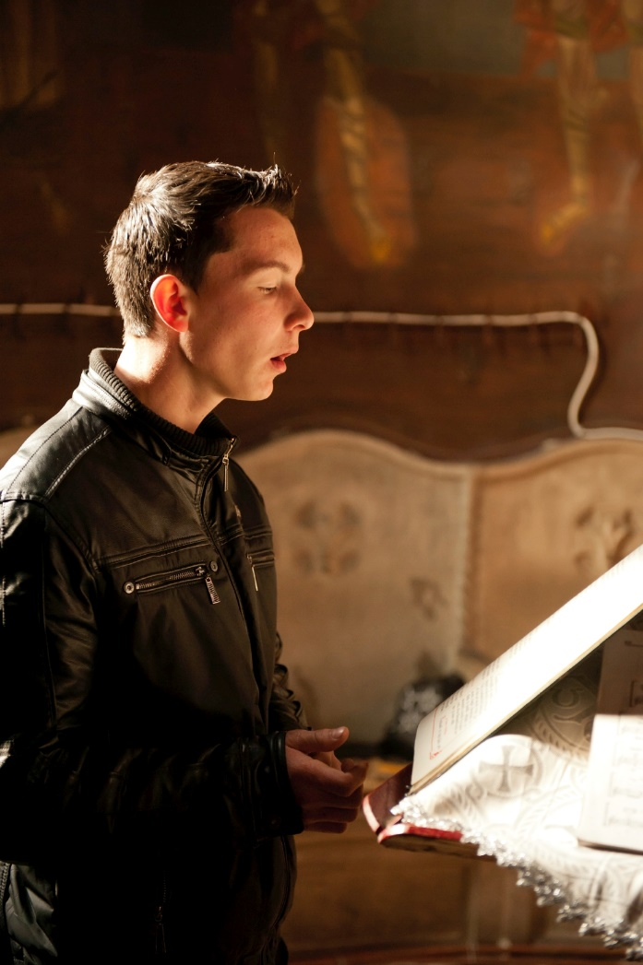
The Liturgy of the Word Today
Following the First Reading, a selection from the Book of Psalms is proclaimed.
This is generally proclaimed as a responsorial psalm.
First Reading
Psalm
Second Reading
Gospel
© buburuzaproductions / iStockphoto.com
Notes:
Notes: Explain that a responsorial psalm means that the assembly participates by singing a refrain in between the verses of the psalm. Tell the students that because the psalm is usually sung, many people forget that this actually is a Scripture reading. You may wish to have students think of psalms that are commonly used at liturgies in your school community or in their home parishes. You might also wish to play the recordings of some psalms that are frequently used in the school or parish community.

Slide 8
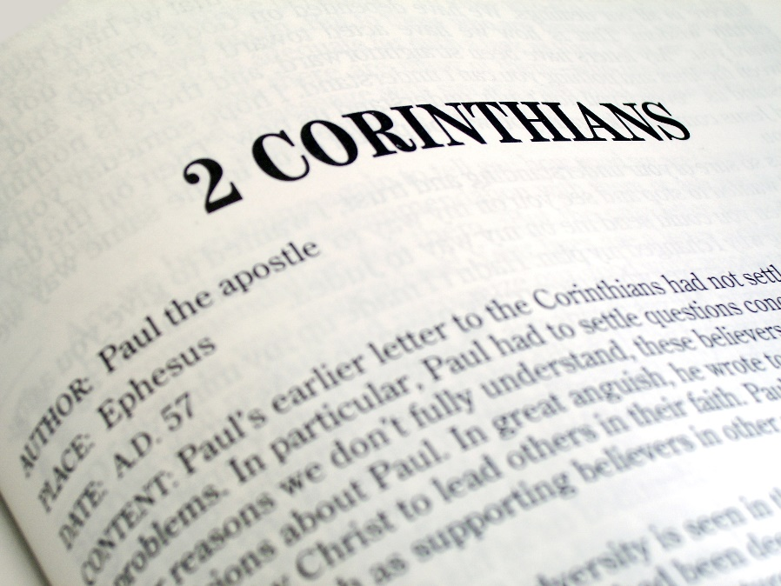
The Liturgy of the Word Today
The Second Reading is taken from the New Testament.
The Lectionary calls for a reading of one epistle in a more-or-less continuous fashion.
First Reading
Psalm
Second Reading
Gospel
© Matthew T Tourtellott / Shutterstock.com
Notes:
Notes: Share with the students that the Second Reading is generally taken from one of the epistles (letters). Because they are presented in a continuous fashion, these readings may or may not be thematically related to the Old Testament reading or to the Gospel.
You may wish to have students recall some examples of epistles—Romans, Corinthians, Colossians, etc.

Slide 9
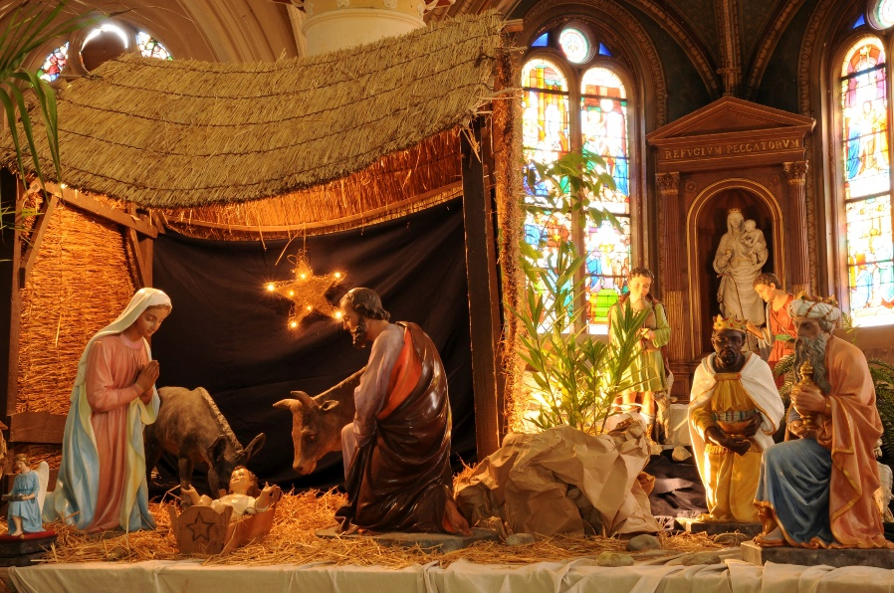
The Liturgy of the Word Today
The Second Reading does not continue in a semi-continuous fashion during Advent, Christmas, Lent, and Easter.
In these seasons, all of the readings proclaimed, including the Second Reading, may reflect the theological emphases of these seasons.
First Reading
Psalm
Second Reading
Gospel
© Pack-Shot / Shutterstock.com

Slide 10
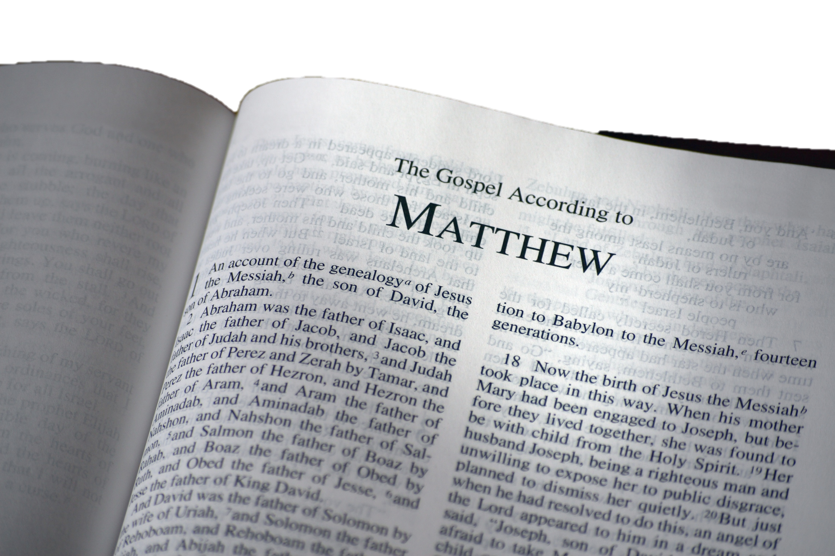
The Liturgy of the Word Today
The Liturgy of the Word culminates in the proclamation of a reading from one of the four Gospels.
Matthew
Mark
Luke
John
First Reading
Psalm
Second Reading
Gospel
© Vibe Images / Shutterstock.com

Slide 11
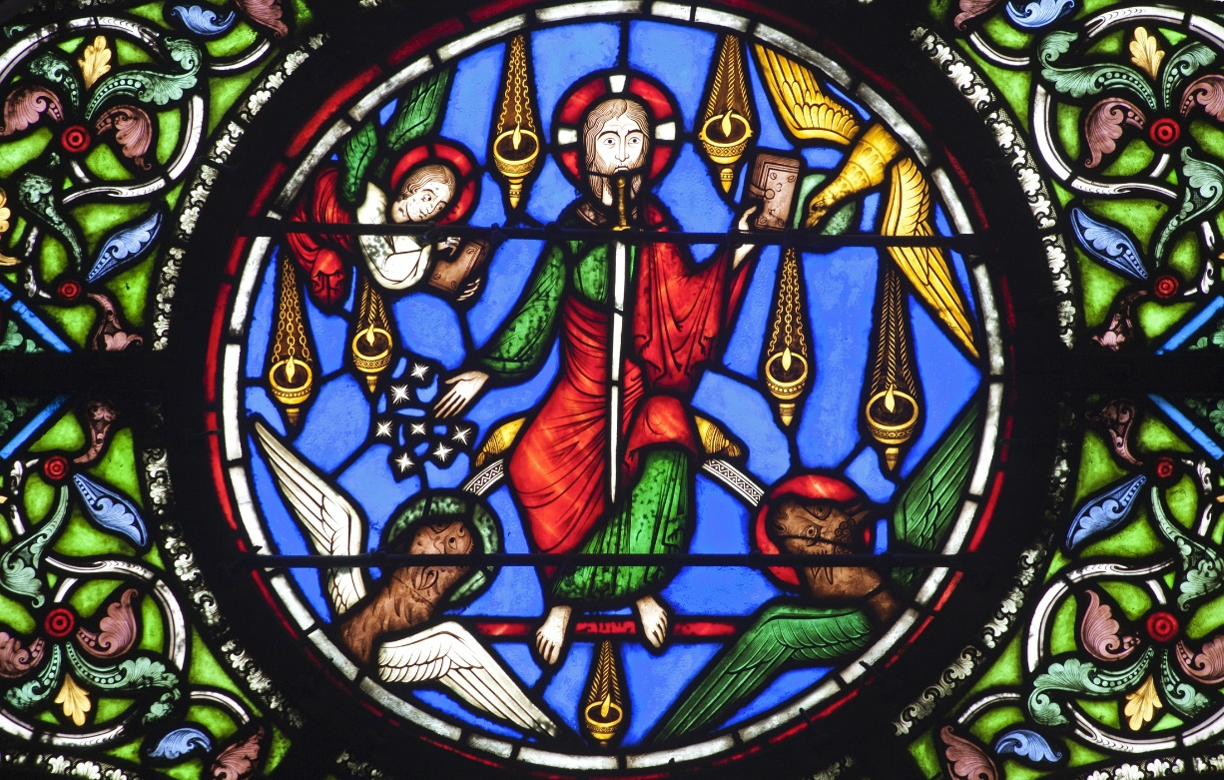
Organization of Readings: Sundays
The Sunday readings are arranged in a 3-year cycle.
In Year A, primarily from Matthew.
In Year B, primarily from Mark.
In Year C, primarily from Luke.
© Renata Sedmakova / Shutterstock.com
Notes:
Notes: Explain to the students that John’s Gospel is used on some Sundays of Year B (since Mark is the shortest Gospel), and on selected Sundays of the Lenten and Easter seasons. Ask the class if they know what year of the Lectionary—A, B, or C—the Church is currently in.

Slide 12
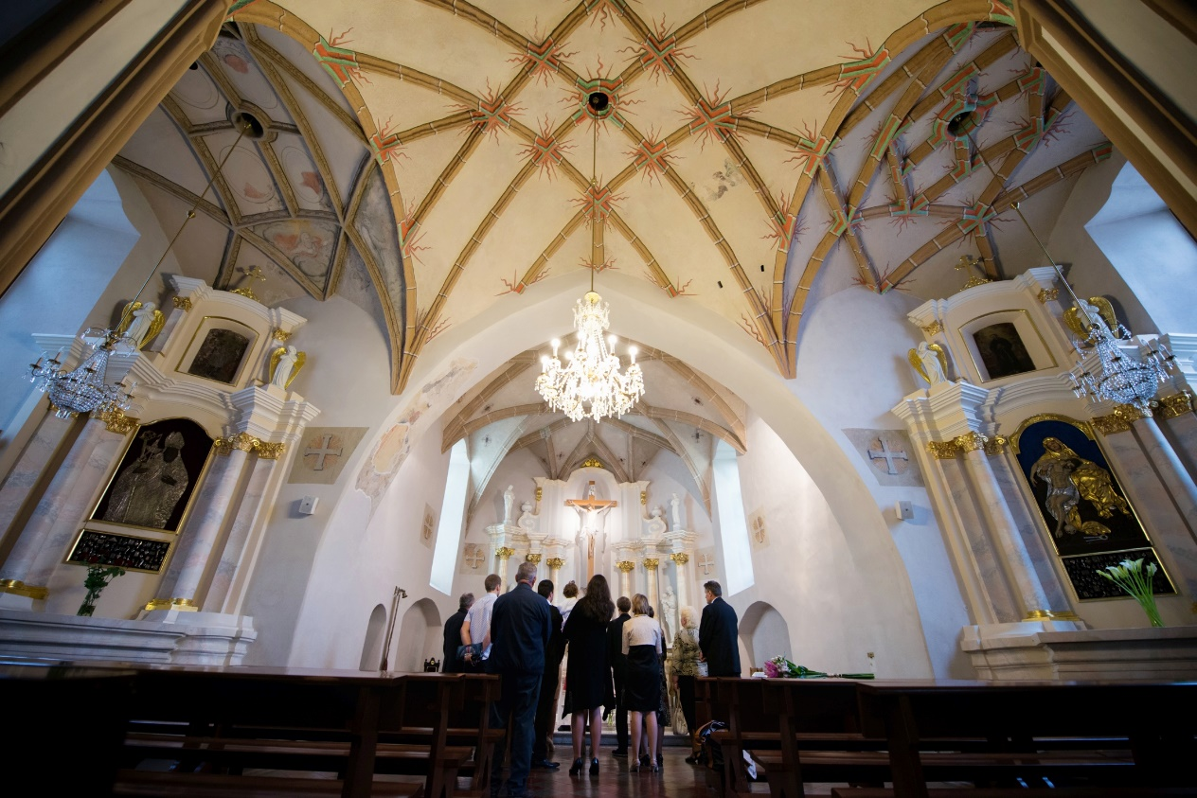
Organization of Readings: Weekdays
The weekday readings in the Lectionary are arranged in a 2-year cycle.
Odd-numbered years are year I.
Even-numbered years are year II.
© vivver / Shutterstock.com
Notes:
Notes: If you are showing this PowerPoint any time following the first Sunday of Advent, then the new cycle of readings has already begun. For example, year II of the weekday Lectionary begins following the first Sunday of Advent 2015.

Slide 13
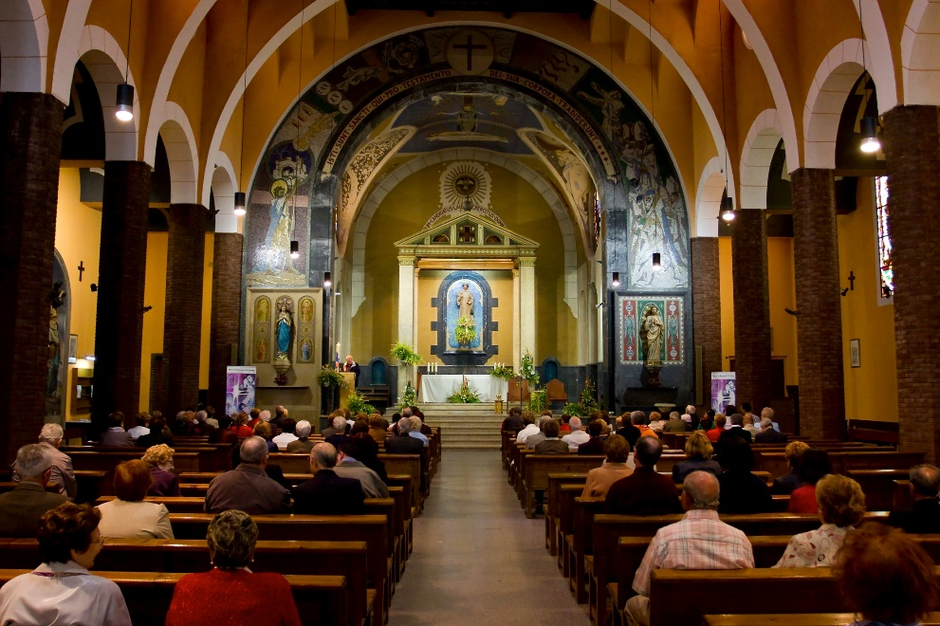
Advantages of the Lectionary?
Exposes us to a wide variety of readings.
Challenges us with readings we might otherwise ignore as too difficult or problematic.
Ensures that we will hear God’s saving message of love as expressed in both Testaments.
© Natursports / Shutterstock.com
Notes:
Notes: Ask the students if they can think of other advantages to having a Lectionary in the Catholic Church.

