Slide 1
The Church in the World
The Church Course
Document # TX001511

Slide 2
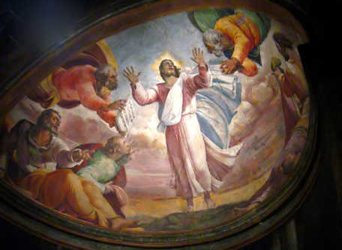
One True Path
Jesus is the one true path to salvation.
Through our Baptism we are called to spread this truth, the Good News.
Image in public domain
Notes:
(Notes: Discuss with the students what we mean by the Good News [salvation through grace, modeled through action].)

Slide 3
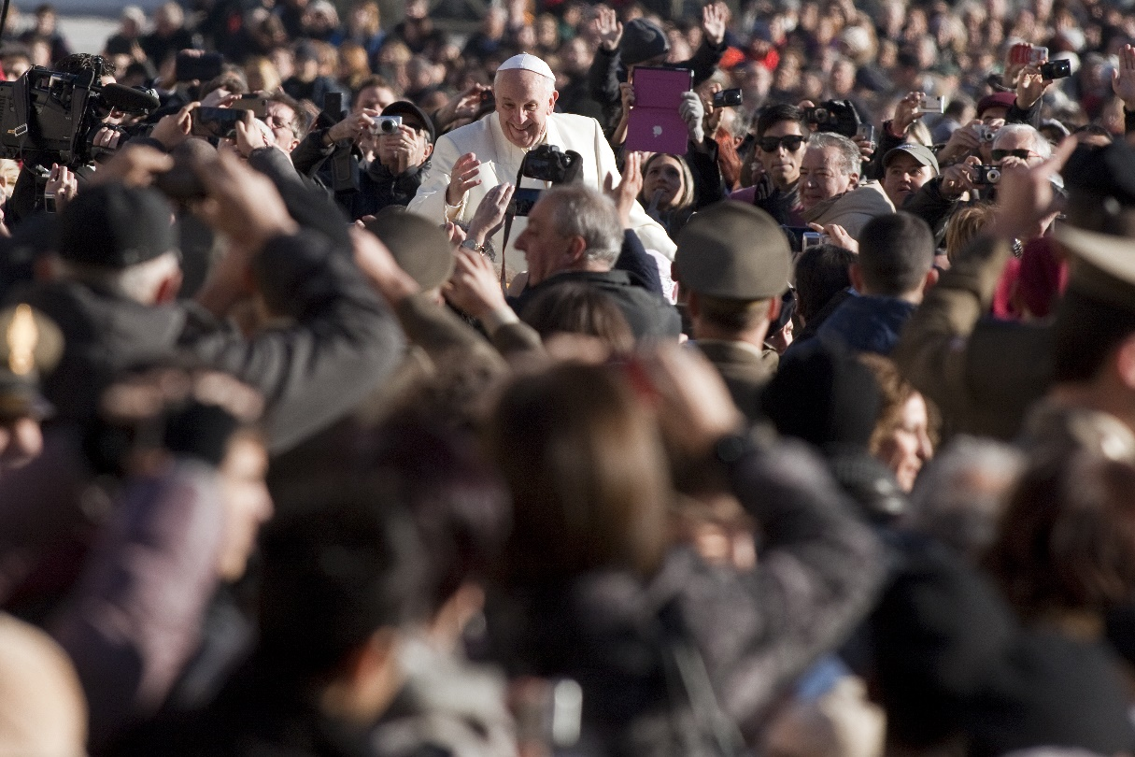
Entrusted with Truth
God has entrusted that truth to the Church.
Thus the Church must proclaim the truth to the world.
© giulio napolitano / Shutterstock.com

Slide 4
Truth Inspires Activity
This obligation inspires and gives life to the Church’s missionary activity.
Notes:
(Notes: If you wish to take the time now, you can stop here and discuss the Church’s activities in the world.)

Slide 5
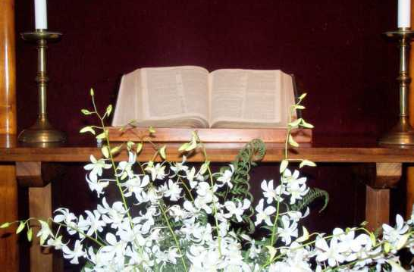
Deposit of the Word of God
Together, Sacred Scripture and Sacred Tradition are a single deposit of the Word of God, where the Church encounters God.
© hcucc.org

Slide 6
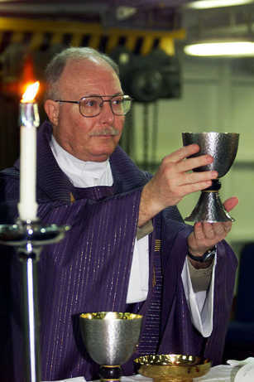
Giving Life
Through her teaching, life, and worship, the Church gives to each generation all that she is and all that she believes.
Image in public domain

Slide 7
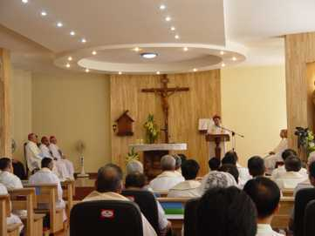
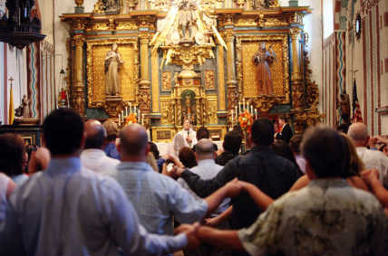
The Church Is Catholic
The Church is:
Local
National
Global
© vietcatholicnews.com
© Furiousphotographersblog.com
Notes:
(Notes: Emphasize that the Church is found in all countries of the world.)

Slide 8
Signs of the Times
The Church is responsible for looking at the particular circumstances of each generation and interpreting them in light of Scripture and Tradition.

Slide 9
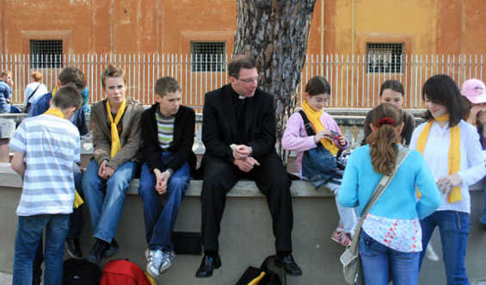
Church and the Modern World
Interpreting the signs of the times in light of the Gospels brings the Church into dialogue with different cultures and groups.
But she always remains constant in her universal mission.
© nickomargolies.com
Notes:
(Notes: Be sure to emphasize that the Church never wavers on truth, no matter what the current culture says.)

Slide 10
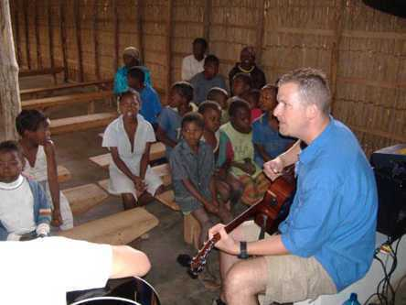
Proclaim and Act
It is not enough for the Church to proclaim the Gospel message.
She must be able to apply that message to the issues facing each generation.
Image in public domain

Slide 11
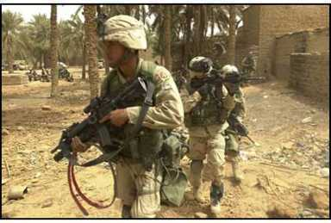
Our Generation
In our generation the Church must apply a Gospel perspective to issues such as:
International conflicts (just war, peace, and justice)
Health care reform (ensuring dignity of all life)
Economic justice (care for the poor)
Technology (sanctity of all life)
Image in public domain

Slide 12

Ageless message
The essential Gospel message does not change, but it requires wisdom and discernment to understand how it applies to these and other particular issues.
© shutterstock/Yuri Arcurs

Slide 13

Engaging Modern Culture
The Church has a responsibility to be active in the modern world, promoting and proclaiming the truth that has been entrusted to her—by God.
The Church often finds itself in the position of standing counter to the developments in our modern society.
© nashvillescene.com

Slide 14
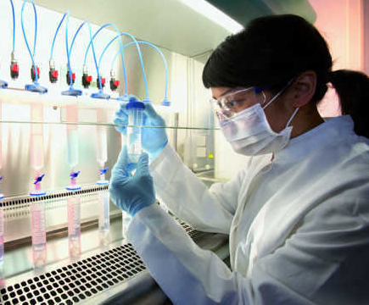

Today’s Issues
What are some of the issues facing Catholics and the Church today?
Embryonic stem-cell research
Cloning
Birth control
Abortion
Euthanasia
Marriage
Images in public domain
Notes:
(Notes: Here is an opportunity for you to engage the class in discussion. You and they don’t have to resolve the issues right now, but just bring them to light for later discussion.)

Slide 15

Culture of Death
One of the most pressing issues the Church must work to transform in the world is what Pope Saint John Paul II called “the culture of death.”
Euthanasia
Abortion
© shutterstock/michaeljung
Notes:
(Notes: Ask the students to explain why these constitute a culture of death.)

Slide 16
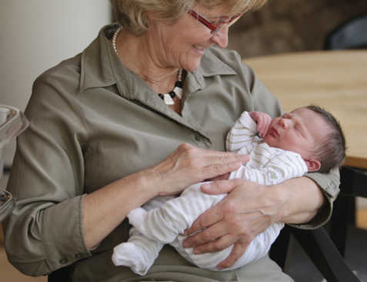
Life Is Sacred
The Church recognizes that from the moment of conception until the time of natural death, all human life is sacred and should be treated with care and dignity.
© shutterstock/Rikard Stadler
Notes:
(Notes: Emphasize that protecting life involves not only the conceived but also the elderly and chronically ill.)

Slide 17
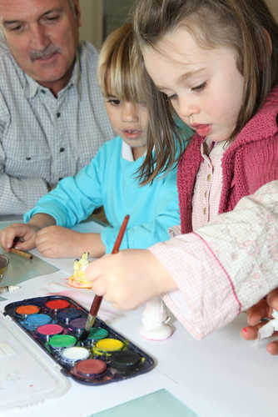
Standing Firm
The Church stands firm in promoting a “culture of life.”
At the heart of this is educating people to have a profound respect for the sacredness of every human life.
© shutterstock/auremar

Slide 18
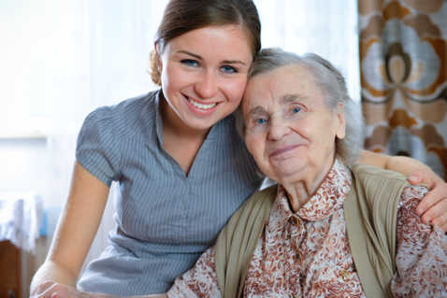
All Life Is Sacred
The Church calls for new programs to care for the sick and the elderly.
The Church also calls for political action against unjust laws that do not respect the right to life of innocent persons.
© shutterstock/Alexander Raths
Notes:
(Notes: Mention that the chronically ill and disabled must also be protected, despite the medical costs. It has not always been so in our society.)

Slide 19

The Church and Politics
What about the concept of separation of Church and state?
This means that the government will not support a particular religion or establish a national religion.
It does not mean that the Church can have no say in the political arena.
© pollsb.com

Slide 20
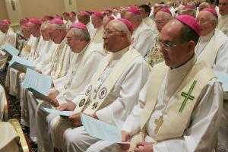
Right and Responsibility
The Church has the right and the responsibility to bring Christian values into the public debate.
She addresses specific issues that affirm or stand counter to the Gospel message.
Her input strengthens the public debate.
© catholiclivingtoday.blogspot.com
Notes:
(Notes: Be sure to address the fact that standing counter to society’s pressures is difficult, but that we are guided by the Church to stand for truth, no matter what pressures are put on us to change.)

Slide 21
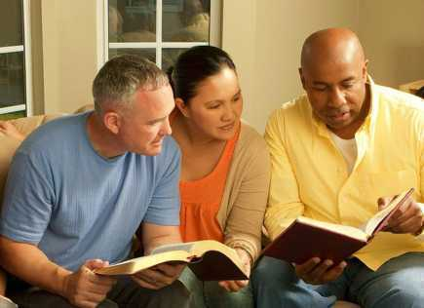
Evangelization
The Church has a missionary mandate to help all people to share in the communion of the Holy Spirit.
Evangelization is the primary way we accomplish that mission.
We must teach the truth to the world.
Image in public domain
Notes:
(Notes: Ask the students for ideas of how they might evangelize in their world [home, school, work, play].)

Slide 22
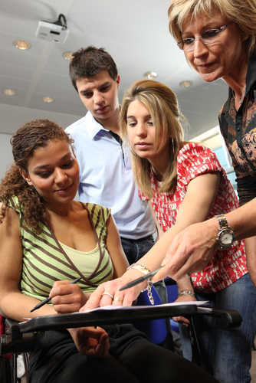
Ways of Evangelizing
Youth and adults:
At home
At school
At work
During sports
During social events
Quietly, one on one, as appropriate (don’t pressure, simply invite)
© shutterstock/auremar

Slide 23
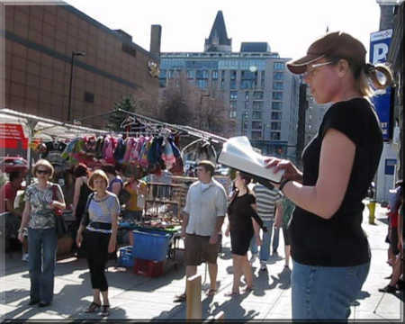
Proclaiming
© thewordstreetjournal.com
We are to proclaim Christ both by our words and by the witness of our lives.
Three situations in which the Church is to evangelize the world today:

Slide 24
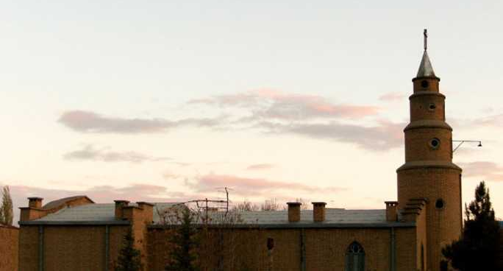
First
In cultures, communities, and groups where Christ and the Gospel message are not known, or where the people lack the ability to adequately proclaim the faith
Image in public domain
Notes:
(Notes: Mention the fact that in some countries [i.e., China, Iran, Saudi Arabia], people must live their faith in silence. They need our support as much as people who have no faith to lay claim to.)

Slide 25
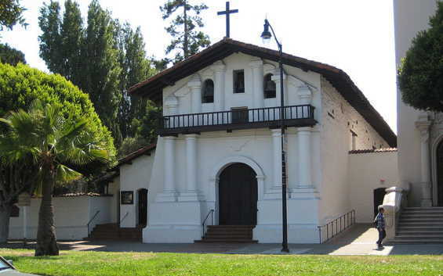
Second
In places where there are active and vibrant Christian communities, evangelizing by continuing to carry out her activity and pastoral care
Image in public domain
Notes:
(Notes: Even the Apostles returned to places where they had preached before, to reinforce and strengthen the new belief of Church members. We must always strengthen one another’s faith.)

Slide 26

Third
In circumstances where people or groups have been baptized in the faith but no longer actively live the faith―or even consider themselves members of the Church―and live a life far removed from Christ and his Gospel.
This is a new evangelization, or a renewed evangelization.
© shutterstock/JHershPhoto

Slide 27
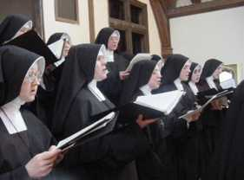
Religious Orders
Religious orders play a vital role in the evangelical mission of the Church. These groups include the following:
Franciscans
Dominicans
Jesuits
Mother Teresa’s Missionaries of Charity
Poor Clares
Sisters of Saint Joseph of Carondelet (teachers)
Image in public domain

Slide 28
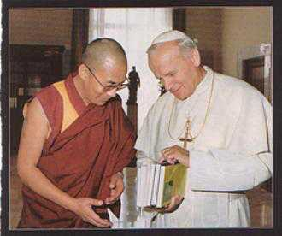
Dialogue
The Church seeks dialogue with people of different religions, witnessing to her own faith while acknowledging and encouraging the spiritual and moral truths found in their religions.
But the Church does not support any religious groups that lead people astray or distort the image of God found in all humans.
© starlightgrove.org
Notes:
(Notes: Emphasize that the Church is the repository of truth as given to us by God and Christ. We must never lose sight of that fact. Other faiths possess truth, but the fullness of truth resides in the Catholic Church.)

Slide 29

Diversity
The Church recognizes and embraces diversity.
“So then you are no longer strangers and sojourners, but you are fellow citizens with the holy ones and members of the household of God, . . . with Christ Jesus himself as the capstone” (Ephesians 2:19–20).
© bcnn4youth.com

Slide 30
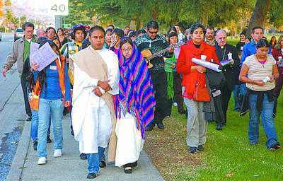
Evidence of Diversity
What are some examples of the Church’s diversity?
Races and nationalities in the Church
Pilgrimages
La Posadas
Cultural festivals
Global presence (how can we not be diverse?)
© laprensaenlinea.com
Notes:
(Notes: Elicit other ideas of diversity from the students, from their own experiences, if possible.)

Slide 31
What Questions do you have on the following topics?
Church and politics
Church and life issues
Church and marriage
Church and relationships
Notes:
(Notes: This would be a good place to initiate discussion about the Church’s stance on life issues. The media distort what the Church preaches and believes. It would be good to know how your students are challenged on these issues.)

