Slide 1
What’s in a Name? The Dynamism of the Eucharist
The Sacraments
Document #: TX002131

Slide 2

The
Eucharist
What is it?
© Shaiith/shutterstock.com
Notes:
Alternate Image Options: monstrance with the Eucharist, and with plate of bread and grapes

Slide 3
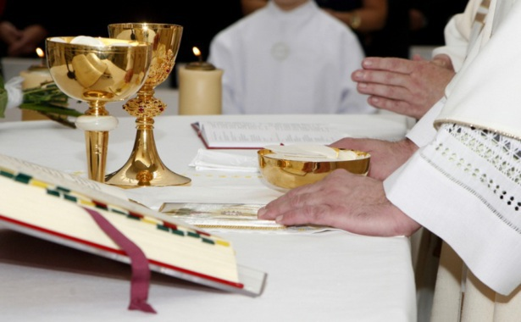
The Eucharist
© Jozef Sedmak/shutterstock.com
Notes:
Notes:
Q. What is the meaning of the word Eucharist?
The word comes from the Greek word eucharistein, which means “thanksgiving.”
It is related to the idea of “blessing” because Jesus took, blessed, broke, and gave the bread; the Jewish berakah, integral to the Eucharist, is a blessing that acknowledges God’s presence and continued saving action.
Q. Describe the action of God and response of God’s people.
God’s action: Actions that always reveal God’s active presence in both Jewish and Christian traditions are those of giving thanks and blessing. That is because God gave us everything: God blessed and saved us first. In faith we believe that God continues to do the same in the present.
Our response: For us the appropriate response is thanking and blessing God in return by participating in the Eucharist and by doing God’s will in our daily lives.

Slide 4
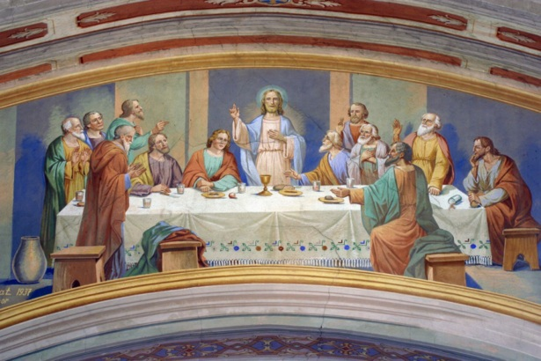
The Lord’s Supper
© Zvonimir Atletic/shutterstock.com
Notes:
Notes:
Q. What is the meaning of the term Lord’s Supper?
The term Lord’s Supper recalls the Passover meal that Jesus shared with his disciples on the night before he died.
Q. Describe the action of God and response of God’s people.
God’s action: Jesus made the ultimate sacrifice of dying on the cross for our sins. He identified himself with the Eucharistic elements of bread and wine during the Passover meal when he said, “Do this in memory of me” (Luke 22:19).
Our response: We respond to Jesus’ command every time we celebrate the Eucharist in his name and witness to his presence among us in the world.

Slide 5
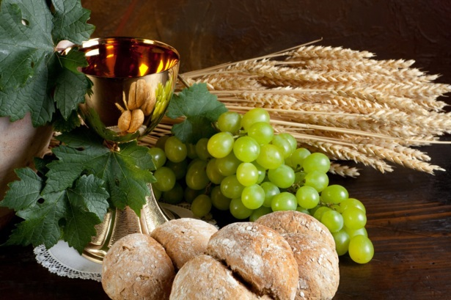
The Breaking of the Bread
© Anneka/shutterstock.com
Notes:
Alternate Image Option: Christ at the supper at Emmaus
Notes:
Q. What is the meaning of the phrase “the breaking of the bread”?
A Jewish custom that Jesus observed at the Last Supper, and at the supper in the inn along the road to Emmaus, was the host’s breaking the bread and distributing it. Jesus had broken bread in this way many times, even in the miracle of feeding the five thousand.
Q. Describe the action of God and response of God’s people.
God’s action: Jesus’ body was broken for our salvation. This Paschal sacrifice is made new each time the consecrated bread is broken at the Eucharist.
Our response: We are healed and made one when we receive Christ’s Body and Blood in the celebration of the Eucharist. Like the disciples of Emmaus, our eyes are opened and we recognize Jesus in the breaking of the bread and in our lives.

Slide 6

The Eucharistic Assembly
© Galushko Sergey/shutterstock.com
Notes:
Notes:
Q. What is the meaning of the term Eucharistic assembly?
The word assembly comes from the Greek word synaxis. Syn means “together,” and axis means “central point.” Our lives turn around the Eucharist; it is the “source and summit” of our lives.
Q. Describe the action of God and response of God’s people.
God’s action: Jesus rose from the dead on Sunday, the day of the Resurrection, for the salvation of the world.
Our response: We are drawn by Christ especially on Sunday, the day of the Resurrection, as a Eucharistic assembly to celebrate our salvation in Christ.

Slide 7
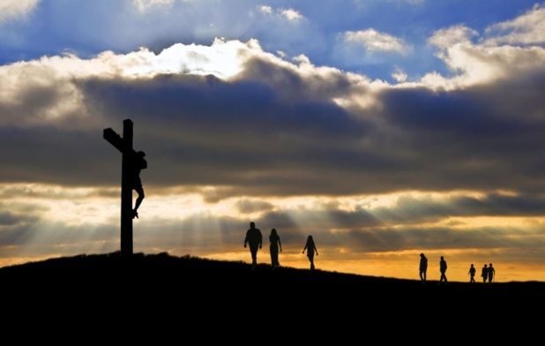
The Holy Sacrifice
© Matt Gibson/shutterstock.com
Notes:
Notes:
Q. What is the meaning of the name “the Holy Sacrifice”?
The only perfect sacrifice is Jesus’ death on the cross for the forgiveness of our sins and the promise of eternal life. The Eucharist is the fullest expression of this sacrifice.
Q. Describe the action of God and response of God’s people.
God’s action: Jesus died on the cross, the perfect sacrifice of praise for the forgiveness of our sins.
Our response: We gather to celebrate these Sacred Mysteries, this perfect sacrifice, in the Eucharist, and to extend Jesus’ sacrifice by our own way of living.

Slide 8
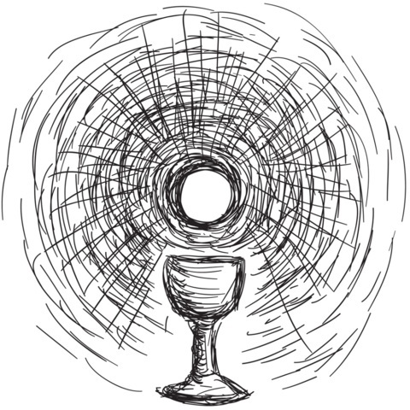
The Holy and Divine Liturgy
© robodread/shutterstock.com
Notes:
Alternate Image Option: priest holding up Host at Mass
Notes:
Q. What is the meaning of the term Holy and Divine Liturgy?
The term Holy and Divine Liturgy sometimes refers to the Church’s liturgy as a whole rather than one specific Sacrament. Like the term Sacred Mysteries, this term captures the centrality of the Eucharist.
Q. Describe the action of God and response of God’s people.
God’s action: The words holy and divine indicate God’s action of “setting apart” the celebration of the Eucharist as something distinctly initiated by God.
Our response: The community takes active part in the celebration of the Eucharist realizing that God’s initiative is at work in us.

Slide 9
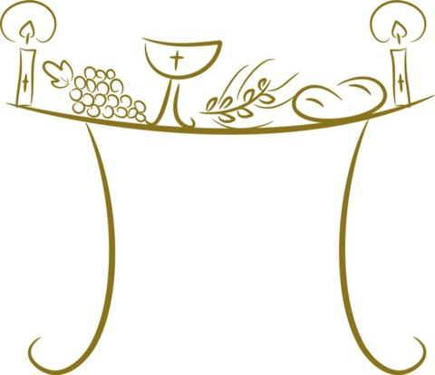
Holy Communion and Holy Mass
© Michaela Steininger/shutterstock.com
Notes:
Alternate Image Option: Communion at Mass with many nations shown, perhaps at World Youth Day
Notes:
Q. What is the meaning of the term Holy Communion and Holy Mass?
The word communion indicates that we are united with Christ and share with him and the whole Church as a single body. The word Mass comes from the Latin word missa, a word meaning “sent.” Used in the Dismissal of the Mass, it means that we are sent as an assembly to accomplish Christ’s mission in the world. The Eucharist is also similarly known as bread of angels, bread from Heaven, medicine of immortality, and viaticum, which is the Eucharist for the dying and means “with you on the way.”
Q. Describe the action of God and response of God’s people.
God’s action: God unites us as a single body, sends us to do his will in the world, and is always with us on our journey toward eternal life.
Our response: The assembly freely assents to being made holy by the presence of Christ so that the community may, in turn, sanctify the world by doing God’s will.

Slide 10
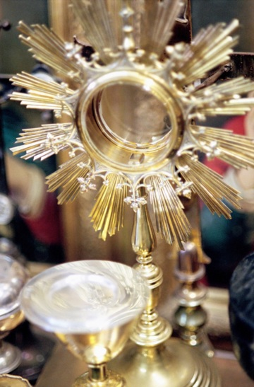
Christ Is Present in the Eucharist
© AISPIX/shutterstock.com
Notes:
Alternate Image Option: The Last Supper, perhaps in an unusual or modern style
Notes: Conclude by emphasizing the idea that God’s presence in the Eucharist and in our lives is an active, dynamic presence. We’ve heard it said, “Love is a verb.” Saint John the Evangelist said, “God is love.” Using the logic of a syllogism, it follows that “God is a verb.” God continuously gives life, and so God is a dynamic presence and power in our life and world.
(Scripture texts used in this work are taken from the New American Bible, revised edition © 2010, 1991, 1986, 1970 Confraternity of Christian Doctrine, Washington, D.C. All Rights Reserved. No part of the New American Bible may be reproduced or transmitted in any form or by any means, electronic or mechanical, including photocopying, recording, or by any information storage and retrieval system, without permission in writing from the copyright owner.)

