Slide 1
Habakkuk 3:17–19
The Paschal Mystery Course
Document # TX001336

Slide 2
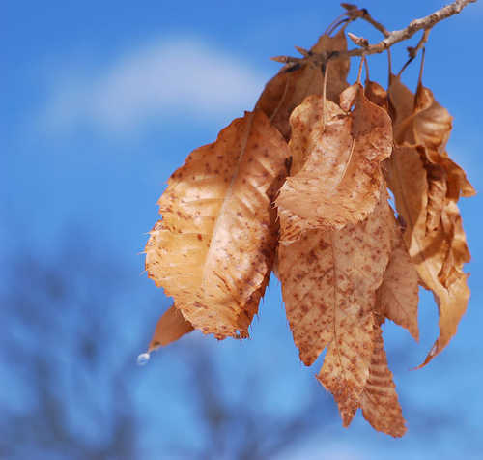
For though the fig tree blossom not
nor fruit be on the vines,
Image in public domain

Slide 3
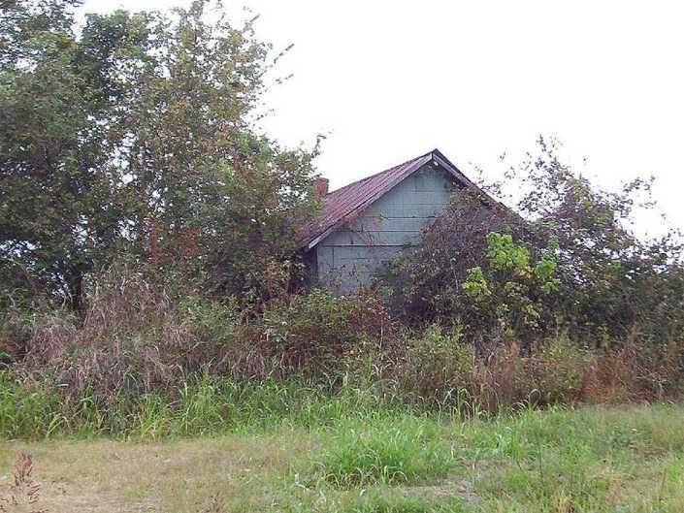
Image in public domain

Slide 4
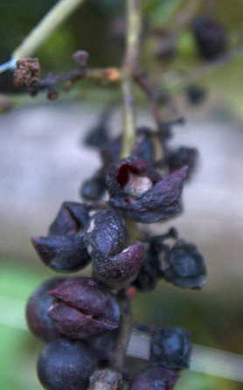
Though the yield of the olive fail
and the terraces produce no nourishment,
Image in public domain

Slide 5
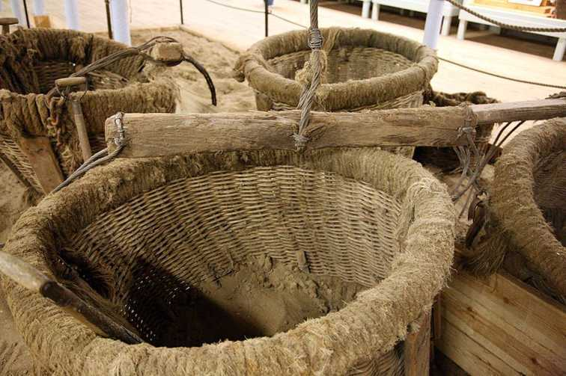
Image in public domain

Slide 6
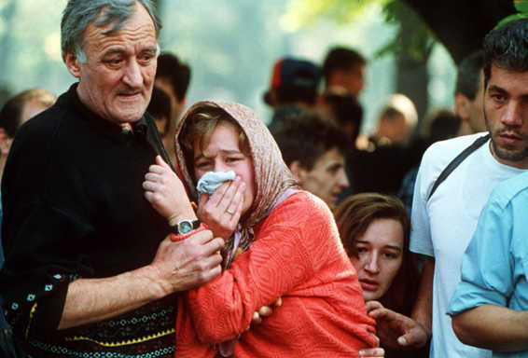
Though the flocks disappear from the fold
and there be no herd in the stalls,
Image in public domain

Slide 7
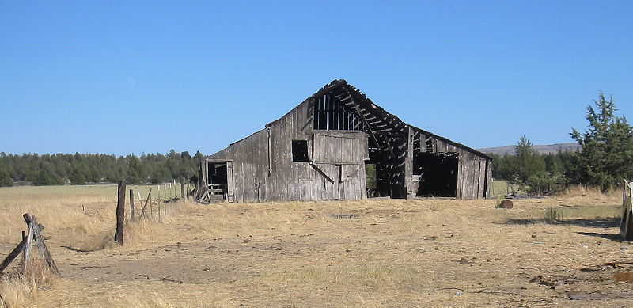
Image in public domain

Slide 8
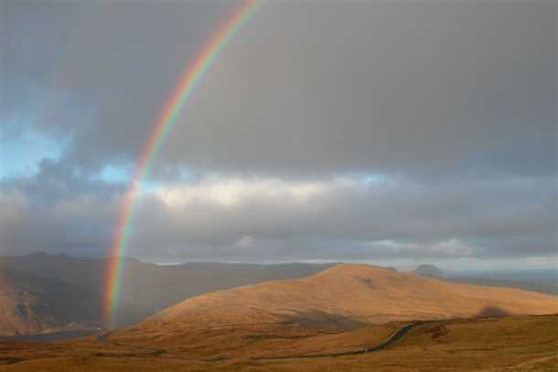
Yet will I rejoice in the Lord
and exult in my saving God.
Image in public domain

Slide 9
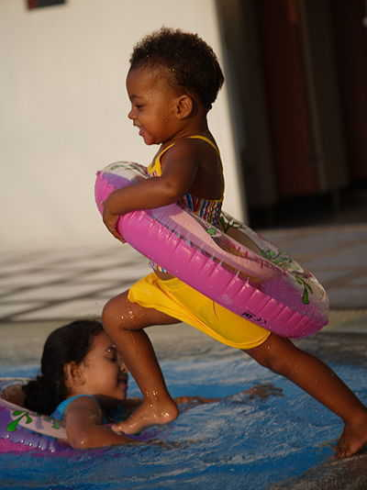
Image in public domain

Slide 10
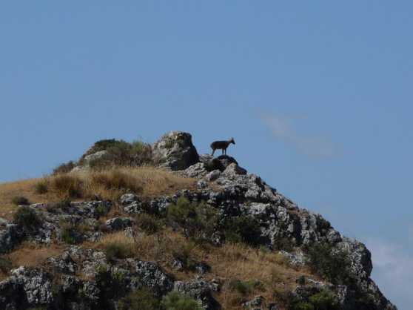
God, my Lord, is my strength;
he makes my feet swift as those of hinds
and enables me to go upon the heights.
Image in public domain

Slide 11
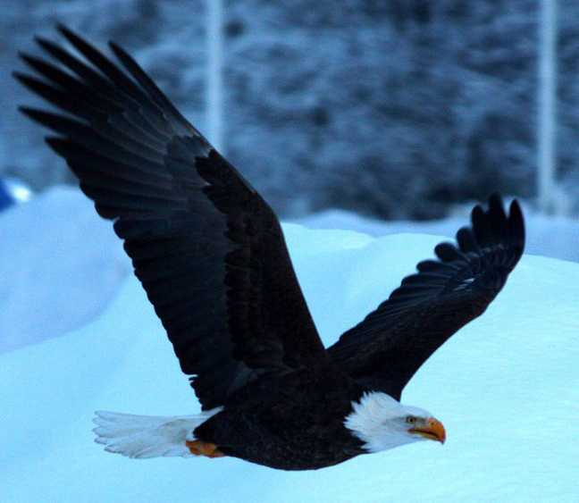
panoramio.com

