Slide 1
Exegesis and Ideological Analysis
The New Testament
Document #: TX002212
Notes:
Notes: Ideological analysis refers to the biases, assumptions, or strongly held beliefs that underlie our interpretation of Scripture. It seeks to illuminate how people of different backgrounds might interpret the scriptural text in ways that may support their own group and denigrate others.

Slide 2
Notes:
Notes: Everyone has an ideology, but ideologies are often invisible until . . .

Slide 3
© Michal Kowalski/shutterstock.com
Notes:
Notes: . . . we come across one with which we disagree. Everyone has a unique cultural background that affects the way we view things.

Slide 4
What different backgrounds are we talking about?
socioeconomic: the rich and the poor
culture, race, ethnicity: people of majority and minority groups, especially those who have experienced racism and other systematic oppression
gender: women and men
sexuality: heterosexual and homosexual
vocation: single, married, celibate
religion: those who believe in one God or in many gods

Slide 5
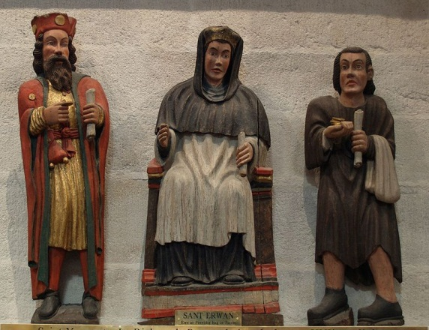
In Matthew 26:11, Jesus says “The poor you will always have with you . . .”
Notes:
Notes: Some might read this text and interpret it to mean “We really cannot do anything about poverty. Let the poor stay poor!” In this way the Scripture text might be used as a way to support the apathetic views of the rich about the plight of the poor.
Ideological analysis, though, would have us look more closely at the context in which Jesus spoke those words. In fact, he is saying it in response to the disciples after they criticize him for allowing a woman to anoint him with oil. They are upset because the money for the oil could have been used for the poor. Jesus’ entire response, then, is “The poor you will always have with you; but you will not always have me.” Jesus defends the compassionate actions of this woman who anticipates his crucifixion. Soon Jesus will no longer be physically present to the disciples, but he will be made known to them through those who are hungry, thirsty, naked, ill, and imprisoned (see Matthew 25:31–46).

Slide 6
Ideological analysis asks the following kinds of
questions of the text:
What group of people might be viewed as superior in the text? What group of people might be viewed as inferior in the text?

Slide 7
How can this text be read and interpreted in such a way as to liberate people who are dominated, oppressed, or marginalized?

Slide 8
Does a particular group of people or a character demonstrate faith, intelligence, or perseverance?

Slide 9
What do you notice about the way Jesus speaks about or interacts with this particular person or group of people?

Slide 10
In what way might this text be used by one group of people in society to dominate or oppress another group?

Slide 11
In what way might this text be used by a particular group in society to support its opinions or perceptions of a particular issue?

