Slide 1
The Social Dimension of the Paschal Mystery
Catholic Social Teaching
Document #: TX001944

Slide 2
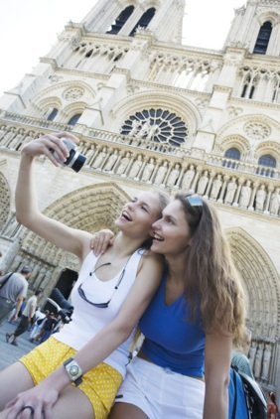
True faith always has a social dimension.
Image in shutterstock

Slide 3
God’s plan of salvation is both personal and communal. We need to care about others, not just ourselves.
Image in shutterstock

Slide 4
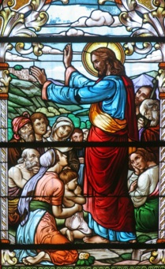
Christ gave us a New Law (the Sermon on the Mount) to teach us how to live as citizens of God’s Kingdom, completing the instruction that began with the Old Law.
Image in shutterstock
The Holy Spirit empowers us to build the Kingdom of God here on earth.
Interesting Fact: Matthew’s Gospel refers to the Kingdom of God four times.

Slide 5
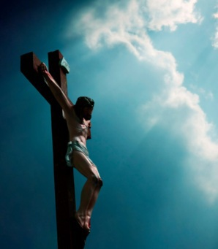
The New Testament teaches us that God’s love is fulfilled through the life and work of Jesus Christ.
Image in shutterstock
We call this the Paschal Mystery—the life, death, Resurrection, and Ascension of Jesus Christ.
The Paschal Mystery is the fulfillment of the New Covenant that God makes with all people.

Slide 6
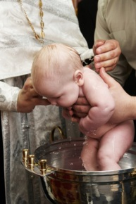
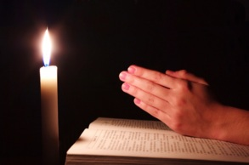
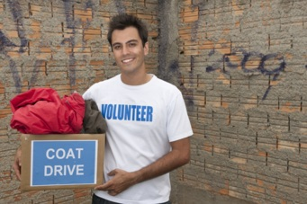
For people to enter into the New Covenant, we must
Image in shutterstock
Image in shutterstock
Image in shutterstock
place our faith in Jesus,
be baptized,
and follow Christ’s New Law of Love.

Slide 7
• be compassionate toward others, • live justly, • respect the life and dignity of every person, • share our material goods to help others in need, • and build just societies that protect the essential rights of all people.
By Leon Brocard (originally posted to Flickr as IXS_2631) [CC-BY-2.0 (www.creativecommons.org/licenses/by/2.0)], via Wikimedia Commons
The New Law of Christ requires us to

Slide 8
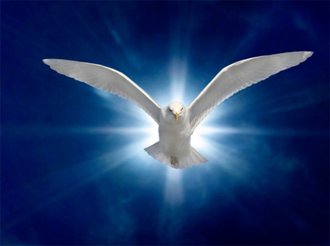
The Holy Spirit calls us to conversion, empowers us for service, and helps us to grow in holiness.
Image in shutterstock

Slide 9
Each person’s salvation is based on his or her personal decision and actions. We must commit to being a member of the Body of Christ, make decisions to partake in the Sacraments, make good moral choices, serve others, and live a just life.
Image in shutterstock

Slide 10
The communal dimension of salvation is based in community. We are united as one family through the Sacraments and are therefore called to take care of all our brothers and sisters in Christ.
Image in shutterstock

