Slide 1
The Mystery of Suffering
The Paschal Mystery
Unit 4, Chapter 10
Document #: TX005800
Notes:
Notes: The notes on the slides, which are review from the student text, provide context for a reflection on the mystery of suffering and how we are a part of it. Every fourth slide has a question for journaling. You can play the presentation automatically, or advance from slide to slide based on students’ responses (e.g., do they need more time to write, are they examining the image, or do they look bored?).

Slide 2
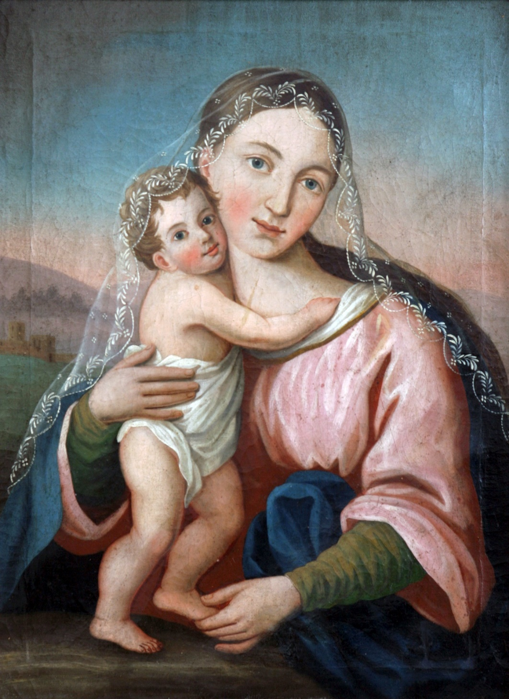
© Zvonimir Atletic / Shutterstock.com
Notes:
Notes: The Incarnation was an act of solidarity God undertook for humanity’s salvation.

Slide 3

© CHOATphotographer / Shutterstock.com
Notes:
Notes: Solidarity is defined as “a union of one’s heart and mind with those who are poor or powerless or who face an injustice.”

Slide 4
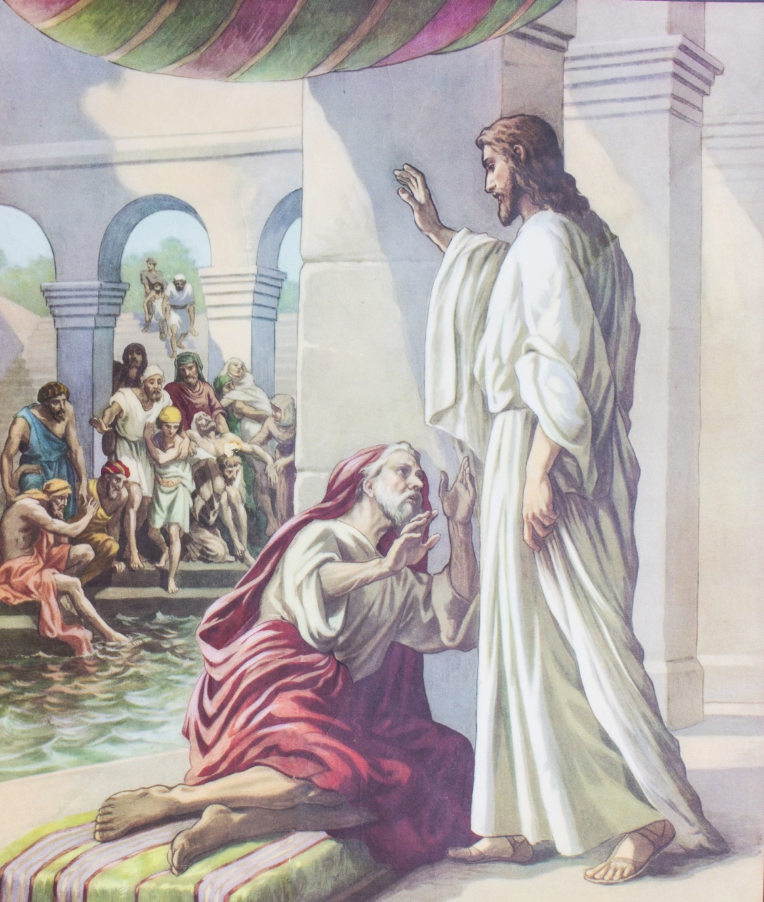
© Freedom Studio / Shutterstock.com

Slide 5
How did Jesus demonstrate solidarity with the poor, the powerless, or those who faced injustice?

Slide 6
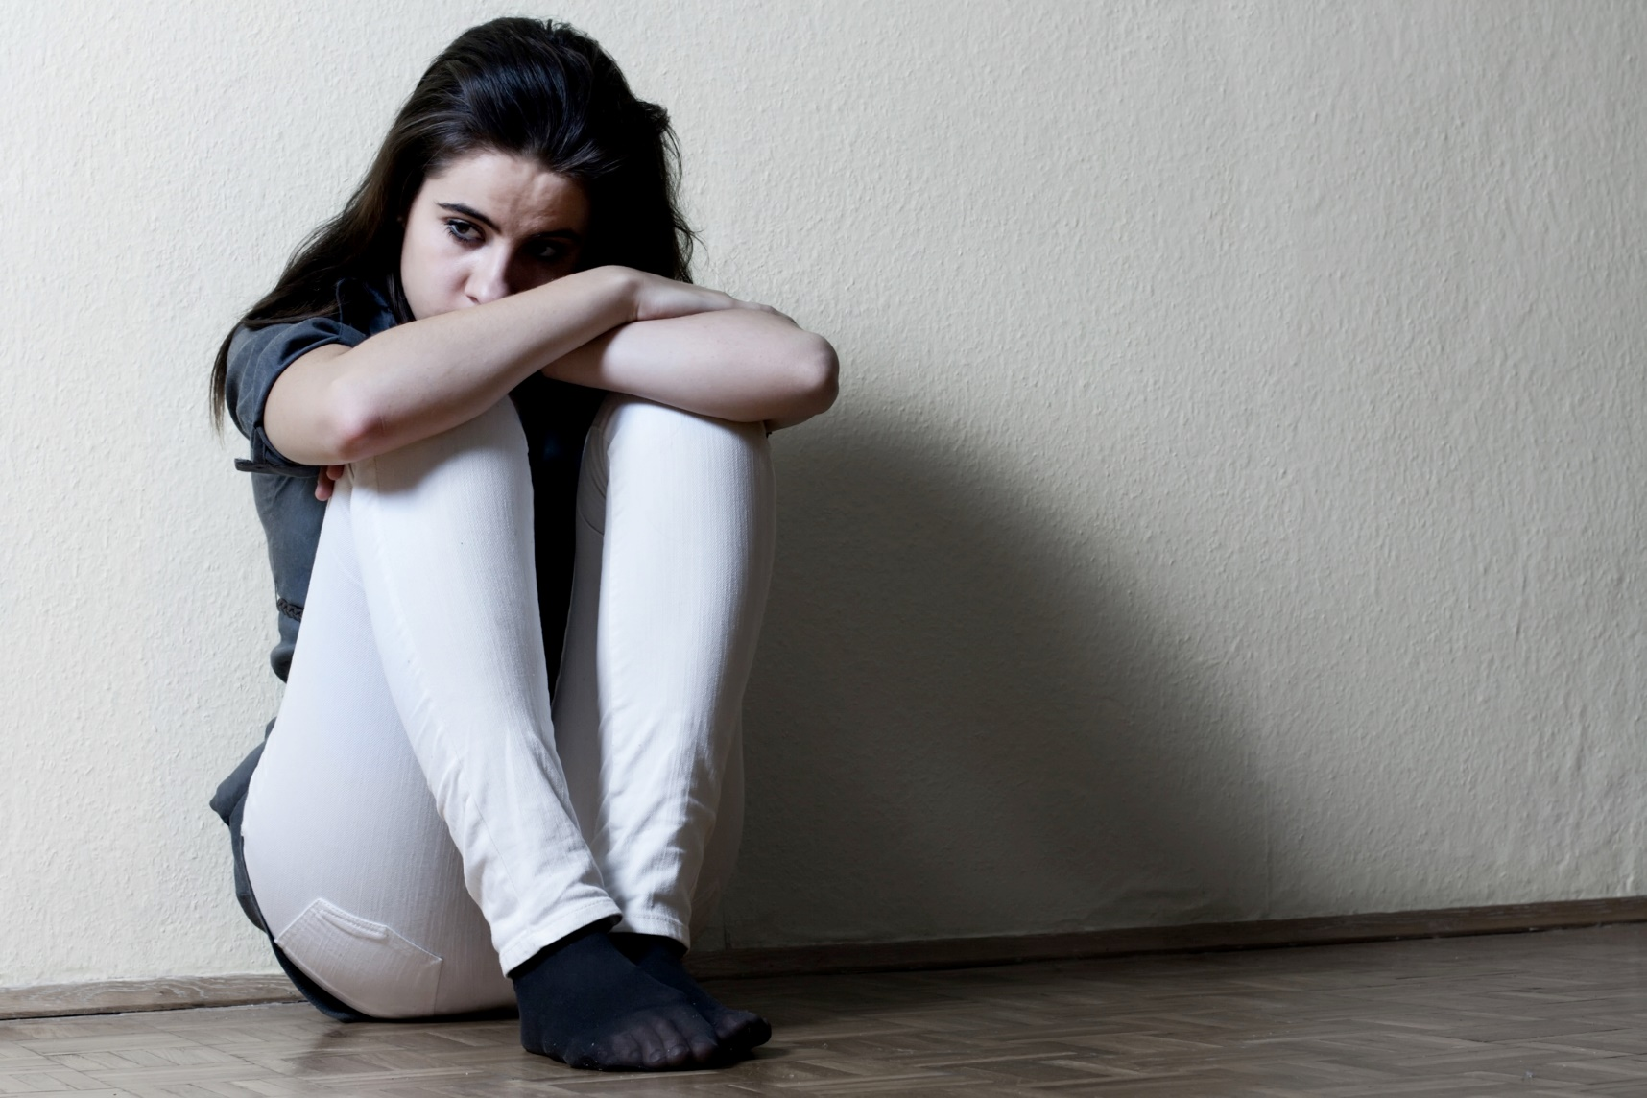
© Mita Stock Images / Shutterstock.com
Notes:
Notes: In becoming human in the Person of Jesus, God enters into true solidarity with us: in Jesus, God shares in and sanctifies (makes holy) all the realities of our lives, including our suffering.

Slide 7
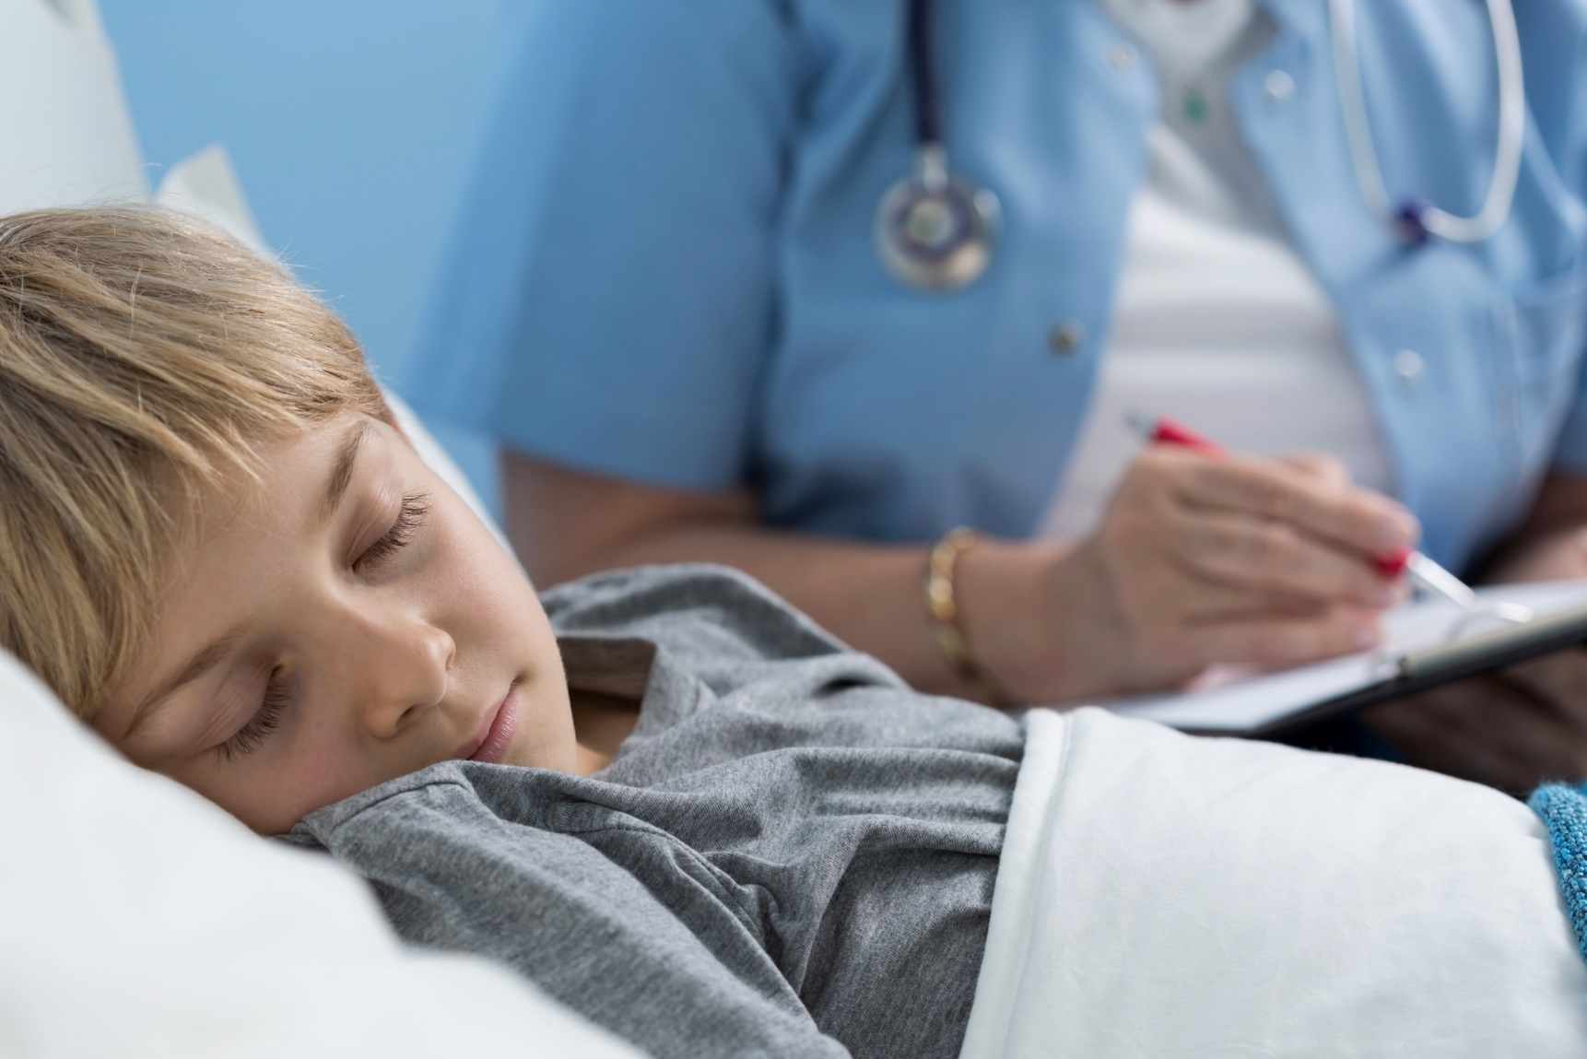
© Photographee.eu / Shutterstock.com

Slide 8

© Monika Gniot / Shutterstock.com

Slide 9
When have you needed to know that
God was standing by you in a
time of suffering?

Slide 10
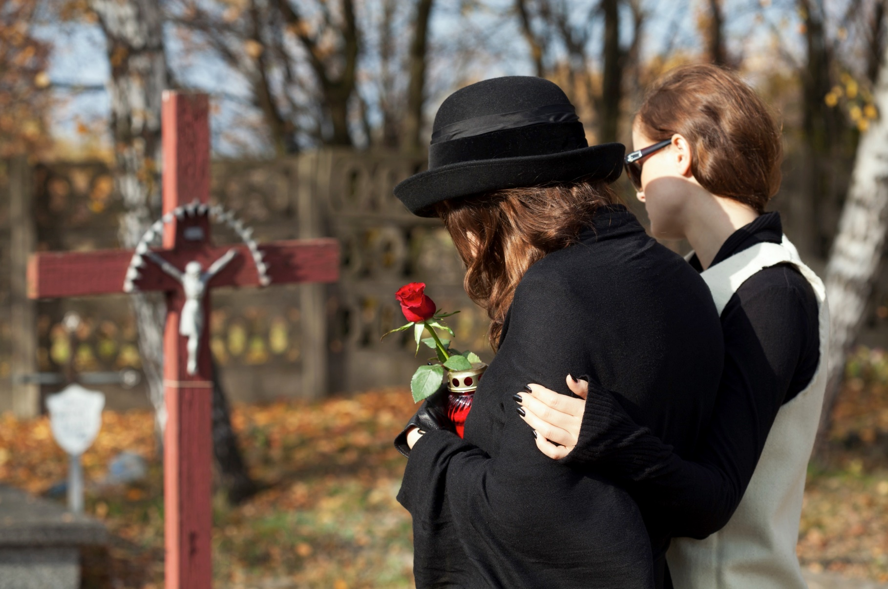
© Photographee.eu / Shutterstock.com
Notes:
Notes: In Jesus, God even experiences the ultimate human suffering: death. In truly living and dying as a real human being, Jesus forever united heaven and earth and gave us the grace of redemption.

Slide 11

© Monkey Business Images / Shutterstock.com
Notes:
Notes: When we experience suffering—big or small—we can take courage and comfort in the knowledge that Jesus himself has gone before us.

Slide 12
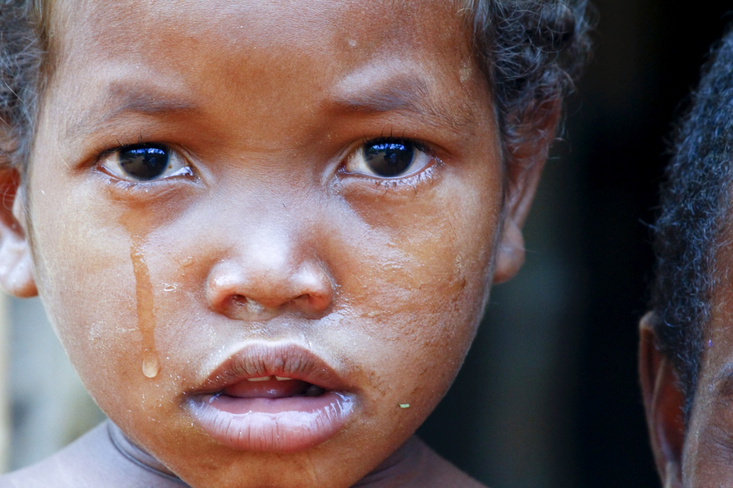
© Damian Ryszawy / Shutterstock.com

Slide 13
Do you find it helpful to know that
Jesus suffered as we do?

Slide 14
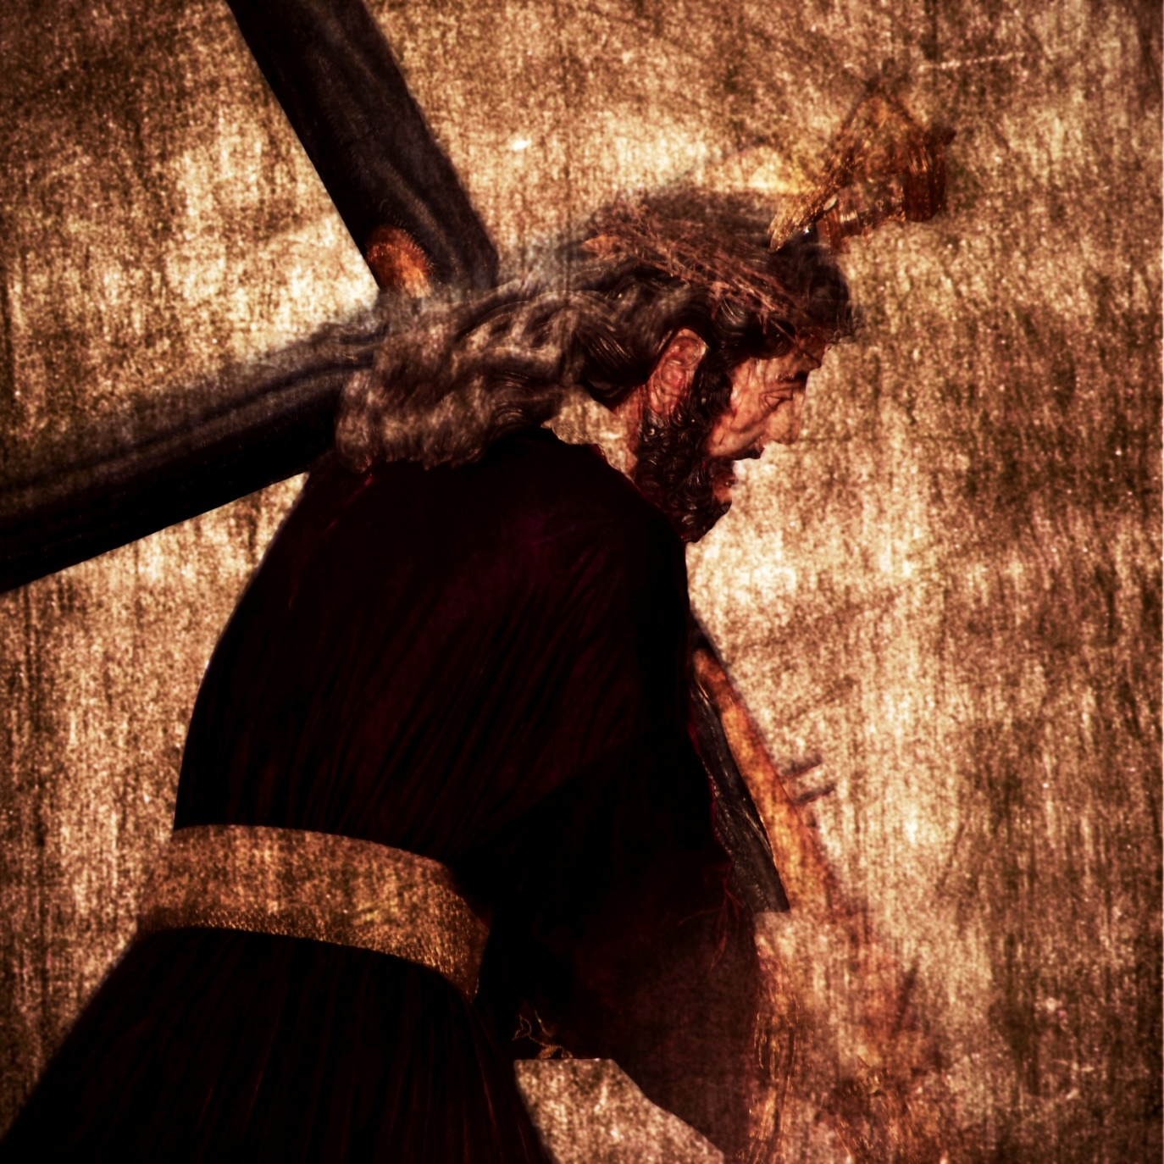
© nito / Shutterstock.com
Notes:
Notes: We are called to follow the example of Jesus with a readiness to take on suffering for the good of others. This does not mean that we are to seek out suffering intentionally or try to make ourselves miserable. It does mean that we must be willing, at least sometimes, to put aside our own needs, desires, or comfort in order to be of service to others, especially those most in need.

Slide 15
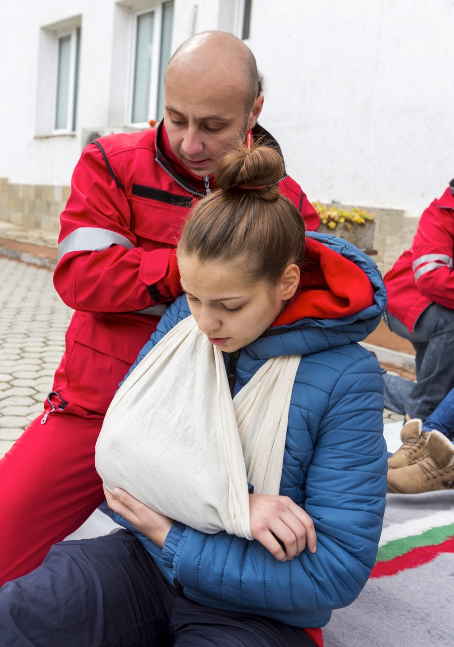
© Cylonphoto / Shutterstock.com

Slide 16
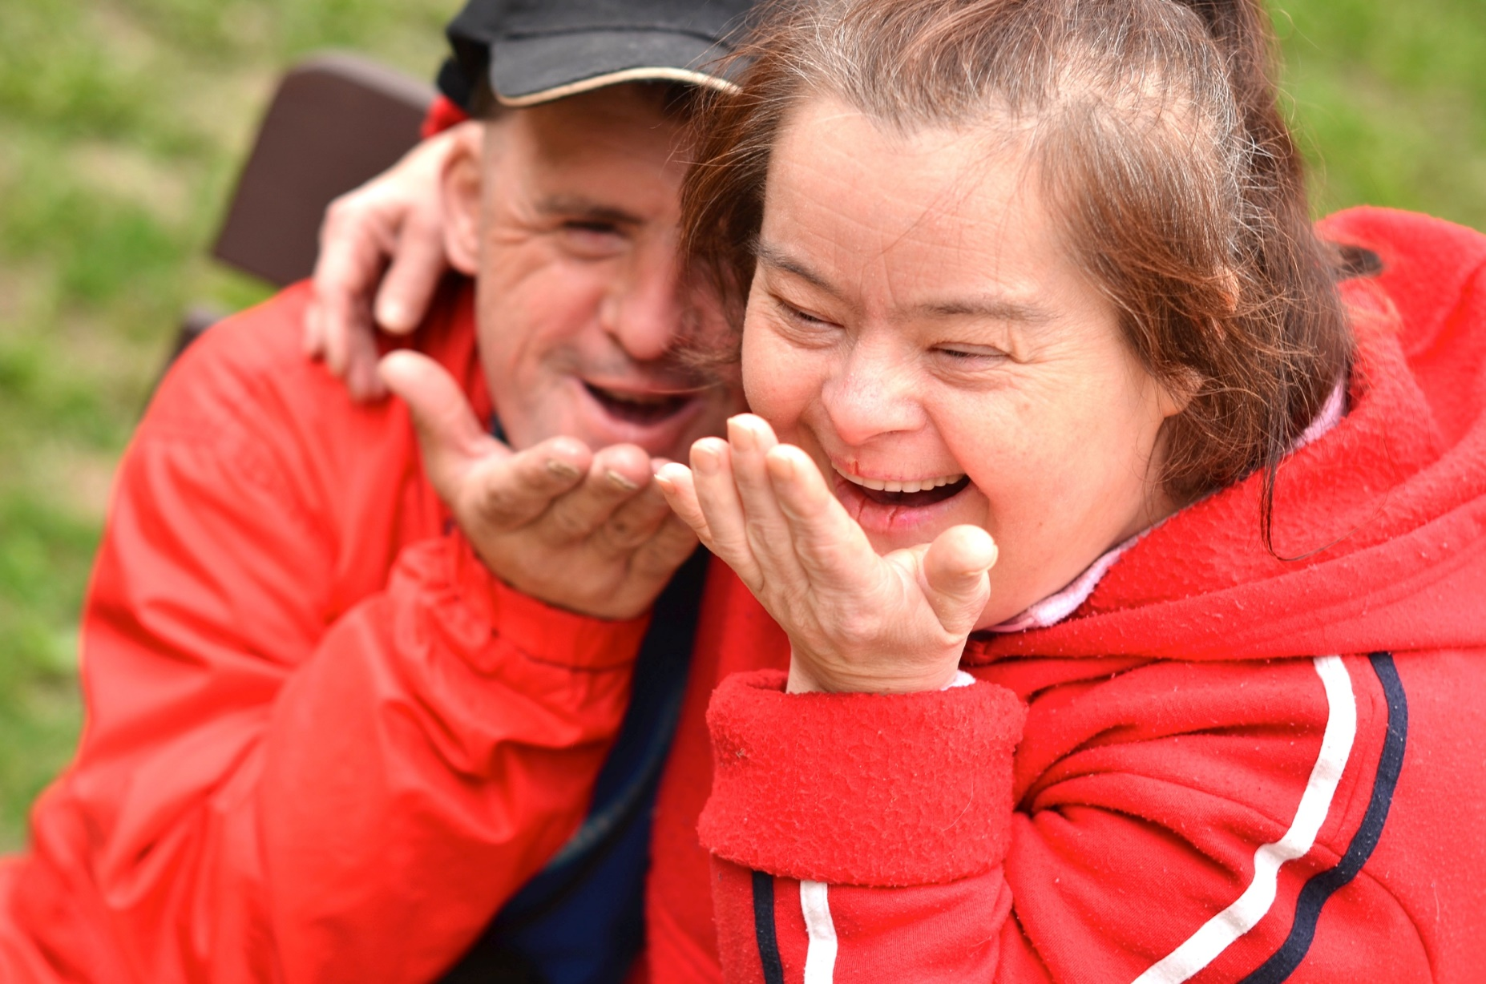
© Marcel Jancovic / Shutterstock.com

Slide 17
When have you been called to put aside what you wanted, or to go beyond your comfort zone, to be of service?

