Slide 1
Chapter 13: Christianity
World Religions: A Voyage of Discovery
DOC ID #: TX003950

Slide 2
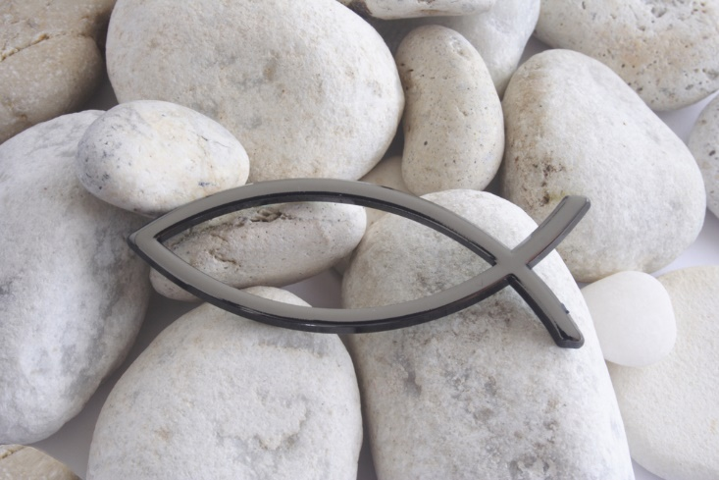
IXThUS
Ixthus is Greek for fish.
It summarizes the Christian gospel, or “Good News”:
I (Iesu, Jesus)
X (Christos, Christ)
ThU (theou uios, Son of God)
S (soter, Savior)
© Pilar Echevarria / www.shutterstock.com
Notes:
Notes: More could be said about the Christian gospel, and of course variant summaries could be given. The fish symbol was used by early Christians as a means of self-identification, although the notion that they needed to live in constant fear of the Roman authorities sometimes is overemphasized; actual persecutions of Christians, especially in the first two centuries, were scattered and quite rare. The assertion that Jesus was “Son of God,” however, was a potential source of conflict, as the Romans already had their sons of gods in their emperors, some of whom—notably Augustus, Tiberius, Titus, and Domitian—were sons of, respectively, the deified Julius Caesar, Augustus, and Vespasian (Titus and Domitian were brothers).

Slide 3
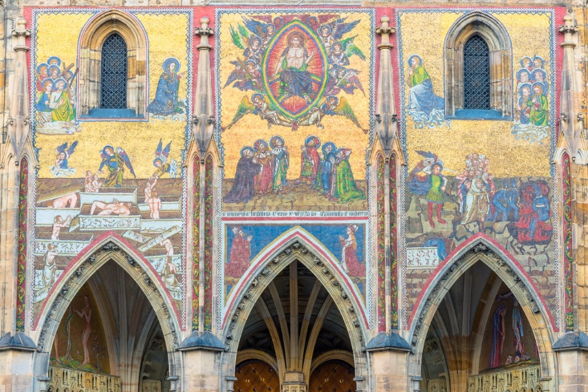
The Last Judgment: Christian Eschatology
Eschatology refers to teachings about “the last things” (ta eschata in Greek).
Christian eschatology includes several key doctrines:
the Second Coming of Christ
resurrection of the dead
judgment of both the living and the dead
Heaven / Hell
© elvistudio / www.shutterstock.com
Notes:
Notes: The mosaic shown on this slide is in the Saint Vitus Cathedral, located in Prague, Czech Republic. It was completed in 1371 and is typical of many medieval and early modern portrayals of the Last Judgment. Most New Testament scholars contend that Christianity arose within the apocalyptic worldview that was prevalent among Jews living in Roman Palestine at the time of Jesus. The worldview holds that an apocalypse, “revelation,” is provided to the Elect, or those righteous enough to be chosen by God. The revelation told of the imminent end of the world (eschaton in Greek, commonly known as Armageddon or—in a nonliteral use of the term—the Apocalypse). This event would be accompanied by resurrection of the dead and divine judgment of all, with the righteous to be rewarded in Heaven and (according to some accounts) the wicked to be condemned to Hell. The Old Testament Book of Daniel, written about 165 BC, is an example of apocalyptic literature and is the earliest extant reference to resurrection of the dead.

Slide 4
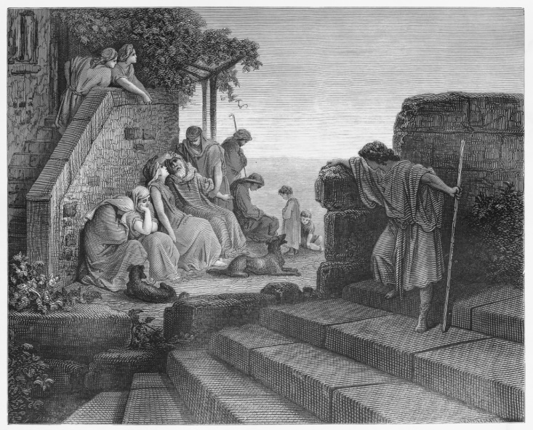
Return of the Prodigal Son
The parable exemplifies the Christian ideal of agape, selfless, unconditional love.
The parable is recounted in the Gospel of Luke (15:11–32).
Jesus’ central teachings about love are featured in the Gospel of Matthew’s Sermon on the Mount.
© Nicku / www.shutterstock.com
Notes:
Notes: The drawing shown on this slide by Gustave Dore is from a collection of illustrations of biblical stories published in 1855. Among the essential teachings is Matthew 5:43–45: “You have heard that it was said, ‘You shall love your neighbor and hate your enemy.’ But I say to you, Love your enemies and pray for those who persecute you, so that you may be children of your Father in heaven.” The Bible nowhere states “hate your enemy” (this must have been a common oral teaching at the time of Jesus), but Leviticus 19:18 states “. . . you shall love your neighbor as yourself: I am the Lord.” Among many cultural allusions to the parable are the hymn “Amazing Grace” (with the verse “I once was lost but now I am found”) and the Rolling Stones song “Prodigal Son” (“My son was lost but now he is found”) from their 1967 album Beggar’s Banquet.

Slide 5
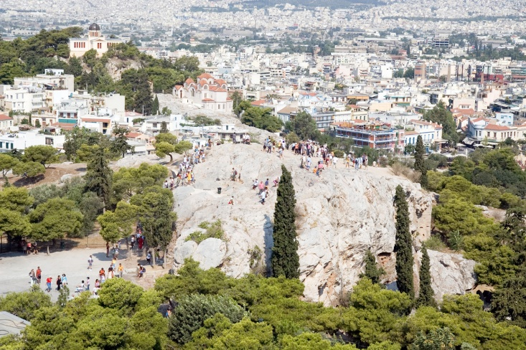
The Apostle Paul
According to the Acts of the Apostles, Paul preached the Christian message in Athens on the Areopagus.
He used ideas familiar to his audience to introduce a new perspective.
He preached throughout Greece, Asia Minor, Syria, and Malta in the first century.
© Vovez / www.shutterstock.com
Notes:
Notes: Paul’s speech in Athens is recounted in Acts 17:16–34; the scene is the subject of a painting by Raphael. The painting on this slide shows the Areopagus (“Hill of Ares”) as seen from the nearby Acropolis. Key New Testament passages regarding Paul’s call to be apostle to the Gentiles include Galatians 1:13–18, in which he reports his encounter with the Risen Christ. Acts 9:1–22 sets forth a varying account, undoubtedly embellished given what Paul himself says in Galatians.

Slide 6
Christian Prayer
Prayer is an essential worship practice for Christians.
The Gospel of Matthew (6:9–13) presents Jesus instructing his followers on how to pray.
His words have been repeated in Christian services through the centuries as the Lord’s Prayer.
© Charlotte Purdy / www.shutterstock.com
Notes:
Notes: Prayer is done either during public worship or in private, and sometimes it involves accompanying ritual practices and objects, such as, in Catholicism, the use of rosary beads. Incorporation with prayer of other practices and objects include the Catholic practice of visiting the Stations of the Cross, and the Orthodox Christian use of the Philokalia, a collection of texts compiled from the fourth through the fifteenth centuries. The Jesus Prayer is intended to be repeated continuously: “Lord Jesus Christ, Son of God, have mercy on me.”

Slide 7
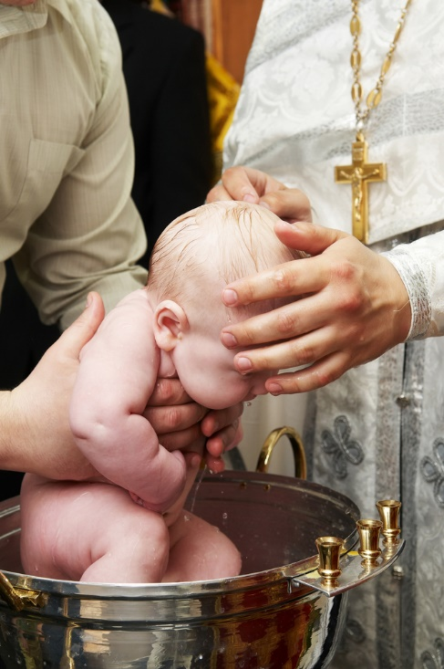
Christian Sacraments: Baptism
A sacrament is a ritual of special significance, believed to bestow God’s grace on the participants.
Baptism is believed to cleanse the person of sin and to mark the beginning of a new life in Christ.
© Dmitry Kalinovsky / www.shutterstock.com
Notes:
Notes: Catholicism and Eastern Orthodoxy practice Seven Sacraments; most Protestants practice only two—Baptism and Holy Communion, or the Eucharist. Baptism usually involves a sprinkling of water but sometimes partial or even full immersion. The Greek word for sacrament is mysterion (“mystery”), an idea operative in such sacramental events as the consecration of bread and wine for the Eucharist. The other five Sacraments are: Confirmation, Marriage, Holy Orders, Penance and Reconciliation (or Confession), and Anointing of the Sick.

Slide 8
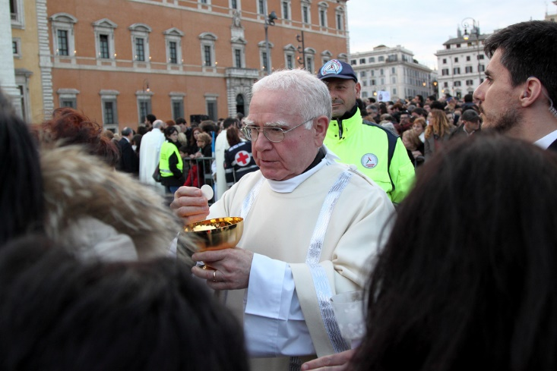
Christian Sacraments: Holy Communion, or the Eucharist
The Sacrament of the Eucharist recalls the Last Supper that Jesus held with his disciples.
The Gospel of Mark 14:22–24 (and parallels in Matthew and Luke) recounts this event, and in turn is the basis for the ritual.
© MattiaATH / www.shutterstock.com
Notes:
Notes: Protestants tend to regard the bread and wine as symbolic, whereas the Catholic act of Consecration by the priest is believed to transform them into the Body and Blood of Christ. The transformative act of consecrating the bread and wine is a good example of the “mystery” inherent in the Sacraments. Early Christian worship was modeled on that of Judaism, which featured three main aspects: a Scripture reading, a prayer, and a sermon. The Eucharist was added to this threefold model; hence there are two main liturgies.

Slide 9
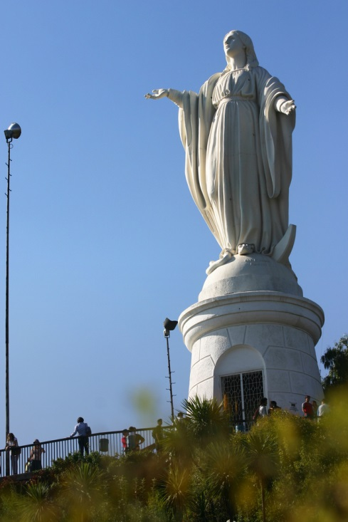
The Virgin Mary
Mary is venerated by Christians as the Mother of God
Through the centuries, saints have been role models and patron benefactors.
Saints—most especially the Virgin Mary—have been the objects of great affection and veneration.
© Paulo Neres / www.shutterstock.com
Notes:
Notes: The statue of the Virgin Mary shown on this slide stands on San Cristóbal Hill, in Santiago, Chile. The veneration of saints is well known to Catholic and Orthodox Christians, less so to Protestants. This would be a good opportunity to delve into some related topics in more detail, such as martyrdom or the degree of correlation between saints and their festival days with pre-Christian deities and their worship. For example, Saint Valentine’s Day coincides almost exactly with the Roman festival of Lupercalia (February 13), which featured fertility rites.

Slide 10
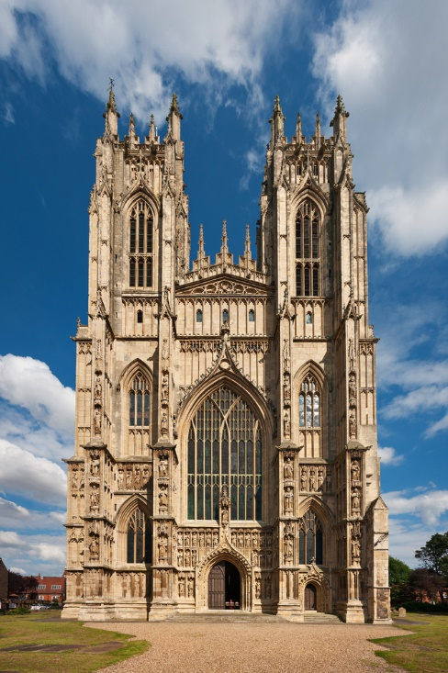
Church Architecture
Throughout the history of Christianity, the word church has connoted both the community of Christians and the distinctive place of worship.
Predominant architectural styles down through the Middle Ages include:
Byzantine
Romanesque
Gothic
© Khirman Vladimir / www.shutterstock.com
Notes:
Notes: The English term church is derived from the Greek kuriakon, “that which belongs to the lord.” Obviously much more could be said and shown to present the exceedingly rich architectural traditions of Christianity. The integration of theological ideals with architectural advancements is particularly interesting; for example, the desire to let in more light, representative of the divine, and the astonishing architectural feats that produced the great Gothic cathedrals of Europe. The church shown on this slide is in the Gothic style and is located in Yorkshire, England.

Slide 11
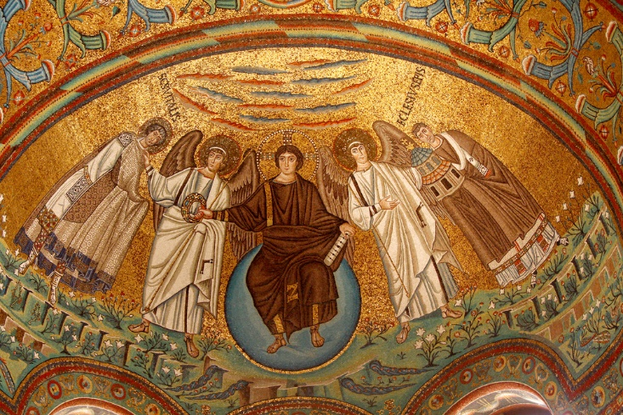
An Early Depiction of Jesus
San Vitale, a church in Ravenna, Italy, is famous for its exquisite mosaics.
Artistic depictions of Jesus through the centuries have varied widely.
The Byzantine versions typically present a youthful Jesus with short black hair.
© Samot / www.shutterstock.com
Notes:
Notes: San Vitale was built by the order of Byzantine Emperor Justinian (reigned from 527 to 565), who is featured on this slide in a nearby mosaic along with twelve attendants—clearly drawing a parallel to Christ and his twelve disciples. The empress Theodora is featured, also with twelve attendants, in a mosaic that faces that of the emperor. A provocative book on artistic representations in the early centuries that includes consideration of San Vitale is Thomas F. Mathews’s The Clash of Gods: A Reinterpretation of Early Christian Art (Princeton, NJ: Princeton University Press, 1999).

Slide 12
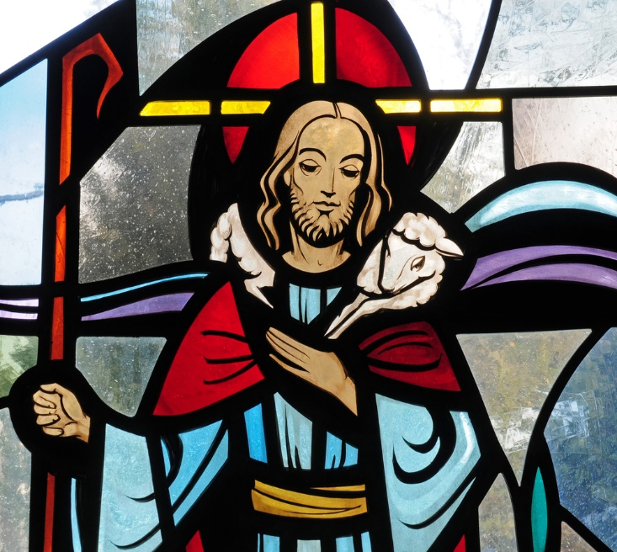
Jesus as Good Shepherd
Jesus has been depicted as the Good Shepherd since the early centuries of Christianity.
Jesus compared himself to a shepherd who would give up his life to protect his sheep (see John 10:11).
© Nancy Bauer / www.shutterstock.com
Notes:
Notes: We have no evidence with regard to the actual appearance of Jesus. The most famous ancient sculpture of Jesus as Good Shepherd is in the Vatican Museums. In The Clash of Gods, Mathews includes consideration of this type of depiction.

Slide 13
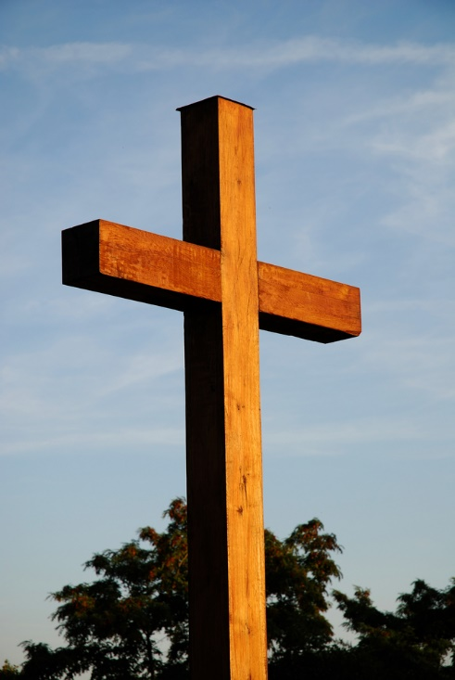
The Cross
The cross, a Roman implement of execution, became for Christians a symbol of triumph.
Many different types of crosses have been developed.
Most are still popularly used in worship and as ornamental adornments.
© Brasiliao / www.shutterstock.com
Notes:
Notes: The reversal of symbolic meaning of the cross is remarkable. Roman crucifixion was intended to be not only excruciatingly painful but also humiliating. To the Romans, the fact that Christians celebrated as triumphant the crucifixion of a condemned criminal was baffling (see Tacitus, Annals, 15.44).

