Slide 1
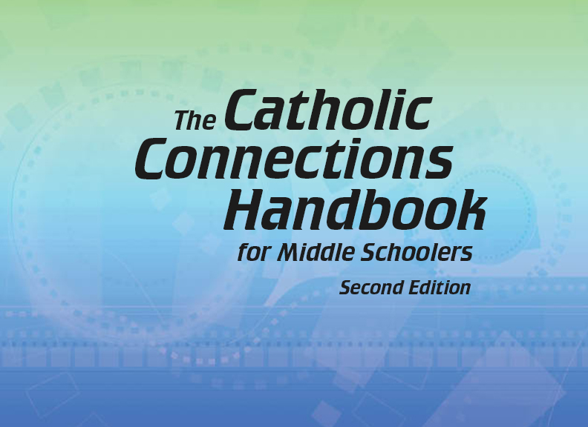


Slide 2
Christian Morality
and Social Justice
Chapter C
Respecting Sexuality

Slide 3

Chapter Summary
Respecting Sexuality
In this chapter, the second half of chapter 44 in the Handbook, we will consider homosexuality, faithful marriage, and living a chaste lifestyle in keeping with God’s plan. The discussion of homosexuality emphasizes that each person, no matter one’s sexual inclination, is a child of God. The discussion of marriage brings up the topic lifelong fidelity. The Ninth Command-ment is presented as a call to purity of heart in our relationships with one another.
© art_of_sun/www.istockphoto.com

Slide 4
Key Scripture Passage
“My friends, fill your minds with those things that are good and that deserve praise: things that are true, noble, right, pure, lovely, and honorable.”
(Philippians 4:8; Handbook, page 487)

Slide 5

“Homosexuality”
(Handbook, pages 483–484)
We are all children of God.
© hidesy/www.istockphoto.com

Slide 6
“Homosexuality”
(Handbook, pages 483–484)
Some people have a strong attraction to people of the same sex.
God asks us to stay sexually pure outside of sacramental marriage.
All people are children of God.

Slide 7

“Homosexuality”
(Handbook, pages 483–484)
“Chastity is expressed notably in friendship with one’s neighbor. Whether it develops between persons of the same or opposite sex, friendship represents a great good for all. It leads to spiritual communion.” (Catechism of the Catholic Church, 2347)
“The local Church community is also a place where the person with a homosexual inclination should experience friendship. This community can be a rich source of human relationships and friend-ships, so vital to living a healthy life. In fact, within the Church human friendship is raised to a new order of love, that of brothers and sisters in Christ.” (United States Conference of Catholic Bishops, “Ministry to Persons with a Homosexual Inclination: Guidelines for Pastoral Care,” November 14, 2006)
© winnond/www.istockphoto.com

Slide 8

“Homosexuality”
(Handbook, pages 483–484)
Journal It!
© RuslanDashinsky/www.istockphoto.com
How is friendship to be lived out through the Church?
How can you work toward being a better friend to all?

Slide 9
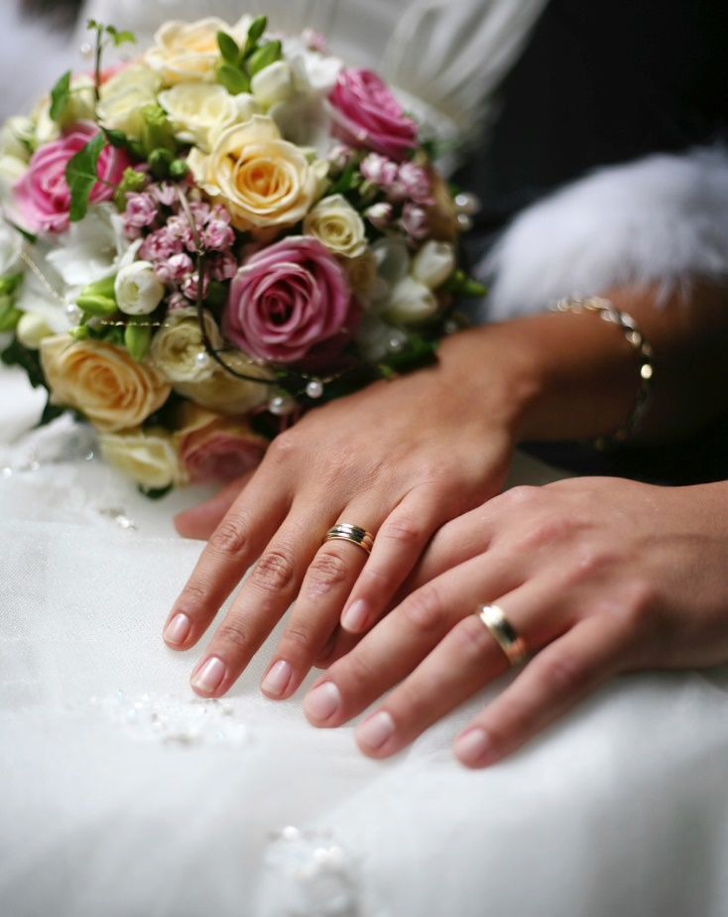
“Before You Say ‘I Do’”
(Handbook, pages 484–485)
Marriage is a lifelong commitment.
© sansara/www.istockphoto.com

Slide 10
“Before You Say ‘I Do’”
(Handbook, pages 484–485)
Marriage is a forever commitment and must be taken seriously.
Married couples are to remain faithful to their marriage vows.
Married couples are to accept children as gifts from God.

Slide 11
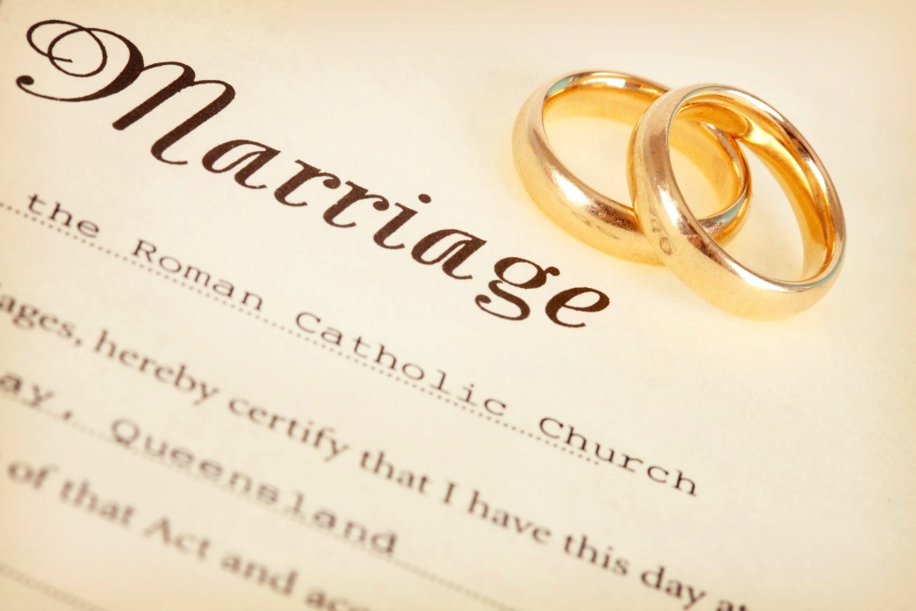
“Before You Say ‘I Do’”
(Handbook, pages 484–485)
Activity: “Marriage Is for Life”
Your teacher will arrange the class into pairs, giving each pair a Bible.
Read and discuss Matthew
19:3–12, answering the following questions:
What is Jesus saying about marriage and divorce?
Is this the same view our modern world has of marriage and divorce? Why or why not?
Do you think married life is harder, easier, or about the same today as it was in Jesus’ time? Why?
© hidesy/www.istockphoto.com

Slide 12

“The Ninth Commandment: Keeping Your Heart Clean”
(Handbook, pages 486–489)
The Ninth Commandment acknowledges our concupiscence and calls
us to purity of heart.
© Luckeyman/www.istockphoto.com

Slide 13
“The Ninth Commandment: Keeping Your Heart Clean”
(Handbook, pages 486–489)
The Ninth Commandment guides us to purity of heart, keeping our desires “in bounds” and working against concupiscence, or the tendency to sin as a result of Original Sin.
The Holy Spirit gives us the gift of temperance to fight concupiscence.
Purity of heart keeps us honest and helps us see things from God’s perspective. With purity of heart, we see our body and the bodies of others as God’s creation and a dwelling place of the Holy Spirit. We don’t blindly follow the crowd but think through our decisions with patience and discipline, including “what not to wear” (or modesty in dress) and “how not to act” (or modesty in words and deeds).
Purity of heart is a grace from God to which we can open ourselves.
We gain purity of heart through prayer and receiving the Sacraments, especially the Eucharist and Penance and Reconciliation.

Slide 14

“The Ninth Commandment: Keeping Your Heart Clean”
(Handbook, pages 486–489)
Activity: “Crossword Creation”
Review important words from chapter 44. This includes the Key Words from page 478 in the Handbook as well as a few others:
  sexuality, chastity, adultery, fornication, masturbation, pornography, homosexuality, concupiscence, temperance, purity of heart, modesty, patience
2. Your teacher will arrange you into groups of two or three.
3. Using graph paper and the important words, make a crossword puzzle—with definitions of the words as clues. Make an answer key as well.
© blackred/www.istockphoto.com

Slide 15

Let’s Review!
(Handbook, pages 483–489)
Review what you have learned in this chapter.
© iQoncept/www.shutterstock.com

Slide 16
Let’s Review!
(Handbook, pages 483–489)
We are all children of God.
Marriage is a lifelong commitment.
The Ninth Commitment acknowledges our concupiscence and calls us to purity of heart.

Slide 17

Let’s Review!
(Handbook, pages 483–489)
Activity
Your teacher will divide the class into three groups.
Each group will be assigned a piece of information from the chapter.
Prepare a skit that conveys the information you are assigned.
Present your skit to the class!
© TracyWhiteside/www.shutterstock.com

Slide 18
Acknowledgments
The scriptural references and quotations in this presentation are from the Good News Translation® (Today’s English Version, Second Edition). Copyright © 1992 by the American Bible Society. All rights reserved. Bible text from the Good News Translation (GNT) is not to be reproduced in copies or otherwise by any means except as permitted in writing by the American Bible Society, 1865 Broadway, New York, NY 10023 (www.americanbible.org).
The first excerpt on slide 7 is from the English translation of the Catechism of the Catholic Church for use in the United States of America, second edition, number 2347. Copyright © 1994 by the United States Catholic Conference, Inc.—Libreria Editrice Vaticana (LEV). English translation of the Catechism of the Catholic Church: Modifications from the Editio Typica copyright © 1997 by the United States Catholic Conference, Inc.—LEV.
The second excerpt on slide 7 is from “Ministry to Persons with a Homosexual Inclination: Guidelines for Pastoral Care,” issued by the United States Conference of Catholic Bishops (USCCB), November 14, 2006. Copyright © 2006, USCCB. All rights reserved. To order a copy of this statement, visit usccbpublishing.org.
During this presentation’s preparation, all citations, facts, figures, names, addresses, telephone numbers, Internet URLs, and other pieces of information cited within were verified for accuracy. The authors and Saint Mary’s Press staff have made every attempt to reference current and valid sources, but we cannot guarantee the content of any source, and we are not responsible for any changes that may have occurred since our verification. If you find an error in, or have a question or concern about, any of the information or sources listed within, please contact Saint Mary’s Press.

