Slide 1
The Resurrection and Ascension of Jesus
The Paschal Mystery
Unit 3, Chapter 7
Document #: TX005438

Slide 2
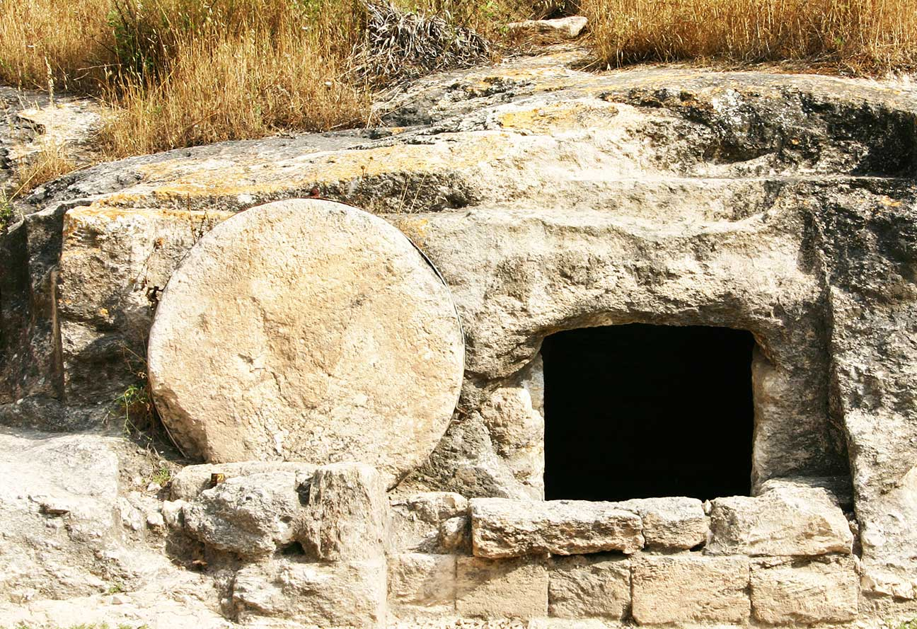
The Events of the Resurrection
Jesus was able to save us from sin and death because he is human and divine.
The Resurrection provides us with proof for this truth.
Jesus’ Resurrection was an actual historical event.
© doulos / istock
Notes:
Notes: Direct the students to read 1 Corinthians 15:3–6, found in the introduction to chapter 7 of the student text. Tell them that this statement is the earliest known Christian creed, or statement of faith: scholars believe it was written about twenty years after Jesus’ death and Resurrection.
This slide corresponds to student text content in article 25.

Slide 3
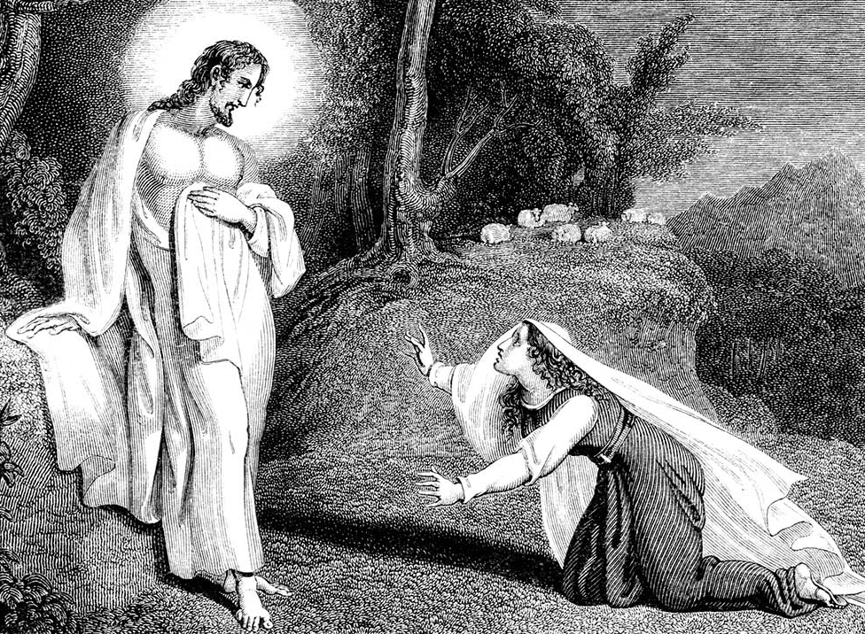
Common Points in the Gospel Accounts
Women disciples discover that the body of Jesus is not in the tomb.
The women learn from angels that Jesus is alive.
Jesus reveals himself to Mary Magdalene.
Jesus appears to groups of disciples.
© TonyBaggett / istock
Notes:
Notes: Direct the students to read the Did You Know? sidebar, “Jewish Burial Customs,” in article 25 of the student text. Explain that the women returned to the tomb to prepare the body for final burial.
This slide corresponds to student text content in article 25.

Slide 4
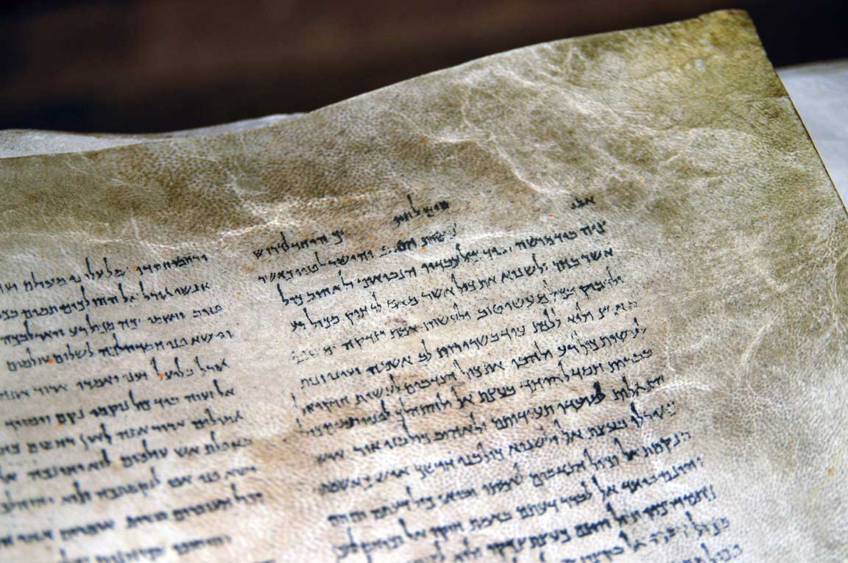
Evidence for the Resurrection
We can trust the historical validity of the New Testament texts.
The Resurrection was a consistent belief in the early Church.
The tomb was empty.
Jesus’ followers underwent a profound change.
© ChameleonsEye / Shutterstock
Notes:
Notes: Explain each point in the section “Evidence for the Truth of the Resurrection” in article 25 of the student text. Ask volunteers to explain why belief in the Resurrection is important to their faith. Consider sharing your own answer.
This slide corresponds to student text content in article 25.

Slide 5
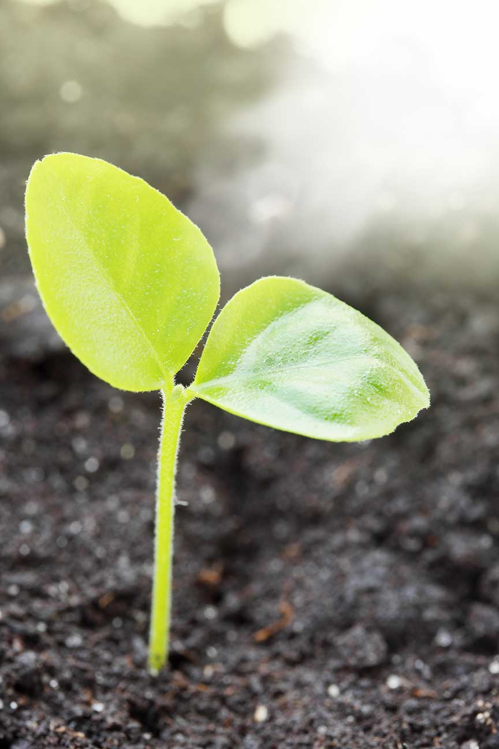
What Does the Resurrection Mean?
We cannot explain in human terms what the resurrected Jesus was like.
Being in Jesus’ risen presence gave people peace and hope.
© Malivan_Iuliia / Shutterstock
Notes:
Notes: Ask the students to describe some of the characteristics of the Risen Jesus (he could appear and disappear suddenly; he could be touched; he could eat; his words could be heard by several people at once; he wasn’t immediately recognizable, but once the disciples recognized him, they could see he was the same person they knew from before).
This slide corresponds to student text content in article 26.

Slide 6
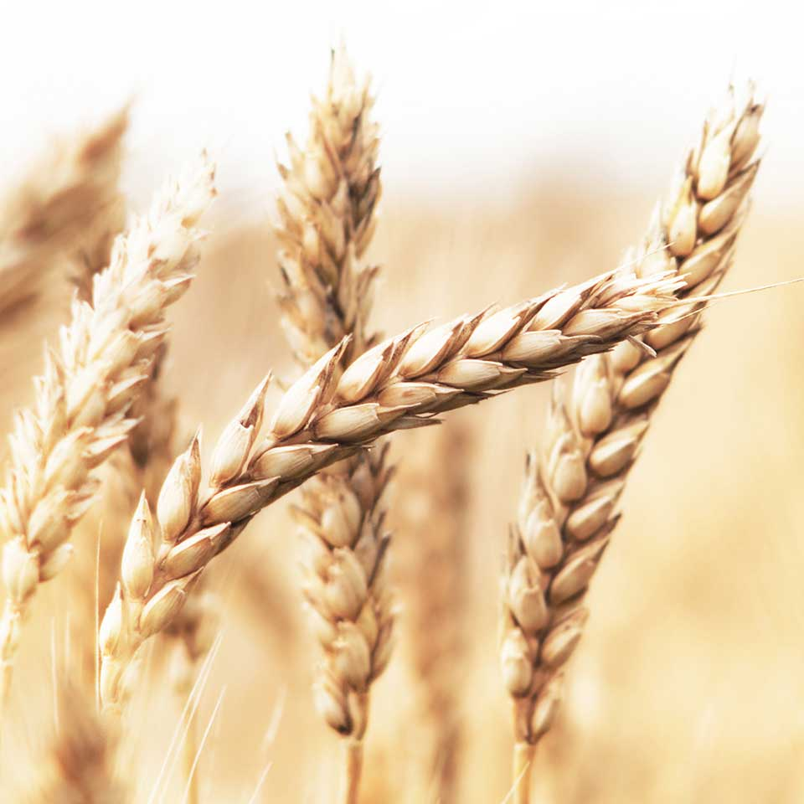
First Corinthians, Chapter 15
The Risen Christ appeared to many people.
Christ’s Resurrection guarantees that we too will experience resurrection.
A resurrected body is transformed.
© Strahil Dimitrov / Shutterstock
Notes:
Notes: Discuss Saint Paul’s analogy for the resurrected body, likening it to a seed that becomes something very different when it grows as a plant.
This slide corresponds to student text content in article 26.

Slide 7
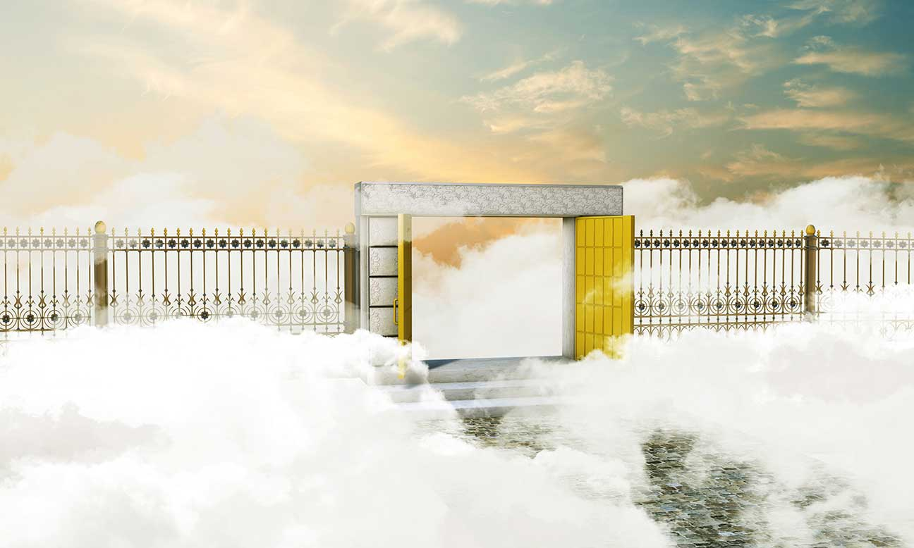
The Significance of Christ’s Resurrection
It confirms that Jesus is the Son of God and his teachings are true.
The Resurrection opens the way to new life.
© andrea crisante / Shutterstock
Notes:
Notes: Ask which of Jesus’ teachings, those listed as bullet points in article 27 of the student text or others, would be hardest to believe if there were no Resurrection.
This slide corresponds to student text content in article 27.

Slide 8
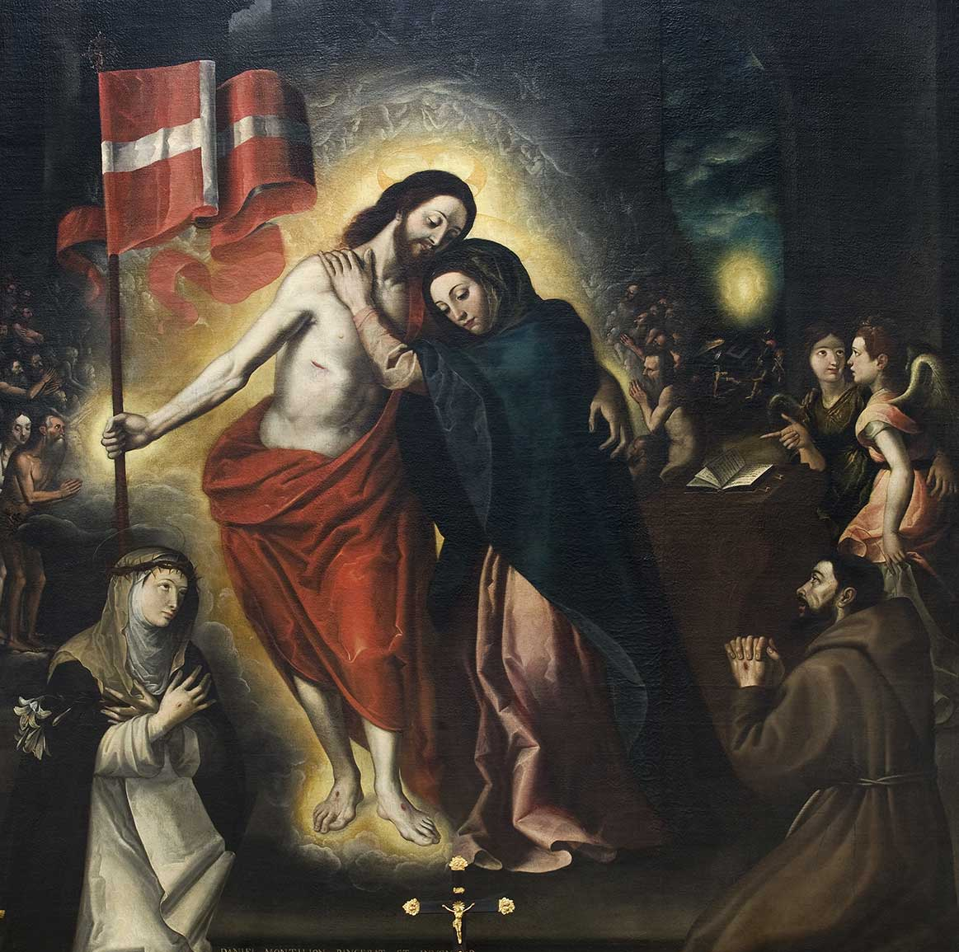
The Resurrected Christ
The Risen Jesus continued to appear to his followers for forty days.
He taught his disciples how to interpret Scripture.
He directed them to continue his mission.
© fotogiunta / Shutterstock
Notes:
Notes: Explain that before his Resurrection, Jesus descended into Hell and brought salvation to all the righteous souls who had died.
This slide corresponds to student text content in article 28.

Slide 9
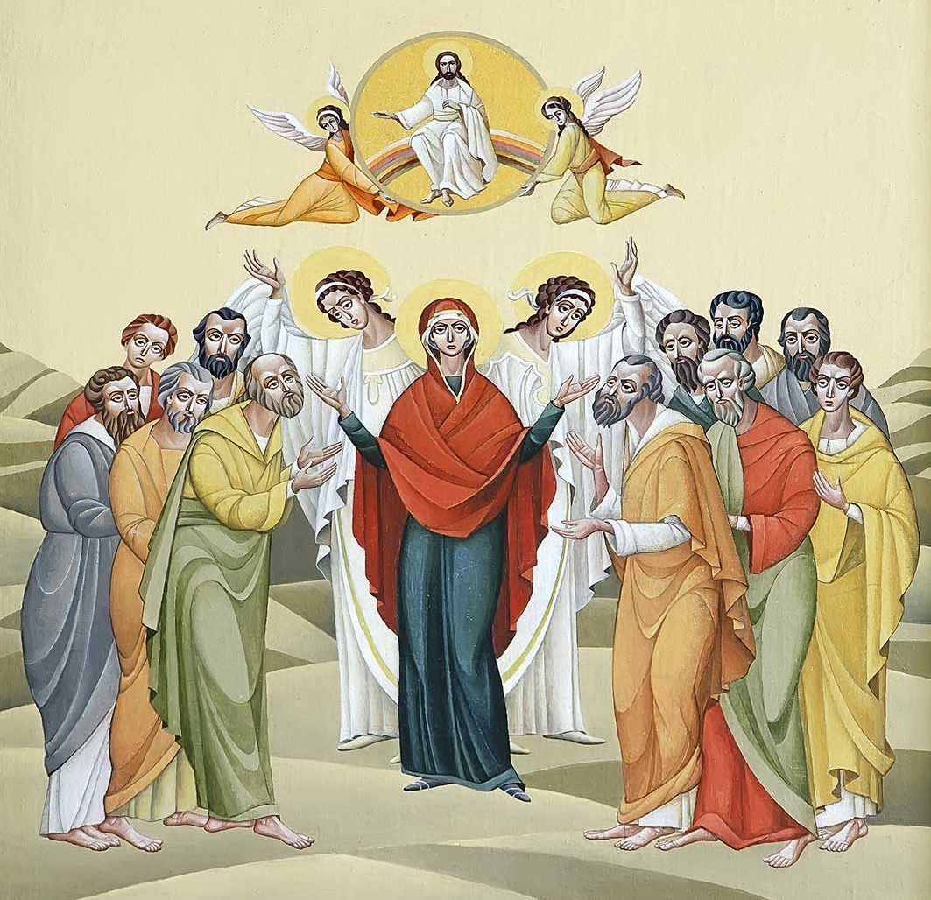
The Ascension
The Ascension is an event that is beyond our human comprehension.
Jesus left this world to be with his Father in Heaven.
He is now more present to us than during his earthly life through the power of the Holy Spirit.
© Dmitrydesign / Shutterstock
Notes:
Notes: Read aloud the sidebar definition for paradox in article 28 of the student text. Direct the students to read the “Primary Sources” sidebar in article 28, “Here He Is.” Ask for comments.
This slide corresponds to student text content in article 28.

Slide 10
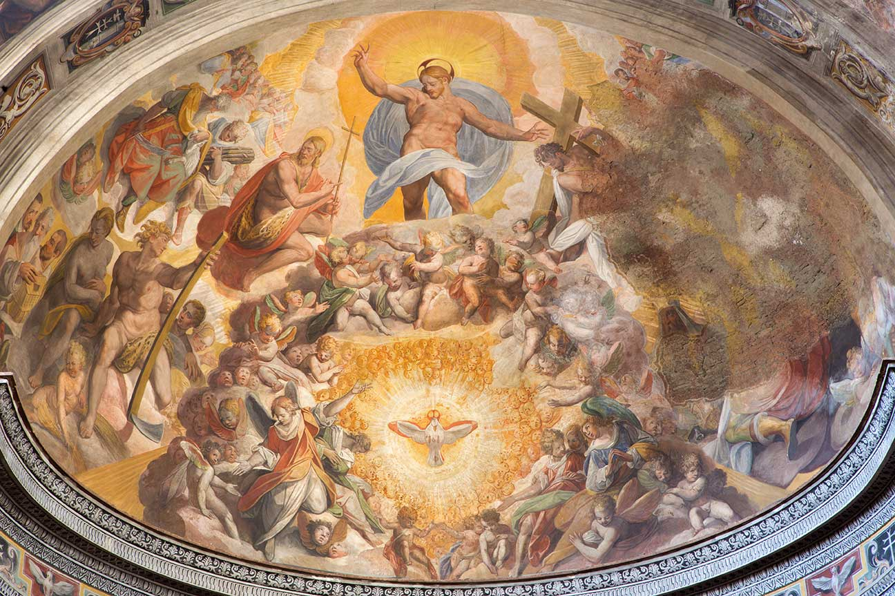
The Ascension Reveals Christ’s Glory
Jesus has full authority over Heaven, earth, and even Hell.
He opened Heaven to humanity.
He is more present to us, unlimited by time and space.
© Renata Sedmakova / Shutterstock
Notes:
Notes: Explain the symmetry between the Incarnation (coming to earth, humbled) and the Ascension (leaving earth, glorified), as discussed in the section “The Ascension Reveals Christ’s Glory” in article 28 of the student text.
This slide corresponds to student text content in article 28.

Slide 11
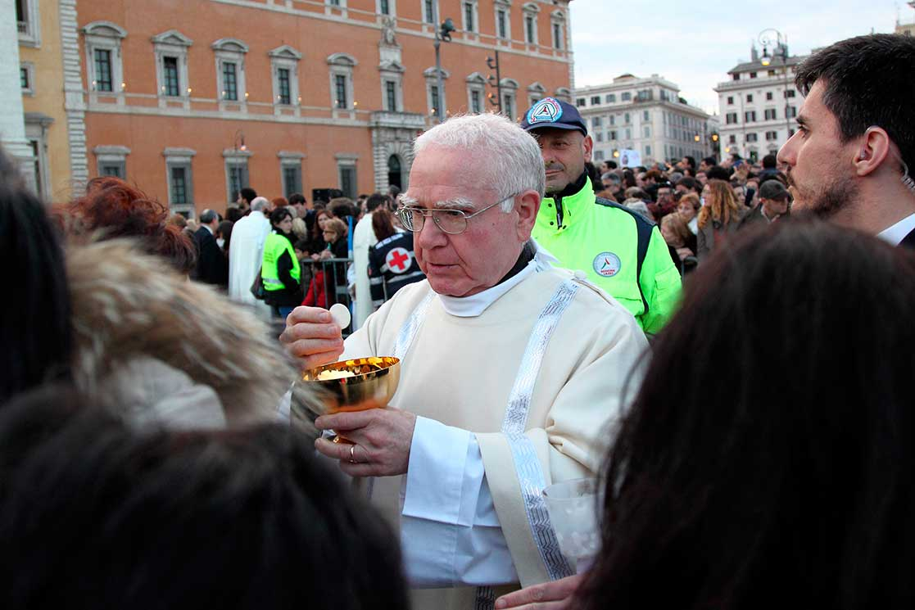
Jesus Is Present Today
He is present to us in the Eucharist . . .
in Sacred Scripture . . .
in our private prayer, in the liturgy, through our loved ones . . .
and in our service to others.
© MattiaATH / istock
Notes:
Notes: Ask the questions that conclude article 28 in the student text: Think of all the ways Christ is present to us after his Ascension. Which one makes you feel most connected to the Risen Christ? Why?
This slide corresponds to student text content in article 28.

