Slide 1
Knowing God: Reason and Revelation
The Catholic Faith Handbook for Youth, Third Edition
Chapter 2
Document #: TX003133
Notes:
Use this presentation to introduce or review the key points in chapter 2 of the student handbook.

Slide 2

Why should we want to know about God?
Our need to be loved, and to return love, are signs of our need for God.
Each of us has an empty space that can only be filled by God.
We are made to live in spiritual union with God, in whom we can find true happiness.
Copyright: STILLFX / www.shutterstock.com
Notes:
Share with the students this quote from Saint Augustine’s Confessions, “For you have made us for yourself, and our hearts are restless until they rest in you” (from page 23 in the student handbook). Explain that we were made for this very purpose—to find happiness with God.

Slide 3
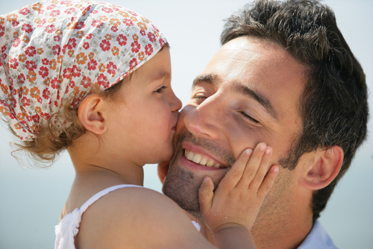
Copyright: auremar / www.shutterstock.com
Discovering God through Observation and Reason
The beauty of nature
The experience of loving and being loved by someone
The inner prompting to do the right thing
Knowing through reason that something greater than us is responsible for these things
Notes:
Ask the students to silently recall being in touch with something greater than themselves.

Slide 4

Discovering God through Natural Revelation
We can know God from the world and the human person.
We can know God by appreciating and studying the natural world.
Copyright: PT Images / www.shutterstock.com
We can know God by listening to the voice of conscience.
Because of Original Sin, human reason is limited.
Notes:
Explain the concept introduced on pages 24–25 of the student handbook, that Original Sin has affected human reason, so that we are likely to use our reason to rationalize bad choices or wrong beliefs. Encourage the students to give examples from teen life, such as saying that cheating in school is okay because everyone does it.

Slide 5
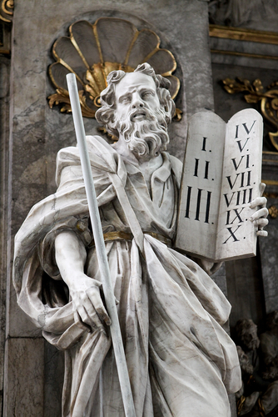
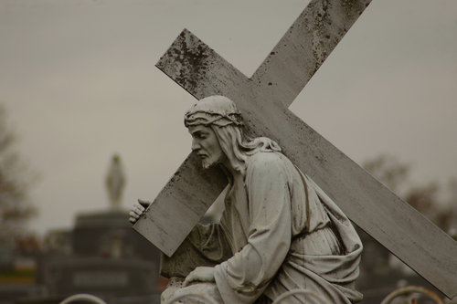
Discovering God through Divine Revelation
God made himself known to the Chosen People throughout their history.
God revealed himself through his Son, Jesus.
Copyright: jorisvo / www.shutterstock.com
Jesus Christ is the fullest and complete Revelation of who God is.
Through Jesus, God established his covenant with the human race forever.
Copyright: Les byerley / www.shutterstock.com
Notes:
Ask the students how we know about these events. Prompt them, if necessary, to mention both the Bible and the Church as sources of God’s Revelation.

Slide 6
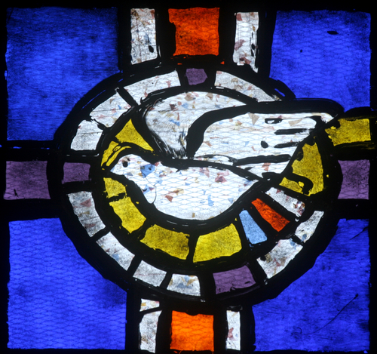
Deposit of Faith: Scripture and Tradition
The Apostles of Jesus handed on what they knew about Jesus.
Early Church writers produced the Gospels and Letters.
Copyright: Zvonimir Atletic / www.shutterstock.com
Notes:
Explain that the Holy Spirit guided the Apostles and the biblical writers, and continues to guide the Church’s Magisterium today.

Slide 7

Biblical Inspiration and Interpretation
The Bible tells us what we need to know for our salvation, without error.
The Holy Spirit inspired the biblical authors to write what God wanted us to know.
The Bible may not always be correct in historical and scientific details.
Reading the Bible is very important but also requires some work.
Copyright: Sorin Popa / www.shutterstock.com
Notes:
Ask the students to give examples of scientific information we have today that would have been unknown to Bible writers. Use their examples to explain that even though they were inspired, the biblical authors had human limitations. Ask the students what kinds of knowledge might fall under the heading “what we need to know for our salvation.”

Slide 8
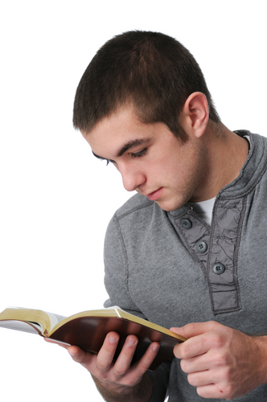
Reading the Bible: PRIMA
Pray
Read
Imagine
Meditate
Apply
Copyright: Carlos E. Santa Maria / www.shutterstock.com
Notes:
Direct the students to refer to the Live It! sidebar “Reading the Bible: The PRIMA Process,” on page 25 of the student handbook. Ask for volunteers to explain each of the words on the slide as steps in the process.

