Slide 1



Slide 2
Christian Morality
and Social Justice
Chapter 38
Living the Moral Life

Slide 3

Chapter Summary
Living the Moral Life
In this chapter, you will consider what living a moral life means. Living morally requires that we develop a clear understanding of what God is asking of us. God created us with the inherent ability to know what is right and good—the natural law—but humans still choose sin. This is the legacy of Original Sin. God also gave us the Ten Command-ments, the Beatitudes, and the virtues to guide our free will in helping us to choose rightly and to grow closer to God.
© ChrisGorgio/www.istockphoto.com

Slide 4

Introduction and “Off to a Great Start”
(Handbook, pages 416–418)
Free will is the basis for our moral responsibility, and we look to Sacred Scripture to guide our choices.
© master-garry/www.istockphoto.com

Slide 5

Introduction and “Off to a Great Start”
(Handbook, pages 416–418)
Activity: “Free Will Flowchart”
In groups you will do the following:
Brainstorm ways free will plays a role in your life. Make sure to write down your ideas!
Construct a flowchart with four or more statements that respond to this question:
Why should I live a moral life?
© BigToto/www.shutterstock.com

Slide 6
Introduction and “Off to a Great Start”
(Handbook, pages 416–418)
God has a plan for us even before we are born, and God guides us in life through Sacred Scripture, the teachings of the Church, and the virtues.
Free will is a gift from God.
God has always promised us salvation, and the way of life given to us by Jesus (living the Beatitudes through the grace of the Holy Spirit) leads us to full life now and to the glory of Heaven.

Slide 7
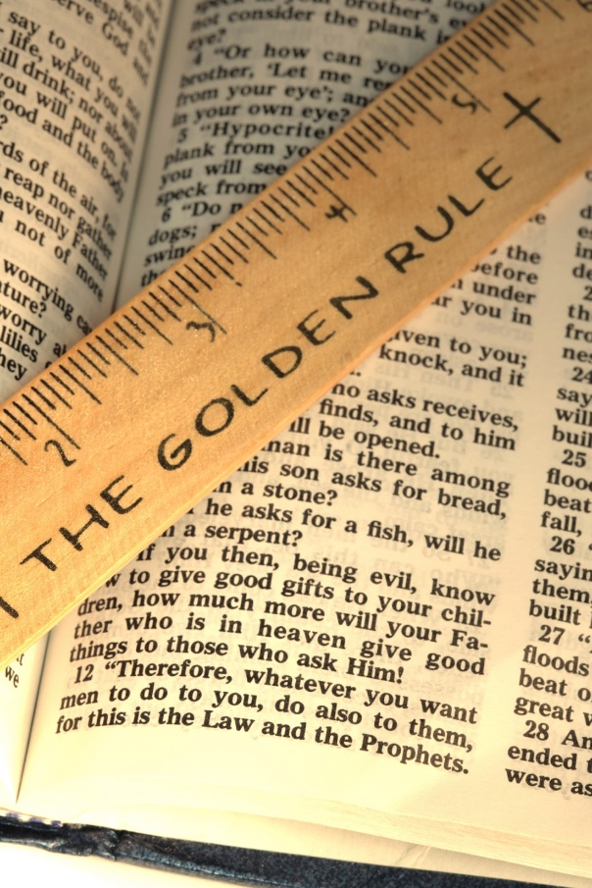
“Walking the Talk”
(Handbook, pages 419–420)
The Ten Commandments and the Golden Rule (see Matthew 7:12) given to us by Jesus summarize God’s Law for us.
©cstar55/www.istockphoto.com

Slide 8
“Walking the Talk”
(Handbook, pages 419–420)
We can look to Sacred Scripture to light our path.
The Ten Commandments and the Golden Rule (see Matthew 7:12) summarize God’s Law for us.
We have the freedom to choose whether to follow Jesus.

Slide 9

“Walking the Talk”
(Handbook, pages 419–420)
Journal It!
“Freedom consists not in doing what we like, but in having the right to do what we ought.” (Pope Saint John Paul II, Homily, Baltimore, MD, 1995)
What do you think this
quote means?
How does it relate to your
current life?
© badmanproduction/www.istockphoto.com

Slide 10
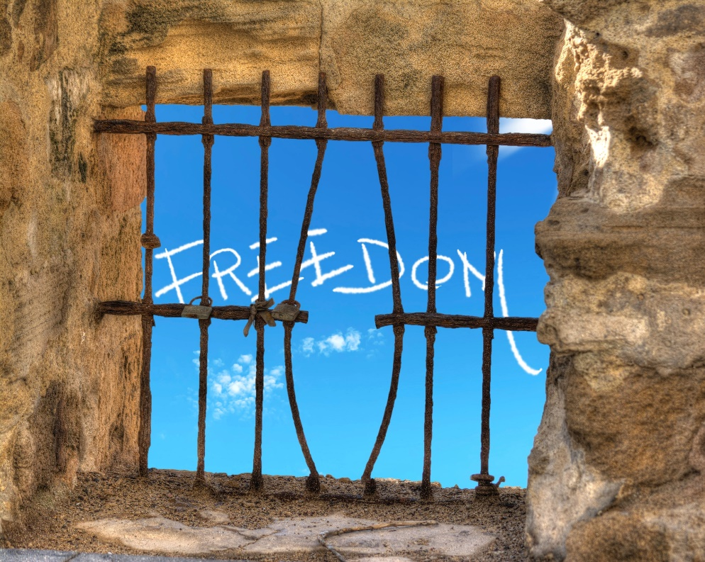
“You’re Born with It” and “Higher Love”
(Handbook, pages 420–422)
Natural law is an inborn understanding of what is good. God uses the teachings of the Old Law to prepare us for the Good News of Jesus in the Gospels.
© AlKane/www.istockphoto.com

Slide 11
“You’re Born with It” and “Higher Love”
(Handbook, pages 420–422)
From birth everyone is equipped with an understanding of what is good.
Because natural law expresses God’s moral vision, it never changes.
Natural law should form the basis of society’s laws.
God uses the Old Law’s teachings (the Ten Commandments) to prepare us for the Good News of Jesus in the Gospels.
The Sermon on the Mount (including the Beatitudes) is the ultimate expression of the New Law.

Slide 12
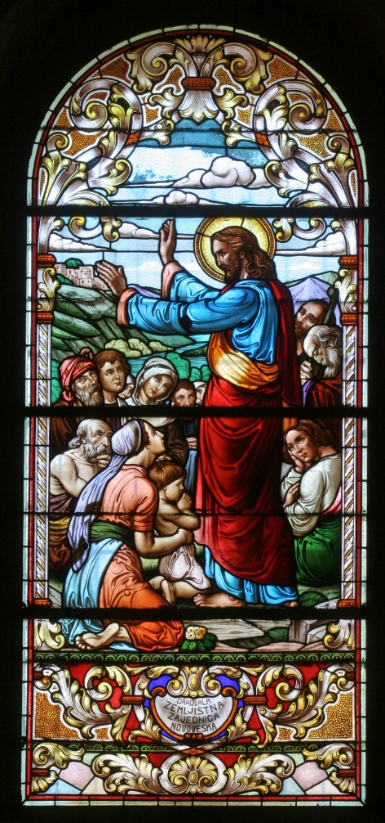
“You’re Born with It” and “Higher Love”
(Handbook, pages 420–422)
Activity: “Jesus’ Teaching in the Sermon on the Mount”
In groups of three or four…
Read your assigned portion of the Sermon on the Mount (see list at right).
Write down your understanding of that teaching.
Share with the class!
  Matthew 5:13–16
Matthew 5:21–24
Matthew 5:25–26
Matthew 5:38–42
Matthew 5:43–48
Matthew 6:1–4
Matthew 6:5–6
Matthew 6:24–27
Matthew 7:1–5
Matthew 7:12
© ZvonimirAtletic/www.shutterstock.com

Slide 13
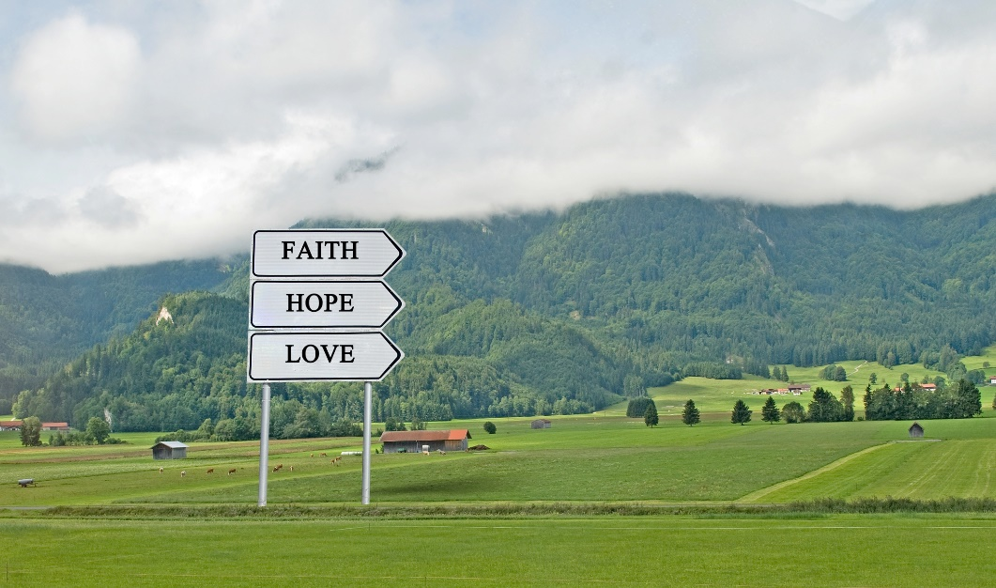
“Virtues” and “Always Closer”
(Handbook, pages 422–424)
Virtues are habits we develop to help us consistently do the right thing. The cardinal virtues (human virtues) and the theological virtues help us walk the paths of faith and reason and thus come closer to God.
© arka38/www.shutterstock.com

Slide 14
“Virtues” and “Always Closer”
(Handbook, pages 422–424)
Virtues are habits we develop to help us consistently do the right thing. Virtues grow through practice.
The four cardinal virtues (the human virtues) are prudence, justice, temperance, and fortitude.
The theological virtues are faith, hope, and love. They guide the human virtues in making our relationships with God and neighbor more perfect.
Living a moral life is one way we worship God.

Slide 15

“Virtues” and “Always Closer”
(Handbook, pages 422–424)
Journal It!
Journal two paragraphs reflecting on the following question:
What does it mean to live a virtuous life? How can you grow in virtue?
© alexmillos/www.shutterstock.com

Slide 16
Acknowledgments
The excerpt from Pope Saint John Paul II on slide 9 is from “Homily of His Holiness, Oriole Park at Camden Yards, Baltimore MD, 1995,” at www.vatican.va/holy_father /john_paul_ii/homilies/1995/documents/hf_jp-ii_hom_19951008_baltimore_en.html. Copyright © 1995 Liberia Editrice Vaticana.
To view copyright terms and conditions for Internet materials cited here, log on to the home pages for the referenced websites.
During this presentation’s preparation, all citations, facts, figures, names, addresses, telephone numbers, Internet URLs, and other pieces of information cited within were verified for accuracy. The authors and Saint Mary’s Press staff have made every attempt to reference current and valid sources, but we cannot guarantee the content of any source, and we are not responsible for any changes that may have occurred since our verification. If you find an error in, or have a question or concern about, any of the information or sources listed within, please contact Saint Mary’s Press.

