Slide 1
Grace
The Paschal Mystery Course
Document # TX001314

Slide 2
The lasting effects of Original Sin are real.
Shutterstock/Martin Allinger

Slide 3
Shutterstock/Martin Allinger
Original Sin has shattered our harmony with God,
with others,
and with the world we live in.
Notes:
(Notes: Ask the students to recall the articles they selected as illustrations of sin. Ask for examples of the effects of sin as each phrase appears.)

Slide 4
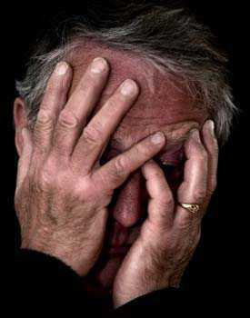
Original Sin has affected how we feel about ourselves.
© Emotionalcompetency.com
Notes:
(Notes: Ask the students to recall the journal exercise or article exercise. Ask how sin affects our feelings about ourselves.)

Slide 5
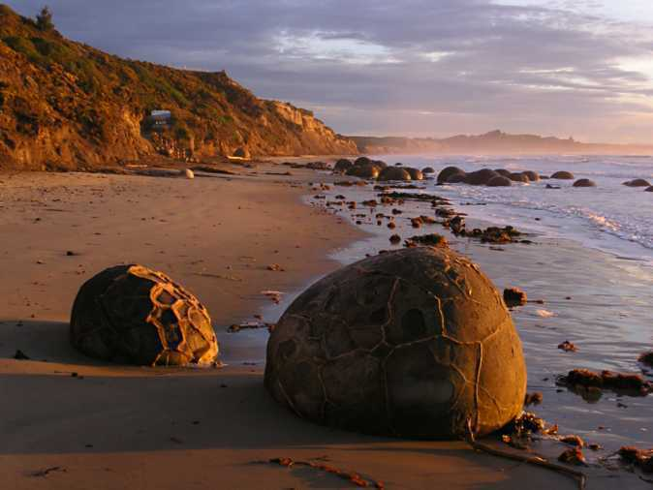
Even so, God’s grace is much stronger than humanity’s sinfulness.
Image in public domain

Slide 6
Humanity was created in God’s image
able to enter into communion with others
united with others as caretakers of the earth
capable of self-knowledge
© matsuregional.com
Notes:
(Notes: After the initial phrase appears, ask the students what it means to be created in God’s image. After they have shared, explain that Church teaching mentions three human characteristics reflecting the image of God. Now click to show the bulleted material.)

Slide 7
God’s grace can restore that original holiness and righteousness.
Image in public domain

Slide 8
What is Grace?
Image in public domain
Notes:
(Notes: Ask the students to share their ideas about the meaning of the term. Explain that Church teaching describes grace in many different ways.)

Slide 9
Grace is participation in the life of God.
Grace is God’s own life infused into our human souls.
Grace is the help we need to respond to God’s call to be his adopted sons and daughters.

Slide 10
The Effects of Grace
Grace allows us to love with Christ’s love.
Notes:
(Notes: Ask the students to respond to this statement. How do they interpret it? How does it make them feel? What does it bring to mind? As the students respond, click on the next three slides to encourage further thought.)

Slide 11
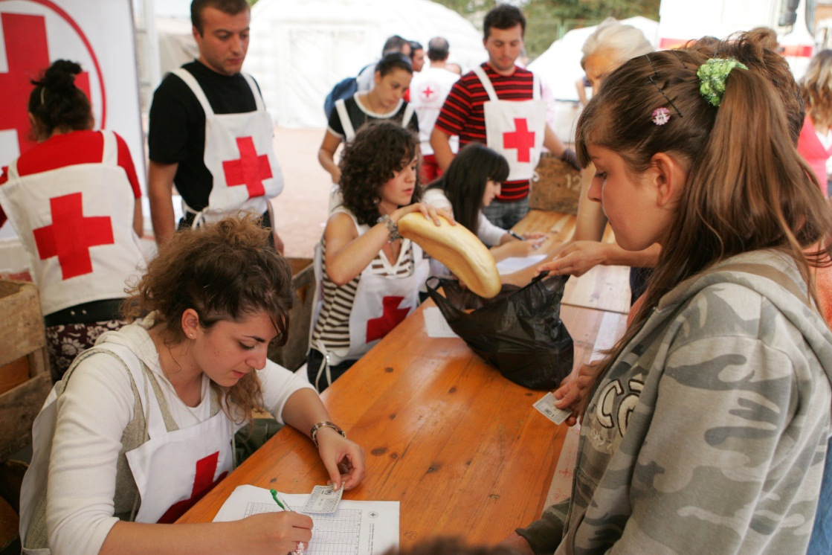
The Effects of Grace
Grace allows us to love with Christ’s love.
© kojoku / Shutterstock.com

Slide 12
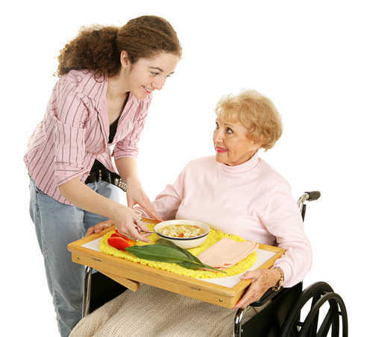
The Effects of Grace
Grace allows us to love with Christ’s love.
© Lisa F. Young/shutterstock

Slide 13
The Effects of Grace
Grace allows us to love with Christ’s love.
© Novak/shutterstock

Slide 14
Grace perfects the virtues and good qualities we develop in life.
Notes:
(Notes: Ask the students to respond to this statement. How do they interpret it? How does it make them feel? What does it bring to mind? As the students respond, click on the next three slides to encourage further thought.)

Slide 15
Grace perfects the virtues and good qualities we develop in life.
Image in public domain

Slide 16
Grace perfects the virtues and good qualities we develop in life.
© shutterstock/Sergey Kaliganov

Slide 17
Grace perfects the virtues and good qualities we develop in life.
© shutterstock/Tatiana Belova

Slide 18
Grace offers us a parent-child relationship with God.
Notes:
(Notes: Ask the students to respond to this statement. How do they interpret it? How does it make them feel? What does it bring to mind? As the students respond, click on the next three slides to encourage further thought.)

Slide 19
Grace offers us a parent-child relationship with God.
Image in public domain

Slide 20
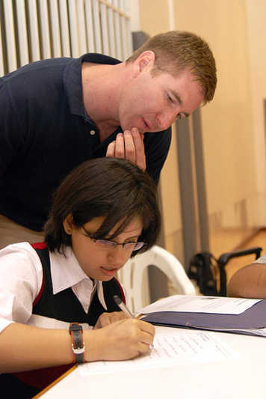
Grace offers us a parent-child relationship with God.
Image in public domain

Slide 21
Grace offers us a parent-child relationship with God.
© digitalskillet/istockphoto.com

Slide 22
Grace makes us holy, healing the soul of sin.
Notes:
(Notes: Ask the students to respond to this statement. How do they interpret it? How does it make them feel? What does it bring to mind? As the students respond, click on the next three slides to encourage further thought.)

Slide 23
Grace makes us holy, healing the soul of sin.
Image in public domain

Slide 24
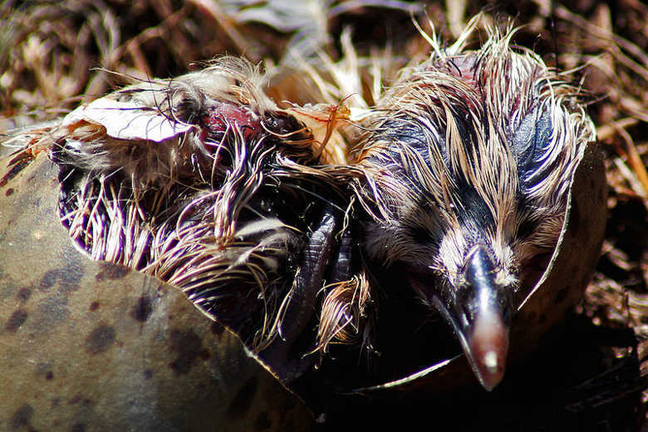
Grace makes us holy, healing the soul of sin.
Image in public domain

Slide 25
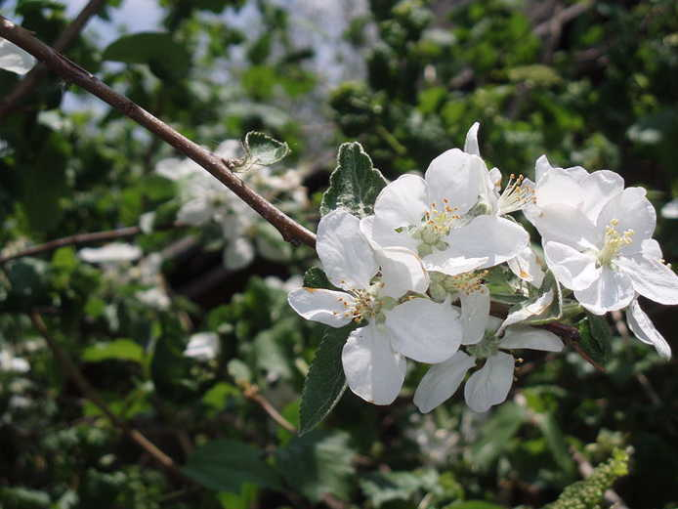
Grace makes us holy, healing the soul of sin.
Image in public domain

Slide 26
Grace allows us to respond to God’s call to enter into eternal life.
Notes:
(Notes: Ask the students to respond to this statement. How do they interpret it? How does it make them feel? What does it bring to mind? As the students respond, click on the next three slides to encourage further thought.)

Slide 27
Grace allows us to respond to God’s call to enter into eternal life.
Shutterstock/Monkey Business Images

Slide 28
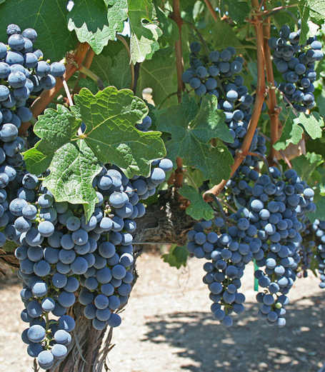
Grace allows us to respond to God’s call to enter into eternal life.
Image in public domain

Slide 29
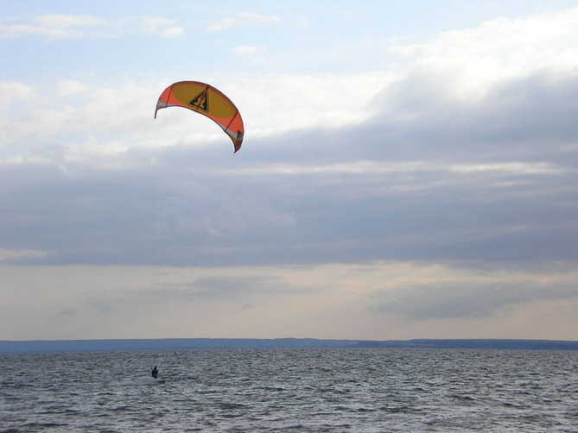
Grace allows us to respond to God’s call to enter into eternal life.
Image in public domain

