Slide 1
The Redemptive Nature of Christ’s Earthly Life
The Paschal Mystery
Unit 2, Chapter 5
Document #: TX005436

Slide 2
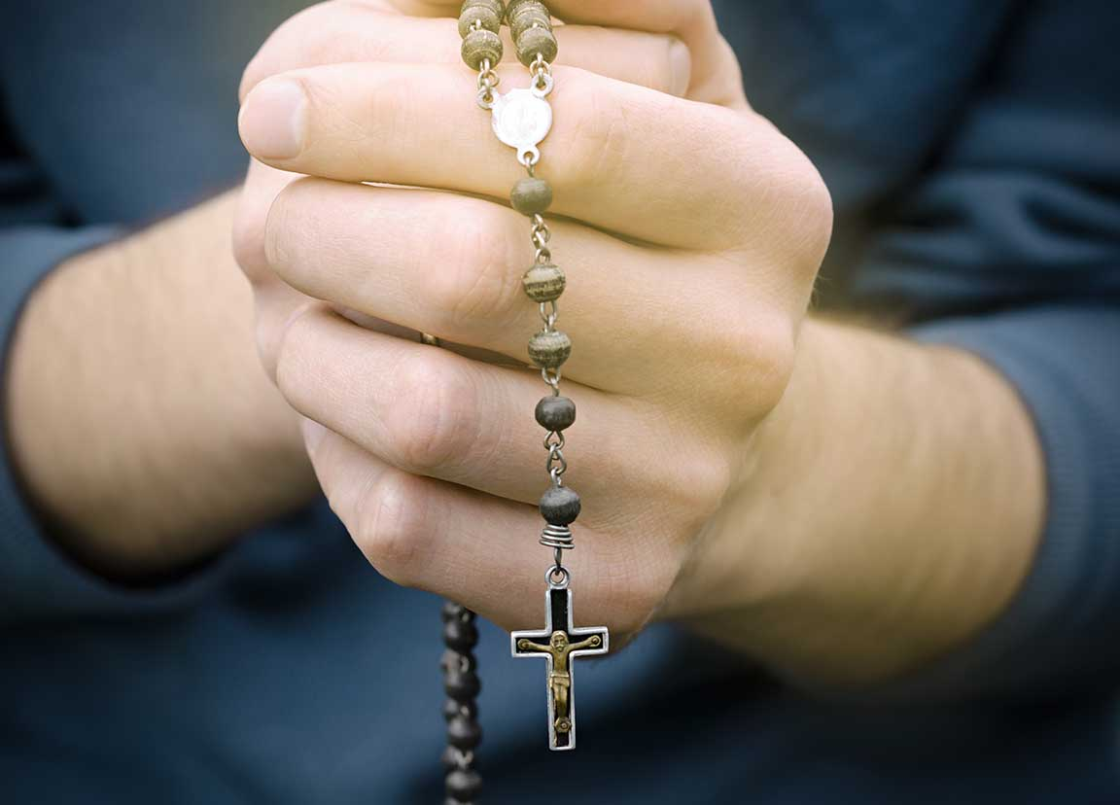
The Luminous Mysteries
Pope Saint John Paul II recommended a new set of mysteries for the Rosary.
Each mystery commemorates a significant moment in Jesus’ public ministry.
Each reveals the Kingdom as it is present in Jesus.
© nadyatess / Shutterstock
Notes:
Notes: Review the chart in article 16 of the student text. Discuss the description of the Kingdom of God that follows the chart: the restoration of the fullness of communion between humans and God, and among all people. Refer to the chart to illustrate with examples.
This slide corresponds to student text content in article 16.

Slide 3
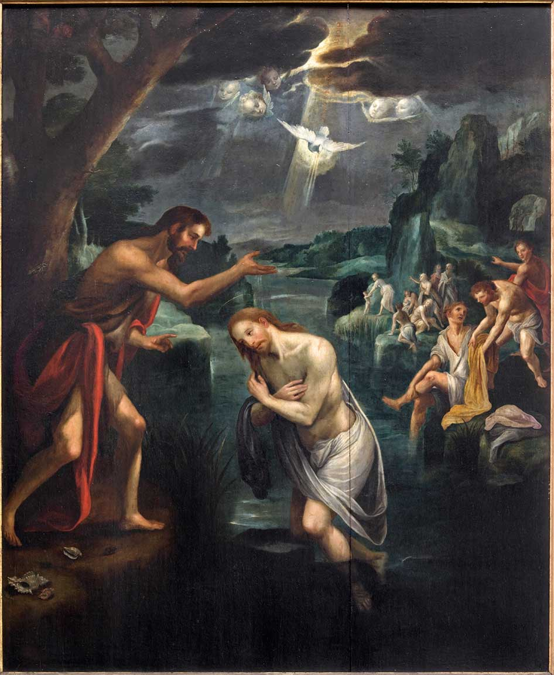
A Baptism and a Wedding
Jesus’ Baptism is an example of his perfect obedience to his heavenly Father.
His Baptism reveals that Jesus is the Second Person of the Holy Trinity.
The Wedding at Cana recalls the start of Christ’s public ministry.
© sedmak / istock
Notes:
Notes: Ask volunteers to explain the first two bullet points, as found in the section “The Baptism in the Jordan” in article 16 of the student text.
This slide corresponds to student text content in article 16.

Slide 4
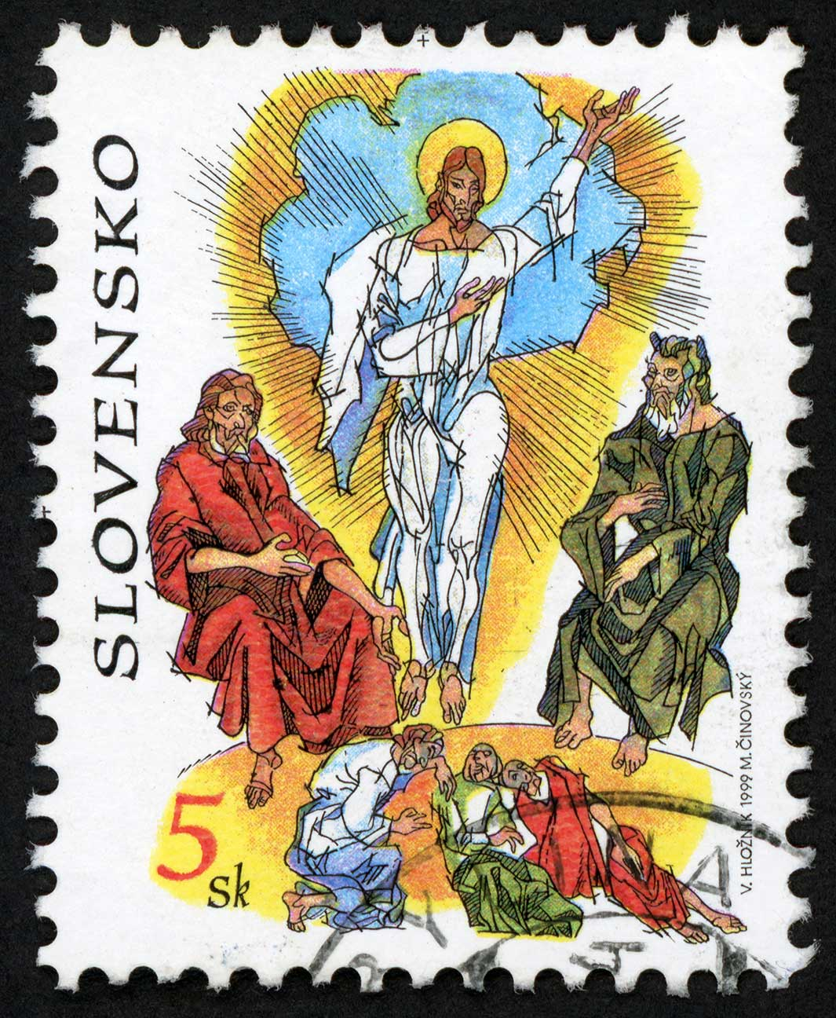
The Gospel and the Transfiguration
The Proclamation of the Gospel reveals that the Kingdom is present in Jesus.
Wherever Jesus went, the Kingdom of God was present for those who put their faith in him.
The Transfiguration is a sign that Jesus is the Messiah.
© Oldrich / Shutterstock
Notes:
Notes: Read the account of the Transfiguration in Matthew 17:1–8. Discuss its meaning for Jesus’ Jewish followers. Point out that this event helped to strengthen their faith shortly before Jesus’ Passion.
This slide corresponds to student text content in article 16.

Slide 5
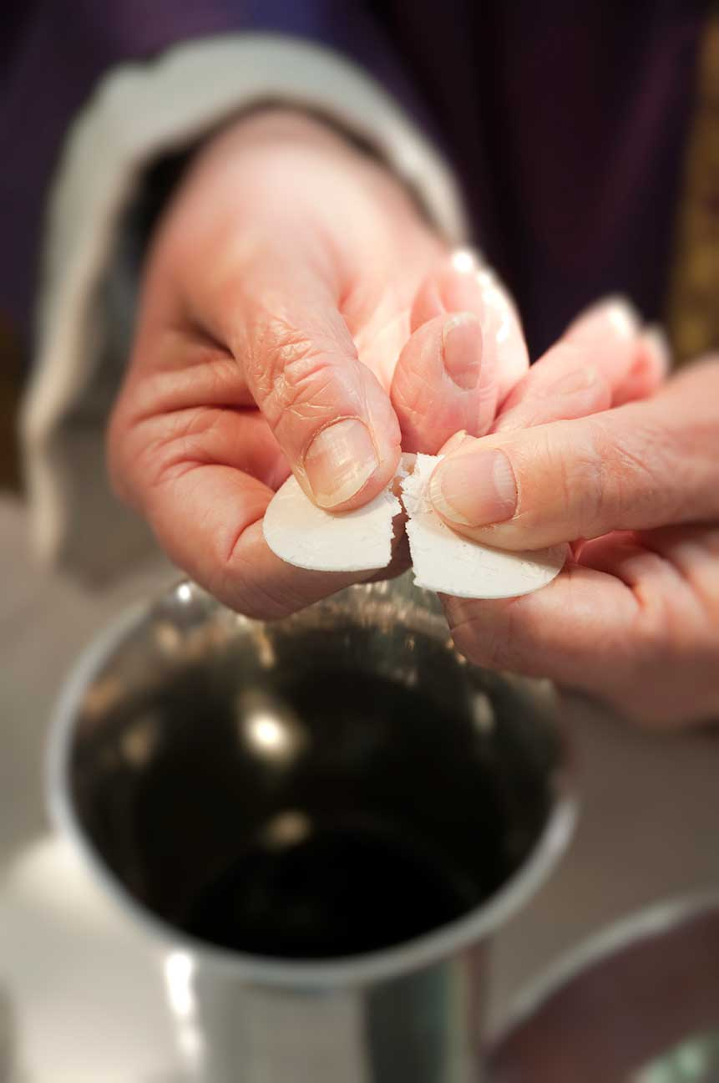
The First Eucharist
Jesus turned bread and wine into his sacred Body and Blood.
He shared these with the Apostles and told them to “do this in memory of me.”
This mystery reveals that Jesus is the Lamb of God, who gives his life for us.
© redhoney / istock
Notes:
Notes: Ask the questions that conclude article 16 of the student text: Which of the Luminous Mysteries most clearly reveals Jesus as “light” to you? Why?
This slide corresponds to student text content in article 16.

Slide 6
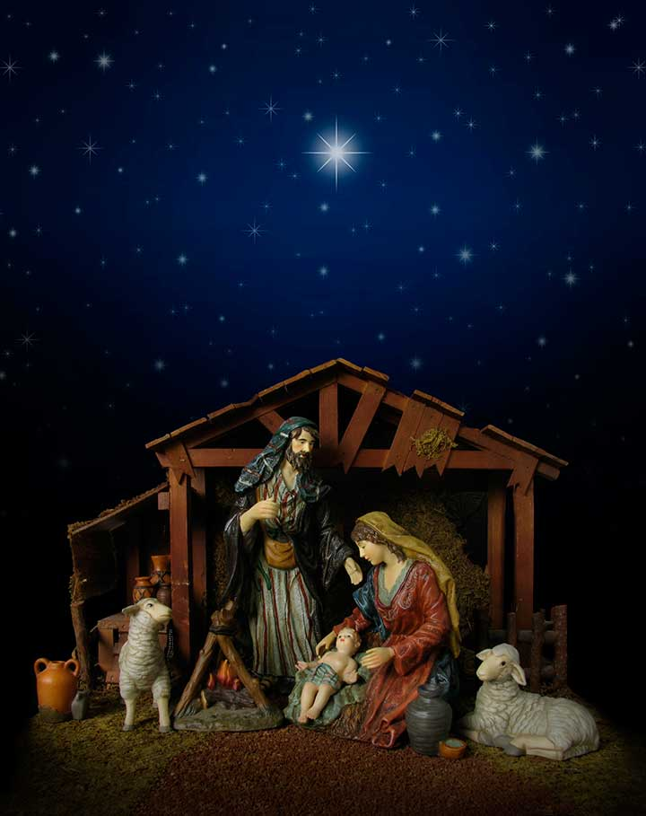
Jesus’ Humble Beginnings
Jesus embraced the poverty into which he was born.
He taught that the wealthy have a special obligation to help the poor.
He showed that poverty of heart helps us recognize our need for God.
© duckycards / istock
Notes:
Notes: If the students have Bibles, direct each to read one of the passages listed near the end of article 16, perhaps in groups. Ask for summaries of each story. Ask the questions that conclude article 17: What does it mean to trust in God and not in material comfort or security? Do you find this easy or difficult?
This slide corresponds to student text content in article 17.

Slide 7

Christ’s Obedience
The Son of God lived a life of perfect obedience to his Father.
He redeemed Adam’s disobedience, and he was an example for us.
When we are obedient to God, we grow in holiness.
© Christopher Futcher / istock
Notes:
Notes: Read aloud Philippians 2:5–8, found in the section “Redeeming Adam’s Disobedience” in article 18 of the student text. Ask for examples of Jesus’ obedience, as in the section “Jesus’ Example of Obedience.” Ask for examples of obedience to God from modern life.
This slide corresponds to student text content in article 18.

Slide 8
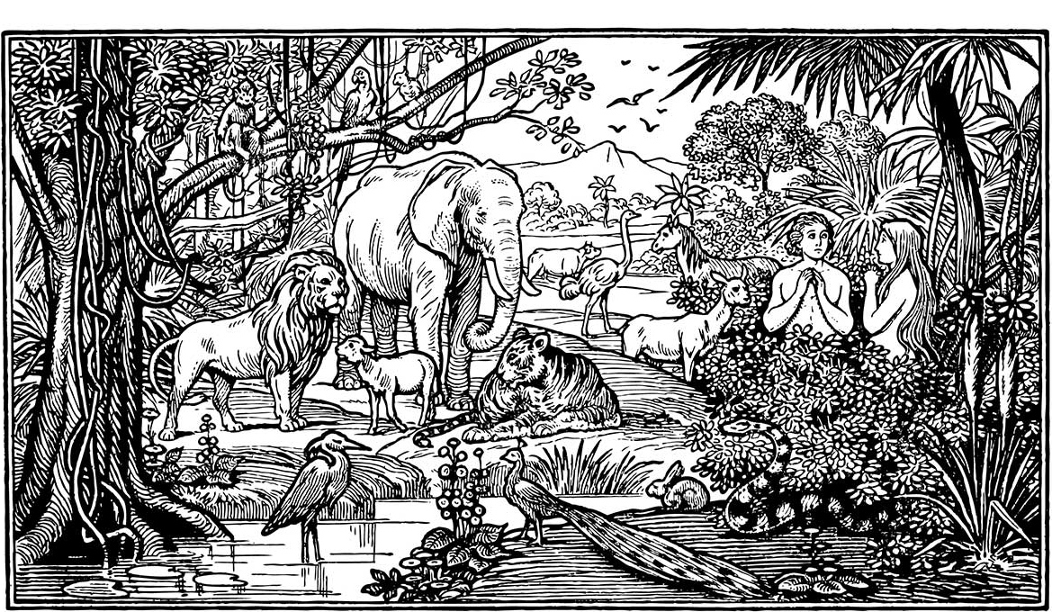
Christ’s Moral Teaching
Jesus goes beyond the letter of the Old Law to challenge us to live the spirit of the Law.
Living the New Law is a return to original holiness and original justice.
We are to make choices that bring us into full communion with God and others.
© lynea / Shutterstock
Notes:
Notes: Ask how Jesus summarized the New Law (the Great Commandment, as recorded in Mark 12:29–31, quoted in the opening section of article 19 of the student text). Point out that the New Law fulfills the Old Law.
This slide corresponds to student text content in article 19.

Slide 9
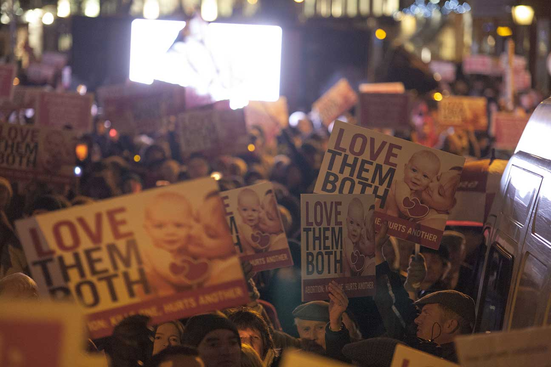
The Sermon on the Mount
The “mini-Gospel” is found in Matthew, chapters 5‒7.
It includes “You have heard it said . . .” statements.
These exemplify how Jesus purifies our conscience . . .
. . . by teaching us the true meaning of God’s Law.
© Paul Keeling / Shutterstock
Notes:
Notes: Discuss examples of the thoughts and attitudes Jesus condemns in these statements, and how he calls us to live instead. Ask how “consciousness-raising” or “raising awareness” is similar to, and different from, the way Jesus purifies our conscience. (Both involve learning and informing our conscience; Jesus’ teaching is from God, and he offers the grace to follow it.)
This slide corresponds to student text content in article 19.

Slide 10
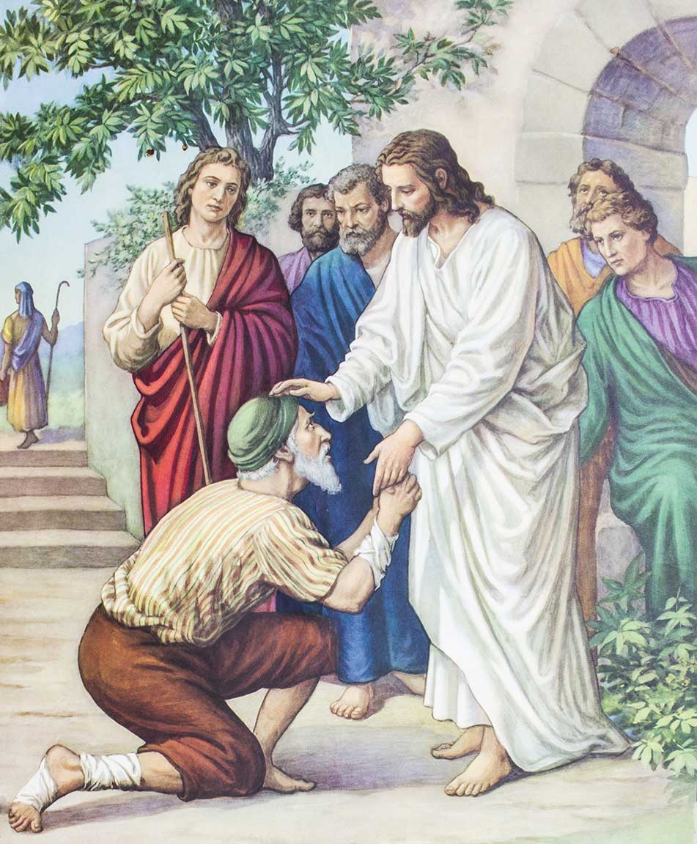
Christ’s Healings
Jesus’ healings are a sign that the Father’s plan of salvation is being fulfilled.
Christ restores the wholeness of body, mind, and spirit he intended us to have.
His healings are a promise that in the Kingdom of Heaven, we will all be made whole and will experience no more suffering.
© iamfree007 / Shutterstock
Notes:
Notes: Explain that illness and disability were associated with sin in the time of Jesus, as discussed in the section “Sickness and Health in Biblical Cultures” in article 20 of the student text. Direct the students to read the Pray It! sidebar in article 20, “Comfort the Sick,” and discuss the spiritual and mental aspects of illness that we ask Christ to heal.
This slide corresponds to student text content in article 20.

Slide 11
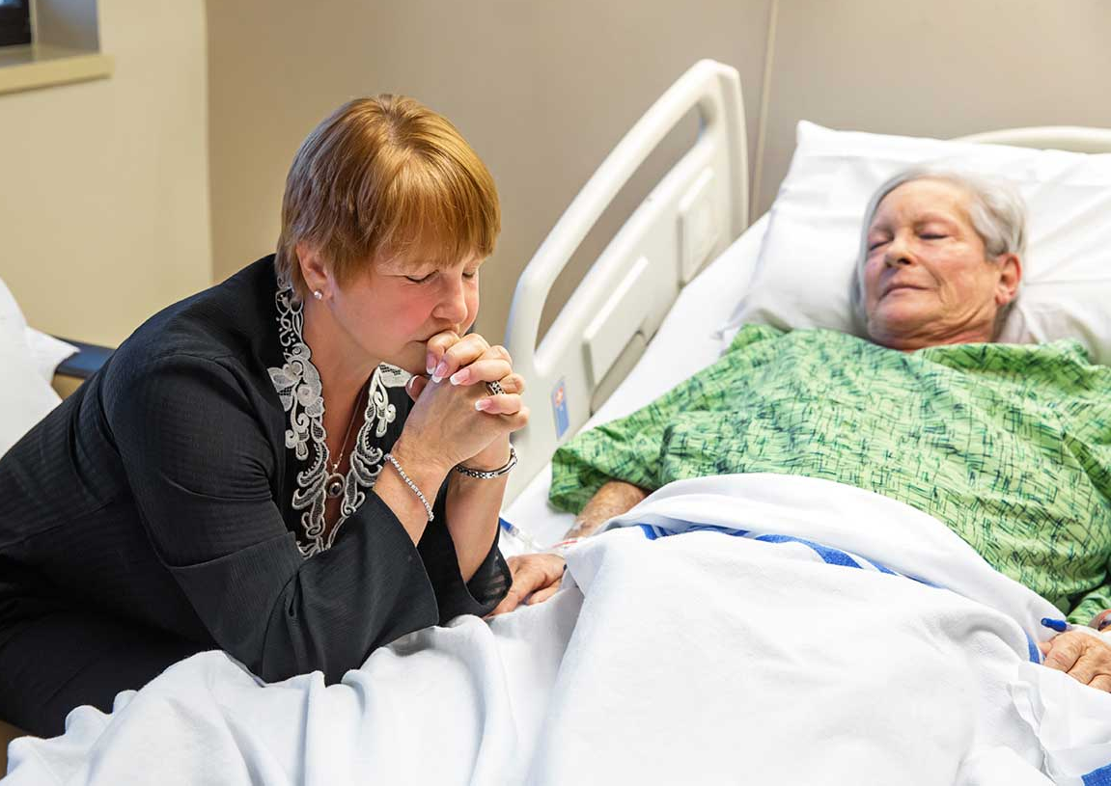
Today
The Church continues Christ’s healing ministry by:
◦ supporting the work of medical professionals
◦ providing chaplains at hospitals
◦ offering the Sacrament of Anointing of the Sick
© Jodi Jacobson / istock
Notes:
Notes: Explain that the Church encourages anyone with a serious illness to seek out the Sacrament of Anointing of the Sick, including those undergoing surgery for a dangerous illness, children who are old enough to understand the Sacrament, and elderly people who are weak.
This slide corresponds to student text content in article 20.

