Slide 1
Discovering God in Creation
Jesus Christ: God’s Love Made Visible, Second Edition Unit 2, Chapter 5
Document#: TX004810

Slide 2
“Find God in All Things”
Every experience of our lives can make us aware of God’s presence.
All experiences—good and bad—can lead us into closer communion with God.
© Steve Debenport / iStockphoto.com
Notes:
Explain that since God wants us to know him, the Holy Spirit enables us to encounter God in our daily experiences. Ask what we need to do in order to “find God in all things” (have faith, look for God’s presence, reflect on experiences).
This slide corresponds to content in article 20, “Discovering God in Our Daily Lives,” in the student book.

Slide 3
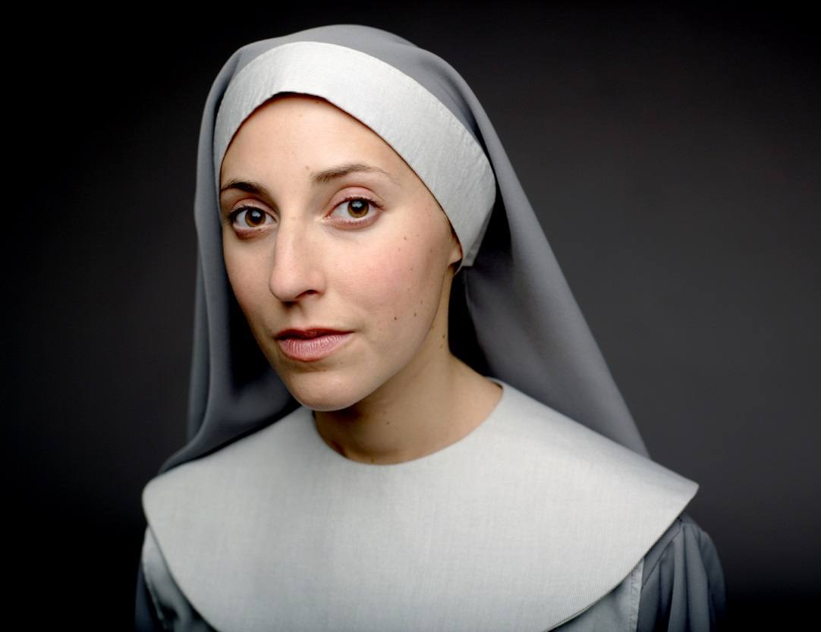
The Faith of Others
The faith of other believers is a powerful witness and support for us.
© bubbalove / iStockphoto.com
Notes:
Share an example of a faith witness in your own life, and invite the students to do so as well. Ask how the faith of others can support us.
This slide corresponds to content in article 21, “Discovering God in the Faith of Others,” in the student book.

Slide 4
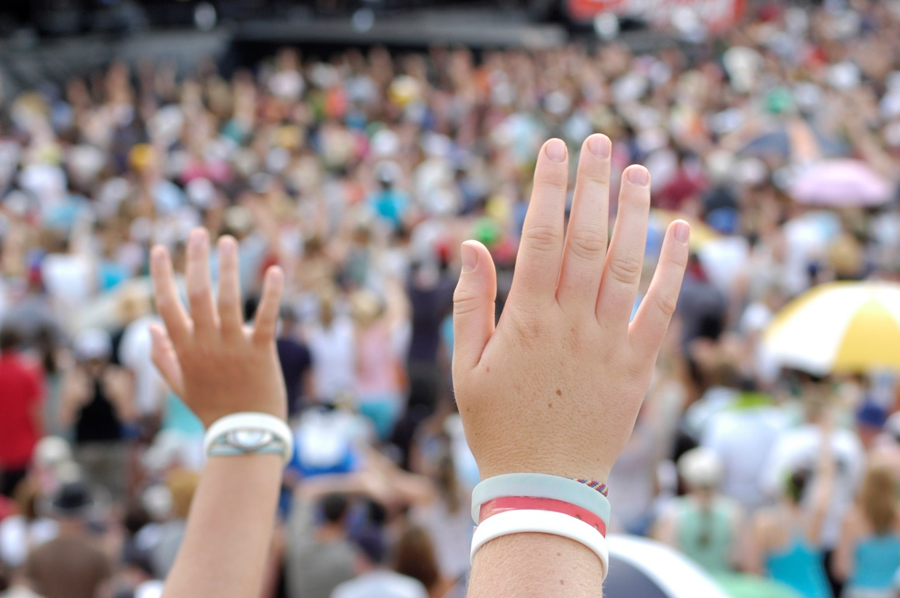
The Example of the Early Church
Jesus wanted his followers to live and work as a dedicated community.
They were to demonstrate Christian fellowship and service.
Their shared life of faith enabled them to persevere in holiness.
© deanmillar / iStockphoto.com
Notes:
Discuss holiness in the context of Christian community, touching on service, faithfulness to the Gospel message of love, and commitment to worship.
This slide corresponds to content in article 21, “Discovering God in the Faith of Others,” in the student book.

Slide 5
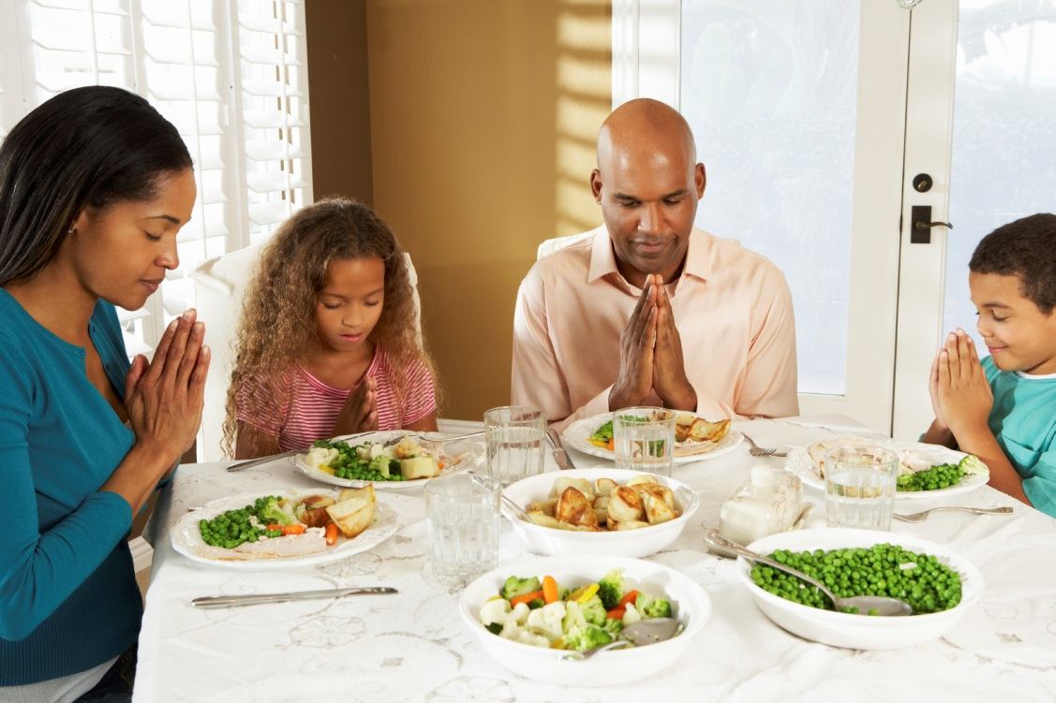
Family
The family is the domestic church, the foundation of the Christian life.
It is where we first learn about our faith.
Family members can encourage our growth in faith.
They can stand by us during times of doubt.
© monkeybusinessimages / iStockphoto.com
Notes:
Ask the students to identify some features of family life that they might see in a family that is committed to being the domestic church.
This slide corresponds to content in article 21, “Discovering God in the Faith of Others,” in the student book.

Slide 6
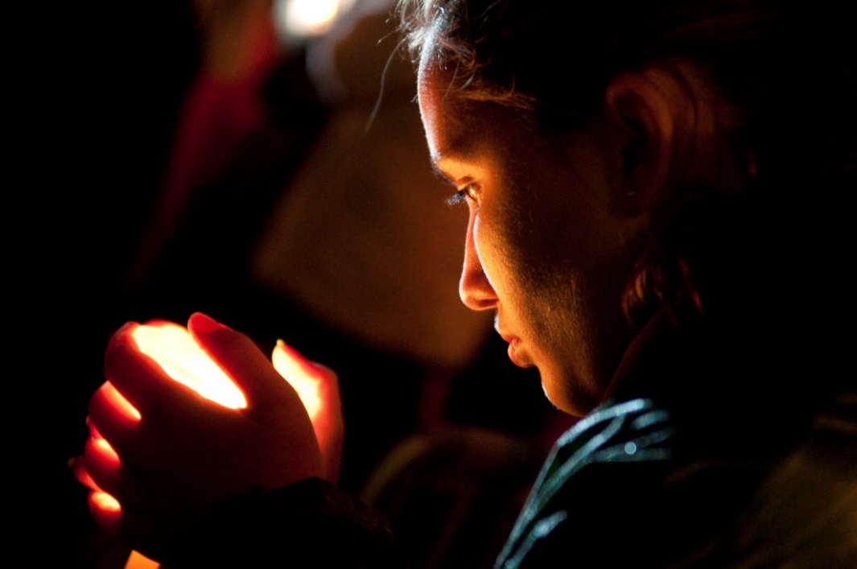
Communal Prayer
Communal prayer is central to our Catholic identity.
Celebrating the Eucharist tells us that we are the Body of Christ.
United by our Baptism, strengthened by the Eucharist, we are to be the light of the world.
© rui_noronha / iStockphoto.com
Notes:
Emphasize that at Mass we gather with the entire Communion of Saints and pray for a wide range of people. Ask the students to recall the groups named in the Eucharistic prayer (the entire Church, the Pope, the local bishop, all the clergy, those who have died).
This slide corresponds to content in article 21, “Discovering God in the Faith of Others,” in the student book.

Slide 7
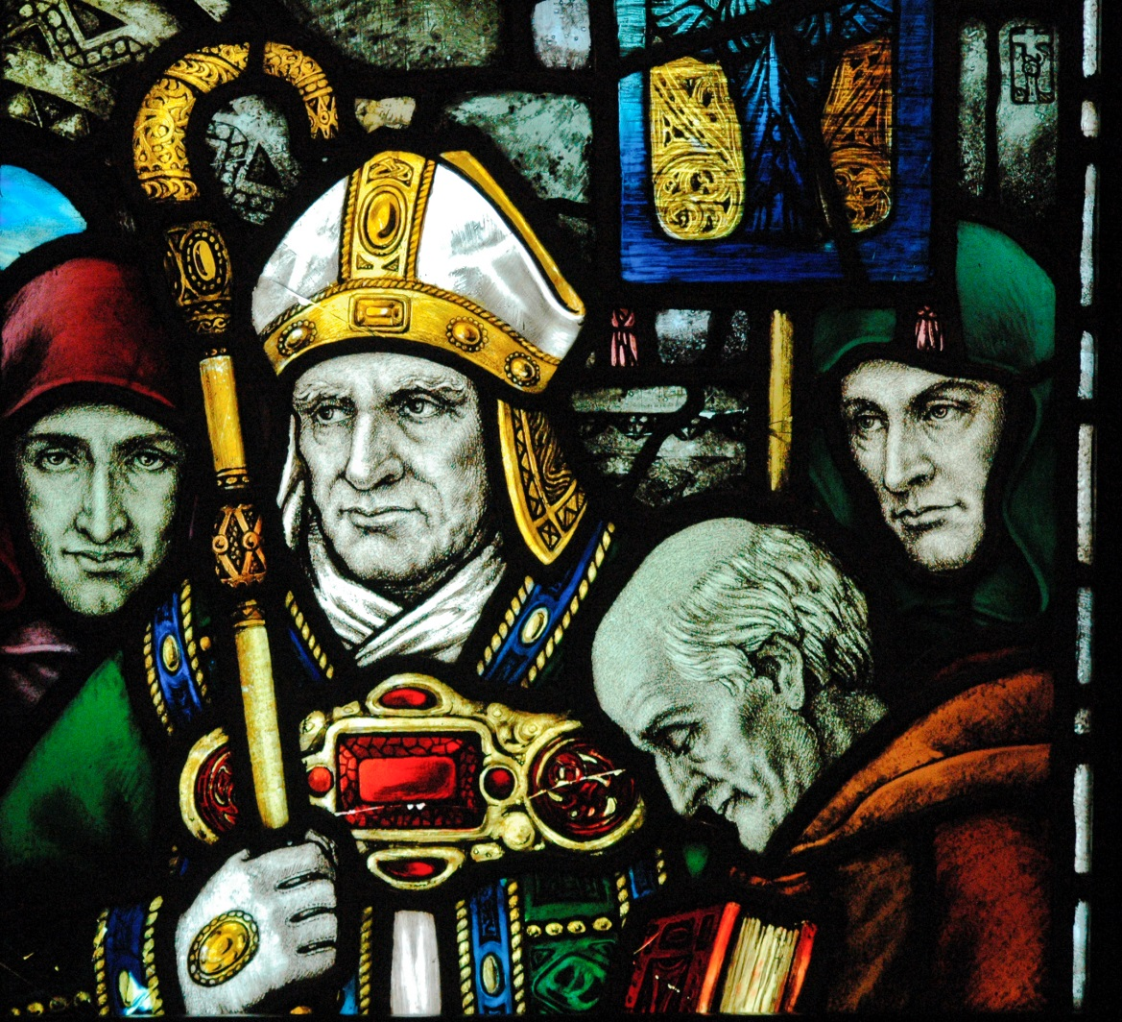
The Saints: Models of Holiness
We can especially perceive God at work in the lives of the saints.
These are the holy men and women who have lived in every time and place.
The Church has officially canonized some of them as saints.
© JayKay57 / iStockphoto.com
Notes:
Clarify the last bullet point, explaining that there have been many saints throughout history (and in our own time) who have not been canonized. Saint Patrick is pictured.
This slide corresponds to content in article 22, “The Saints: Our Models of Holiness,” in the student book.

Slide 8
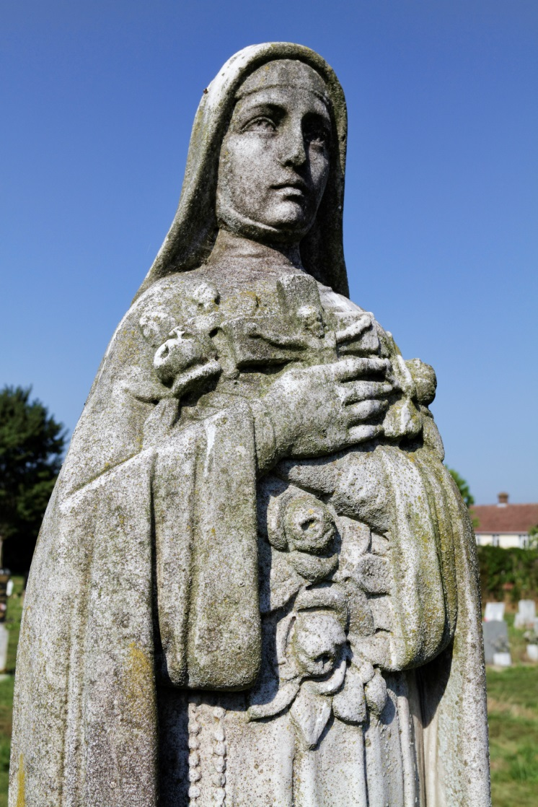
The Saints: Intercessors
We often seek the help of the saints and ask for their prayers.
Catholics do not worship the saints.
The saints have been friends of God, and by their witness they invite us to befriend God.
© Whiteway / iStockphoto.com
Notes:
Ask the students about saints who are special to them. Share your own relationship with one or more saints as models and intercessors. Saint Thérèse of Lisieux is pictured.
This slide corresponds to content in article 22, “The Saints: Our Models of Holiness,” in the student book.

Slide 9
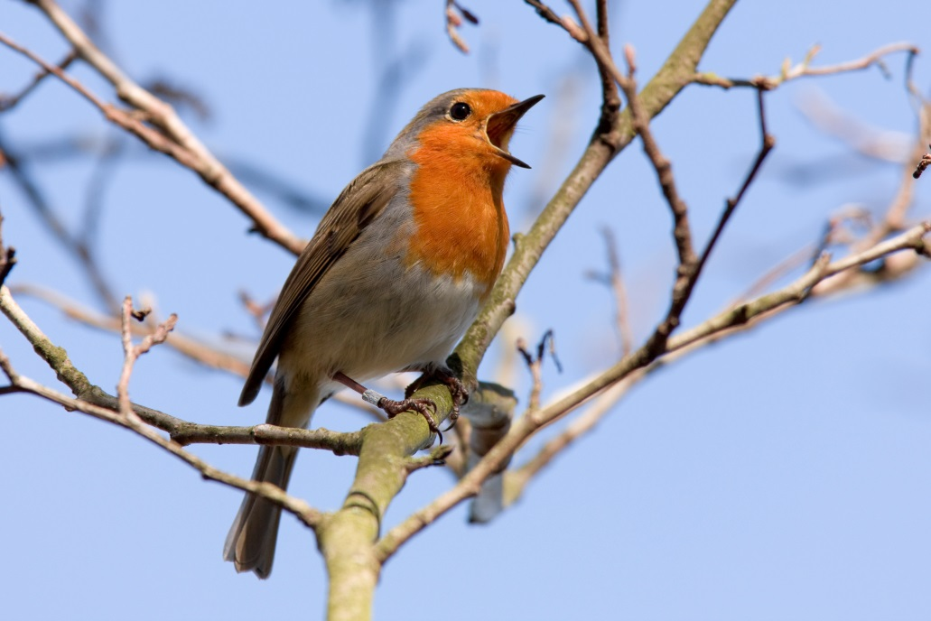
God in the Natural World
Even small things can reveal the wonder of nature and can move us to prayer and to praise.
An attentive eye and ear may prompt us to praise a plant growing on a window ledge, a bird chirping a morning song, or a dog wagging its tail.
© Andrew_Howe / iStockphoto.com
Notes:
Ask for examples of nature scenes or events that inspire praise.
This slide corresponds to content in article 23, “Discovering God in the Natural World,” in the student book.

Slide 10
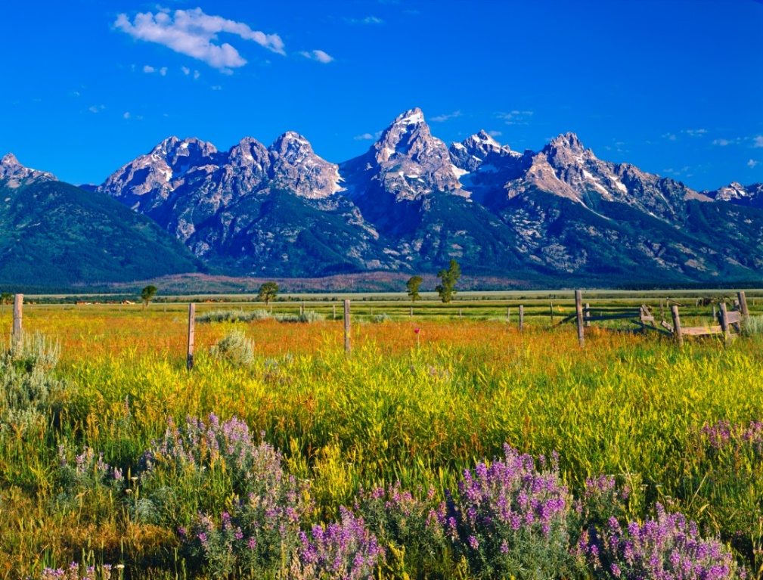
Creator of the Natural World
Through nature we can know that God is the Creator of all that is.
All creatures of the earth, because of their divine origin, reflect God’s glory.
© Ron and Patty Thomas Photography / iStockphoto.com
Notes:
Read Psalm 19:1–7, describing how the skies praise God, declaring his glory.
This slide corresponds to content in article 23, “Discovering God in the Natural World,” in the student book.

Slide 11
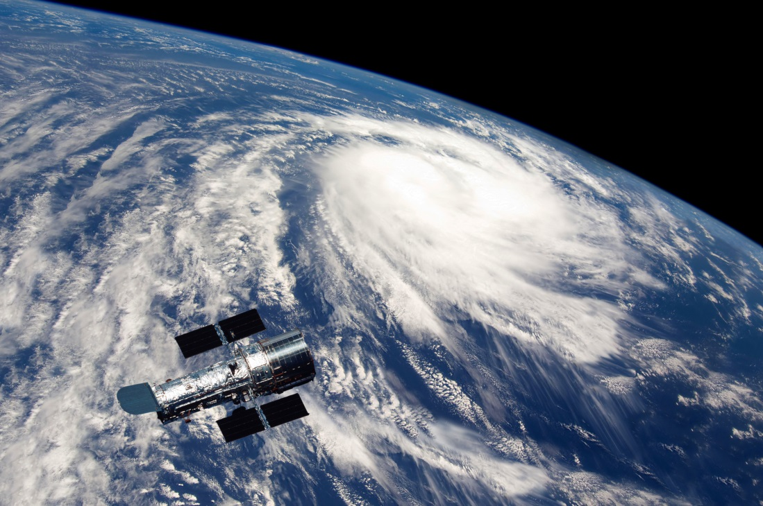
The Role of Science
There is no discrepancy between faith and reason; both are gifts from God.
The fact that God brought the universe into being is a key religious truth.
Science can inform us about how this may have been accomplished.
© fongfong / Shutterstock.com
Notes:
Point out that belief in the divine origin of the universe does not mean that Catholics oppose scientific inquiry. Explain that science can reveal God’s glory in new and amazing ways.
This slide corresponds to content in article 23, “Discovering God in the Natural World,” in the student book.

Slide 12
Through the Human Intellect
Our human reason and intellect can help us to know about God.
© matspersson0 / iStockphoto.com
Notes:
Explain that Saint Thomas Aquinas, considered to be the greatest Catholic theologian, used Aristotelian principles to explore and explain Catholic doctrine.
This slide corresponds to content in article 24, “Discovering God through the Human Intellect,” in the student book.

Slide 13
The Gift of Intellect
The Church has urged us to use our minds to grow in understanding our faith.
God gave us the gift of human intellect to understand and know him more fully.
© kickstand / iStockphoto.com
Notes:
Ask how Saint Anselm described theology, and ask what the academic discipline of theology studies.
This slide corresponds to content in article 24, “Discovering God through the Human Intellect,” in the student book.

Slide 14
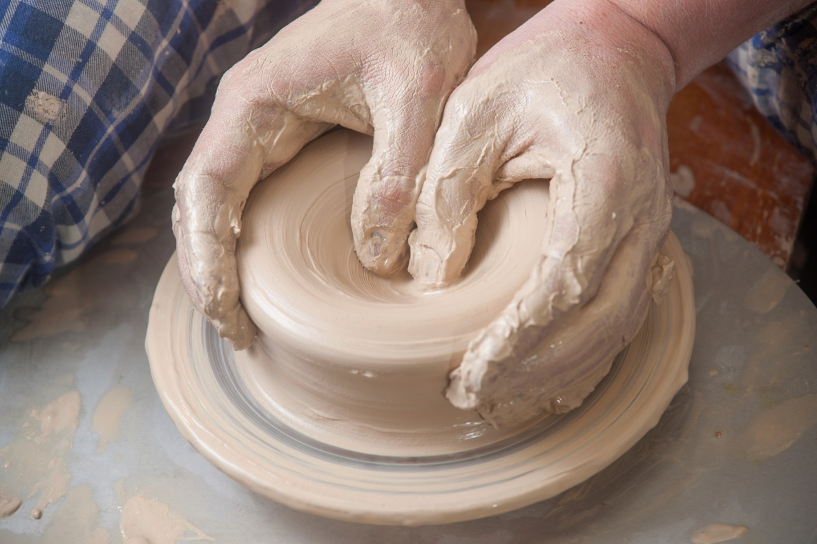
Speaking about God
The language we use to express our knowledge of God can never fully capture the Divine Mystery.
This is why there is a great diversity of representations of God in Sacred Scripture.
© kozak_kadr / iStockphoto.com
Notes:
Discuss some images of God found in Scripture, as in article 24 in the student book.
This slide corresponds to content in article 24, “Discovering God through the Human Intellect,” in the student book.

