Slide 1
Psalm 139
The Paschal Mystery Course
Document # TX001315

Slide 2

Lord, you have probed me, you know me:
you know when I sit and stand;
you understand my thoughts from afar.
© 29september/shutterstock

Slide 3
My travels and my rest you mark;
with all my ways you are familiar.
© 29september/shutterstock

Slide 4
Even before a word is on my tongue,
Lord, you know it all.
© 29september/shutterstock

Slide 5
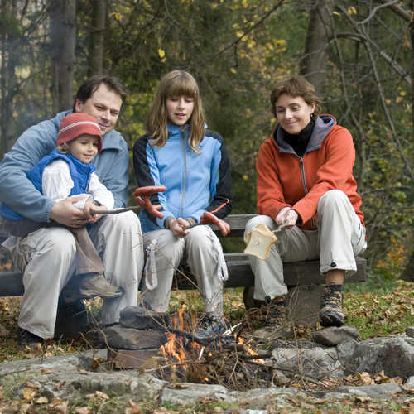
Behind and before you encircle me
and rest your hand upon me.
© Gorilla/shutterstock

Slide 6
Such knowledge is beyond me,
far too lofty for me to reach.
© Gorilla/shutterstock

Slide 7
Where can I hide from your spirit?
From your presence, where can I flee?
© Gorilla/shutterstock

Slide 8
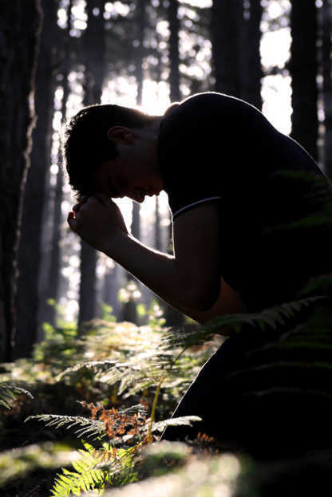
If I ascend to the heavens, you are there;
if I lie down in Sheol, you are there too.
© BalazsT/shutterstock

Slide 9
If I fly with the wings of dawn
and alight beyond the sea,
© BalazsT/shutterstock

Slide 10
Even there your hand will guide me,
your right hand hold me fast.
© BalazsT/shutterstock

Slide 11
If I say, “Surely darkness shall hide me,
and night shall be my light”—
© BalazsT/shutterstock

Slide 12
Darkness is not dark for you,
and night shines as the day.
Darkness and light are but one.
© BalazsT/shutterstock

Slide 13
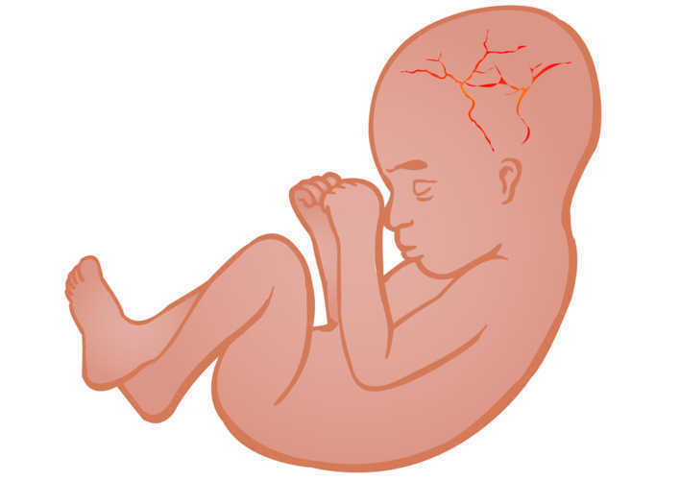
You formed my inmost being;
you knit me in my mother’s womb.
Shutterstock/lelik759

Slide 14
I praise you, so wonderfully you made me;
wonderful are your works!
My very self you knew;
Shutterstock/lelik759

Slide 15
my bones were not hidden from you,
When I was being made in secret,
fashioned as in the depths of
the earth.
Shutterstock/lelik759

Slide 16
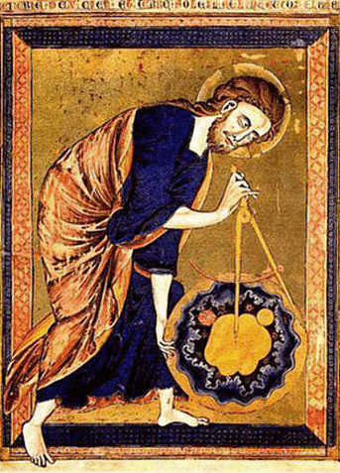
Your eyes foresaw my actions;
in your book all are written down;
my days were shaped, before one came to be.
Image in public domain

Slide 17
How precious to me are your designs, O God;
how vast the sum of them!
Image in public domain

Slide 18
Were I to count, they would outnumber the sands;
to finish, I would need eternity.
Image in public domain

Slide 19
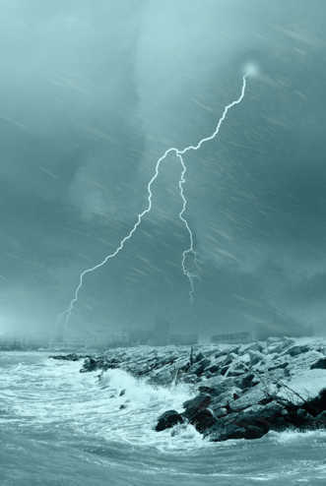
If only you would destroy the wicked, O God,
and the bloodthirsty would depart from me!
© shutterstock/lafoto

Slide 20
Deceitfully they invoke your name;
your foes swear faithless oaths.
© shutterstock/lafoto

Slide 21
Do I not hate, Lord, those who hate you?
Those who rise against you, do I not loathe?
© shutterstock/lafoto

Slide 22
With fierce hatred I hate them,
enemies I count as my own.
© shutterstock/lafoto

Slide 23
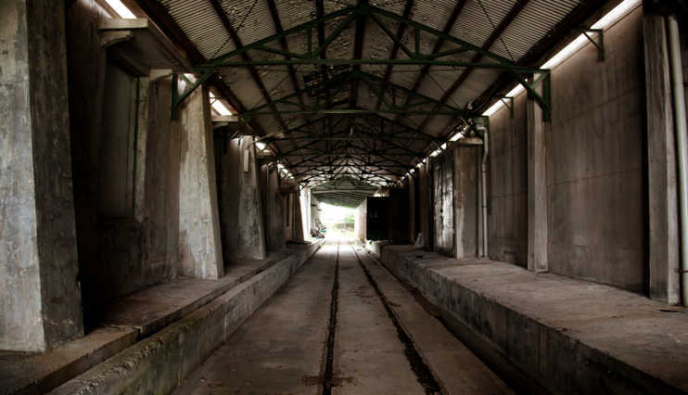
Probe me, God, know my heart;
try me, know my concerns.
© littlesam/shutterstock

Slide 24
See if my way is crooked,
then lead me in the ancient paths.
© littlesam/shutterstock

