Slide 1
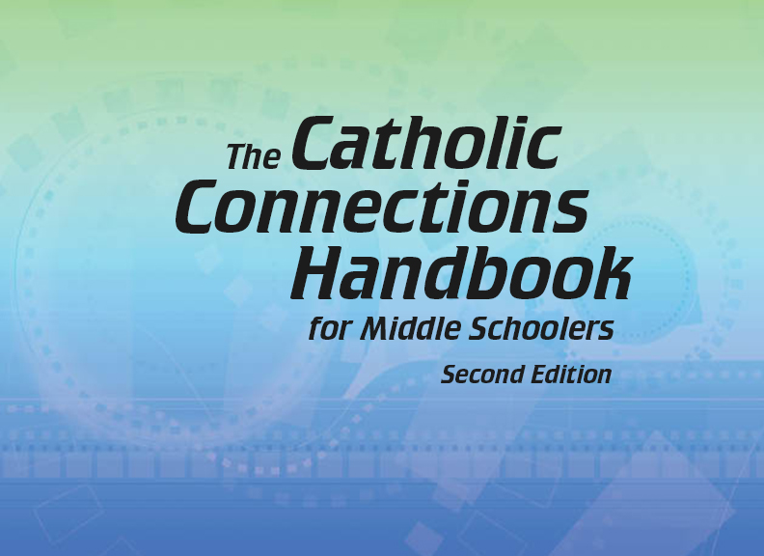

Slide 2
The New Testament
and the Church
Chapter B
The Bible: The Gospel of John

Slide 3
Chapter Summary The Bible: The Gospel of John
This chapter will explore the unique Gospel of John.
It will also explore the Gospel’s passion to show the Risen Christ to people needing to see him.
You will experience Jesus in many relationships and encounters, including those with the woman at the well, Nicodemus, his Beloved Disciple, and his mother.
Through symbolic language, the Gospel of John portrays Jesus as he reveals ways to understand God’s Kingdom and God’s great love for us.

Slide 4
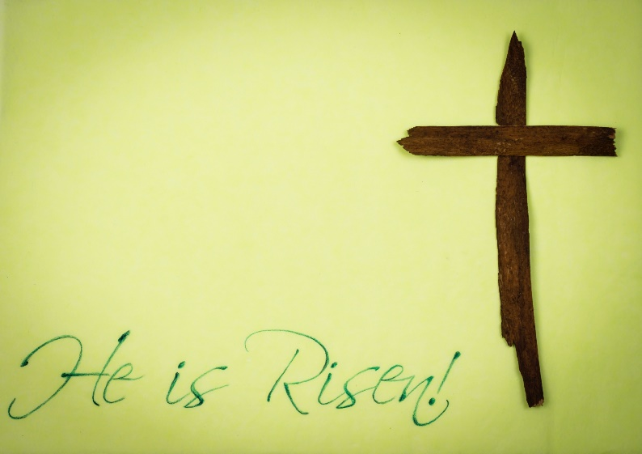
“New Beginnings” (John 1:1–14, 3:1–16)
John’s Gospel helps its readers see that the Risen Christ is present in their lives. Its use of symbolic language leads us to deeper understanding of God’s love.
John’s Gospel offers signs of
hope for people eager to see the
Risen Christ.
© Bernie Meyers/www.istockphoto.com

Slide 5
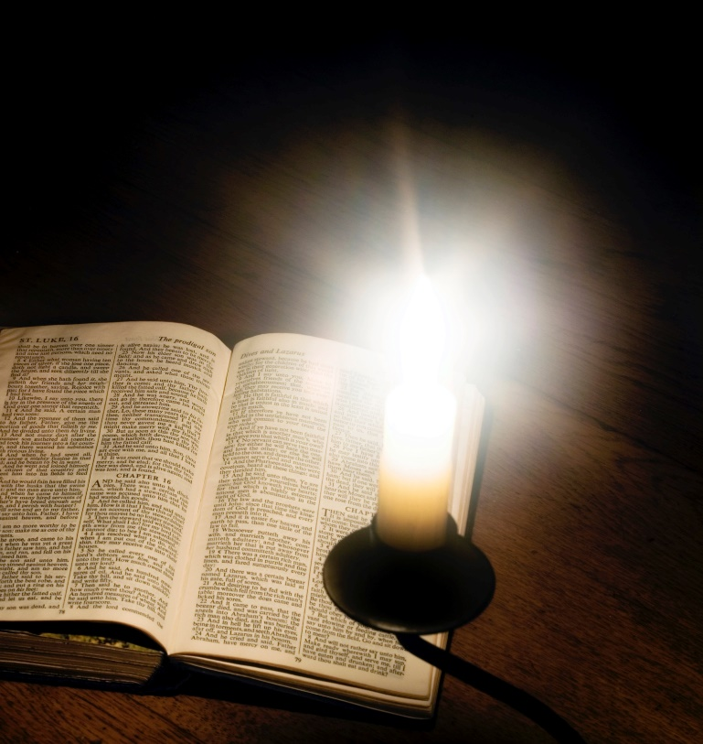
“New Beginnings” (John 1:1–14, 3:1–16)
John’s use of symbolic language connects us to deeper realities. For example, Jesus is the Word of God, making him the source of life and creation.
John shows us that Jesus existed before creation, is present among us today, and is eternal. He is timeless.
© RapidEye/www.istockphoto.com

Slide 6
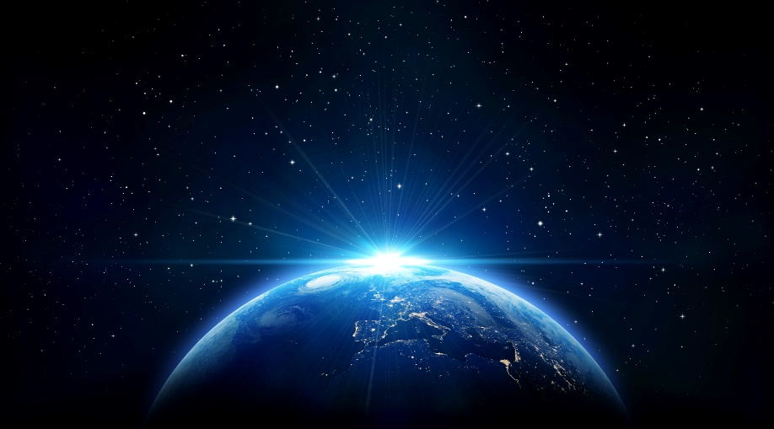
“New Beginnings” (John 1:1–14, 3:1–16)
Activity
Read Genesis 1:1–10.
When does creation begin?
How does God create things such as light, the sky, the earth, the sea?
Does God exist before creation begins?
Does the Holy Spirit exist before creation begins?
Does Jesus exist before creation begins? Where is he?
Read John 1:1–14.
Who is the Word?
If Jesus is the Word, was Jesus with God from the very beginning?
What was the Word’s role in creation?
Remembering back to Genesis, how did God create things?
According to Genesis 1:9, does the Word, or light, still exist?
©romrf/www.shutterstock.com

Slide 7
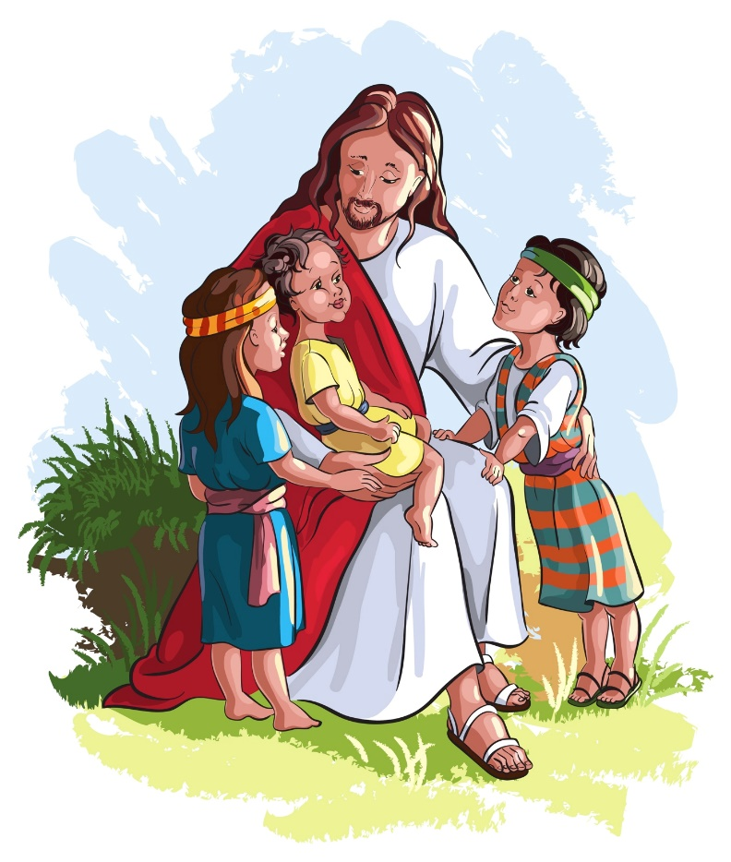
“We Come to Know Jesus” (John 4:1–30, 11:1–44)
John’s Gospel emphasizes how Jesus’ encounters and relationships with people help them come to know him as the Messiah and know eternal life.
Jesus’ encounters with people in John’s Gospel have deep meaning and the power to transform.
©Anna Yefimenko/www.shutterstock.com

Slide 8
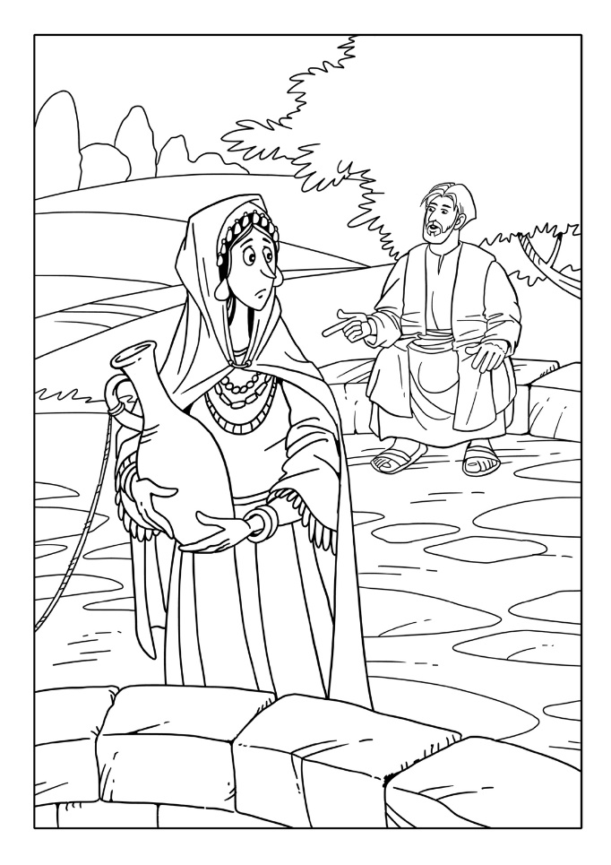
“We Come to Know Jesus” (John 4:1–30, 11:1–44)
Jesus offers living water—the promise of eternal life—to the woman at the well.
Jesus is the source of eternal life to all who believe in him.
Discussion Questions
Are you afraid or nervous about interacting with people who are different than you and your friends?
How can you make an effort to reach out to those who are different, like Jesus did?
©askib/www.shutterstock.com

Slide 9
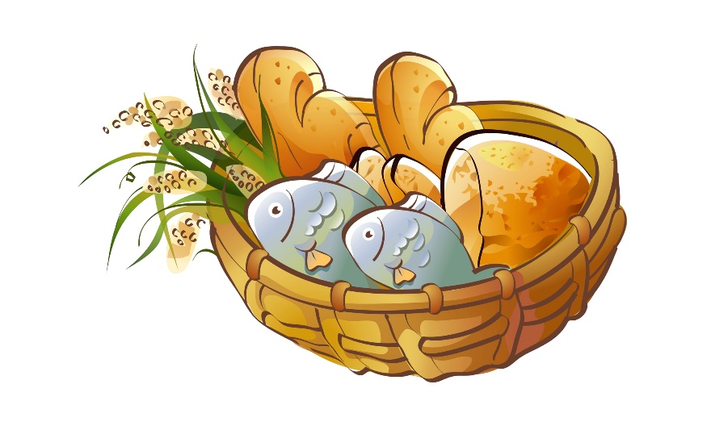
“Meals with a Message” (John 2:1–12, 14:1–17)
In John’s Gospel, there are two special moments centered around meals that teach us about Jesus and his mission.
In John’s Gospel, Jesus gives discourses to help us understand what we need to know about God’s Kingdom. In other Gospels, Jesus often taught in parables.
©zzveillust/www.shutterstock.com

Slide 10
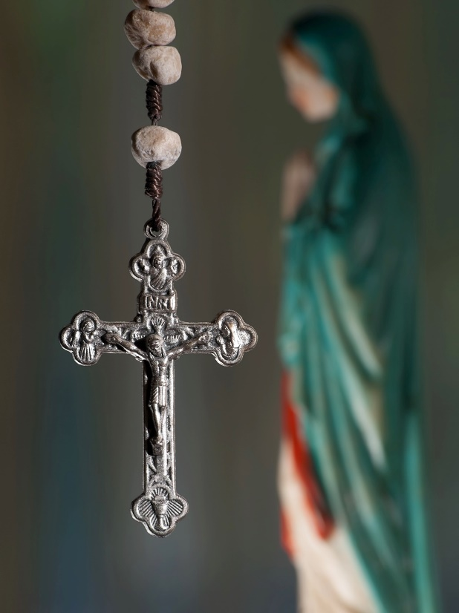
“Meals with a Message” (John 2:1–12, 14:1–17)
Jesus emphasizes that by knowing him, we know his Father.
Jesus is the way, the truth and the life. He is how we know the Father, and no one goes to the Father except through him.
Discussion Question
How can Mary be seen as an example of what it looks like to know and follow Jesus?
©Vladimir Koletic/www.shutterstock.com

Slide 11
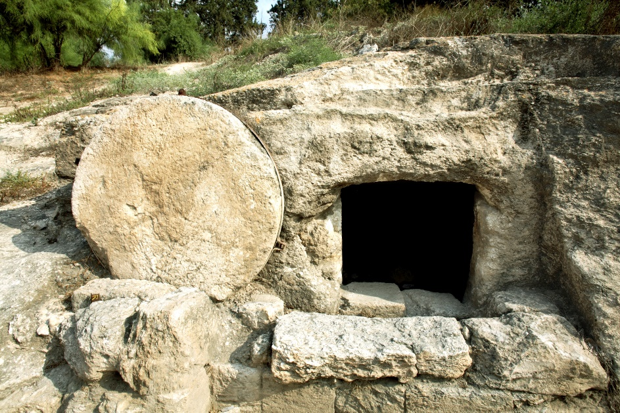
“Get on Your Feet” (John 13:1–15, 20:1–10)
John’s story of Jesus’ Passion, death, and Resurrection calls each of us as beloved disciples to take action and spread the Good News.
John’s stories from Jesus’ Passion, death, and Resurrection contain meaning for today’s disciples.
In John’s Resurrection story, the Beloved Disciple is the first to believe the Good News that Jesus is risen.
©Mordechai Meiri/www.shutterstock.com

Slide 12
“Get on Your Feet” (John 13:1–15, 20:1–10)
John’s use of an unnamed character suggests that those who seek to love Jesus, including us, can be quick to realize the Good News.
Discussion Questions
Have you ever had your
feet washed at Mass on
Holy Thursday or watched
this ritual? What was that
like?
What are some types of
service work that you have
done, or of which you are aware,
that can be dirty and messy?
©R. Gino Santa Maria/www.shutterstock.com

