Slide 1
The Three Degrees of Holy Orders: Deacons, Priests, and Bishops
Vocations, Unit 5

Slide 2
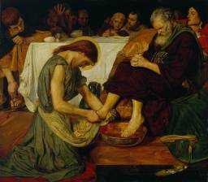
The Role of a Deacon
The deacon . . .
is called to serve as Jesus served
has a special call to minister to the poor
Image in public domain
Notes:
Teacher Notes: At the end of the last Passover meal, according to the Gospel of John (13:1–17), Jesus placed a towel around his waist, and with a bowl of water began to wash his disciples’ feet. His message to the disciples was clear: They must become servants of all, just as Christ’s life was a life of service. Service is the fundamental role of the deacon.

Slide 3
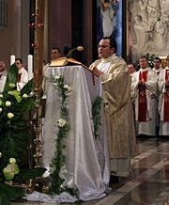
The ministry of a deacon today involves . . .
assisting at the Eucharist (especially reading the Gospel, preaching the homily, and distributing Holy Communion)
visiting the sick and elderly and poor
baptizing infants and witnessing marriages
helping with religious education programs
newworldencyclopedia.org
Notes:
Teacher Notes: The specific role of the deacon arose in the early Church when the number of Gentile, or non-Jewish, Christians grew and these Christians complained that some of their poor were being neglected. The service of the poor not only describes the primary role of the deacon, but is also the central prophetic role of the Church—that is, to advocate for the poorest and most vulnerable members of society.

Slide 4
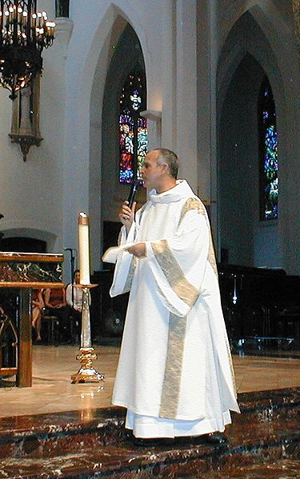
There are two types of deacons
Transitional Deacons: Those who are ordained a deacon in preparation for becoming a priest.
Permanent Deacons: Those who are ordained to serve permanently as a deacon. A deacon may be married but cannot remarry should his wife die.
Image in public domain
Notes:
Teacher Notes: The permanent diaconate was revived after Vatican II. Permanent deacons today most often serve as assistants to the pastor of a parish.

Slide 5
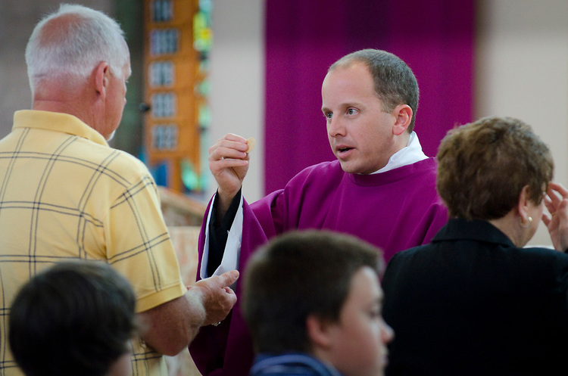
Quietly Reflect on the Ministry of a Deacon
stlouisreview.com
Notes:
Teacher Notes: The ministry of a deacon includes assisting at the Eucharist (especially reading the Gospel, preaching the homily, and distributing Holy Communion); assisting the pastor by visiting the sick, elderly, and poor; baptizing infants and witnessing marriages; and helping with religious education programs.

Slide 6
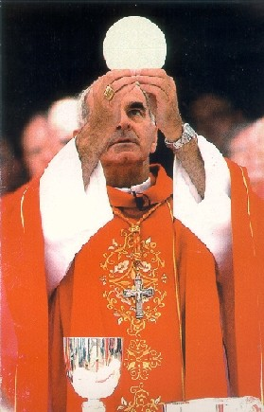
The Role of the Presbyter or Priest
The priest . . .
is an important coworker with the bishop in the mission of teaching, sanctifying, and governing
fulfills his ministry primarily through the celebration of the Sacraments, especially the Eucharist
rc.net
Notes:
Teacher Notes: As the early Church grew, the bishops—the successors of the Apostles—also needed coworkers to assist them with the mission of teaching, sanctifying, and governing. The primary way in which priests fulfill this mission is through the celebration of the Sacraments—especially the Eucharist. Priests also assist bishops in their mission of teaching, governing, and sanctifying through apostolic ministry in parishes, schools, missions, and so on. A priest ordained in the Roman Catholic Church makes a promise of obedience to his bishop and of lifelong celibacy.

Slide 7
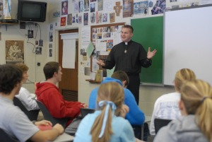
The Ministry of a Priest Today Involves
the celebration of the Sacraments, especially the Sunday Eucharist
sharing in the bishop’s apostolic ministry in parishes, schools, and other works of the diocese
holycrossusa.org

Slide 8
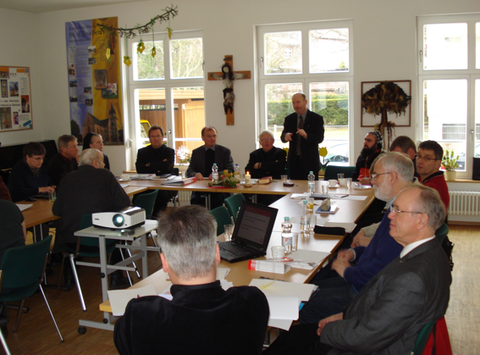
Diocesan Priests Work with Other Priests and with the Bishop
Priests doing apostolic ministry together under the authority of a bishop together form the presbyterate.
Priests who are ordained for a particular diocese (or local church) are incardinated into that diocese as permanent ministers.
All priests promise to pray the Liturgy of the Hours, the official prayer of the Church, each day.
syrorthodoxchurch.com
Notes:
Teacher Notes: Priests who are ordained for and incardinated into a particular diocese under the authority of a bishop are called diocesan priests.

Slide 9
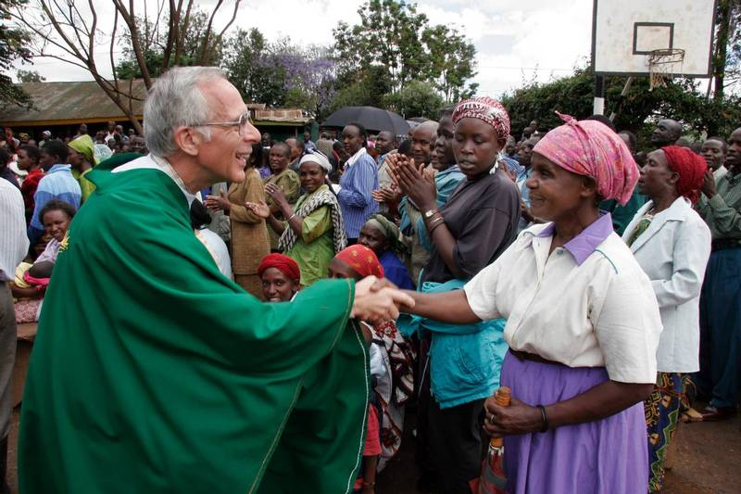
A Second Kind of Priests: Religious Order Priests
Religious order priests are dedicated to a particular type of service within the Church, such as education (Jesuits), mission work (Maryknolls*), prayer and study (Benedictines), or witnesses dedicated to Jesus through a simple lifestyle (Franciscans).
Religious order priests take vows and promise obedience to a religious superior rather than directly to a bishop.
suite101.com
Notes:
Teacher Notes: *Maryknoll priests are technically members of a society of apostolic life, not an order. The four orders are Benedictines, Dominicans, Franciscans, and Jesuits.

Slide 10
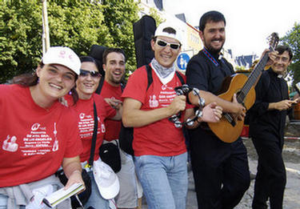
Quietly Reflect on the Ministry of a Priest
© wpwittman.com

Slide 11
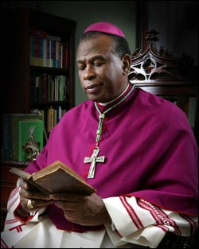
The Role of the Bishop
Bishops . . .
are servants of the servants of God (priests, deacons, and laity)
are ordained into the fullness of Christ’s priestly ministry to teach, govern, and sanctify
often serve as the chief pastor of a local church or diocese
diobelle.org
Notes:
Teacher Notes: Bishops are called to serve the needy, as do deacons, and to serve with a collegial spirit, as do priests. Bishops are a member of the priesthood of the baptized and the order of deacons and presbyters, and they may serve as chief pastor of a local church. Bishops are ordained into the fullness of Christ’s priestly ministry to teach, govern, and sanctify.

Slide 12
The Special Nature of a Bishop’s Ministry
The bishop . . .
is ordained in the line of Apostolic Succession that extends back to the twelve Apostles
together with other bishops, forms what is called the college of bishops
works in union with other bishops and the Pope to form the official teaching office of the Church: the Magisterium

Slide 13
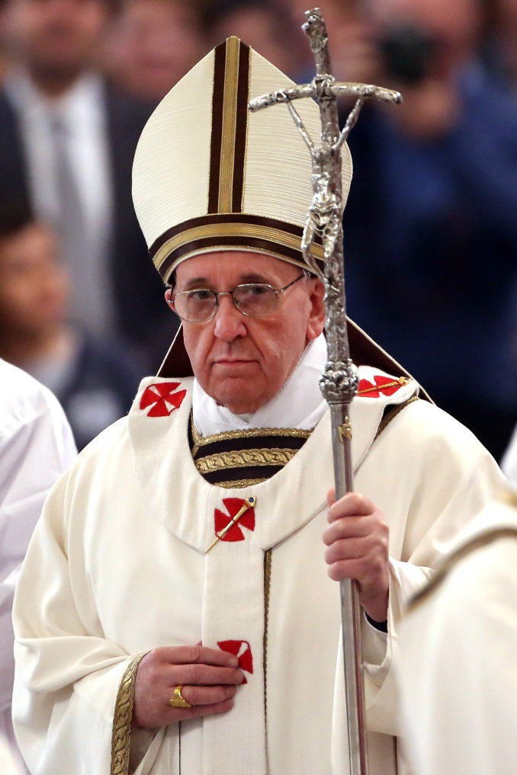
The Bishop Is Part of the Hierarchical Church
Only the Pope can call a man to become a bishop.
The Pope assigns a bishop to lead a particular Church, or diocese.
The Pope is both Bishop of Rome and head of the Church.
Franco Origlia/Getty Images

Slide 14
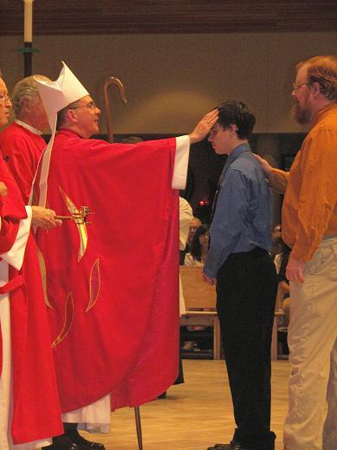
Practical Ministry of a Bishop
Among other things, a bishop . . .
celebrates all the Sacraments; he confirms young people and ordains new priests
administers the business of the diocese: assigns priests; oversees parishes, schools, and charitable organizations; and preaches and writes pastoral letters to the people
sthedwigbucktown.org

Slide 15
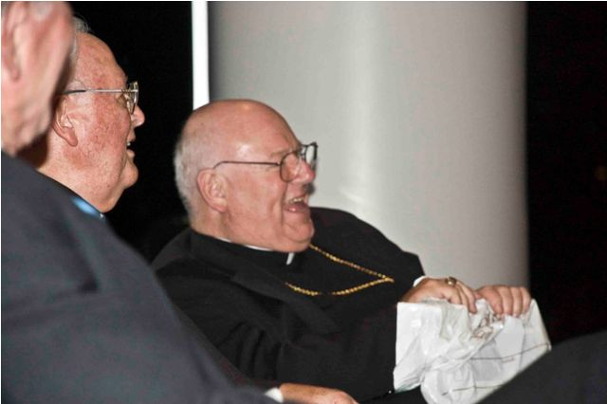
Quietly Reflect on the Ministry of a Bishop
catholicidaho.org
Notes:
Teacher Notes: The symbols of the bishop’s office are his ring (fidelity to the Church), his miter (governing authority), and his crozier (pastoral responsibilities). His official church is the cathedral.

Slide 16
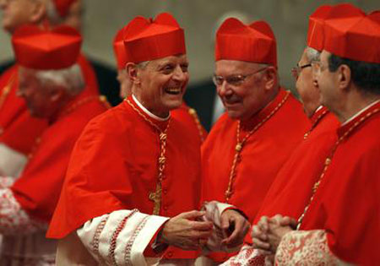
One More Thing: Kinds of Bishops
There are several kinds of bishops, depending on the specific role to which he is called. Can you name and describe them?
bydawnnaret.blogspot.com
Notes:
Teacher Notes: See next slide for answers.

Slide 17
Answers:
1. Diocesan bishop: The chief shepherd of a diocese.
2. Auxiliary bishop: Assists a diocesan bishop in his responsibilities.
3. Archbishop: The head of an archdiocese, who bears responsibility for the smaller neighboring dioceses within his metropolitan territory.
4. Cardinal: A member of the college responsible for electing new popes. Cardinals are appointed by the Pope.

