Slide 1
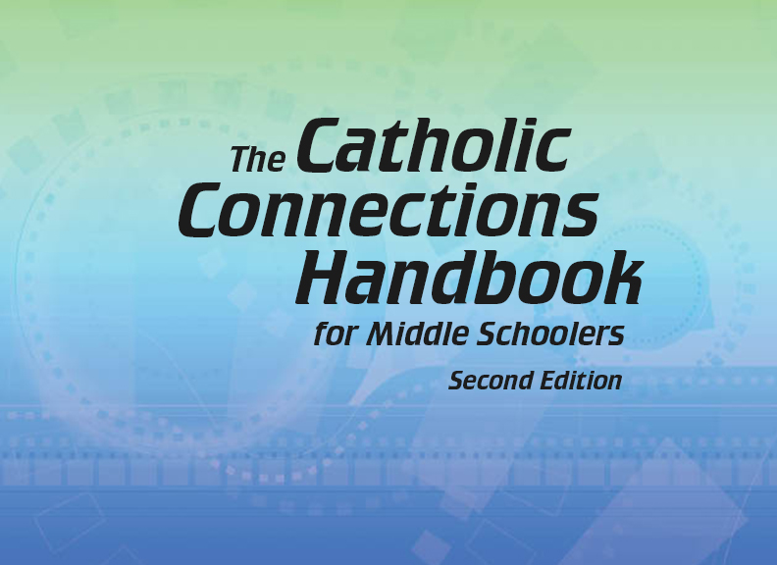


Slide 2

The Old Testament
and the Trinity
Chapter 8
The Bible: Covenants
© PaulCummings/www.shutterstock.com

Slide 3

Chapter Summary
The Bible: Covenants
Through learning about the covenants found in Sacred Scripture, we encounter the God who keeps his promises. Beginning with the covenants made with Abraham, Moses, and King David, and culminating with their ultimate fulfilment in Christ Jesus, God makes and keeps his promise to bring salvation to the world. God’s saving action fulfilled in Jesus continues to be fulfilled by the power of the Holy Spirit acting through the Church.
© phloxii/www.shutterstock.com

Slide 4
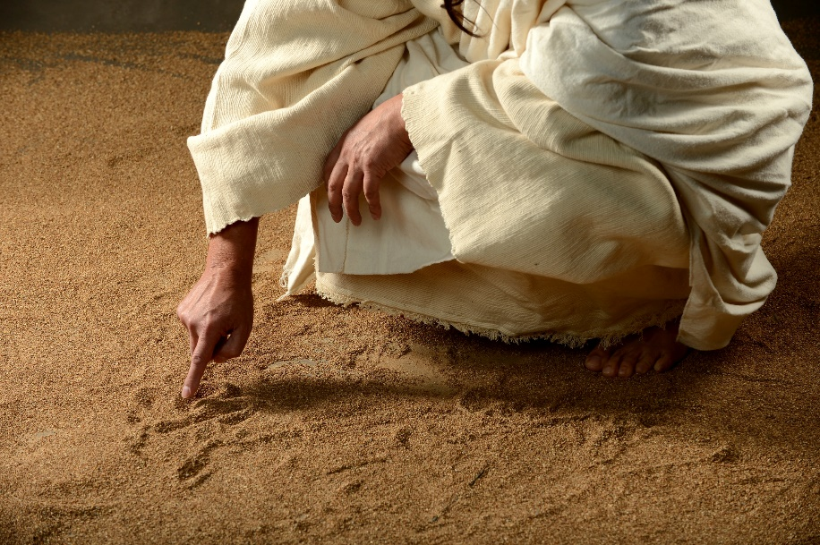
Introduction and “God Gives Second Chances”
(Handbook, pages 88–92)
God enters into sacred agreements with his people called covenants, and God remains faithful to his covenant promises even when his people are not faithful to him.
© CarlosE.SantaMaria/www.shutterstock.com

Slide 5

Introduction and “God Gives Second Chances”
(Handbook, pages 88–92)
The most important promises in the Bible are called covenants, in which both God and people vow to keep a promise forever.
© lassedesignen/www.shutterstock.com

Slide 6
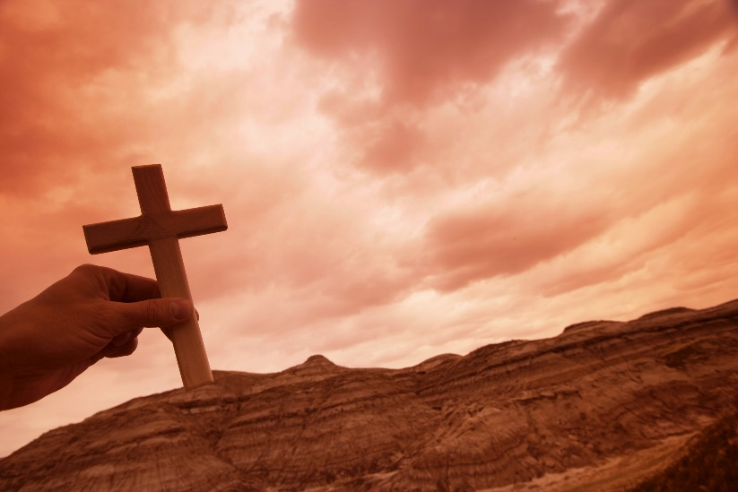
Introduction and “God Gives Second Chances”
(Handbook, pages 88–92)
In the story of Adam and Eve, God promised to deliver us from the power of sin and death.
Despite our sin, God still promises us salvation and continues to give all of us second chances.
© VibeImages/www.shutterstock.com

Slide 7

“God’s Covenant with Abraham and Moses”
(Handbook, pages 93–95)
God entered into a covenant with Abraham, making the Israelites God’s Chosen People, and with Moses when he gave the Israelites the Law.
© osmanpek/www.istockphoto.com

Slide 8
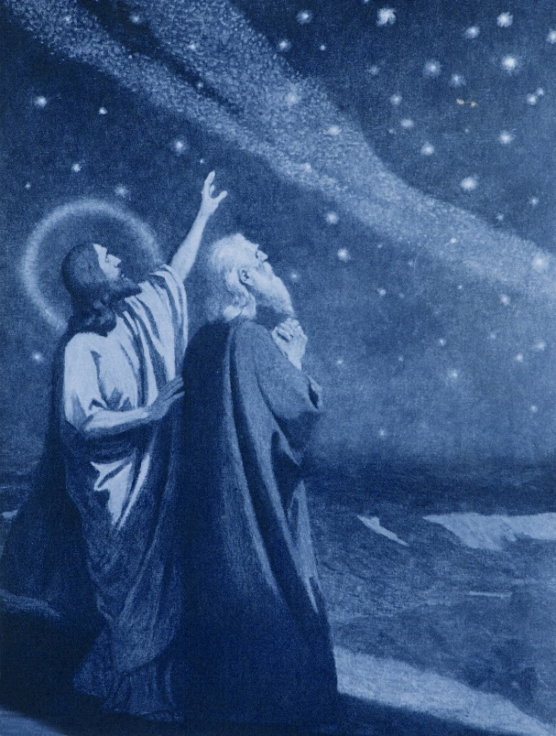
“God’s Covenant with Abraham and Moses”
(Handbook, pages 93–95)
God entered into a covenant with Abraham in which God promised to give Abraham land and many descendants who would be a blessing to all people.
© RenataSedmakova/www.shutterstock.com

Slide 9
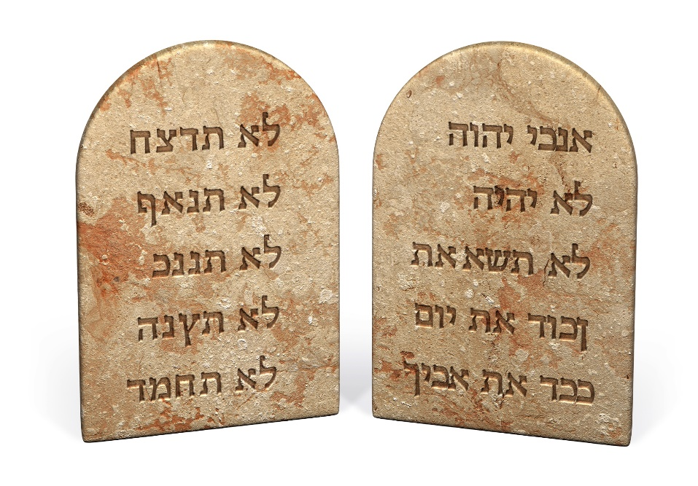
“God’s Covenant with Abraham and Moses”
(Handbook, pages 93–95)
Through Moses God entered into a covenant with the Israelites—called the Mosaic Covenant—in which God promised to be their God and protect them.
Both Moses and the Israelites promised to honor God as the one true God and obey him and his Commandments.
© jgroup/www.istockphoto.com

Slide 10
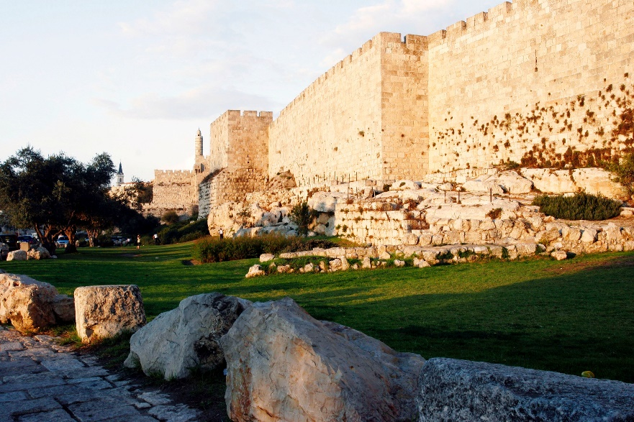
“God’s Covenant with David”
(Handbook, page 95)
God entered into a covenant with David, promising him that he would always have descendants and that his kingdom would last forever.
© vacek37/www.istockphoto.com

Slide 11
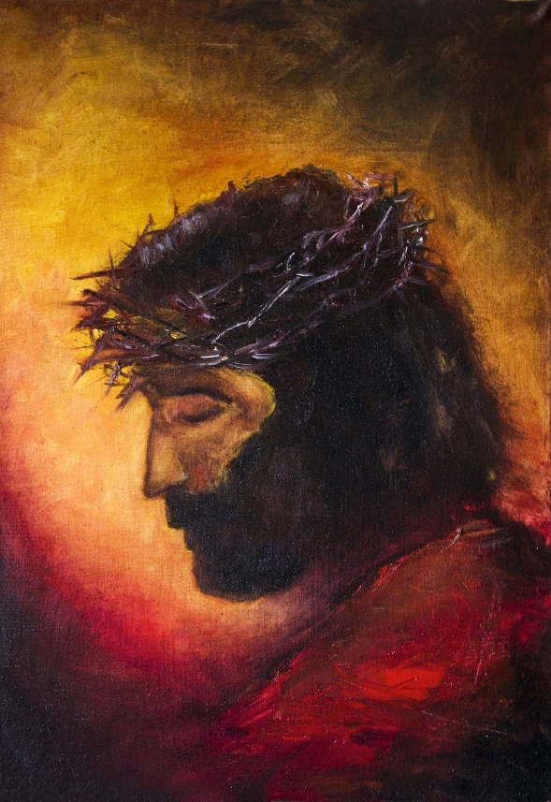
“God’s Covenant with David”
(Handbook, page 95)
As with Abraham, God made a covenant with King David that he would have many descendants.
One of those descendants was Jesus Christ.
© BakhurNick/www.istockphoto.com

Slide 12

“God’s Covenant with David”
(Handbook, page 95)
God also promised David that his kingdom would last forever, but David’s earthly kingdom did not last forever.
David’s kingdom will last forever through the Kingdom of God, established by David’s descendant, Jesus Christ.
© iurii/www.shutterstock.com

Slide 13
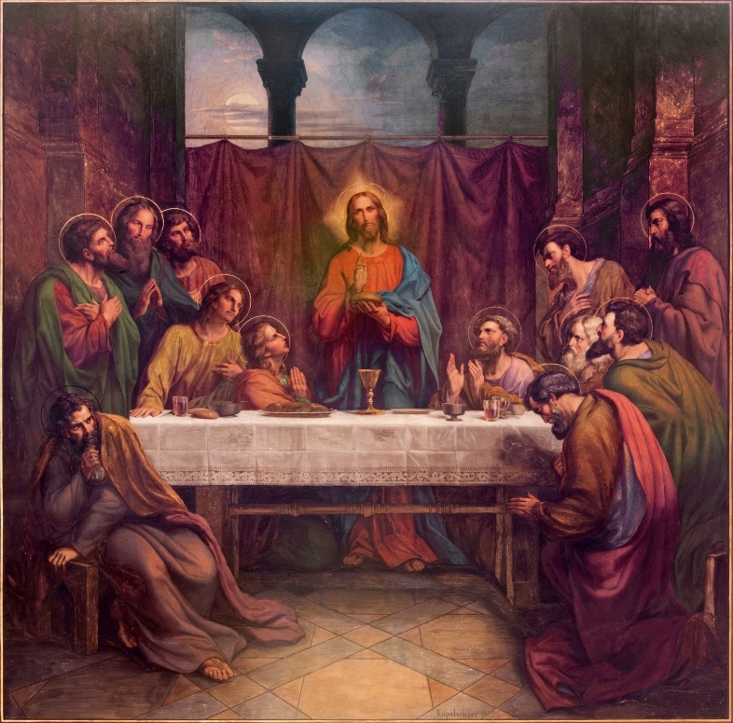
“The New Covenant”
(Handbook, pages 96–97)
Through Jesus Christ, God established a new and everlasting covenant with the human race.
© RenataSedmakova/www.shutterstock.com

Slide 14
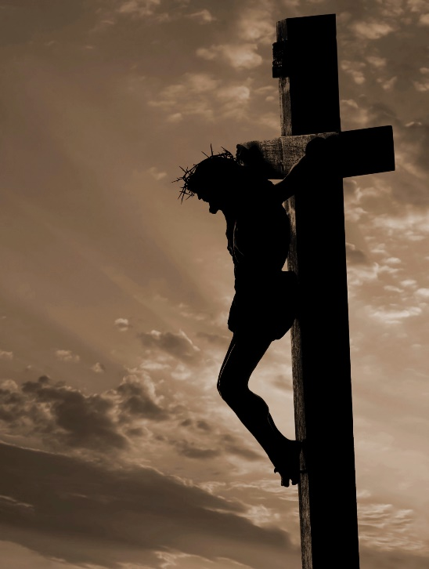
“The New Covenant”
(Handbook, pages 96–97)
When humans have gone astray, God has sent prophets to guide us.
Through God’s son, Jesus Christ, God established an eternal covenant that was the fulfillment of the covenants made with Noah, Abraham, Moses, and David. It is sometimes called the “New Covenant.”
© Liliboas/istockphoto.com

Slide 15
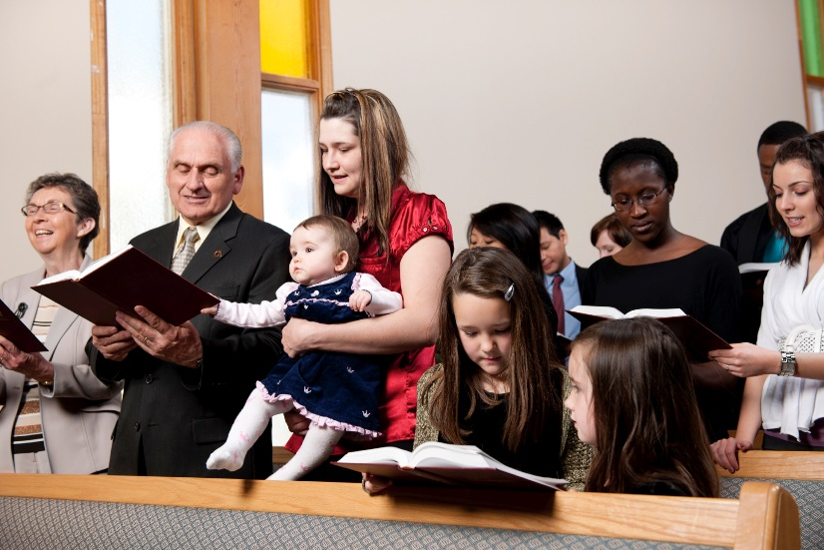
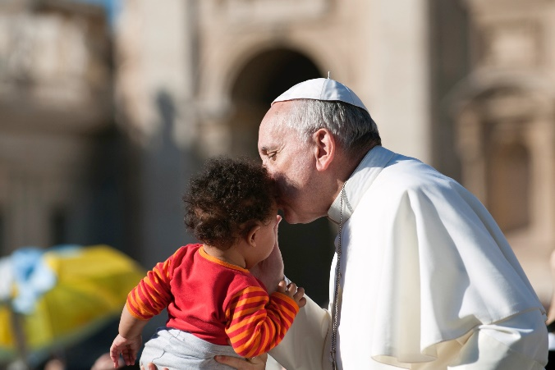
“The New Covenant”
(Handbook, pages 96–97)
The Good News that God’s promise of salvation was fulfilled in Jesus Christ continues to be preached by the Church until Christ returns.
© CEFutcher/www.iStockphoto.com
© neneos/www.istockphoto.com

Slide 16
Let’s Review!
How many of these questions you can answer correctly?
The sacred promises between God and his people are known as what?
What was the name of the leader to whom God promised land and many descendants?
What did God give Moses as a sign of his covenant with him?
What did God mean when he told David his kingdom would last forever?
Who is the fulfillment of all of the covenants made in the Old Testament?
How does the world learn about the promise of salvation?
Notes:
covenants
Abraham
Ten Commandments
He didn’t mean his earthly kingdom would last forever, but that through his descendant, Jesus Christ, his kingdom would be everlasting.
Jesus Christ
through the Church’s witness

