Slide 1
God Is One: Father, Son, and Holy Spirit
Jesus Christ: God’s Love Made Visible, Second Edition
Unit 1, Chapter 1
Document#: TX004806

Slide 2
Catholics Are Monotheistic
The belief in and worship of only one God is called monotheism.
The Bible consistently reveals that there is only one true God.
Jesus himself tells us there is only one God.
© FotografiaBasica / iStockphoto.com
Notes:
Ask the students to explain why people are mistaken when they claim that Catholics believe in three gods or worship saints in addition to God. (See the Did You Know? sidebar in article 1 in the student text.) Symbols of three monotheistic religions are pictured.
This slide corresponds to content in article 1, “God Is One: Catholics Are Monotheistic,” in the student book.

Slide 3
Catholics Are Trinitarian
The Trinity is the central mystery of our faith.
A mystery of faith is a truth that only God can reveal to us.
We are unable to fully grasp a mystery of faith.
We hold to a mystery of faith, and we work to better understand it.
© Blackbeck / iStockphoto.com
Notes:
Ask the students to recall any visual images of the Holy Trinity they may have seen or metaphors for the Trinity they may have learned (a triangle, interlocking circles, a clover leaf, and so on). A triquetra—an interlocking, three-cornered knot, ideally interlaced with a circle—is pictured.
This slide corresponds to content in article 2, “God Is Three-In-One: Catholics Are Trinitarian,” in the student book.

Slide 4
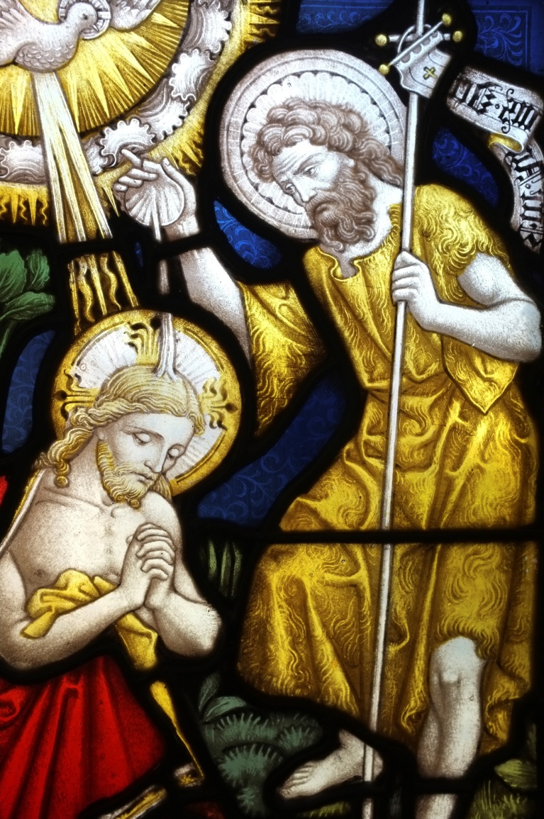
The Mystery of the Trinity
The three Divine Persons are inseparable.
Each is fully God, engaged in the work of our salvation.
They are truly distinct from one another.
The Trinity is revealed by God in Sacred Scripture.
© Alan_Lagadu / iStockphoto.com
Notes:
Read aloud the account of Jesus’ baptism found in Matthew 3:16–17 to illustrate the last bullet point.
This slide corresponds to content in article 2, “God Is Three-In-One: Catholics Are Trinitarian,” in the student book.

Slide 5
God the Father
God the Father is the First Person of the Trinity.
He is the Eternal Source of all that exists.
He loves us, cares for us, provides for us, heals us, and forgives us.
He is just and faithful.
© Dimitris66 / iStockphoto.com
Notes:
Ask what words the students associate with the word father; discuss which of these words they associate with God the Father. Encourage the students to try the three-day challenge described in the Live It! sidebar in article 3 in the student book. The hand of God, a symbol of the Father, is pictured.
This slide corresponds to content in article 3, “The First Person of the Trinity: God the Father,” in the student book.

Slide 6
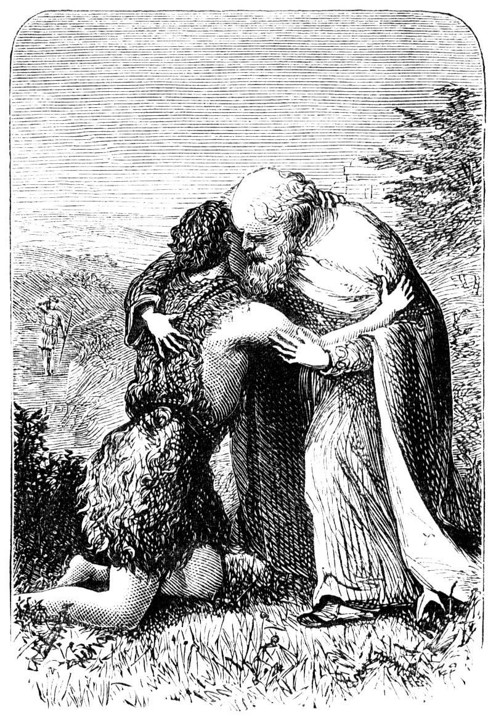
Jesus Reveals the Father
Jesus’ relationship with God is filial—that is, a father-son relationship.
The First Person of the Trinity is the Eternal Father of the Eternal Son.
Jesus’ relationship with God the Father is an intimate one.
© Linda Steward / iStockphoto.com
Notes:
Review the Parable of the Prodigal Son (Luke 15:11–32) to explain Jesus’ teaching about God as Father.
This slide corresponds to content in article 3, “The First Person of the Trinity: God the Father,” in the student book.

Slide 7
God’s Adopted Children
Jesus invites us to call God “Father.”
Jesus invites us to share in his relationship with the Father.
Jesus invites us into the communion of the Holy Trinity, by means of Baptism.
© GlobalStock / iStockphoto.com
Notes:
Direct students to study the photo on this slide. What can this image teach us about the relationship between Jesus and the Father? Discuss what it means to be invited into that relationship.
This slide corresponds to content in article 3, “The First Person of the Trinity: God the Father,” in the student book.

Slide 8
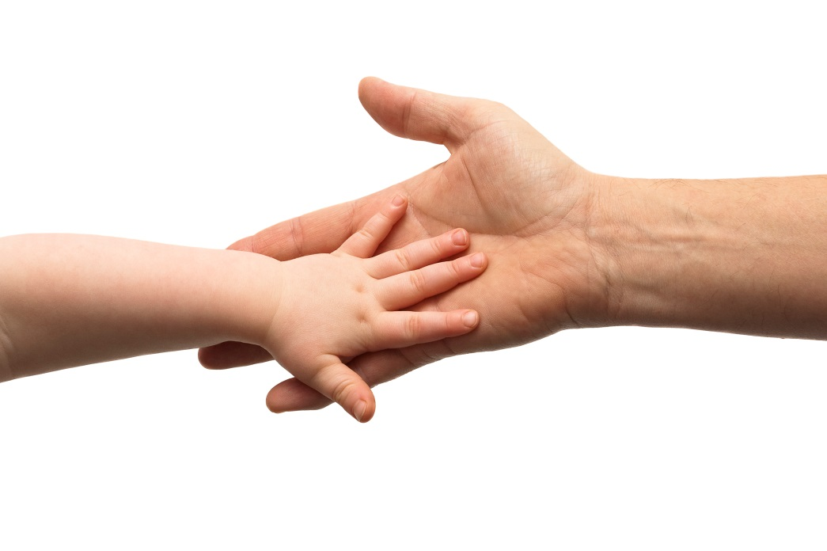
Is God Male?
Judaism and Christianity have always maintained that God has no gender.
Jesus described God as “Spirit.”
God has characteristics that we associate with both fathers and mothers.
© Andrew_Howe / iStockphoto.com
Notes:
Explore characteristics that our culture has traditionally assigned to mothers. If your classroom is multi-cultural, solicit comments from students of various backgrounds. Ask which maternal characteristics describe God.
This slide corresponds to content in article 3, “The First Person of the Trinity: God the Father,” in the student book.

Slide 9
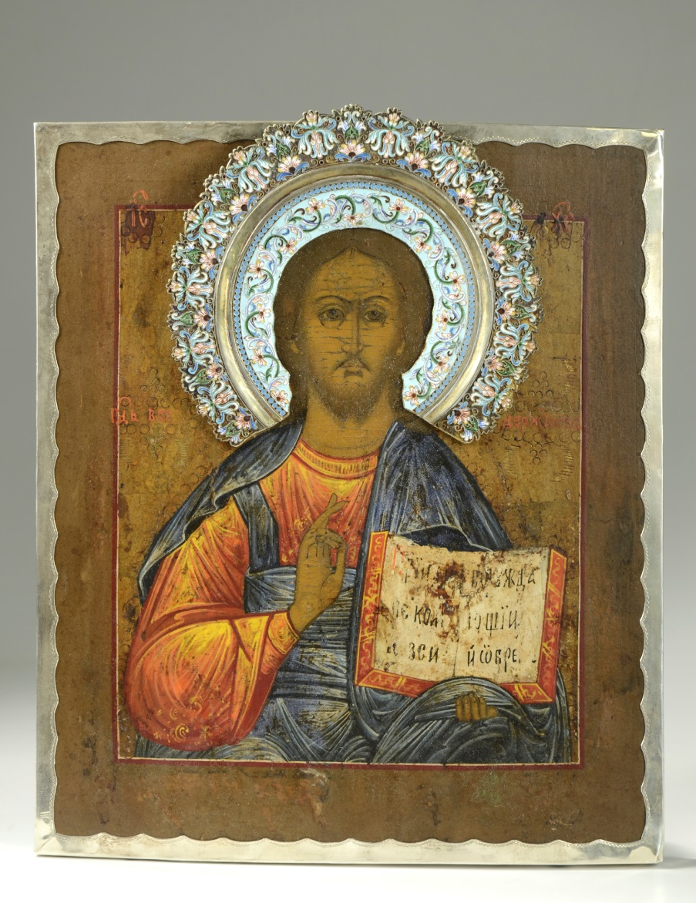
God the Son
The Second Person of the Trinity is God the Son, Jesus Christ.
He is truly God’s own self, made flesh among us.
Jesus is truly and fully man, with a fully human nature.
© PhilipCacka / iStockphoto.com
Notes:
Explain that because Jesus is truly a man, he is able to teach us, through his words and actions, how we are to live as sons and daughters of God. Ask for examples. Point out the tripartite halo in the image, which reminds us of Jesus’ divinity.
This slide corresponds to content in article 4, “The Second Person of the Trinity: God the Son,” in the student book.

Slide 10
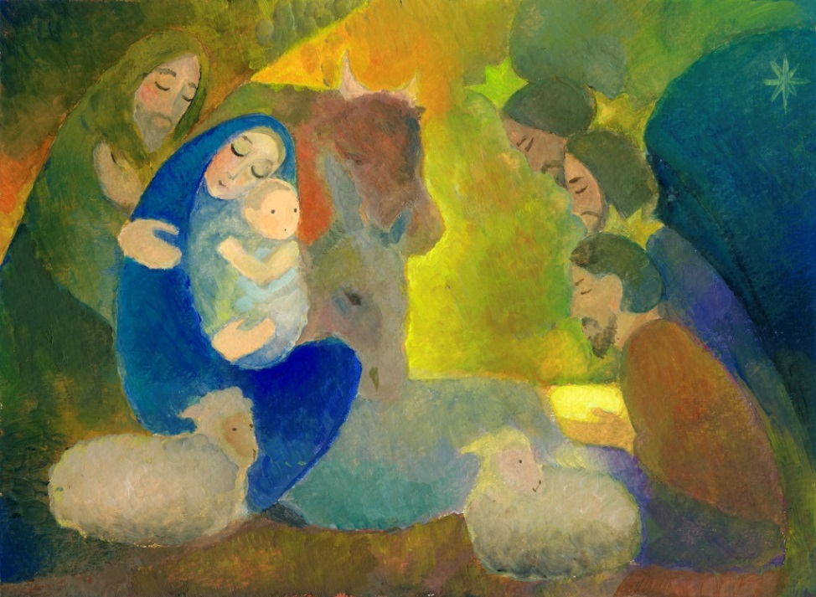
Why Did God Become Incarnate?
to save us by reconciling us to himself
to share divine love with us
to show us how to be holy
to enable us to share in God’s divine nature
© peter zelei / iStockphoto.com
Notes:
Ask for volunteers to explain how Jesus accomplished each point.
This slide corresponds to content in article 4, “The Second Person of the Trinity: God the Son,” in the student book.

Slide 11
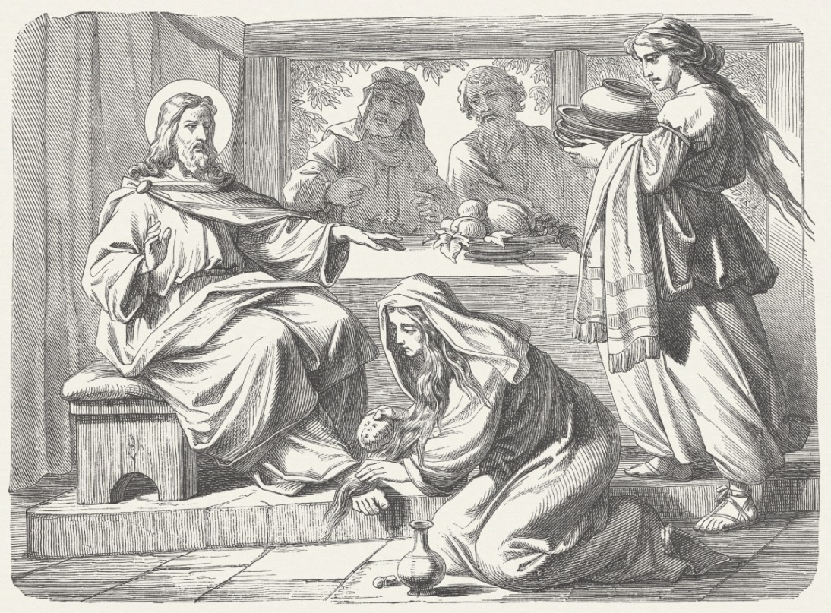
Christ: The Anointed One
Christ is a title given to Jesus.
Christos means “anointed one” in Greek.
Messiah is the Hebrew term for “anointed one.”
Anointing with oil symbolized being chosen by God for a special mission.
© ZU_09 / iStockphoto.com
Notes:
Remind students of the Jewish hope for a Messiah described in the Old Testament. Read the prophecy Jesus applied to himself, found in Luke 4:16–20.
This slide corresponds to content in article 4, “The Second Person of the Trinity: God the Son,” in the student book.

Slide 12
God the Holy Spirit
The Third Person of the Trinity is the Holy Spirit.
The Son and the Holy Spirit share a joint mission.
Together they bring us into the Body of Christ as God’s adopted sons and daughters.
© avdeev007 / iStockphoto.com
Notes:
Explain that the Holy Spirit was not fully revealed until after Jesus’ Resurrection, but that Scripture tells us the Spirit of God was present at Creation and was active through kings and prophets.
This slide corresponds to content in article 5, “The Third Person of the Trinity: God the Holy Spirit,” in the student book.

Slide 13
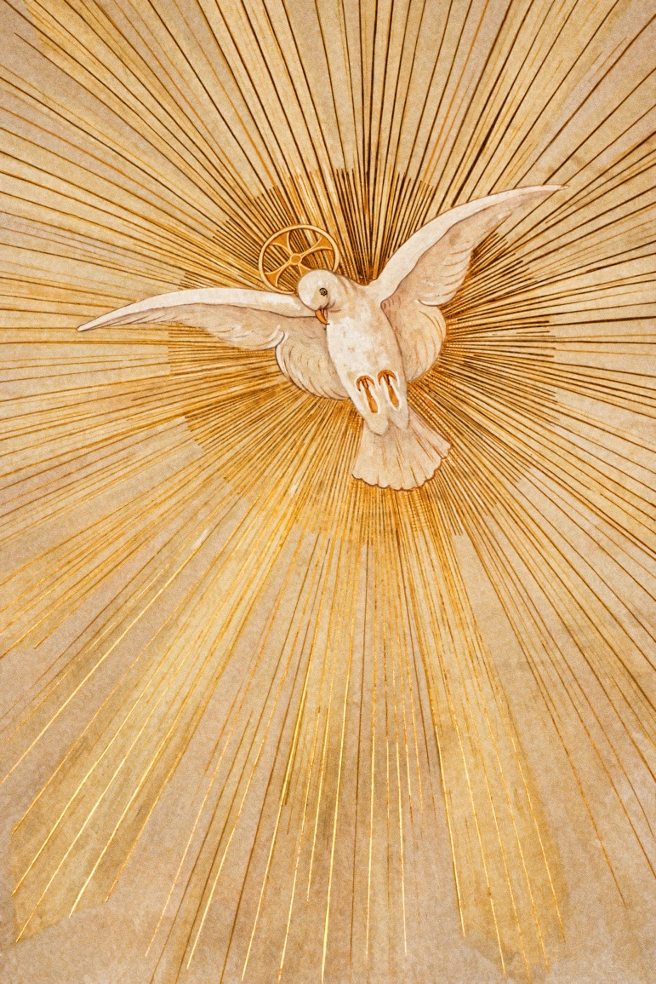
An Advocate
Jesus promised the disciples an advocate who would teach them all they need to know.
At Pentecost Jesus sent the Holy Spirit to be with his disciples forever.
Paraclete, meaning “advocate,” is another name for the Holy Spirit.
© dndavis / iStockphoto.com
Notes:
Explain that the Holy Spirit is an advocate, supporting, strengthening, and empowering us for holiness.
This slide corresponds to content in article 5, “The Third Person of the Trinity: God the Holy Spirit,” in the student book.

Slide 14
The Gifts of the Spirit
With the Spirit’s help, the mission of Jesus becomes the mission of the Church.
The Holy Spirit sanctifies us by offering seven gifts to help us.
These gifts empower us to be true followers of Christ.
© deliormanli / iStockphoto.com
Notes:
Direct students to read the chart “The Gifts of the Holy Spirit” in article 5 in the student book. Ask for volunteers to describe a situation in which one of the gifts would help us follow Christ.
This slide corresponds to content in article 5, “The Third Person of the Trinity: God the Holy Spirit,” in the student book

