Slide 1
The Magisterium: The Teaching Office of the Church
The Church
Unit 3, Chapter 9
Document #: TX005559
© 2016 Saint Mary’s Press
Living in Christ Series

Slide 2

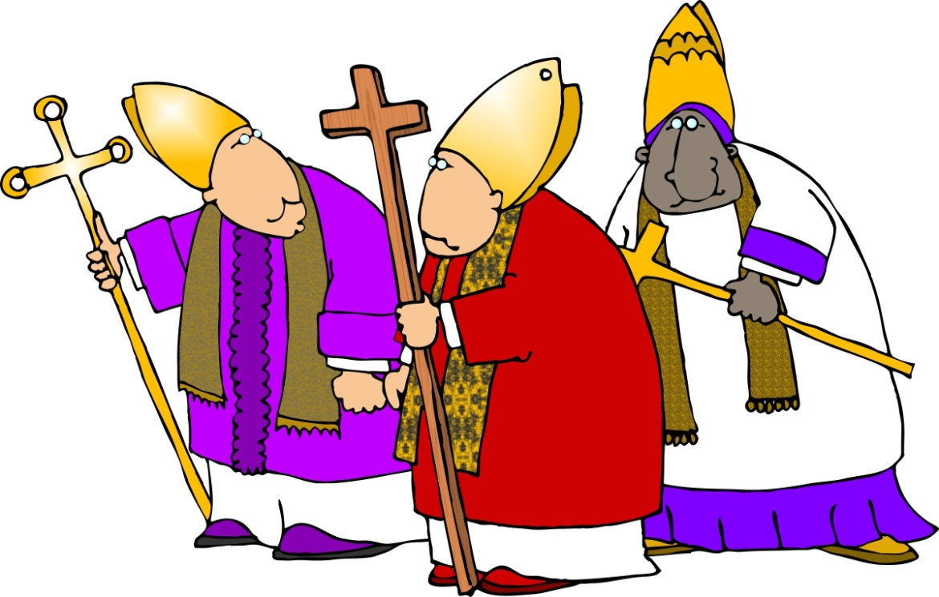
What Is the Magisterium?
The Magisterium is the name given to the official teaching authority of the Church.
The Magisterium interprets the Word of God in Scripture and Tradition.
The bishops in communion with the Pope form this body.
© 2016 Saint Mary’s Press
Living in Christ Series
© Dennis Cox / Shutterstock.com
Notes:
Notes: Point out that the Pope and the bishops have the responsibility of passing on the faith handed on by the Apostles. Explain that they preserve and promote the heritage of faith, but they don’t change it.

Slide 3
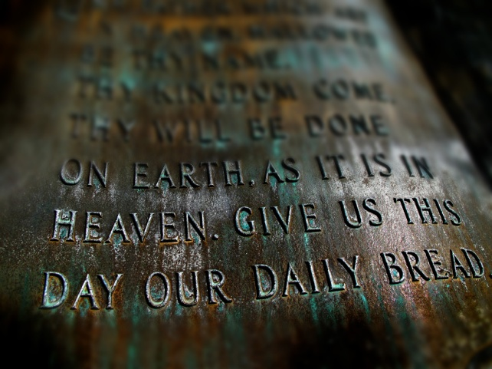
What Does the Magisterium Teach?
The Catechism is a synthesis of the basic contents of Catholic doctrine:
the Nicene Creed
the Sacraments
the Ten Commandments
the Lord’s Prayer
© Lane V. Erickson / Shutterstock.com
© 2016 Saint Mary’s Press
Living in Christ Series
Notes:
Notes: Ask the first of the two questions that conclude article 38 of the student book, “What is one question you have about a mystery of faith or a Church teaching?” If the students have laptops, direct them to perform a search to see if the Catechism covers the topics named, or use the index of the Catechism.

Slide 4

Growth in Understanding Our Faith
theological inquiry
contemplation and study
the teaching of bishops
© 2016 Saint Mary’s Press
Living in Christ Series
© Naypong / Shutterstock.com
Notes:
Notes: Explain that all of these are ways that we can find answers to our questions about our faith. Ask, “How can studying Catholicism help Catholics to deepen their faith?”

Slide 5
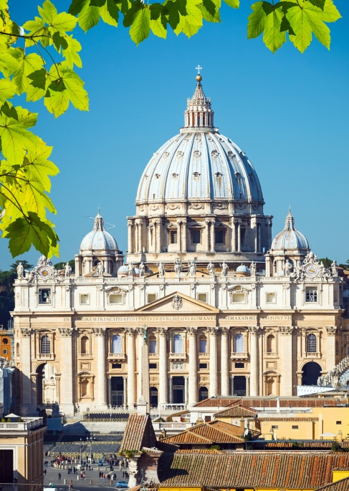
Indefectibility and Infallibility
The Church is incorruptible and without error.
The Church as a whole possesses these charisms . . .
even though individual members have faults and make mistakes.
© S.Borisov / Shutterstock.com
© 2016 Saint Mary’s Press
Living in Christ Series
Notes:
Notes: Remind the students of the spiritual identity of the Church as the Body of Christ. Point out that both of these characteristics (i.e., indefectibility and infallibility) are gifts to the Church from the Holy Spirit.

Slide 6
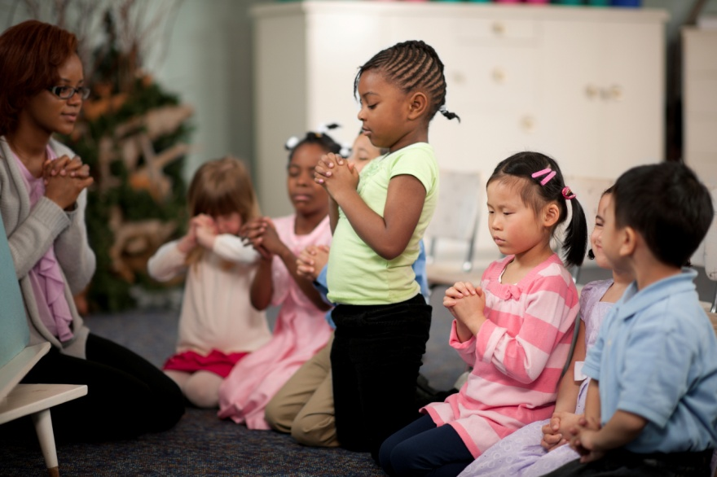
Indefectibility
The Church will remain faithful to Christ’s teachings to the end of time.
Jesus promised evil would not overpower the Church.
His promise ensures that all people can achieve salvation.
© Christopher Futcher / iStock
© 2016 Saint Mary’s Press
Living in Christ Series
Notes:
Notes: Ask why it would be important for the Church to continue on, faithful to Christ, until the end of human history.

Slide 7
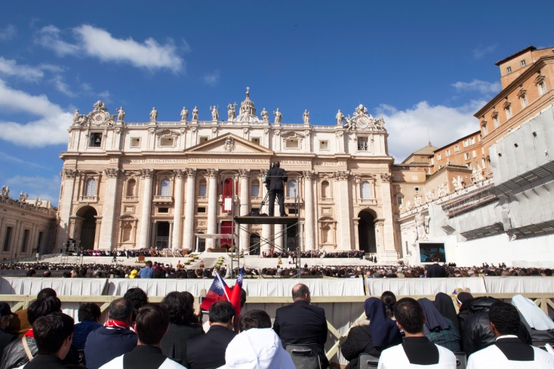
Infallibility
The Church is without error in her teachings.
Infallibility is the Holy Spirit’s gift to the Church.
Our leaders are protected from fundamental errors about faith and morals.
© eZeePics / Shutterstock.com
© 2016 Saint Mary’s Press
Living in Christ Series
Notes:
Notes: Explain that papal infallibility is often misunderstood as applying to all that the Pope teaches. Ask which papal statements are infallible. (See article 40 of the student book.)

Slide 8
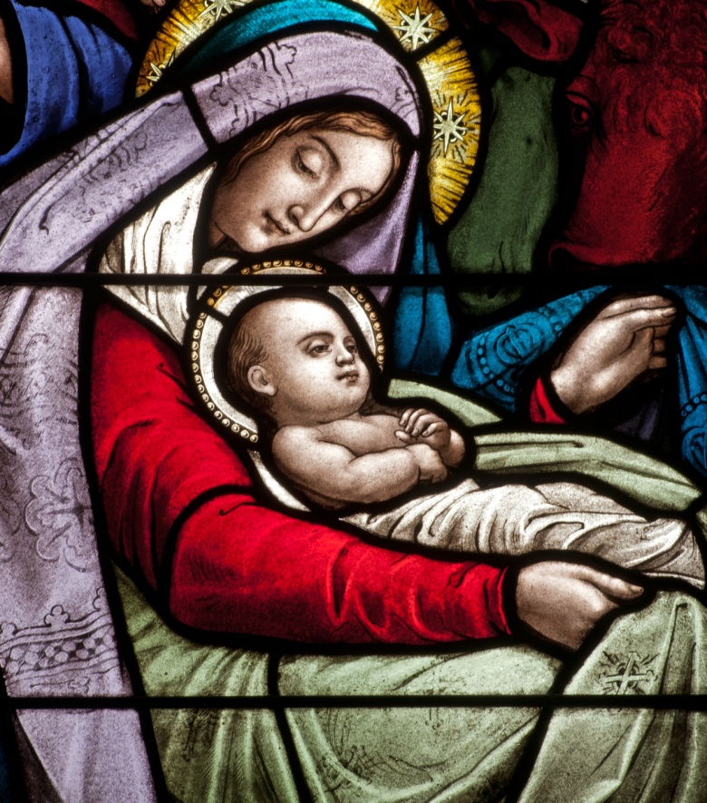
The Hierarchy of Truths
Some truths are more fundamental, and these illuminate other truths.
All Church teachings are interconnected.
Dogmas are those doctrines that are central to Church teaching.
© Nancy Bauer / Shutterstock.com
© 2016 Saint Mary’s Press
Living in Christ Series
Notes:
Notes: Explain that dogmas express the truths we need for our salvation. Invite the students to suggest “dogmas” that underlie other truths in fields of study such as math or science. (For example, we need to know that some information we find online is incorrect. If we don’t accept this “dogma,” we will be wrong about many other things.)

Slide 9

Changing Guidelines for Changing Circumstances
The Church does not change the heritage of faith in Scripture and Tradition.
However, practices and guidelines may change over time.
© squarelogo / Shutterstock.com
© 2016 Saint Mary’s Press
Living in Christ Series
Notes:
Notes: Direct the students to read the sidebar in article 41 of the student book, “Making Friday Special Again.” Discuss the reasons for the change in fasting guidelines and what penitential practices might be meaningful for people today in light of the goal of inner conversion.

Slide 10

Truth and Relativism
We can be tempted to look at a Church teaching as one viewpoint among many.
We can come to believe that truth depends on a person’s opinion or viewpoint.
We believe that God is Truth itself, so God cannot deceive us.
© Aksenova Tatiana / Shutterstock.com
© 2016 Saint Mary’s Press
Living in Christ Series
Notes:
Notes: Read aloud and discuss the suggestion that concludes article 41 of the student book, “Spend some time thinking about how you can differentiate between respecting and accepting people with contradictory beliefs and accepting the contradictory beliefs themselves.”

