Slide 1
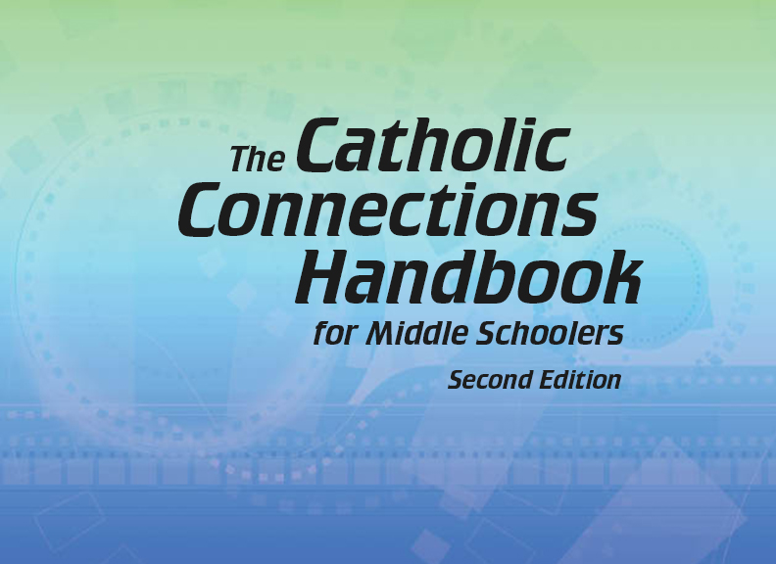


Slide 2

The Old Testament
and the Trinity
Chapter 2
The Bible: God’s Plan
for Salvation
© Merydolla/www.shutterstock.com

Slide 3
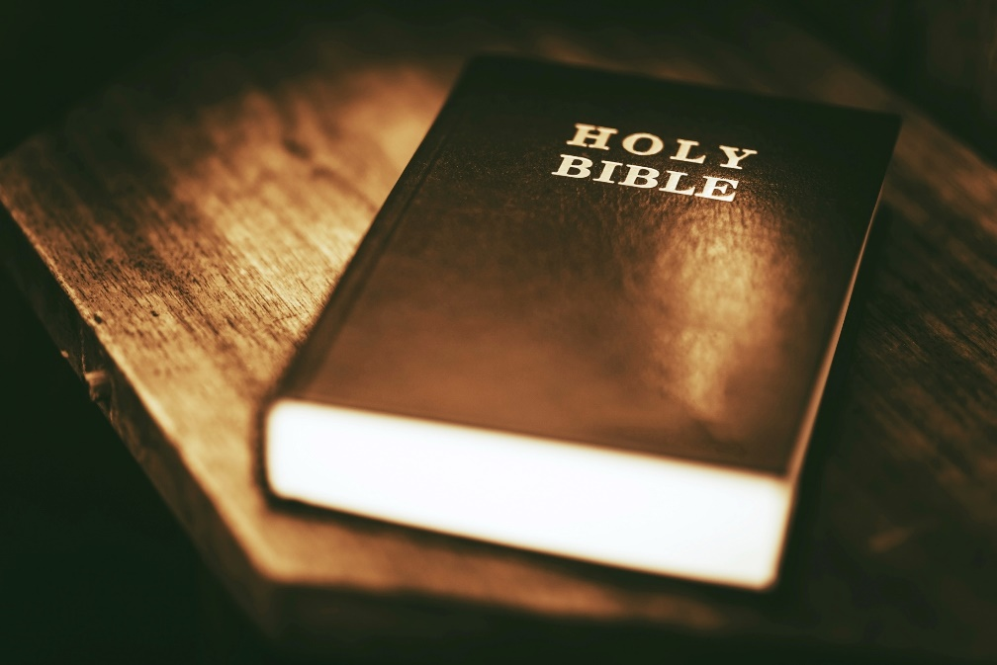
Chapter Summary
The Bible: God’s Plan for Salvation
From the beginning of Creation, God has had a plan of salvation for the whole human family. This plan can be found throughout Sacred Scripture. The Handbook divides salvation history into eight stages, beginning with the Creation of all that exists and culminating with the founding of the Christian Church. Each of us have a role to play as a member of Christ’s Church in sharing the good news of salvation in Christ Jesus.
© welcomia/www.shutterstock.com

Slide 4
Introduction, “Stage 1: Primeval History,” and “Stage 2: The Patriarchs”
(Handbook, pages 24–27)
In the first stage of salvation history, human sin disrupts the loving and full relationships God intended.
In the second stage, God begins the process of repairing the damaged relationship with him caused by sin.
Humans
Humans
God
God
Before sin
After sin

Slide 5
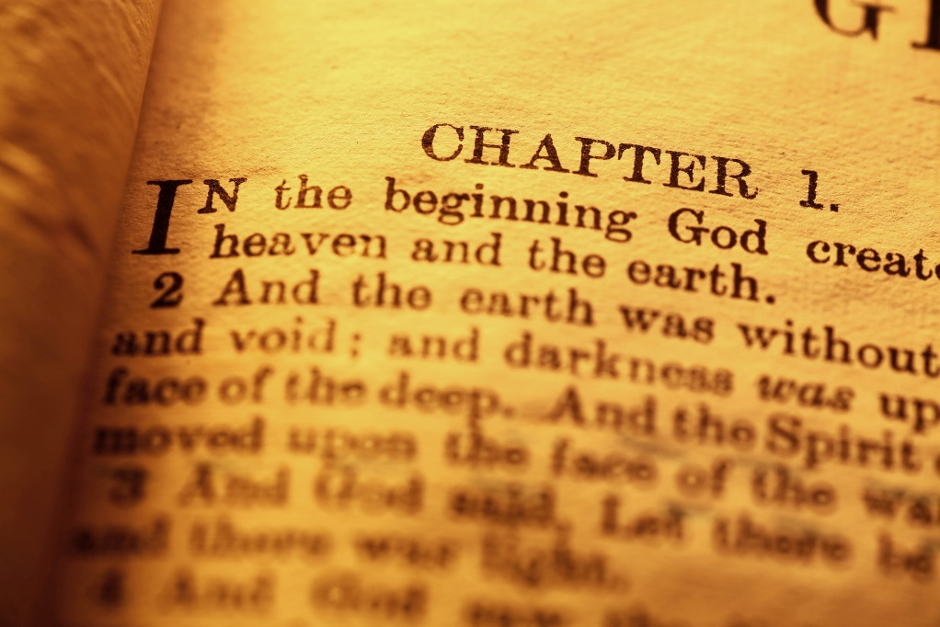
Introduction, “Stage 1: Primeval History,” and “Stage 2: The Patriarchs”
(Handbook, pages 24–27)
The first stage of salvation history is primeval history (or prehistory), which teaches basic truths:
  About the world and all that is in it
  About human beings and their relationship with God
  About the tragedy of sin in the world
© JanakaDharmasena/www.shutterstock.com

Slide 6
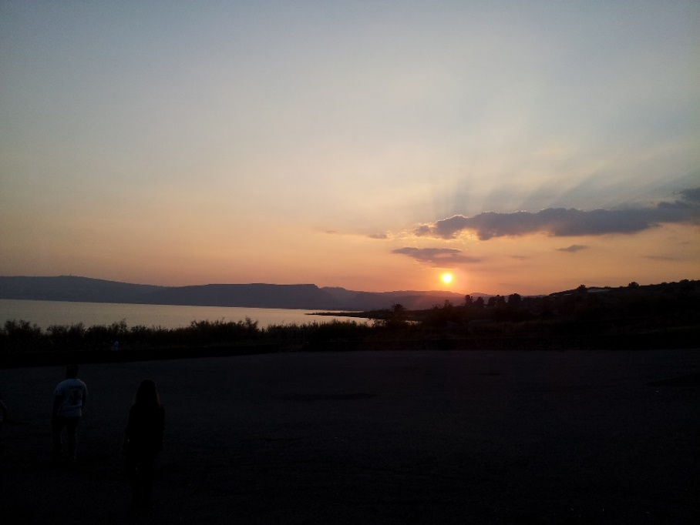
Introduction, “Stage 1: Primeval History,” and “Stage 2: The Patriarchs”
(Handbook, pages 24–27)
Primeval history teaches the following:
  God created all that exists, and it is good.
  All of God’s creatures are created to live in peace and harmony.
  Without help, sin leads to death:
    Destroys our relationship with God
    Destroys our relationships with one another
    Destroys our relationships with all of creation
© janiemaki/SaintMary’sPress
“God looked at everything he had made, and he was very pleased.” (Genesis 1:31)

Slide 7
Introduction, “Stage 1: Primeval History,” and “Stage 2: The Patriarchs”
(Handbook, pages 24–27)
The second stage of salvation history is the patriarchs. In this stage, God forms a covenant with his Chosen People, Israel, and begins the process of repairing our damaged relationship with God.
© MikeElliott/www.shutterstock.com

Slide 8
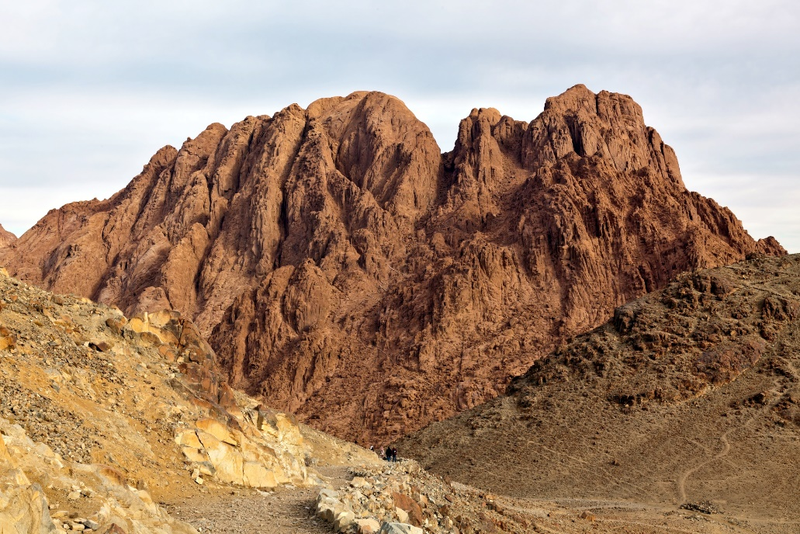
“Stage 3: Egypt and the Exodus” and
“Stage 4: The Promised Land and the Judges”
(Handbook, pages 28–29)
The call of Moses and the Exodus from Egypt continue God’s saving plan in the third stage of salvation history and lead into the fourth stage, where the Israelites enter into the Promised Land.
© IGORROGOZHNIKOV/www.shutterstock.com

Slide 9
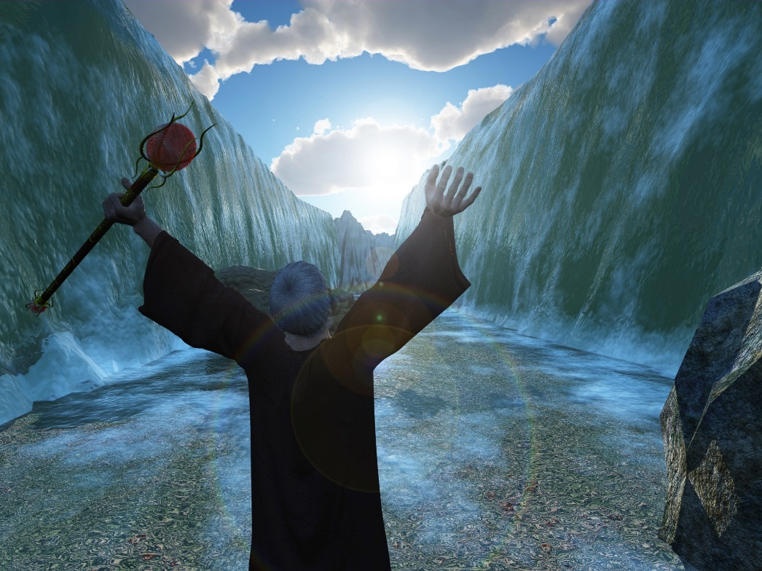
“Stage 3: Egypt and the Exodus” and
“Stage 4: The Promised Land and the Judges”
(Handbook, pages 28–29)
God heard the cry of his children in Egypt and called Moses to lead them out of slavery and into the desert.
© MikeH/www.shutterstock.com

Slide 10
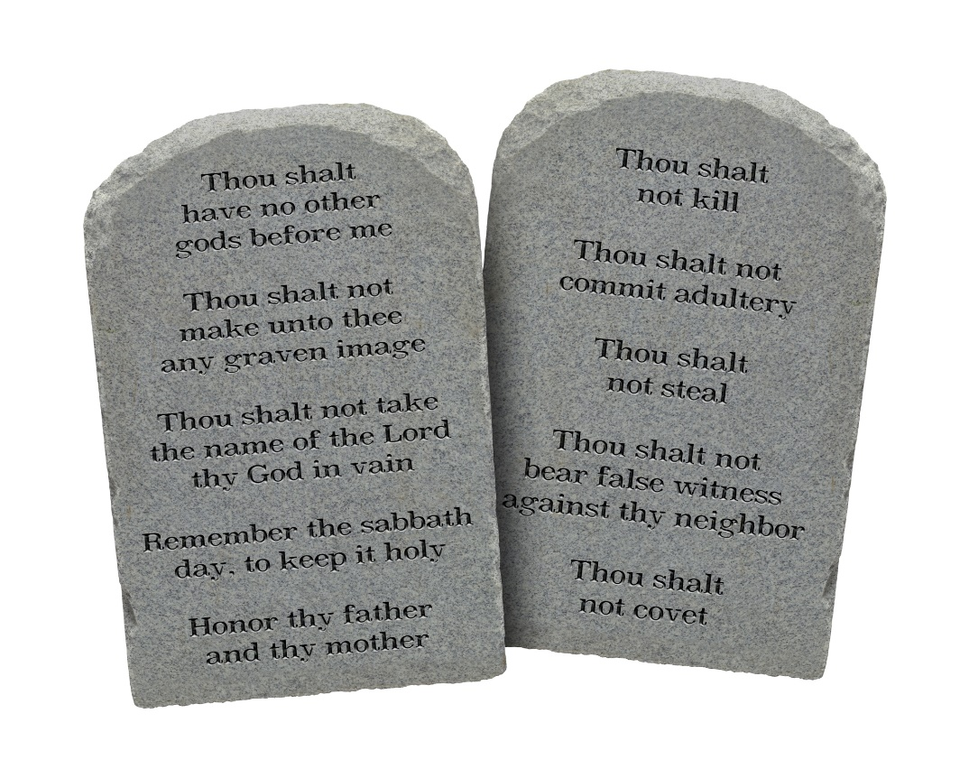
“Stage 3: Egypt and the Exodus” and
“Stage 4: The Promised Land and the Judges”
(Handbook, pages 28–29)
While wandering in the desert, God gave Moses and the people the Commandments of the covenant.
The Commandments taught these once enslaved people how to live out their new-found freedom with responsibility and love.
© MegaPixel/www.shutterstock.com

Slide 11

“Stage 3: Egypt and the Exodus” and
“Stage 4: The Promised Land and the Judges”
(Handbook, pages 28–29)
The Israelites reached the Promised Land, were led into it by Joshua, and fought to gain control of the land.
Once they were settled in the Promised Land, God called special prophets and warriors, called Judges, to help:
  Delivering justice
  Defending the land against invaders
© juuce/www.istockphoto.com

Slide 12

“Stage 5: The Kings and the Prophets” and “Stage 6: The Exile and the Return”
(Handbook, pages 30–32)
The fifth stage of salvation history is the formation of the kingdoms of Judah and Israel. But as a result of their broken covenant with God, the kingdoms fall, leading to the sixth stage, where the Israelites are taken to and return from the Exile in Babylon.
© ImPerfectLazybones/www.shutterstock.com

Slide 13
“Stage 5: The Kings and the Prophets” and “Stage 6: The Exile and the Return”
(Handbook, pages 30–32)
In First Samuel, God grants the Israelites’ request for a king, and it begins the monarchy in Israel.
The first king was Saul, followed by David, who is considered the greatest king, then Solomon, who built the great Temple in Jerusalem.
Saul
First king
David
Greatest king
Solomon
Built Temple

Slide 14
“Stage 5: The Kings and the Prophets” and “Stage 6: The Exile and the Return”
(Handbook, pages 30–32)
After Solomon’s death, Israel divided between the kingdom of Israel in the north and the kingdom of Judah in the south.
Prophets arose, warning of coming catastrophe if the Israelites did not repent and return to covenant fidelity.
Kingdom of Israel
Kingdom of Judah
Israel

Slide 15
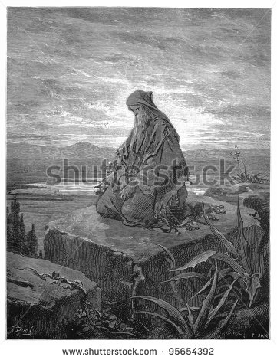
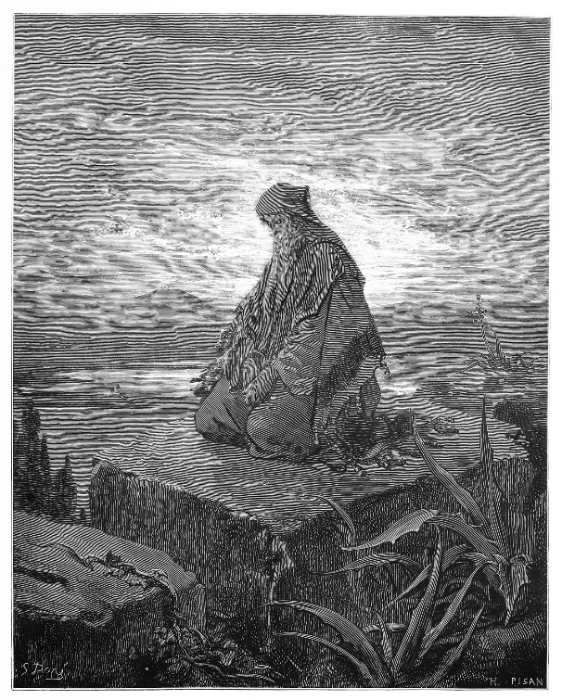
“Stage 5: The Kings and the Prophets” and “Stage 6: The Exile and the Return”
(Handbook, pages 30–32)
Despite the warnings, Israel and Judah turned away from God and were conquered.
  First Israel was conquered by the Assyrians in 721 BC.
  Then Judah was conquered by the Babylonians in 587 BC.
  Prophets began to speak of a future redeemer who might rise up and make them great again.
© Nicku/www.shutterstock.com

Slide 16
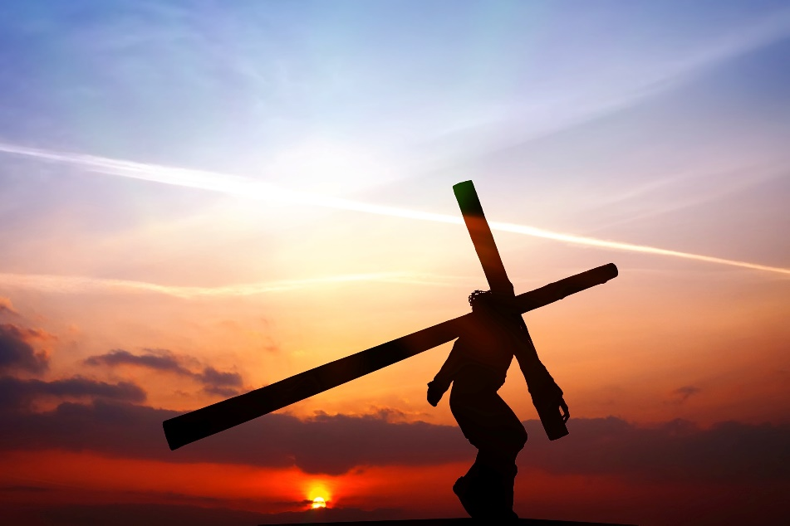
“Stage 7: The Life of Jesus Christ” and “Stage 8: The Church”
(Handbook, pages 33–34)
The seventh and eighth stages of salvation history introduce Jesus Christ, God’s own Son, as the culminating act of God to redeem humanity, and the establishment of the Church, which preaches the good news of salvation in Christ until his return.
© WDGphoto/www.shutterstock.com

Slide 17
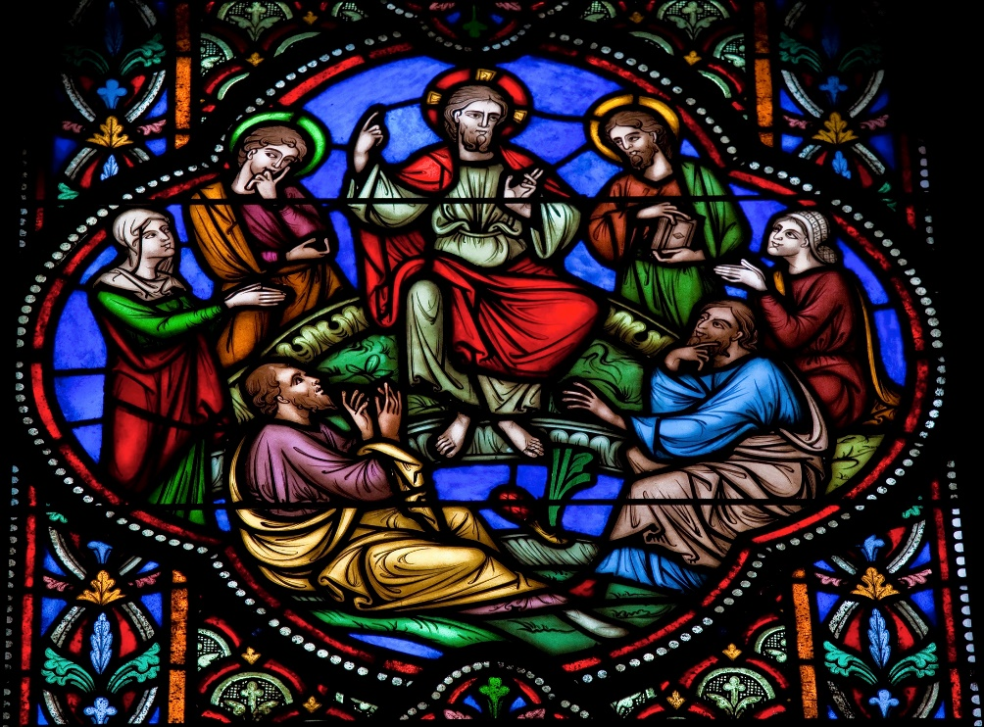
“Stage 7: The Life of Jesus Christ” and “Stage 8: The Church”
(Handbook, pages 33–34)
When the time was right, God sent his only Son, Jesus, to fulfill what he had promised to his Chosen People, Israel.
Jesus was not the warrior and king many expected but instead preached love, justice, and forgiveness.
© VaclavMach/www.shutterstock.com

Slide 18
“Stage 7: The Life of Jesus Christ” and “Stage 8: The Church”
(Handbook, pages 33–34)
Three days following Jesus’ death, God raised Jesus from the dead, and his followers understood that he was in fact the promised Messiah, the Savior.
Jesus instructed his Apostles to spread the good news of salvation to all people, and sent his Holy Spirit to empower them to continue his mission.
The Church continues this mission from Jesus by the power of the Holy Spirit.

Slide 19
Let’s Review!
Unscramble the following events and put them in chronological order:
Moses is given the Ten Commandments.
God forms a covenant with the Israelites in order to begin restoring their broken relationship.
Judges rise up to rule the Israelites.
Israel divides into the kingdoms of Israel and Judah.
God creates human beings and establishes a relationship with them.
God allows kings to lead the Israelite people.
Prophets bring warnings as well as messages of hope.
Adam and Eve sin, thus breaking their relationship with God.
Jesus Christ comes to redeem humanity and begin the Church.

Slide 20
How Did You Do?
Here is the correct order of events:
God creates human beings and establishes a relationship with them.
Adam and Eve sin, thus breaking their relationship with God.
God forms a covenant with the Israelites in order to begin restoring their broken relationship.
Moses is given the Ten Commandments.
Judges rise up to rule the Israelites.
God allows kings to lead the Israelite people.
Israel divides into the kingdoms of Israel and Judah.
Prophets bring warnings as well as messages of hope.
Jesus Christ comes to redeem humanity and begin the Church.

Slide 21
Acknowledgments
The scriptural references and quotations in this presentation are from the Good News Translation® (Today’s English Version, Second Edition). Copyright © 1992 by the American Bible Society. All rights reserved. Bible text from the Good News Translation (GNT) is not to be reproduced in copies or otherwise by any means except as permitted in writing by the American Bible Society, 1865 Broadway, New York, NY 10023 (www.americanbible.org).
During this presentation’s preparation, all citations, facts, figures, names, addresses, telephone numbers, Internet URLs, and other pieces of information cited within were verified for accuracy. The authors and Saint Mary’s Press staff have made every attempt to reference current and valid sources, but we cannot guarantee the content of any source, and we are not responsible for any changes that may have occurred since our verification. If you find an error in, or have a question or concern about, any of the information or sources listed within, please contact Saint Mary’s Press.

