Slide 1
The Format of a First-
Century Letter
The New Testament
Document #: TX002299
Notes:
Notes: Most letters written in the first century follow a standard format. The letters written by Paul (1 Thessalonians, 1 Corinthians, Philippians, Philemon, 2 Corinthians, Galatians, and Romans) and other disciples follow the same format.

Slide 2
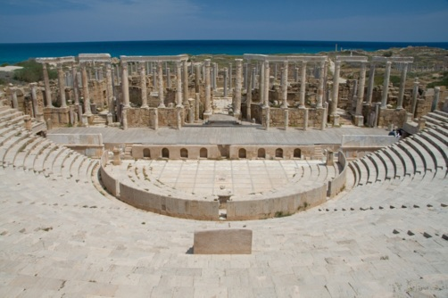
Beginning
sender: from whom
recipient: to whom
formal greeting
thanksgiving (or blessing)
Image from Public Domain - Luca Galuzzi - www.galuzzi.it
Notes:
Notes: In most letters, Paul indicates a coauthor. Generally, there is not only one recipient of the letter; rather, the letter is directed to communities of Christian believers. Paul’s formal greeting includes some combination of the usual Greek greeting of chaire, or “grace,” and the Jewish greeting of shalom, or “peace.” The traditional formulaic greeting is expanded by Paul to include “from God our Father and the Lord Jesus Christ” or other similar reference.
Pause at this point and direct the students to open their Bibles and read Philippians 1:1–11. Ask the students to identify the various subsections of the beginning of this letter from Paul.
• sender: Paul and Timothy
• recipient: “all the holy ones in Christ Jesus who are in Philippi, with the overseers and ministers”
• formal greeting: “grace to you and peace from God our Father and the Lord Jesus Christ”
• thanksgiving: “I give thanks to my God at every remembrance of you . . . because of your partnership for the gospel from the first day until now”

Slide 3
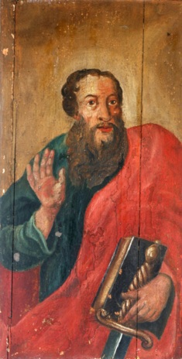
Body
initial exhortation
thesis statement
theological discussion
ethical admonition
© Zvonimir Atletic/shutterstock.com
Notes:
Notes: Sometimes the theological discussion and ethical admonition are intertwined and not easily identified as separate parts in the letter.
Again pause and direct the students to turn to a partner and read Philippians 1:12—4:9. In their pairs, have the students identify the subsections of the body of Paul’s letter. Then invite the students to share their responses with the class.
• initial exhortation: “conduct yourselves in a way worthy of the gospel of Christ” (1:27)
• thesis statement: “complete my joy by being of the same mind, with the same love, united in heart, thinking one thing” (2:2)
• theological discussion: “Have among yourselves the same attitude that is also yours in Christ Jesus, / Who, though he was in the form of God, / did not regard equality with God something to be grasped. / Rather, he emptied himself, / taking the form of a slave, / coming in human likeness; / and found human in appearance, / he humbled himself, / becoming obedient to death, even death on a cross.” (2:5–8)
• ethical admonition: “I urge Euodia and I urge Syntyche to come to a mutual understanding in the Lord. . . . Rejoice in the Lord always. I shall say it again: rejoice!” (4:2,4)

Slide 4

Conclusion
practical matters
individual greetings
personal postscript
Doxology or prayer
© Mircea Maties/shutterstock.com
Notes:
Notes: Not every letter of Paul includes a personal postscript.
Pause again and direct the students to read Philippians 4:10–23. Have them identify the subsections of the conclusion of Paul’s letter.
• practical matters: “I am very well supplied because of what I received from you through Epaphroditus” (4:18).
• individual greetings: “Give my greetings to every holy one in Christ Jesus. The brothers who are with me send you their greetings; all the holy ones send you their greetings, especially those of Caesar’s household” (4:21–22).
• personal postscript: None
• Doxology or prayer: “The grace of the Lord Jesus Christ be with your spirit” (4:23).

