Slide 1
Care for the Earth
Catholic Social Teaching
Document #: TX002031
Notes:
[Music: Introduction music such as “Peace Is Flowing like a River”]

Slide 2
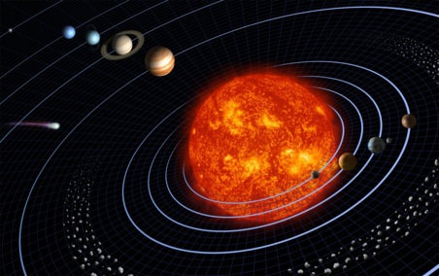
God created the world.
He intended that all its creatures—including human beings—be connected in a harmonious web of life.
He made human beings the caretakers and stewards of creation.
He created the world as a sign of his love and power.

Slide 3

Goods of Creation
The goods of creation . . .
belong to humanity as a whole
are endangered by environmental exploitation and economic decisions
“Every economic decision has a moral consequence” (Pope Benedict XVI).

Slide 4
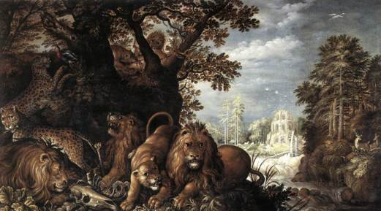
Examining Our Relationship with Creation
How do you relate to the natural world?
How is your daily life shaped by the natural world?
What warning signs or dangers to God’s Creation do you see?

Slide 5
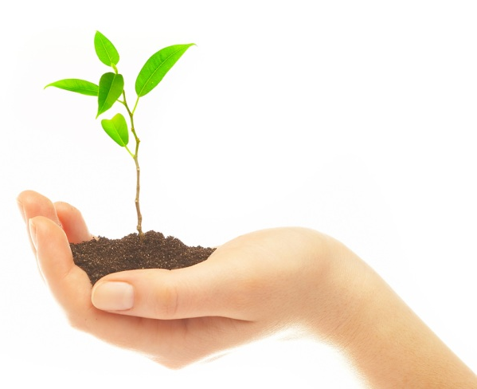
The Interdependence of Creation
Human beings play a unique role in creation.
Interdependent relationships between human beings and the natural world make up the larger community of life.
Image in shutterstock

Slide 6
The Integrity of Creation
Sustaining the integrity of creation is necessary for the earth to thrive as God intends.
Plants require the proper mix of water, sunshine, soil conditions, nutrients, and atmospheric gases in order to grow.
Plants in turn provide living creatures with food and oxygen.
Image in shutterstock
Plants support all other life on the planet, and all other life supports plant life.
Plants need insects and other animals to aerate the soil, aid pollination, and disseminate seeds.

Slide 7
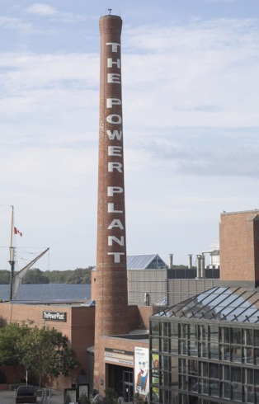
Threats to the Integrity of Creation
rapid increase in the human population
environmental pollution
household, institutional, and municipal waste production
water shortages
destruction and collapse of natural ecosystems
catastrophic natural disasters
modern technical and scientific developments
overconsumption of natural resources
Discussion
What daily choices do we make that have an impact on the integrity of creation?

Slide 8
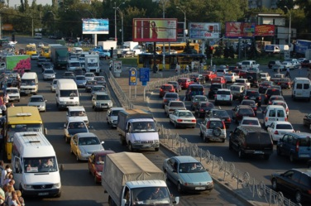
Pollution
From 1987 to 2001, air pollution decreased by 25 percent.
Manufacturing contributes to less than 25 percent of air pollution.
CO₂ emissions from manufacturing declined by 66 percent between 1972 and 2001.
By Shyaulis Andrjus [GFDL (www.gnu.org/copyleft/fdl.html) or CC-BY-3.0 (www.creativecommons.org/licenses/by/3.0)], via Wikimedia Commons
Carbon footprint is a term describing the amount of greenhouse gas emissions produced by an individual, household, or institution.
The Environmental Protection Agency is just one of many agencies that works to protect the environment from pollution.

Slide 9
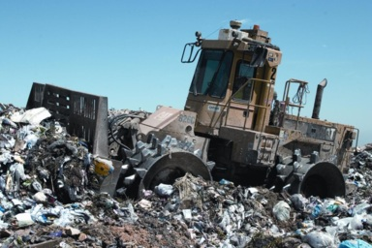
Household, Institutional, and Municipal Waste Production
Waste is a continuous problem.
The amount of solid waste continues to grow through normal human activities.
Mismanagement of municipal waste is a public health hazard.
Waste minimization needs to be a priority, because this in turn leads to reductions in pollution.
Household recycling is an example of ways in which we voluntarily contribute to the common good.

Slide 10
Warning Signs of Damage to the Integrity of Creation
Vanishing species The eradication of insect, plant, and animal species is rapidly accelerating.
Destruction of the rain forest This destruction threatens the delicate balance that sustains life on earth.
Discussion
What factors are contributing to species eradication?
What factors are contributing to the current destruction of the rain forests?

Slide 11
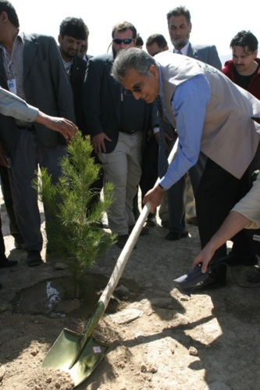
Creation Is Sacred
What does God call us to do?
How does God view creation?
Discussion
What does it mean for humans to protect the integrity of creation?

Slide 12
The Call to Be Stewards
The human race is called to safeguard the integrity of creation.
Human beings are stewards made in the image of God.
Foundations for stewardship are found in the Creation accounts in Genesis.

Slide 13
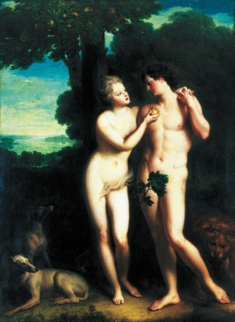
What Do the Creation Accounts Teach Us about Stewardship?
Creation is good because it flows from God’s goodness.
God gives humans dominion over the mineral, vegetable, and animal resources of creation.
God provides for the good of all creation.
Human sin results in suffering, even for the earth.
WikiMediaCommons
Discussion
What can we learn from reflecting on the Creation accounts in Genesis?

Slide 14
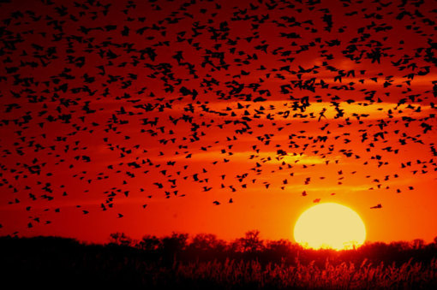
Keys to Understanding the Call to Stewardship
Stewardship respects the sacramental universe.
Stewardship respects God’s gifts for the common good.
Stewardship cares for creation.

Slide 15
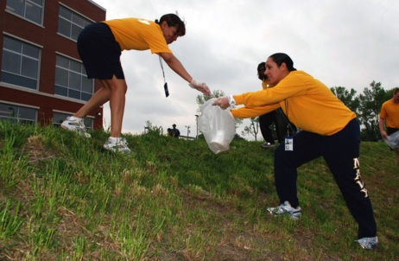
Stewardship: Respect for the Sacramental Universe
Respect for the sacramental universe includes respect for . . .
the dignity of human beings
the basic goodness of all of creation
the presence of God in visible and tangible ways
creation and God’s presence in it

Slide 16
Stewardship:
God’s Gift for the
Common Good
God intended for humans to benefit.
God intended for humans to use the goods of the earth.
Stewardship safeguards natural resources for the benefit of all people, including those who are poor and also future generations.

Slide 17
Stewardship: Caring for Creation
We have these rights and responsibilities:
right to use natural resources for the good
responsibility to ensure the well-being of the
natural world
respect for our role in creation
Image in shutterstock
responsibility to engage in economic practices that use natural resources to preserve the earth now and in the future

Slide 18
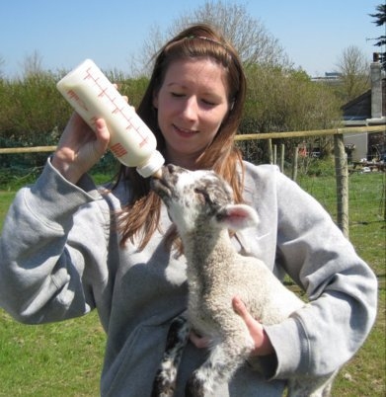
Stewardship means . . .
respecting the integrity of creation
practicing sustainable economics by considering the long-term consequences
practicing environmental accounting, in which we consider the value of the environment when making economic decisions
By Flipflop2011 (Own work) [CC-BY-SA-3.0 (www.creativecommons.org/licenses/by-sa/3.0)], via Wikimedia Commons

Slide 19
Environmental Accounting or Green Accounting
Environmental accounting means . . .
considering the hidden economic value of the natural world
paying attention to the value of life
respecting natural resources as a gift from God

Slide 20
Society’s Role in Stewardship
Society’s role in stewardship includes . . .
sustainable development of natural resources for the future
collaboration between business and government to promote the common good and protect the environment

Slide 21

Living as a Steward of the Earth
To be good stewards of the earth, we can . . .
reduce our consumption of natural resources
recycle, promote recycling, and buy recycled products
share with others
advocate for sound environmental policies
evaluate energy use in home, school, or church
stop polluting
Discussion
What can you start doing today to be a better steward of creation?

Slide 22
Works Cited
Balan, Carmen. 2010. “Carbon-Footprint Policy of the Top Ten Global Retailers: Contribution to Sustainable Development.” Amfiteatru Economic 12, no. 27:52–65.
Blanche, K. Rosalind, John A. Ludwig, and Saul A. Cunningham. 2006. “Proximity to rainforest enhances pollination and fruit set in orchards.” Journal of Applied Ecology 43, no. 6:1182–1187. Academic Search Premier, EBSCOhost (accessed March 30, 2011).
Brekke, Kjell Arne, Gorm Kipperberg, and Karine Nyborg. 2010. “Social Interaction in Responsibility Ascription: The Case of Household Recycling.” Land Economics 86, no. 4:766–784. Econ Lit with Full Text, EBSCOhost (accessed March 30, 2011).
Ferretti, Stefano, Marco Furini, Claudio E. Palazzi, Marco Roccetti, and Paola Salomoni. 2010. “WWW Recycling for a Better World.” Communications of the ACM 53, no. 4:139–143. Business Source Premier, EBSCOhost (accessed March 30, 2011).
Huang, Y. Anny, Manfred Lenzen, Christopher L. Weber, Joy Murray, and H. Scott Matthews. 2009. “The Role of Input-Output Analysis for the Screening of Corporate Carbon Footprints.” Economic Systems Research 21, no. 3:217–242. Econ Lit with Full Text, EBSCOhost (accessed March 30, 2011).
Levinson, Arik. 2009. “Technology, International Trade, and Pollution from US Manufacturing.” American Economic Review 99, no. 5:2177–2192.
Nansai, Keisuke, Shigemi Kagawa, Yasushi Kondo, Sangwon Suh, Rokuta Inaba, and Kenichi Nakajima. 2009. “Improving the Completeness of Product Carbon Footprints Using a Global Link Input-Output Model: The Case of Japan.” Economic Systems Research 21, no. 3:267–290. Business Source Premier, EBSCOhost (accessed March 30, 2011).
Plesea, Doru Alexandru, and Smaranda Visan. 2010. “Good Practices Regarding Solid Waste Management Recycling.” Amfiteatru Economic 12, no. 27:228–241. Econ Lit with Full Text, EBSCOhost (accessed March 30, 2011).

