Slide 1



Slide 2
Christian Morality
and Social Justice
Chapter 40
Honoring God

Slide 3
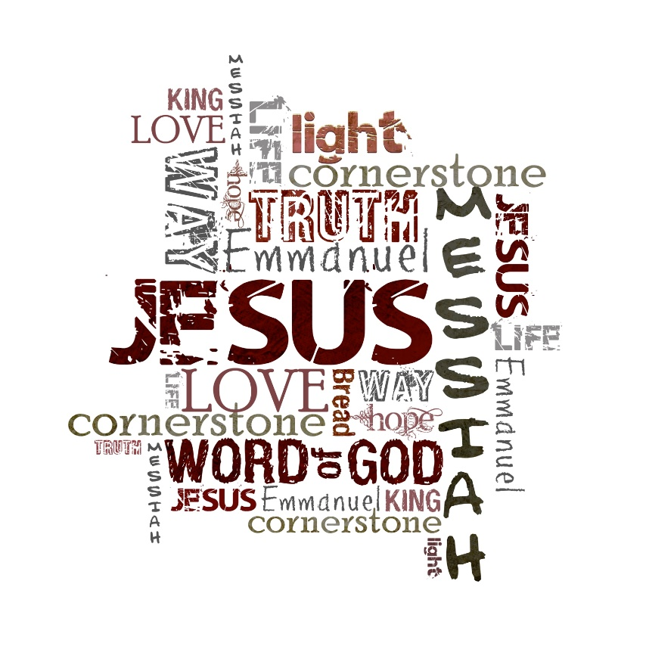
Chapter Summary
Honoring God
Our loving relationship with God is clearly outlined in the first three commandments. This chapter focuses on the ways honoring and praising God bring us into closer communion with him. It also clarifies some common misconceptions about venerating images versus worshiping them. It defines clearly what it means to honor the Lord’s name and emphasizes how important it is to keep the Sabbath holy, not only to honor God but to refresh our own minds, bodies, and spirits.
© Genotar/www.shutterstock.com

Slide 4

Key Point of Reference
“Love the Lord your God with all your heart, with all your soul, with all your strength, and with all your mind”; and “Love your neighbor as you love yourself.” (Luke 10:27; Handbook, page 439)
© Merydolla/www.shutterstock.com

Slide 5

Introduction and “The First Commandment: Honor God”
(Handbook, pages 438–442)
God always comes first in our lives.
© SergiiKorolko/www.shutterstock.com

Slide 6
Introduction and “The First Commandment: Honor God”
(Handbook, pages 438–442)
We must focus on putting God first in our lives. The First Commandment is an “open channel” to God. If we block the channel, we block our own happiness and joy.
Other, false gods can be things like money, power, possessions, and popularity.
Idolatry, abuse of religious practices, and atheism all violate the First Commandment.
There is a distinct difference between idolatry and veneration.

Slide 7

Introduction and “The First Commandment: Honor God”
(Handbook, pages 438–442)
Journal It!
© RuslanDashinsky/www.istockphoto.com
In what ways can you work to keep God “number one” in your life?

Slide 8
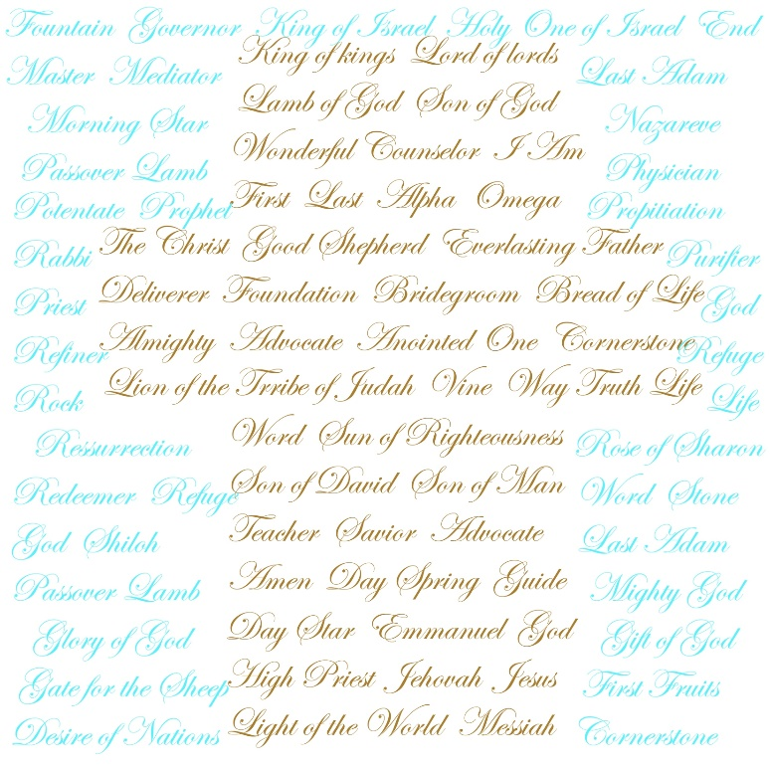
“The Second Commandment: Keep God’s Name Holy” (Handbook, pages 442–444)
The name of the Lord, our God, is sacred, and we should treat it with respect.
© FollowerofChrist900/www.shutterstock.com

Slide 9
“The Second Commandment: Keep God’s Name Holy” (Handbook, pages 442–444)
Because God’s name is holy and sacred, we should use it only with reverence and respect. This includes Jesus’ name.
We should not use the names of God, Jesus, Mary, or the saints in a trivial or offensive manner. An intentional offense in this way is called blasphemy.
An oath is a sacred promise made to God. We should not take oaths in trivial matters. Lying under oath is called perjury.

Slide 10

“The Second Commandment: Keep God’s Name Holy” (Handbook, pages 442–444)
Activity
What do you think the words reverence and blasphemy mean? Write ideas on the board.
Check the meanings in a dictionary.
As you discuss the Second Commandment, you will learn more about the meaning of reverence for God’s name.
© Milkovasa/www.shutterstock.com

Slide 11
“The Third Commandment:
Keep Sunday Sacred” (Handbook, pages 445–447)
Sunday is a day to celebrate our love of God and recreate ourselves by refreshing our minds, bodies, and spirits, all for God’s glory.
© gubgib/www.shutterstock.com

Slide 12
“The Third Commandment:
Keep Sunday Sacred” (Handbook, pages 445–447)
Reflection:
How will you keep Sunday sacred in the future?
Write down your response.
Share your answer.
© ksana-gribakina/www.shutterstock.com

Slide 13

“A Review of the First Three Commandments” (Handbook, pages 438–447)
Review the first three commandments and what you have learned in this chapter.
© IvelinRadkov/www.shutterstock.com

Slide 14
“A Review of the First Three Commandments” (Handbook, pages 438–447)
God always comes first in our lives.
The name of the Lord, our God, is sacred, and we should treat it with respect.
Sunday is a day to celebrate our love of God and recreate ourselves by refreshing our minds, bodies, and spirits, all for God’s glory.

Slide 15
Acknowledgments
The scriptural references and quotations in this presentation are from the Good News Translation® (Today’s English Version, Second Edition). Copyright © 1992 by the American Bible Society. All rights reserved. Bible text from the Good News Translation (GNT) is not to be reproduced in copies or otherwise by any means except as permitted in writing by the American Bible Society, 1865 Broadway, New York, NY 10023 (www.americanbible.org).
During this presentation’s preparation, all citations, facts, figures, names, addresses, telephone numbers, Internet URLs, and other pieces of information cited within were verified for accuracy. The authors and Saint Mary’s Press staff have made every attempt to reference current and valid sources, but we cannot guarantee the content of any source, and we are not responsible for any changes that may have occurred since our verification. If you find an error in, or have a question or concern about, any of the information or sources listed within, please contact Saint Mary’s Press.

