Slide 1
Jesus Christ: True God and True Man
The Catholic Faith Handbook for Youth, Third Edition
Chapter 8
Document #: TX003139
Notes:
This presentation offers key points from chapter 8 of the student handbook in question-and-answer form. You may choose to use it as a review, calling on students to answer the questions before revealing the additional information on the slides.

Slide 2
What Are the Gospels?
The Gospels are written accounts of Jesus’ life.
The authors were inspired by the Holy Spirit.
Reading the Gospels is the best way to learn about Jesus.
Copyright: Stephen Orsillo / www.shutterstock.com

Slide 3
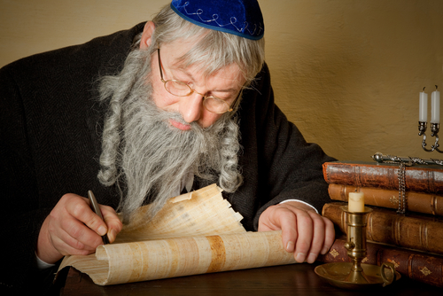
When Were the Gospels Written?
Copyright: Anneka / www.shutterstock.com
A common misconception is that the Gospels were written soon after Jesus’ life.
The earliest Gospel to be written (Mark) may have been written 30 to 40 years after Jesus’ death.
The last Gospel to be written (John) may have been written as late as 60 to 70 years after Jesus’ death.
Notes:
Explain that followers of Jesus first shared sayings and incidents from his life by word of mouth. Tell the students that they will find the earliest Christian writings in the Epistles.

Slide 4
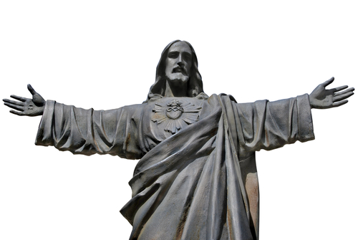
Are the Gospels Biographies?
No. Details of events may be historically inaccurate.
The Gospels accurately reveal what we need to know for our salvation, and they never contradict one another.
The Evangelists applied the stories and teachings to their communities’ unique situations.
The Gospels are faith portraits of Jesus.
Copyright: Alfonso de Tomas / www.shutterstock.com
Notes:
Explain that each Gospel writer made decisions about what to include and how to present the stories in a way that would best communicate Jesus’ identity and mission to his own audience.

Slide 5
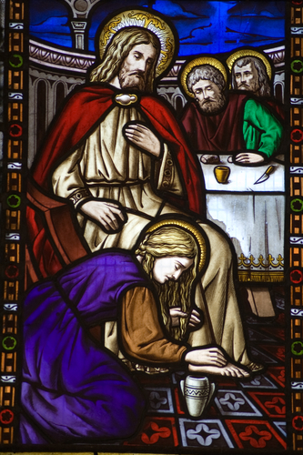
Why Do We Call Jesus the Son of God?
The title “Son of God” signifies a special relationship with God.
Jesus is the only true, eternal Son of the Father.
He is the Second Person of the Holy Trinity.
Copyright: BasPhoto / www.shutterstock.com
Notes:
Explain that in Jesus’ day, as in ours, Jews substituted the term Adonai, meaning Lord, for the actual name of God when reading Scripture aloud in Hebrew.

Slide 6
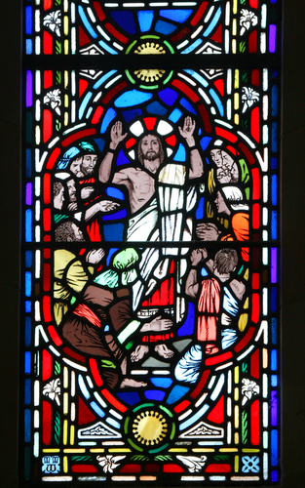
What Is the Incarnation?
It is the mystery of the union of Jesus’ divine and human natures in one Person.
The Incarnation is a mystery we will never be able to fully understand.
Jesus is both “true God and true man.”
Copyright: V. J. Matthew / www.shutterstock.com
Notes:
Explain that the root of the word Incarnation is the Latin word carnis, meaning “flesh.”

Slide 7
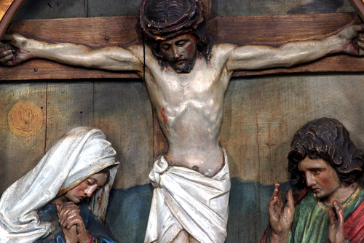
Why Did God Become Incarnate?
Copyright: Zvonimir Atletic / www.shutterstock.com
Jesus is the perfect mediator between God and humanity.
God is able to fully reveal his loving plan for us through Jesus.
In learning about Jesus, we understand more fully what God requires of us.
Notes:
Ask the students what we can learn about God by learning about Jesus.

Slide 8
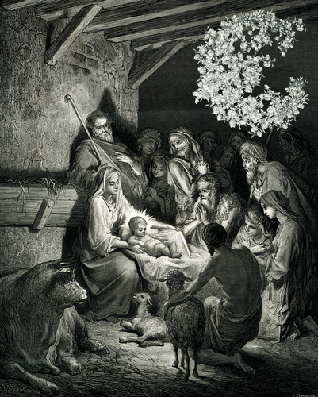
Why Was Jesus Born of a Virgin?
This is a sign of Christ’s divine nature.
Jesus’ birth is a result of God’s initiative.
This also symbolizes that Jesus is the new Adam (with no earthly father).
Copyright: MarkauMark / www.shutterstock.com
Notes:
Explore with the students the parallels between Adam and Jesus. (Neither had an earthly father; Adam showed disobedience, while Jesus showed perfect obedience; Adam introduced sin and death; Jesus conquered sin and death.)

Slide 9
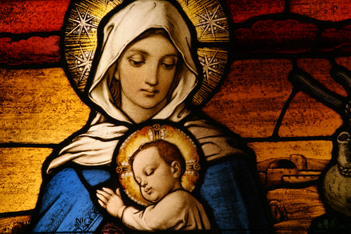
What Do We Believe about Mary?
Since Jesus is God, Mary is the Mother of God, Theotokos.
Mary remained a virgin throughout her life and is the spiritual mother of all Christians.
Mary was without sin all of her life.
Copyright: CURAphotography / www.shutterstock.com
Notes:
Take this opportunity to clear up any confusion about the meaning of the term Immaculate Conception, the doctrine that Mary was conceived without Original Sin.

