Slide 1
The Book of Genesis
The Living Word: The Revelation of God’s Love, Second Edition
Unit 3, Chapter 7
Document#: TX004685

Slide 2

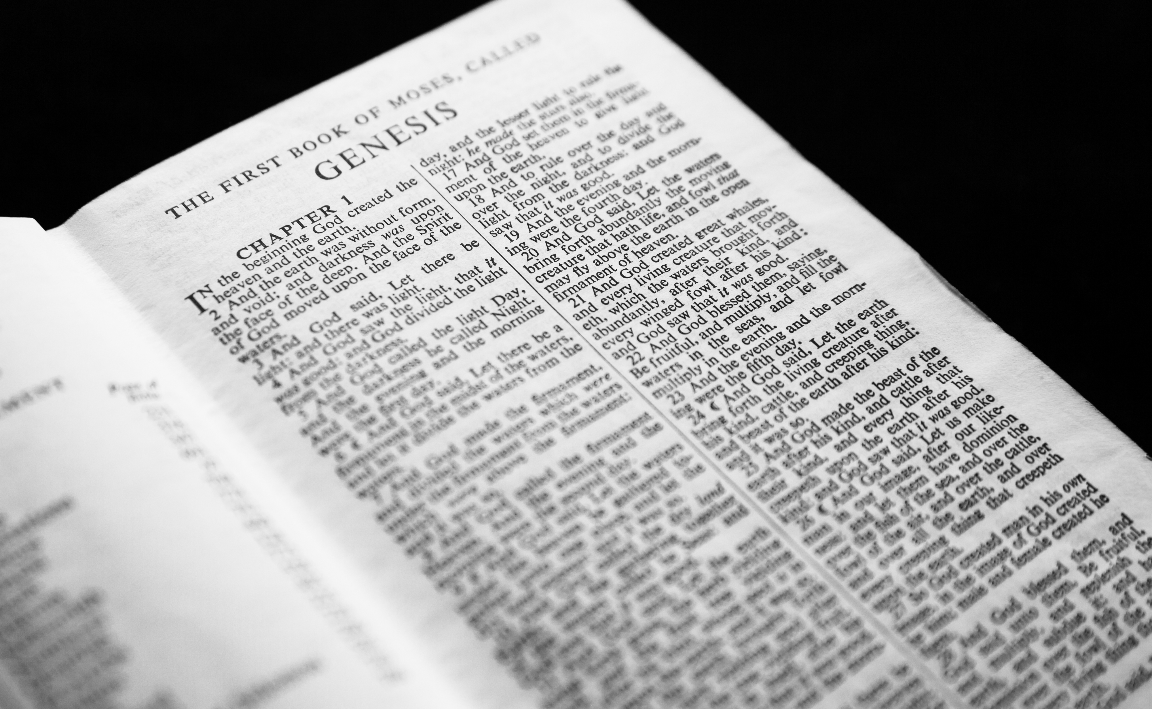
Our Origins as a People of Faith
Genesis is steeped in the truth of God’s saving love.
It is the first of the five books of law, called the Pentateuch.
It explains the role
of humans in the
origin of sin and
its effects.
© Duncan Andison / Shutterstock.com
Notes:
Notes: Ask the students to name the other books of the law (Exodus, Leviticus, Numbers, and Deuteronomy). Point out the Greek root for five, penta; Pentateuch means “five books.”
This slide corresponds to content in the chapter 7 introduction in the student book.

Slide 3
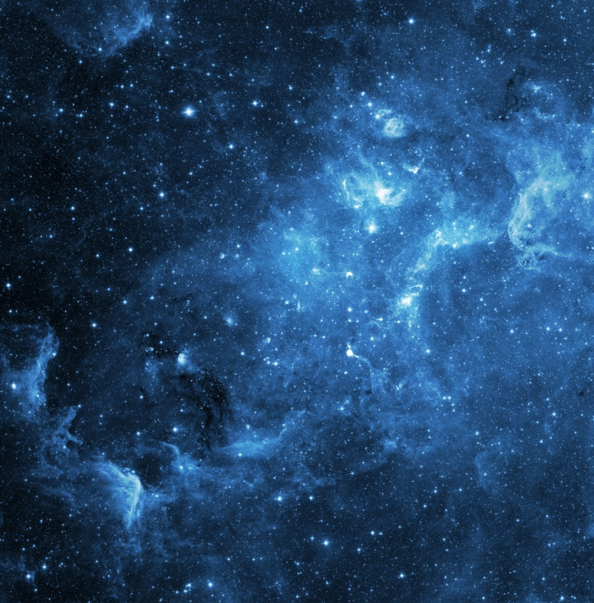
Creation
The beginning of Genesis tells us how God created the world in seven figurative days.
The account of Creation reveals God’s plan of loving goodness.
God’s plan is fulfilled in the Incarnation.
© Triff / Shutterstock.com
Notes:
Notes: To explain the last bullet point, ask the students to describe God’s original plan for human beings. Draw parallels between that plan and the salvation offered by Christ.
This slide corresponds to content in article 33, “Creation: In the Beginning,” in the student book.

Slide 4
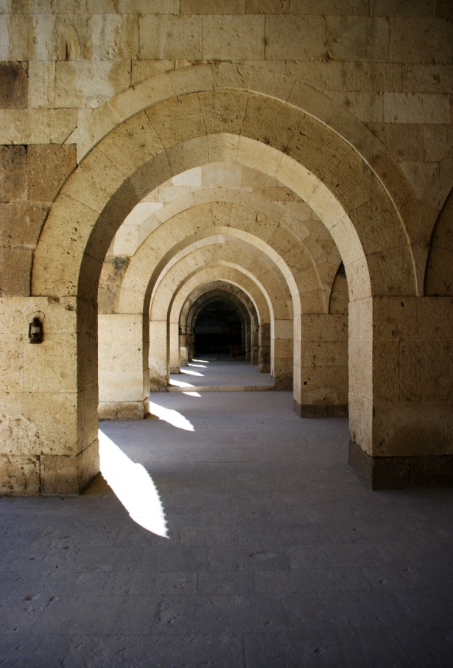
The Primeval History
The accounts found in Genesis, chapters 1–11, are called the primeval history.
They tell of a time before the invention of writing.
They communicate the truth without error because the writing was guided by the Holy Spirit.
© CCat82 / Shutterstock.com
Notes:
Notes: Ask the students these questions: What do you think is the difference between fact and truth? How can that distinction help us to study primeval history?
This slide corresponds to content in article 33, “Creation: In the Beginning,” in the student book.

Slide 5

Two Accounts of Creation
The two accounts of Creation complement each other.
Both accounts use figurative language.
© Dmitry_Tsvetkov / Shutterstock.com
Notes:
Notes: Review with students the contents and structure of the two Creation accounts in Genesis (1:1–2:4 and 2:4–25).
This slide corresponds to content in article 33, “Creation: In the Beginning,” in the student book.

Slide 6

The First Account of Creation
This first account teaches us that the world is fundamentally good.
In this account, we see the power of God: whatever he wills
becomes reality.
The human
person— each
of us— is created
in God’s image.
© catolla / Shutterstock.com
Notes:
Notes: Discuss with the students how embracing the truth that we are images of God might affect our behavior.
This slide corresponds to content in article 33, “Creation: In the Beginning,” in the student book.

Slide 7

The Second Account of Creation
God breathed life into human beings: we share in the divine life.
God created men and women as partners: the sexes
complement
each other.
Adam is to care
for the garden:
we participate in
God’s creative
work.
© Helder Almeida / Shutterstock.com
Notes:
Notes: Ask the students the questions at the end of article 33 in the student book: What does it mean to be called to participate in God’s creative work? How do you respond to this call?
This slide corresponds to content in article 33, “Creation: In the Beginning,” in the student book.

Slide 8
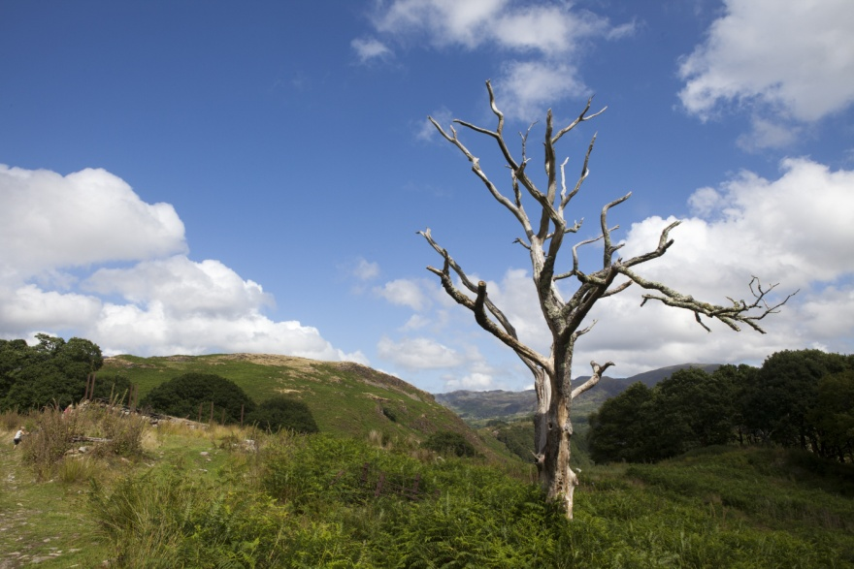
Original Sin
Original Sin, or the Fall, refers to Adam and Eve’s choice to disobey God.
Through Original Sin they lost their original holiness and became subject to death.
Original Sin describes humanity’s fallen state.
© Arjan van Duijvenboden / Shutterstock.com
Notes:
Notes: Invite the students to share what they know about venial and mortal sin. You may refer them to the Did You Know? sidebar in article 34 in the student book.
This slide corresponds to content in article 34, “Original Sin and God’s Response,” in the student book.

Slide 9

The Lasting Influence of Original Sin
The Fall deprived humanity of original holiness and original justice.
The early chapters of Genesis include accounts of the spread of sin after the Fall.
© aerogondo2 / Shutterstock.com
Notes:
Notes: Ask the students to share highlights of the accounts of Cain and Abel, Noah and the Flood, and the Tower of Babel, as described in article 34 in the student book.
This slide corresponds to content in article 34, “Original Sin and God’s Response,” in the student book.

Slide 10
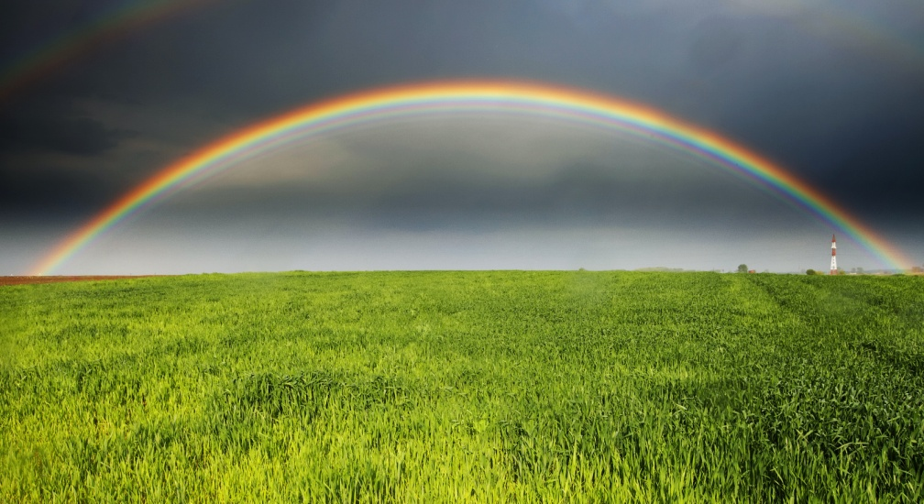
God’s Constant Protection
The early chapters of Genesis offer reassurance about God’s protection and friendship.
Despite the presence of sin, God promised he would save humanity, and he created covenants with his people.
© Mikadun / Shutterstock.com
Notes:
Notes: Explain to the students that Jesus Christ broke the bonds of Original Sin, cleansing us through the waters of Baptism.
This slide corresponds to content in article 34, “Original Sin and God’s Response,” in the student book.

Slide 11

Abraham: Model of Faith
God asked Abram to leave everything behind and set out for an unknown territory.
• He promised that Abram would become a great nation, blessed
by God.
• His descendants
would be a source of
blessing for the world.
© Dudarev Mikhail / Shutterstock.com
Notes:
Notes: Ask the students to name examples of how God might ask us to leave what we know and set out for “an unknown territory.” Ask about the obstacles or difficulties involved.
This slide corresponds to content in article 35, “Abraham: Model of Faith,” in the student book.

Slide 12
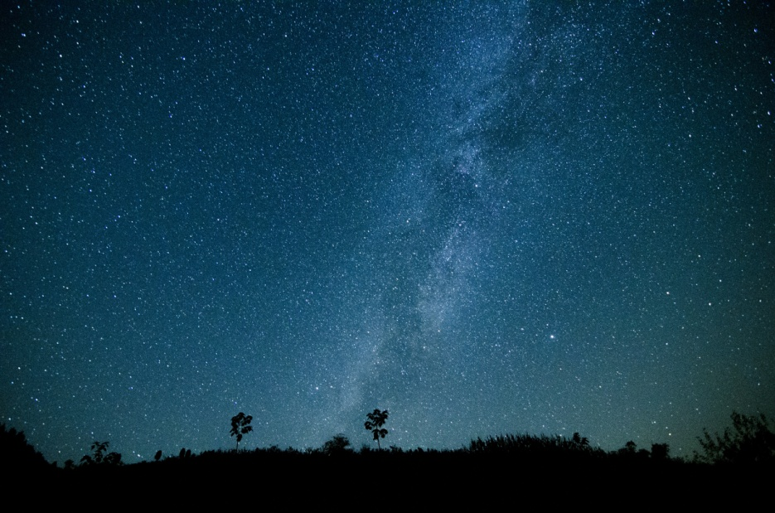
Stars of the Sky
Abram and Sarai were elderly and had no children.
Sarai offered her servant, Hagar, to Abram so he might father a son.
Hagar and Abram had a son, Ishmael.
© WANG WENTONG / Shutterstock.com
Notes:
Notes: Explain to the students that Ishmael, Hagar’s son, would have been seen as the heir, but God assured Abram that descendants as numerous as the stars would come through Sarai’s son.
This slide corresponds to content in article 35, “Abraham: Model of Faith,” in the student book.

Slide 13
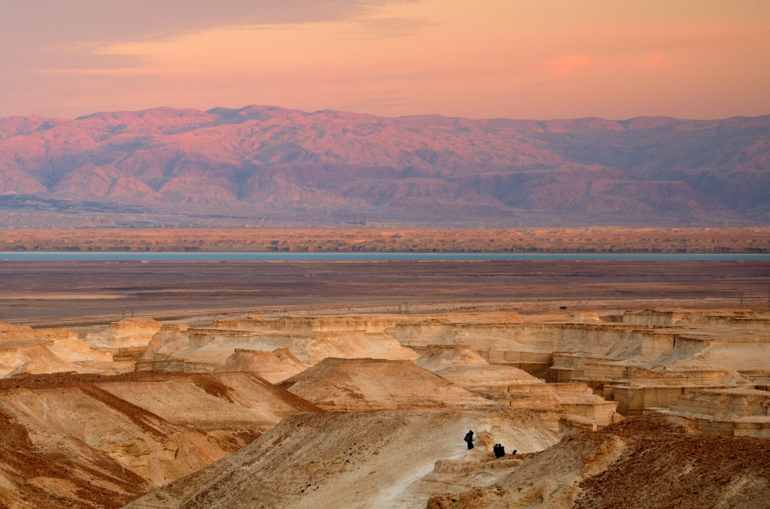
A Promised Land
God established
a covenant with
Abram and his
descendants.
He gave new
names to Abram
and Sarai: Abraham and Sarah.
He promised them descendants and a country of their own.
© Sean Pavone / Shutterstock.com
Notes:
Notes: Explain to the students that God was leading Abraham and Sarah to the Promised Land, a country called Canaan.
This slide corresponds to content in article 35, “Abraham: Model of Faith,” in the student book.

Slide 14
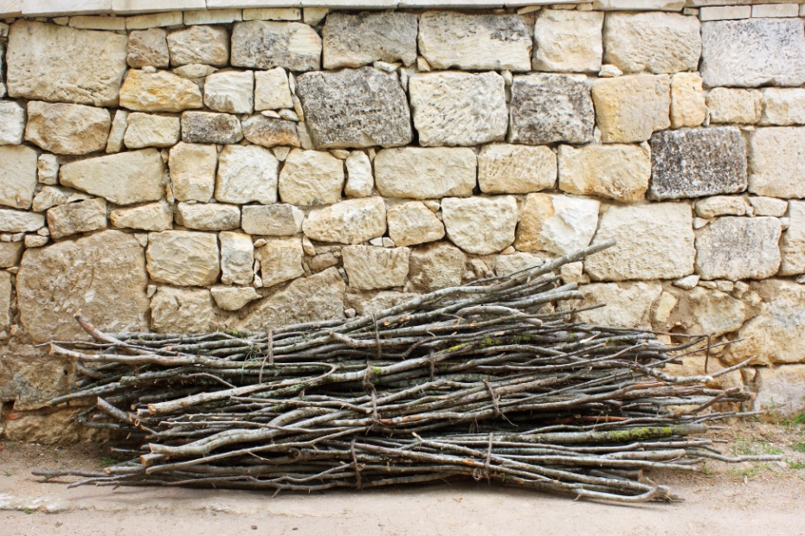
The Testing of Abraham
Sarah finally gave birth to a son, Isaac.
Abraham believed God wanted him to sacrifice Isaac.
Seeing Abraham’s
unshakable faith,
God stopped the
sacrifice.
© Aptyp_koK / Shutterstock.com
Notes:
Notes: You may wish to review with the students the account of Abraham in the Book of Genesis. Remind them that this is a story of true faith, a faith willing to risk all for the love of God.
This slide corresponds to content in article 35, “Abraham: Model of Faith,” in the student book.

Slide 15
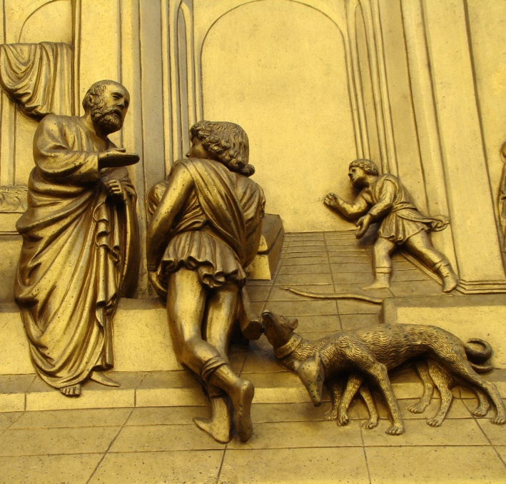
The Covenant Continues
Isaac married Rebekah, who gave birth to twins, Jacob and Esau.
Jacob stole Isaac’s
blessing from his brother,
becoming the next
patriarch.
God changed Jacob’s
name to Israel, which
means “God-wrestler.”
© Malgorzata Kistryn / Shutterstock.com
Notes:
Notes: Explain to the students that the names of Jacob’s sons became the names of the Twelve Tribes of Israel, a confederation of twelve Hebrew clans.
This slide corresponds to content in article 36, “The Covenant Continues with Abraham’s Descendants,” in the student book.

Slide 16
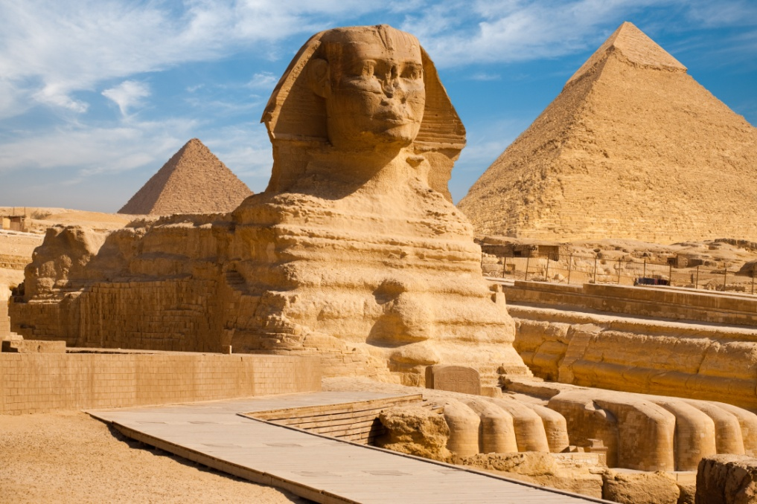
Settling in Egypt
Jacob’s son, Joseph, was sold into slavery by his jealous brothers.
He was taken to Egypt, but he rose to power there.
He saved his
family by bringing
them to Egypt
during a famine.
© Pius Lee / Shutterstock.com
Notes:
Notes: The students may have seen the musical Joseph and the Technicolor Dreamcoat or the DreamWorks movie Joseph: King of Dreams (1999, 75 minutes, unrated). Ask them why the brothers were jealous and how Joseph gained respect in Egypt.
This slide corresponds to content in article 36, “The Covenant Continues with Abraham’s Descendants,” in the student book.

Slide 17

God Keeps His Promises
Genesis shows us that nothing stands in the way of the fulfillment of God’s covenant promises.
These accounts reassure us that God will still guide us to the Promised Land.
© Pavel Vakhrushev / Shutterstock.com
Notes:
Notes: Ask the students to name some examples of barriers we intentionally put up between us and God. Ask them to name some examples of unintended barriers.
This slide corresponds to content in article 36, “The Covenant Continues with Abraham’s Descendants,” in the student book.

Slide 18
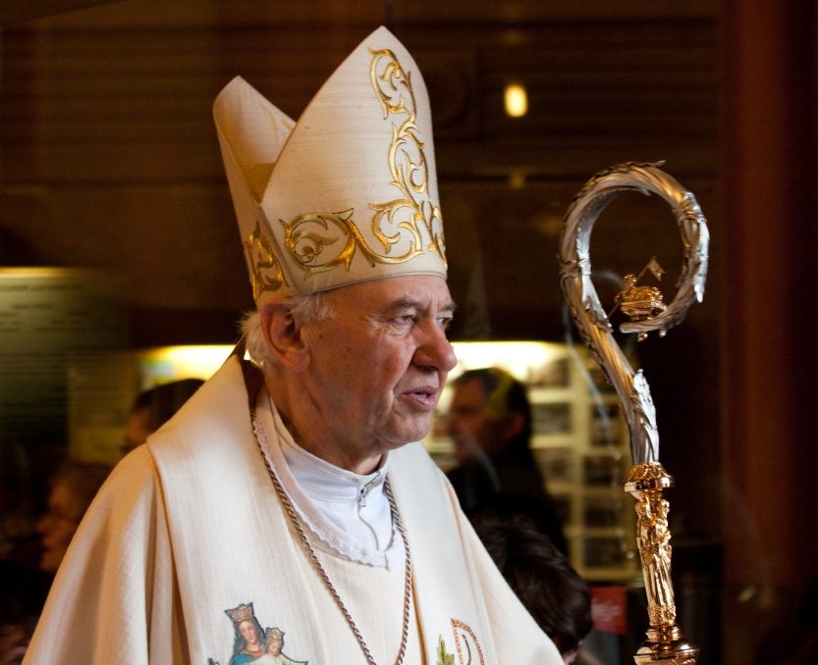
The Continuing Role of Patriarchs
The Old Testament patriarchs were entrusted with spiritual leadership.
Even when they made mistakes, God transformed their mistakes into stepping- stones toward the Kingdom of Heaven.
© Benjamin Kralj / Shutterstock.com
Notes:
Notes: Ask the students to identify a spiritual father or mother from Genesis who inspires them, and to explain why.
This slide corresponds to content in article 37, “The Continuing Role of Patriarchs,” in the student book.

