Slide 1
Suffering and the Paschal Mystery
The Paschal Mystery
Unit 4, Chapter 10
Document #: TX005441

Slide 2
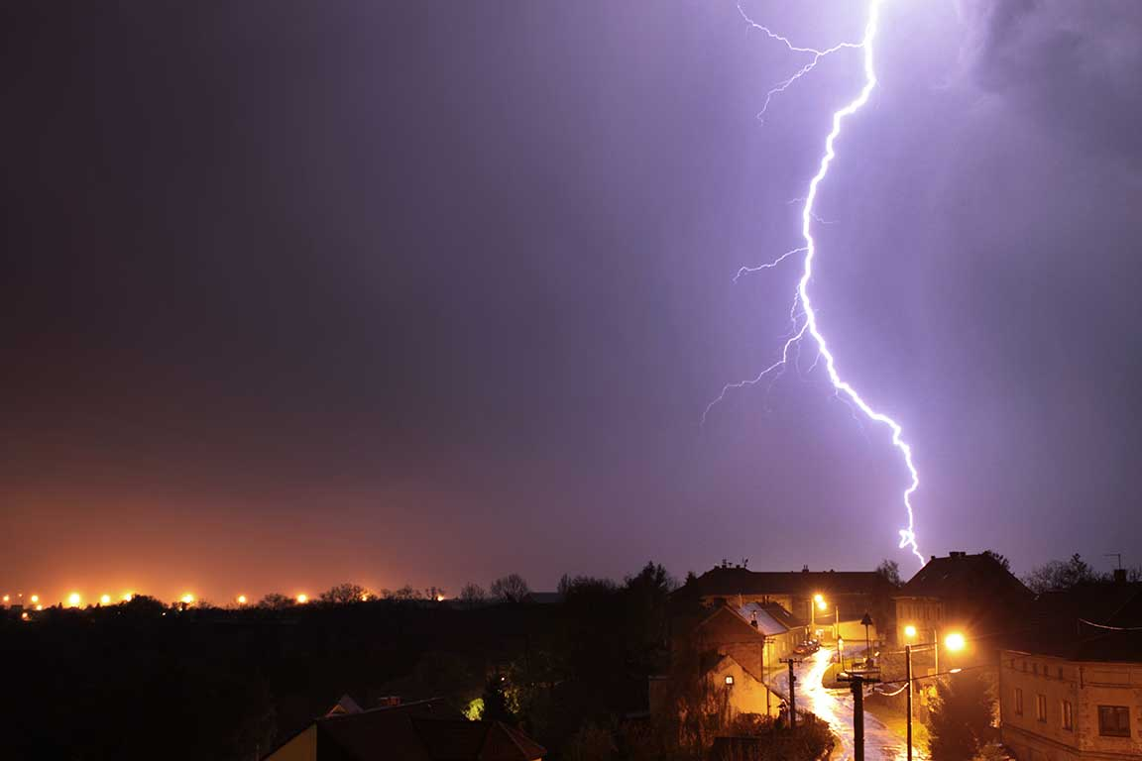
Making Sense of Suffering
Why does God, who is good, allow suffering to exist?
Why do “good” people suffer, just as “bad” people do?
The Book of Job is basically a debate over these issues.
© Miroslav Fechtner / Shutterstock
Notes:
Notes: Explain that in the Bible, God shows Job that suffering is a mystery beyond our full understanding. Tell the students that the Paschal Mystery helps us comprehend something about this mystery.
This slide corresponds to student text content in article 38.

Slide 3

Keys to Understanding Suffering
Suffering is due to Original Sin; it isn’t part of God’s plan for us.
Suffering and sacrifice are the pathway to redemption and salvation.
Sacrifice is simply suffering that we freely accept.
© shellyagami-photoar / Shutterstock
Notes:
Notes: Explain that the Paschal Mystery teaches that God can and will transform suffering and sacrifice into healing and new life. Discuss what the person in the image may be experiencing (loss, painful struggle, slow progress, hope, and so on).
This slide corresponds to student text content in article 38.

Slide 4
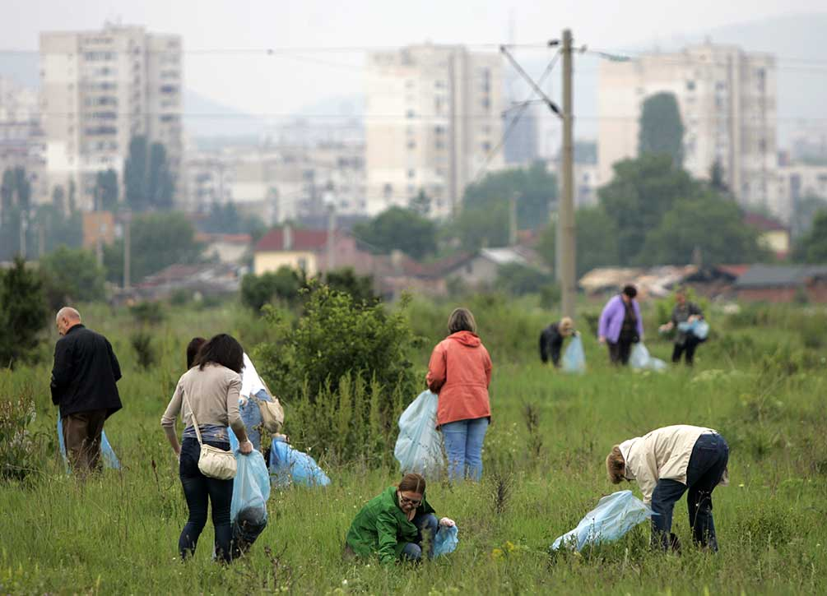
Practical Examples of Everyday Sacrifice
How can we accept suffering as part of our lives as disciples?
We often make sacrifices:
    ◦ for loved ones
    ◦ for those who are needy
    ◦ for the environment
    ◦ to follow the moral teachings of the Gospel
© Cylonphoto / Shutterstock
Notes:
Notes: Direct the students to look over the list in the section “Practical Examples of Everyday Sacrifice,” in article 38 of the student text. Ask how accepting suffering and sacrifice can make life more meaningful and joyful. Discuss the experience of the people in the image.
This slide corresponds to student text content in article 38.

Slide 5
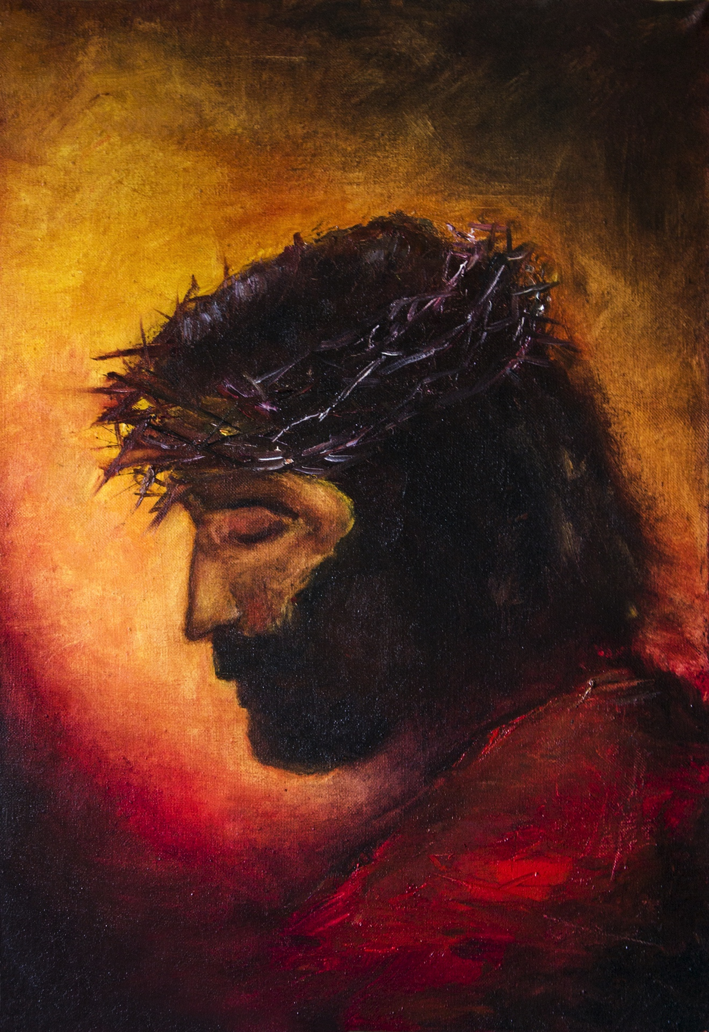
The Example of Jesus
Jesus accepted his Father’s will with courage and strength.
He could have avoided his torturous death if he had chosen to.
He taught about sacrificial love.
He embraced a life of poverty and simplicity.
© Bakhur Nick / Shutterstock
Notes:
Notes: Discuss the Did You Know? sidebar, “The Sacrifice of Martyrdom,” in article 39 of the student text. Ask the students how martyrdom is a witness; ask how the practical examples of everyday suffering described in the section “Practical Examples of Everyday Sacrifice,” in article 38 of the student text, can be a witness. If there is time, briefly discuss the concept of “sacrificing for the right thing,” as described in the section “The Example of Jesus” in article 39: sacrifice alone is not worthwhile if it is toward a self-centered goal.
This slide corresponds to student text content in article 39.

Slide 6
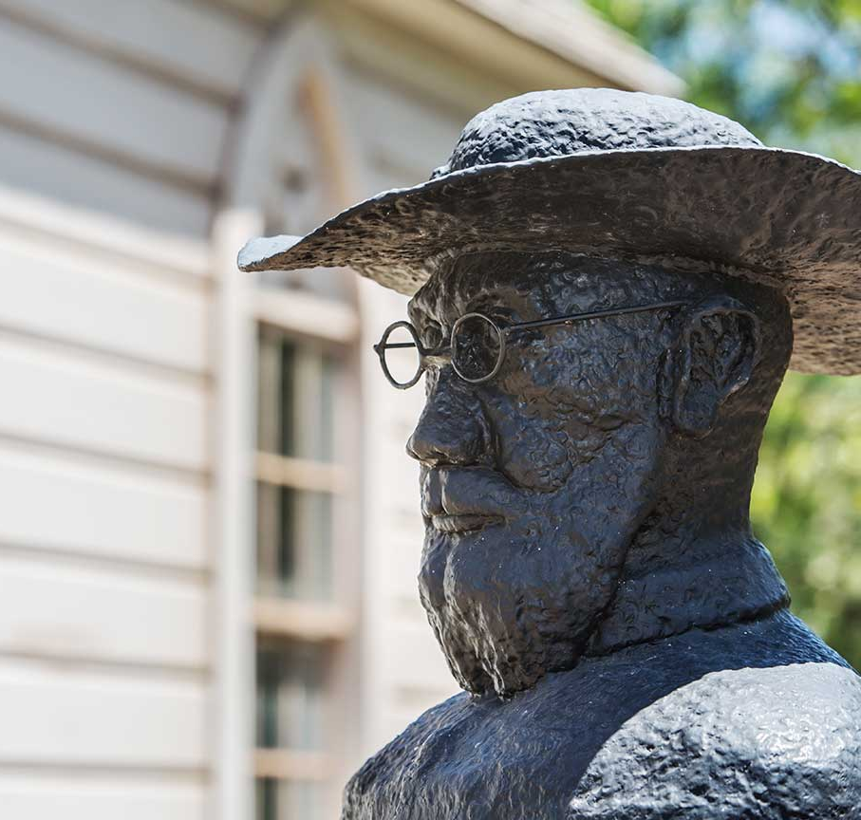
The Example of Saint Damien of Molokai
He volunteered to minister
to a leper colony and became known as the “apostle to the lepers.”
Damien himself was diagnosed with leprosy
years later, . . .
. . . yet he described himself as the “happiest missionary in the world.”
© CREATISTA / Shutterstock
Notes:
Notes: Discuss the profound happiness experienced by people like Saint Damien of Molokai, who sacrifice to serve others. Ask for examples from the students’ lives, or from the lives of people they know.
This slide corresponds to student text content in article 39.

Slide 7
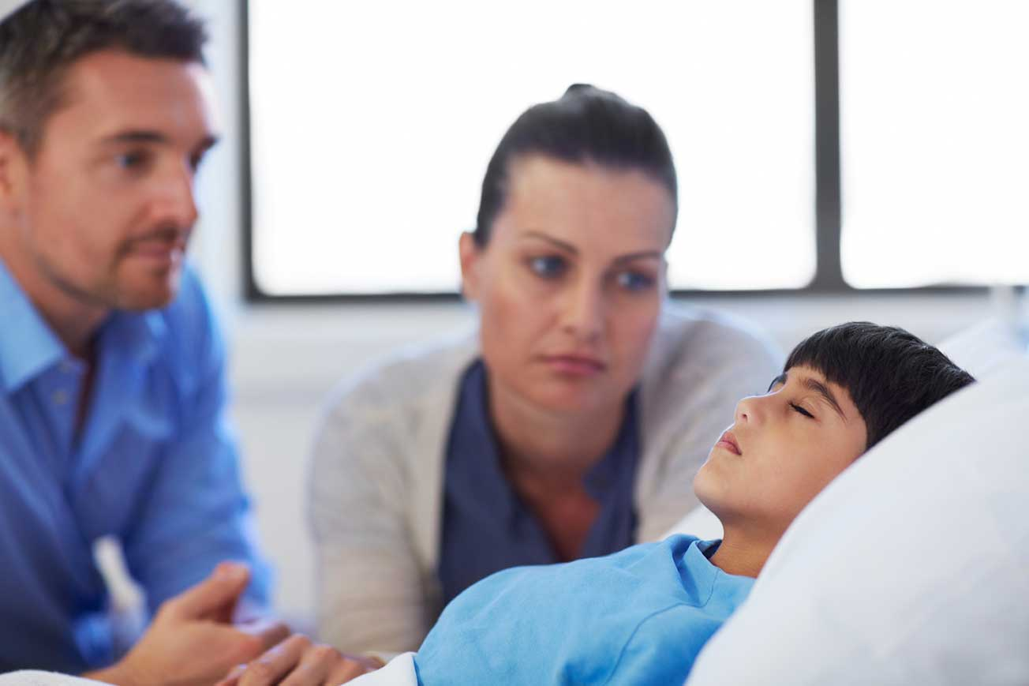
Finding Strength in Times of Suffering
How can anyone be expected to sacrifice their comfort and safety for a greater good?
We can do it only by being empowered by our loving and compassionate God.
© Squaredpixels / istock
Notes:
Notes: Direct the students to read the Pray It! sidebar, “Trust in God,” in article 38 of the student text. Ask how trusting God could be important to the people in the image on the slide.
This slide corresponds to student text content in article 40.

Slide 8
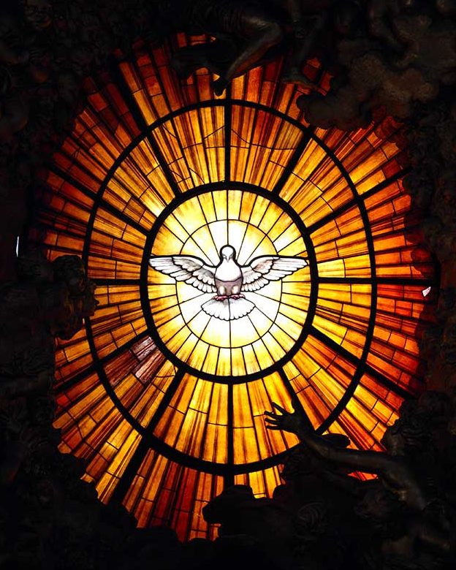
Keys to Finding Hope and Strength
Knowing that God is with us in our suffering
Relying on fortitude, or courage, one of the Seven Gifts of the Holy Spirit
Knowing that suffering is not the end of the story
© tkachuk / Shutterstock
Notes:
Notes: Explain the Church’s role in helping us find hope and strength: our faith community supports us when we suffer; we receive the gifts of the Spirit through Baptism, and they are strengthened at Confirmation; the Church assures us of God’s promises. Remind the students of what they have learned about the Paschal Mystery—Christ’s suffering was not the end of his story; neither will our suffering be the end of our story.
This slide corresponds to student text content in article 40.

Slide 9
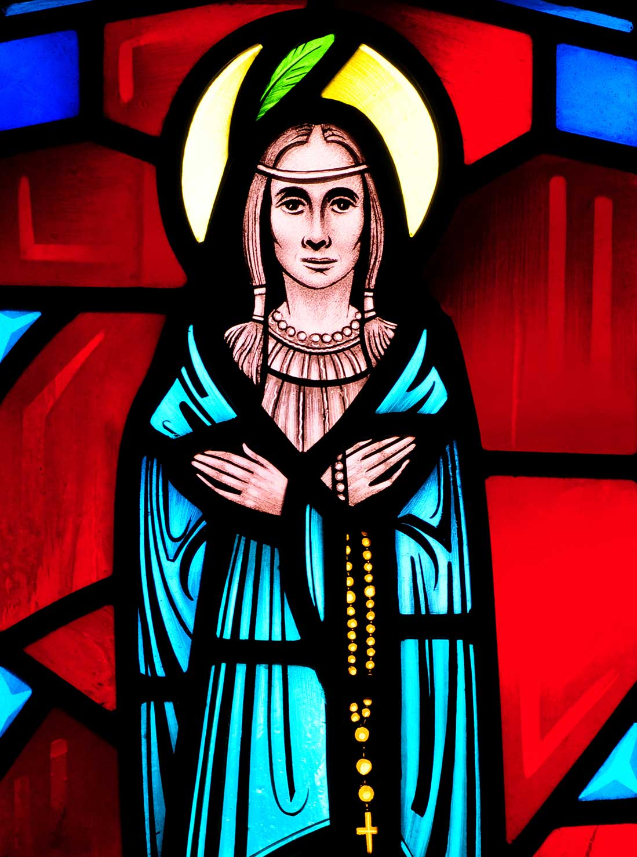
The Example of Saint Kateri Tekakwitha
She was an Algonquin-Mohawk orphaned by smallpox as a child.
After her Baptism, other members of her tribe persecuted her for her faith.
She risked poverty by vowing not to marry so
she could pray and serve others.
© Nancy Bauer / Shutterstock
Notes:
Notes: Ask why we may find it difficult to trust God to care for all our needs, as Saint Kateri Tekakwitha did. Ask what may help us to trust in God.
This slide corresponds to student text content in article 40.

Slide 10
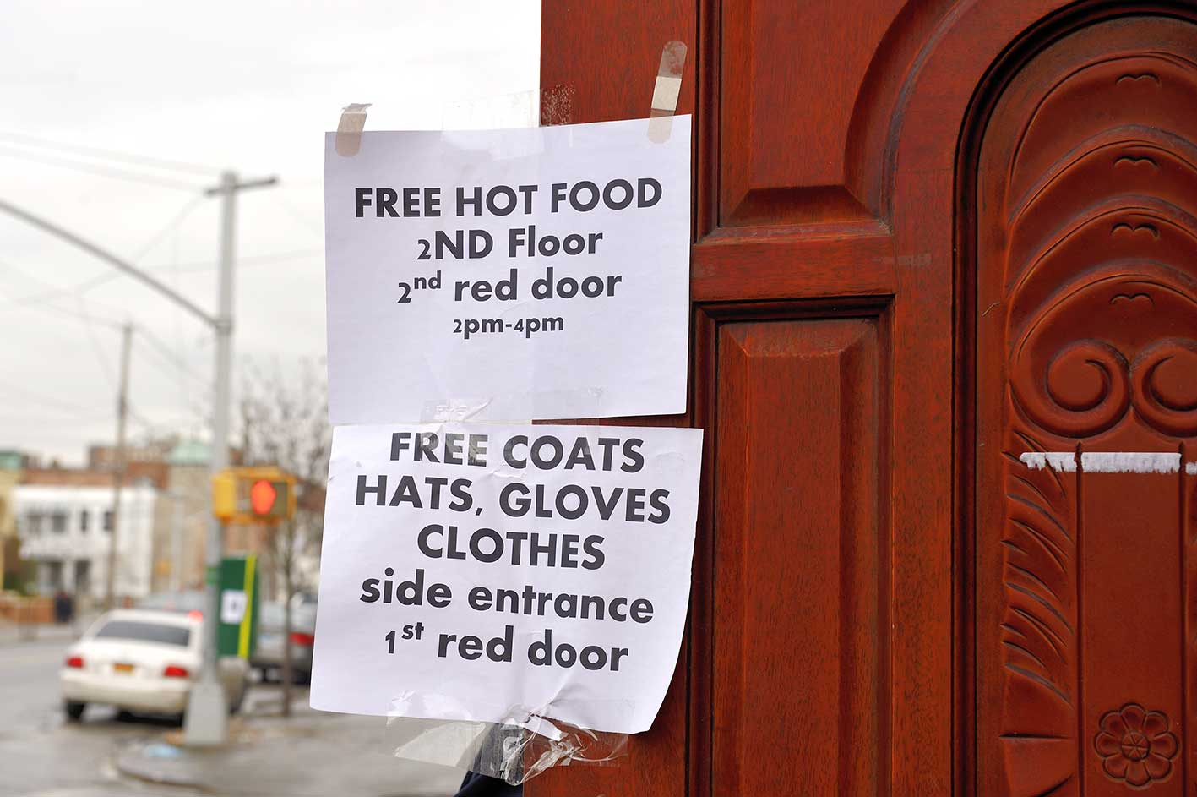
The Promise of the Paschal Mystery in Times of Suffering
We have a responsibility to help however we can to lessen suffering . . .
. . . even though we know we cannot hope to eliminate suffering on earth.
We can trust that in the end God will make all things right.
© robert paul van beets / Shutterstock
Notes:
Notes: Ask for examples of a time when knowing that God will make all things right has helped someone who was suffering or experiencing difficulty. Referring to the image, ask the students how they would feel about helping in a disaster, even though such disasters are likely to happen again.
This slide corresponds to student text content in article 41.

