Slide 1
The Path to Restoration
The Paschal Mystery
Unit 1, Chapter 3
Document #: TX005434

Slide 2
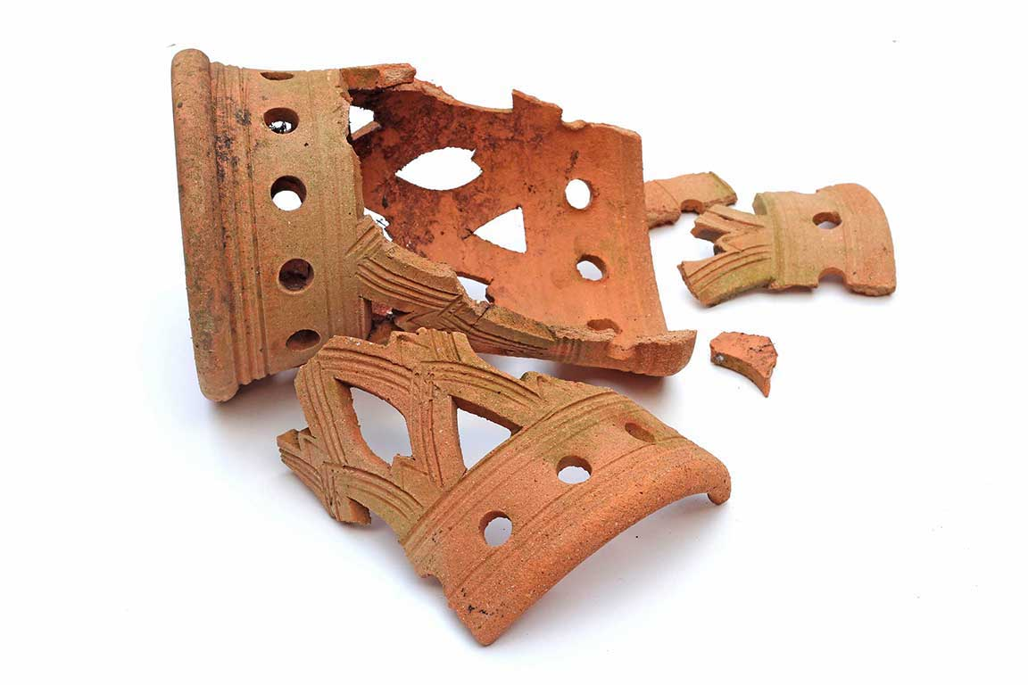
God’s Promise to Adam and Eve
After the Fall, God sought to restore to humanity what was lost.
Even amidst the greatest of tragedies, God does not abandon us.
© jitthiluk / Shutterstock
Notes:
Notes: Review the consequences of the Fall, summarized at the beginning of article 8 in the student text. Ask for examples of how God brings good from suffering and sin. Point out that while God can bring good from individual incidents of suffering and sin, the promise God made to Adam and Eve was to definitively bring good from suffering and sin. God accomplished this through Jesus’ life, death, Resurrection, and Ascension.
This slide corresponds to student book content in article 8.

Slide 3
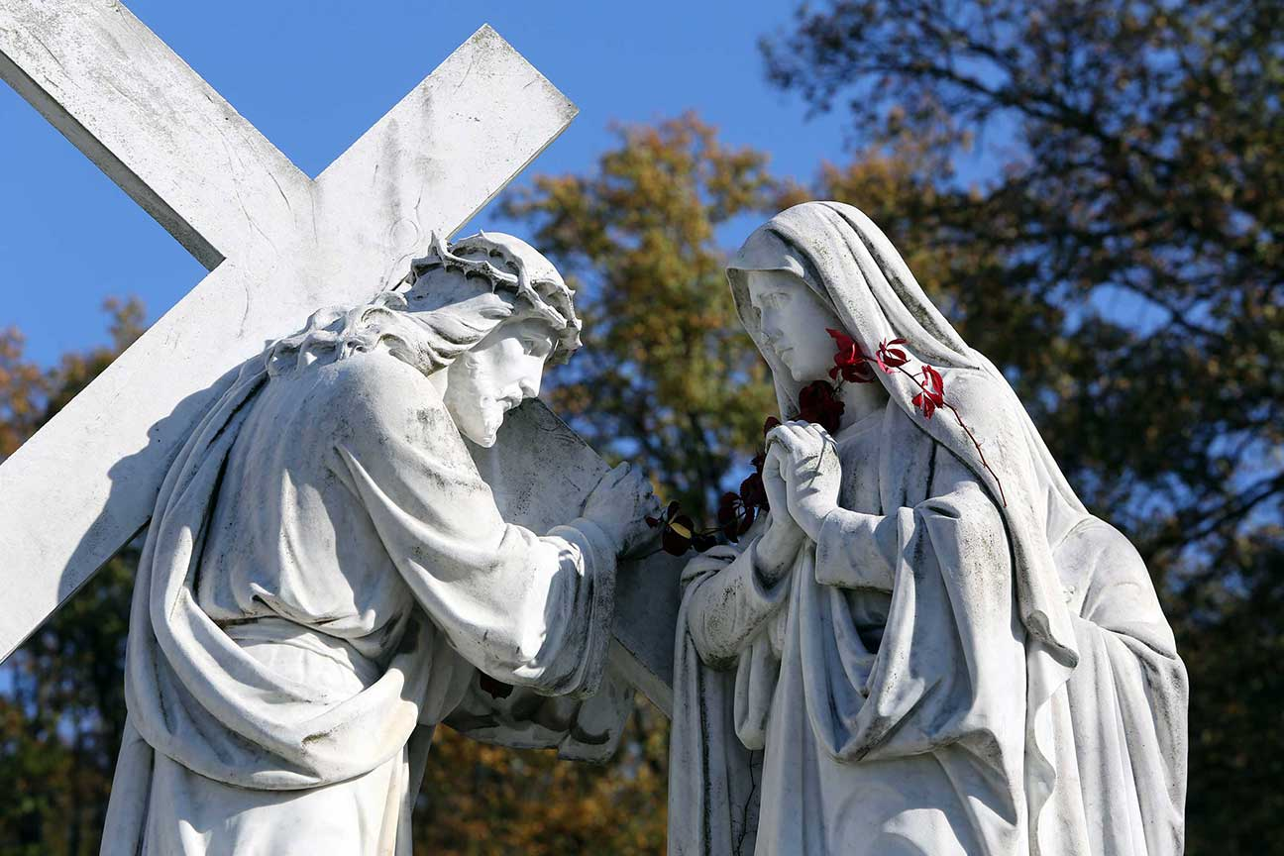
The Protoevangelium
Genesis 3:15 is “the first Gospel.”
It is God’s first promise to send a Savior to free us from the effects of the Fall.
Mary and Christ, the new Eve and the new Adam, restored our original holiness and justice through their obedience.
© Zvonimir Atletic / Shutterstock
Notes:
Notes: Read aloud Genesis 3:15, found at the beginning of the section “The Protoevangelium” in article 8 of the student text. With the students, review the chart explaining the Protoevangelium.
This slide corresponds to student book content in article 8.

Slide 4
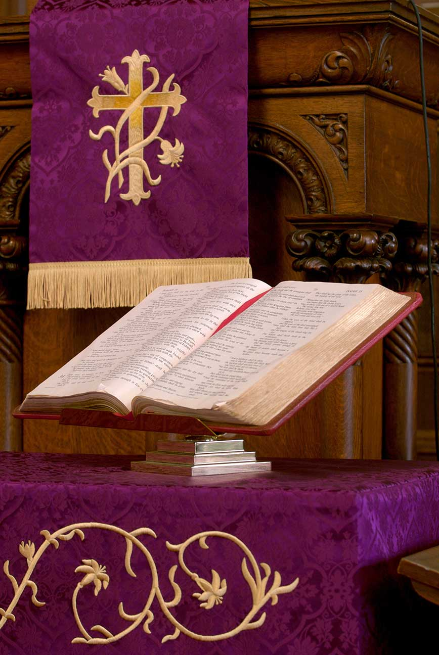
God Remains Faithful
The accounts that follow the Fall in primeval history serve two purposes.
They show the growth and worsening of sin.
They show how God remained faithful in preserving his plan of salvation.
© dlewis33 / istock
Notes:
Notes: Ask how Catholics today encounter God’s presence and his promise of salvation even when they sin.
This slide corresponds to student book content in article 8.

Slide 5
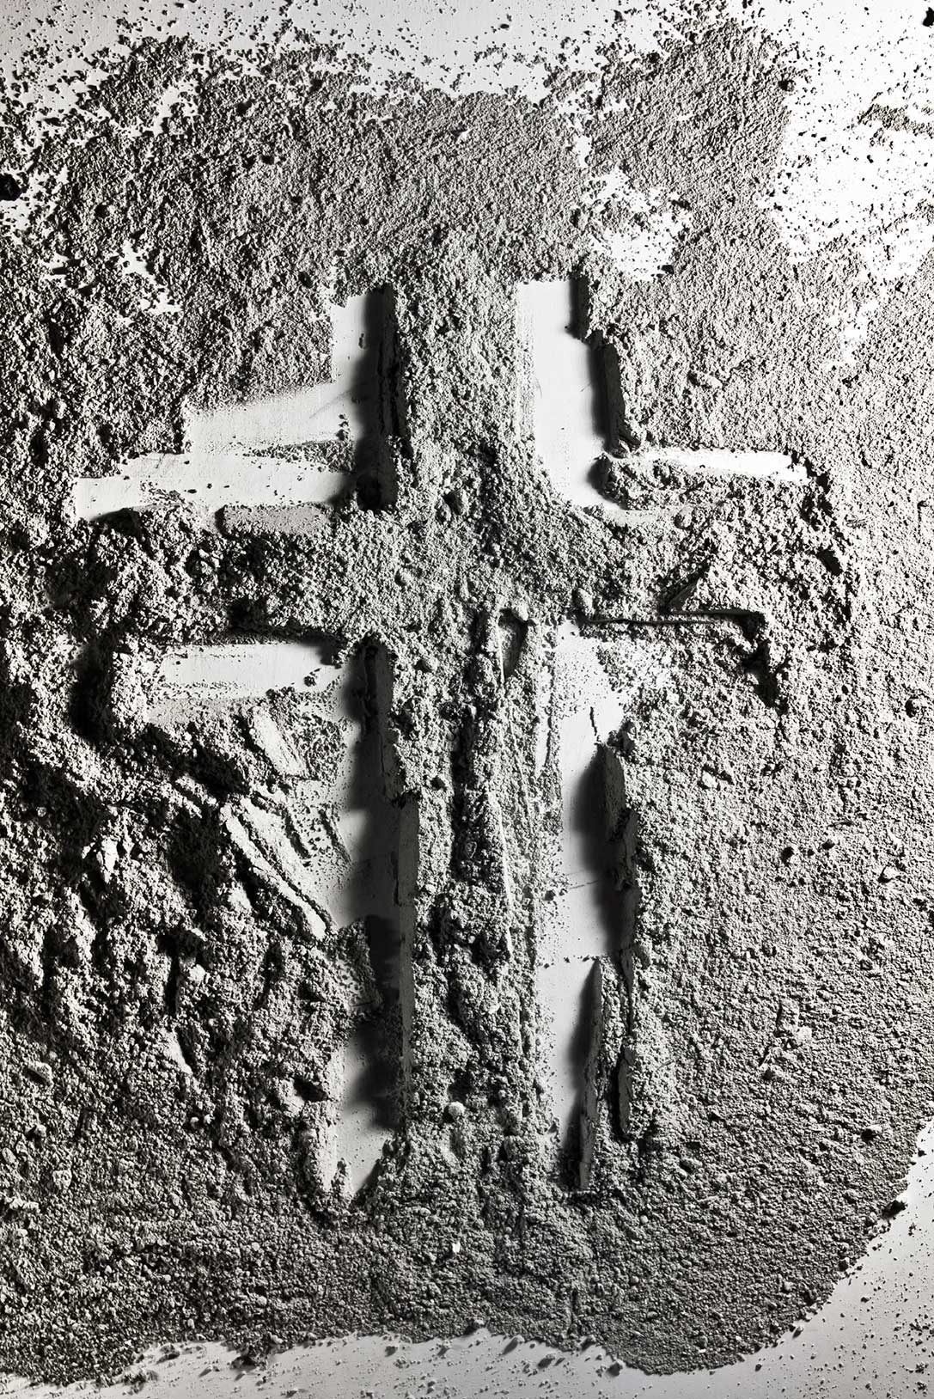
God Takes Action
Cain and Abel (Genesis 4:1‒16)
Noah and the Flood (Genesis 6:5‒9:17)
The Tower of Babel (Genesis 11:1‒9)
© dlewis33 / istock
Notes:
Notes: Direct the students (perhaps in groups) to read these passages, and to explain how God took action to keep his plan of salvation in motion.
This slide corresponds to student book content in article 8.

Slide 6
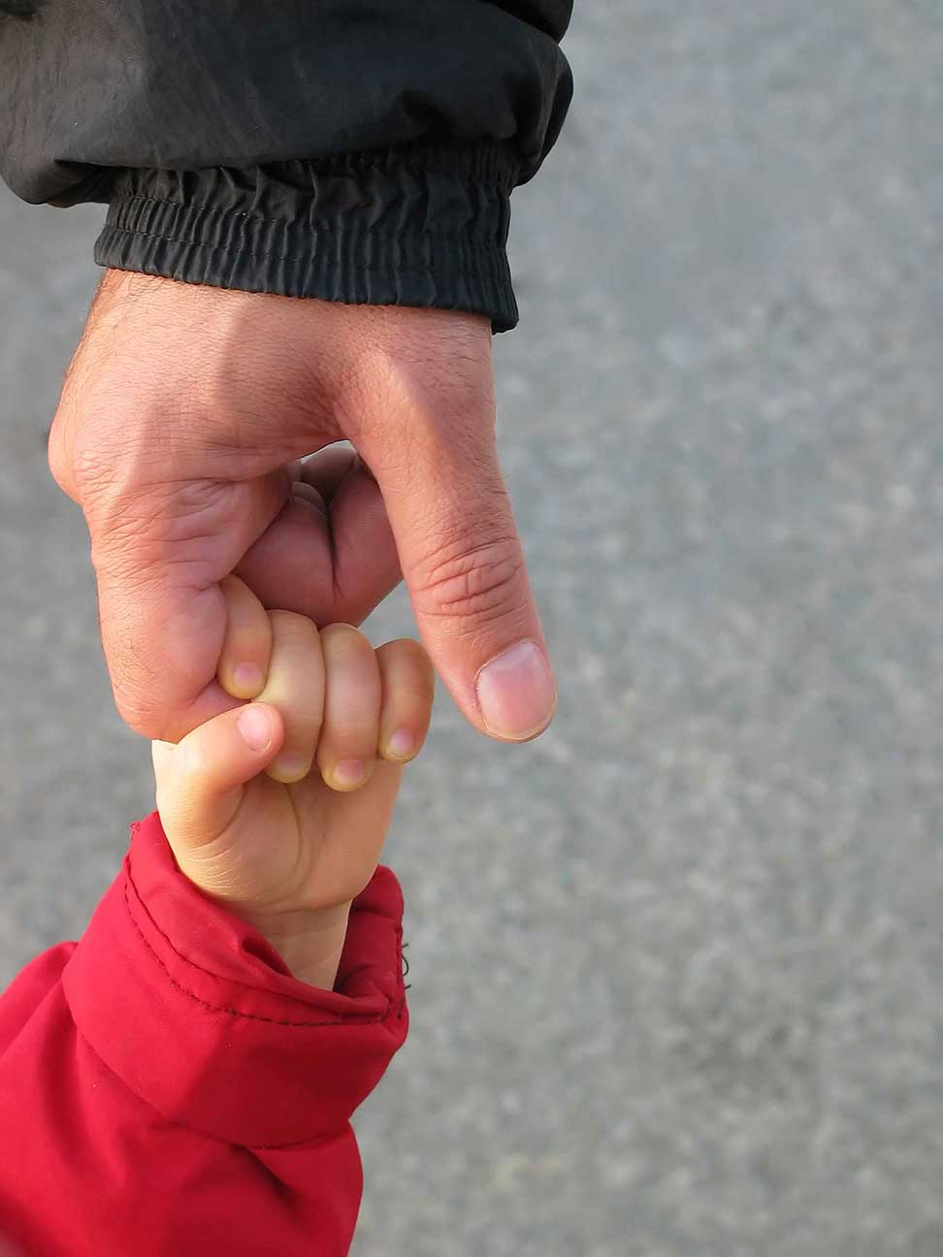
The Old Testament Covenants
A covenant is a solemn agreement between two parties.
Israel’s covenants were with God.
God initiated these covenants and stayed faithful to them.
© tamurlane / istock
Notes:
Notes: Explain that covenants were usually made between a stronger and a weaker king, and were binding agreements. Ask how making a covenant with Israel showed God’s love for his people. (He humbled himself; he desired to be in communion with them; he intended to protect and save them.)
This slide corresponds to student book content in article 9.

Slide 7
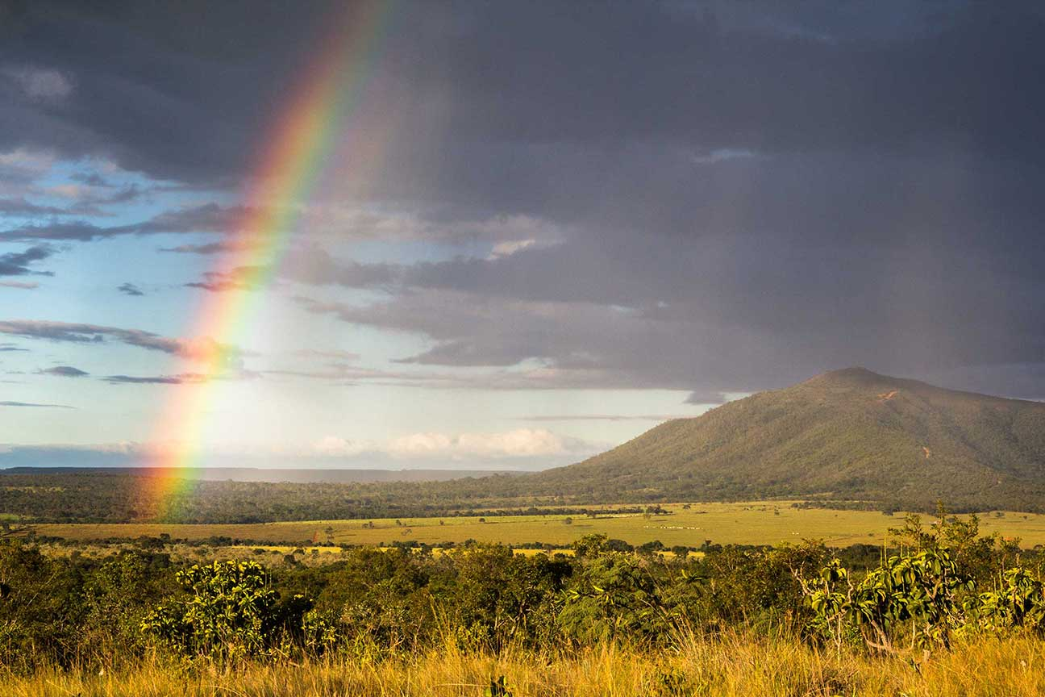
The Covenant with Noah
This covenant extended to all the nations of the world.
It is fulfilled in the New Covenant in Jesus.
© lucas nishimoto / Shutterstock
Notes:
Notes: Ask what promise the rainbow signifies in the account of Noah. Point out that the New Covenant also extends beyond Israel to all people of the world.
This slide corresponds to student book content in article 9.

Slide 8
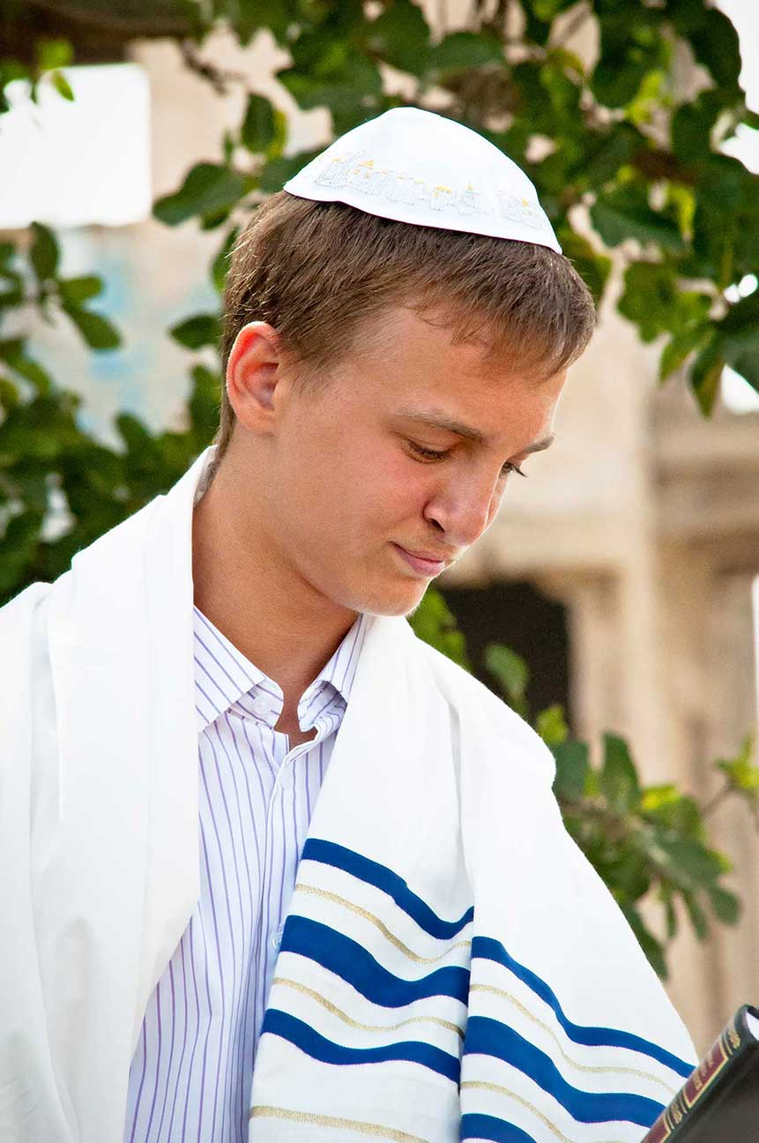
The Abrahamic Covenant
God promised to make of Abraham a great nation:
. . . to provide him and his descendants with a land of their own . . .
. . . and to make them a blessing for all nations.
© Lara65 / Shutterstock
Notes:
Notes: Explain that through the Laws, God taught his Chosen People how to be in right relationship with him and with one another. Ask for examples of how the Law teaches us these things even today.
This slide corresponds to student book content in article 9.

Slide 9
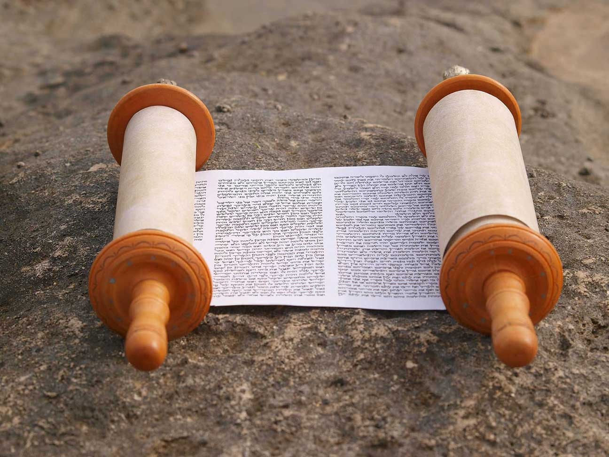
The Mosaic Covenant
God now renewed the covenant he had made with Abraham.
He gave Moses laws for the Israelites to follow as their part of the covenant.
Keeping the Law became the most important sign of faithfulness to the covenant.
© Polyanska Lyubov / Shutterstock
Notes:
Notes: Explain that through the laws, God taught his Chosen People how to be in right relationship with him and with one another. Ask for examples of how the Law teaches us these things even today.
This slide corresponds to student book content in article 9.

Slide 10
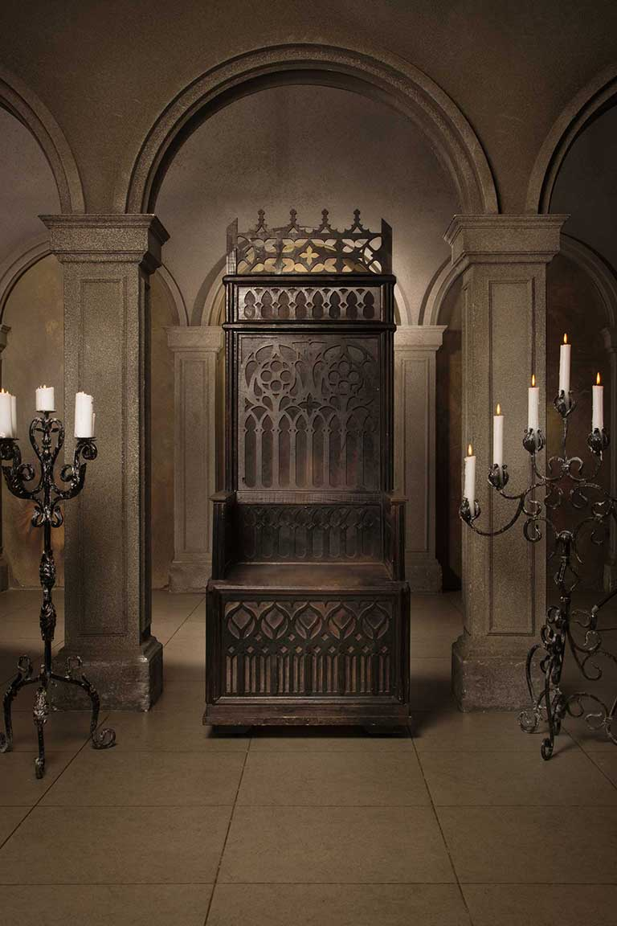
The Davidic Covenant
This promise was delivered to King David by the prophet Nathan.
God promised that David’s descendants would rule forever.
Jesus Christ was a direct descendant of David.
Jesus will reign over the Kingdom of God forever.
© Dm_Cherry / Shutterstock
Notes:
Notes: Ask volunteers to explain how five of the vocabulary terms defined in article 9 (circumcision; patriarch; theophany; Torah; Ark of the Covenant) are connected to the Old Testament covenants.
This slide corresponds to student book content in article 9.

Slide 11
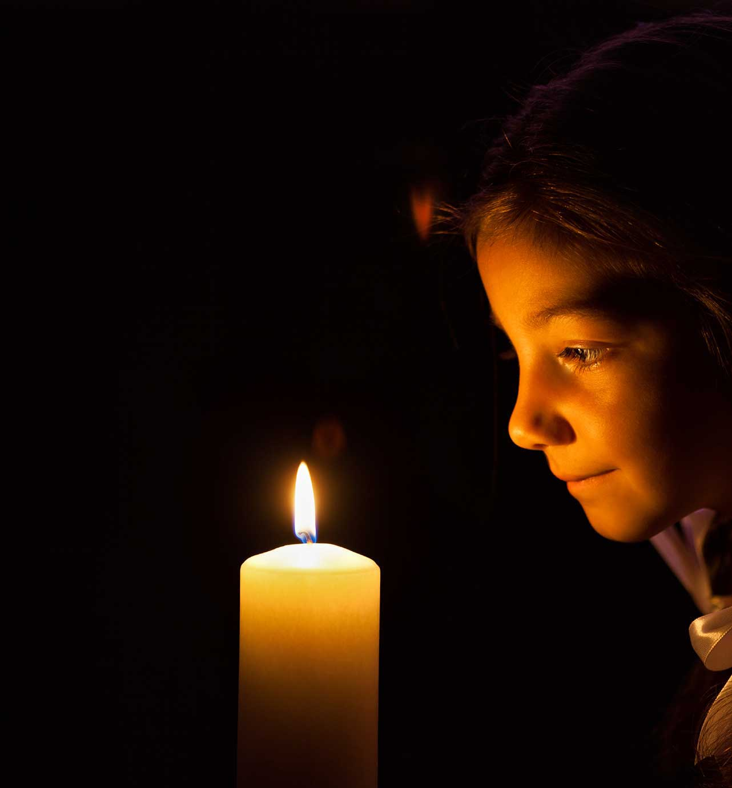
Covenants: Part of God’s Plan
These covenants assure us of God’s commitment to humanity.
They teach us how to live in right relationship with God and with one another.
They point to the restoration of our original holiness and justice.
© gordana jovanovic / istock
Notes:
Notes: Explain that these covenants by themselves are not enough to bring God’s plan of salvation to fulfillment, because of our fallen state. They point the way to the Savior and Messiah, Jesus Christ.
This slide corresponds to student book content in article 9.

Slide 12
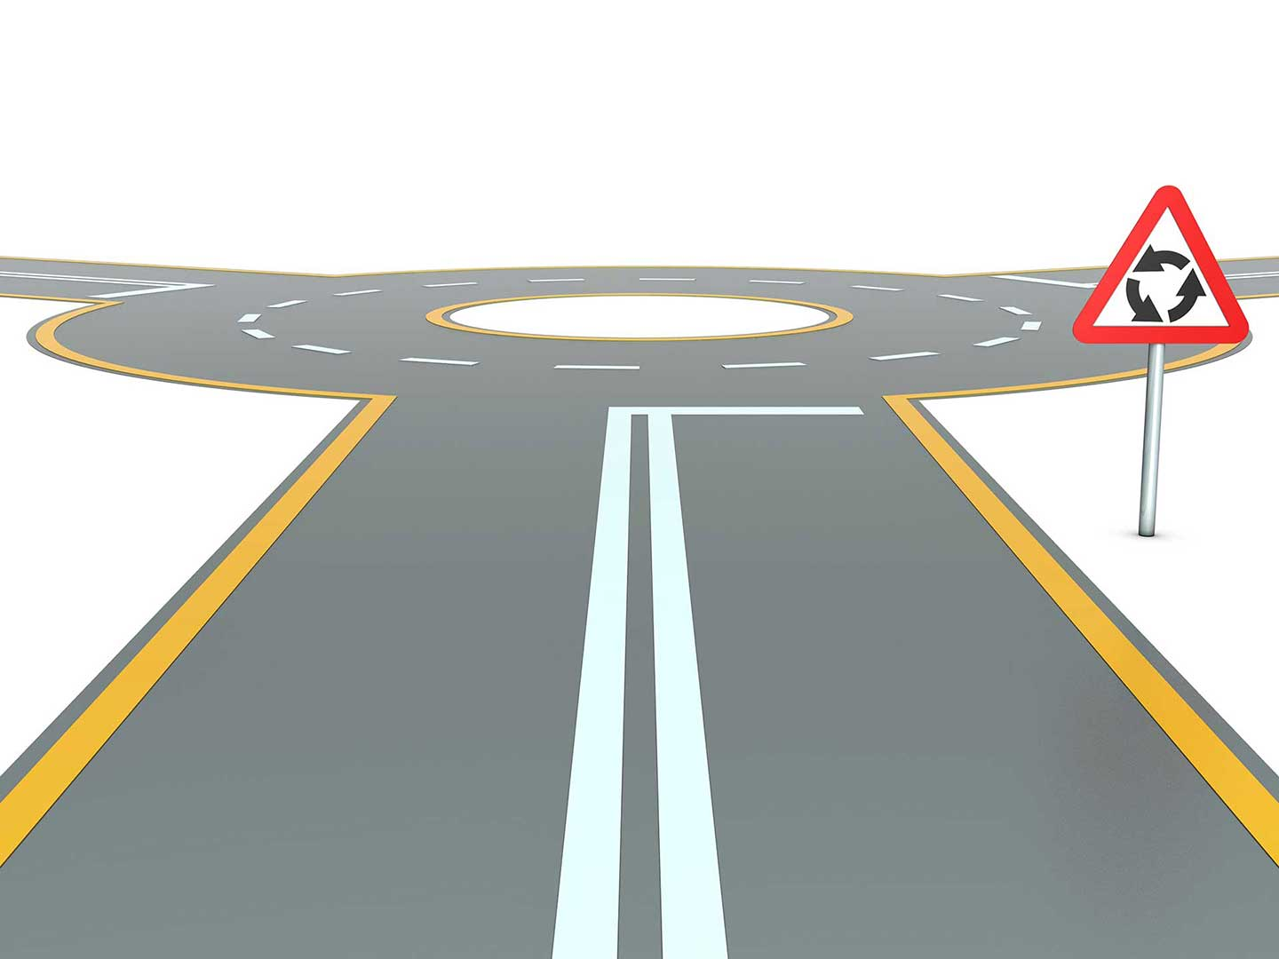
The Judges
After settling the Promised Land, the Israelites forgot the covenant again and again.
God then allowed them to fall into the hands of their enemies.
When they repented, God raised up a judge to lead them to victory.
© desertfox99 / Shutterstock
Notes:
Notes: Review the role of the Judges, as at the beginning of article 10 in the student text. Ask for examples of the cycle of failure and repentance in modern life. Emphasize that in the face of this cycle, God was, and is, faithful to his people.
This slide corresponds to student book content in article 10.

Slide 13
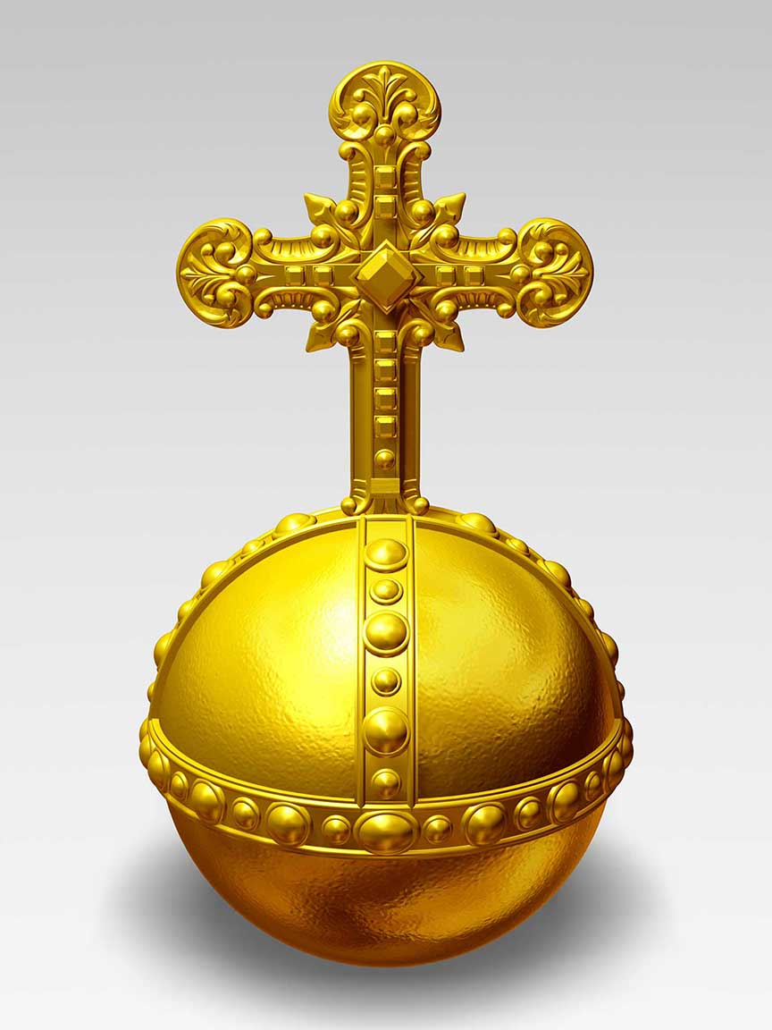
The Monarchy
The Israelites asked Samuel, the last judge of Israel, to appoint a king.
God directed him to anoint the first king of Israel, Saul.
Great kings, such as David and Solomon, foreshadowed the kingship of Jesus Christ.
© jitthiluk / Shutterstock
Notes:
Notes: Review the history of the united kingdom of Israel and its dissolution, as in the section “The Monarchy” in article 10 of the student text. Point out that the intention to be a kingdom committed to the covenant finds fulfillment in the Kingdom of Heaven and the Reign of Jesus Christ.
This slide corresponds to student book content in article 10.

Slide 14
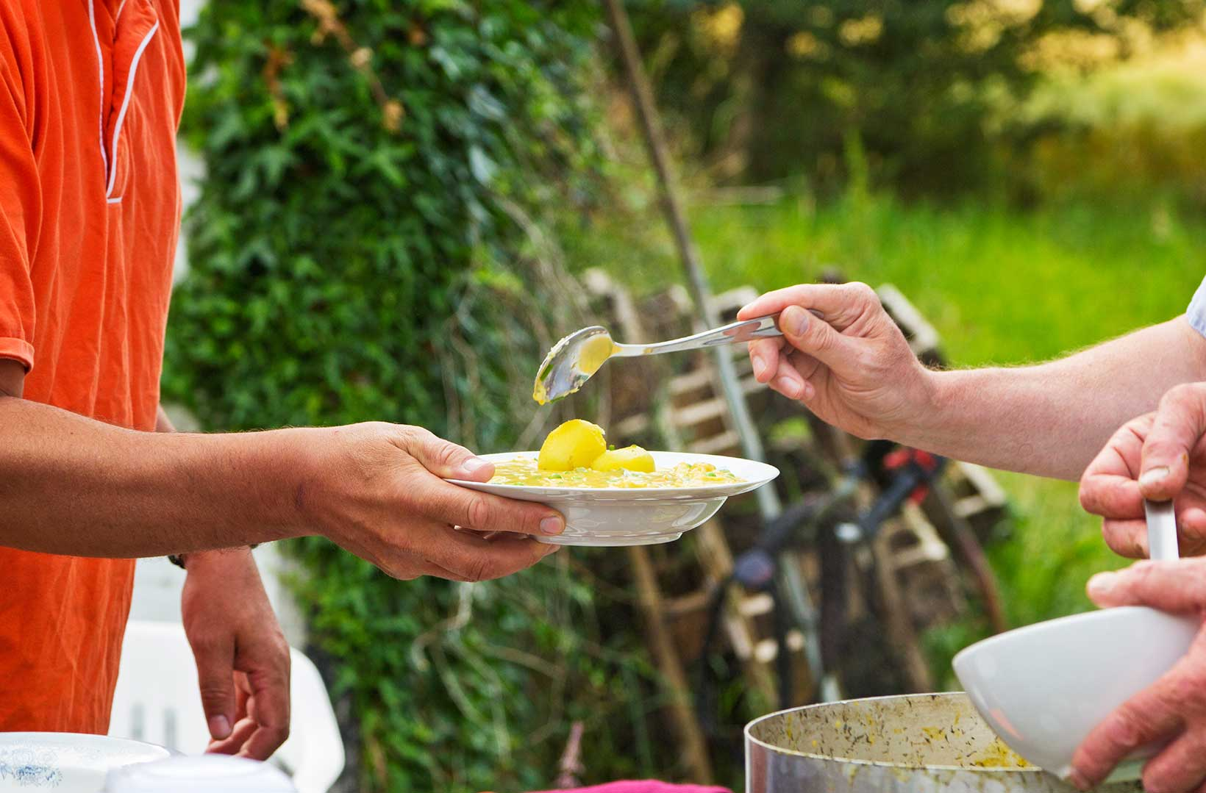
The Prophets
The prophets were the overseers of the covenant.
They called the kings and the people to be faithful.
They foreshadowed Christ’s own role as a prophet.
Jesus Christ will not just proclaim the Word―he is the Word of God Made Flesh.
© danefromspain / istock
Notes:
Notes: Direct the students to read the Live It! sidebar, “What Would the Prophets Tell Us?,” in article 10 of the student text. Discuss the relevance of the prophetic messages in the Bible for our own times.
This slide corresponds to student book content in article 10.

Slide 15

The Growing Messianic Hope
God gave the prophets a vision of a New Covenant and a new heavenly Kingdom.
They offered hope that humanity’s relationship with God would be fully restored.
The wait was over when Jesus Christ was born.
© danefromspain / istock
Notes:
Notes: Direct the students to read the chart in article 11 of the student text. Ask volunteers to put into their own words the promise revealed in each passage. Point out that, taken together, these promises describe the Kingdom of God.
This slide corresponds to student book content in article 11.

