Slide 1
Our Response to Jesus
Jesus Christ: God’s Love Made Visible,
Second Edition
Unit 5, Chapter 16
Document#: TX004822

Slide 2

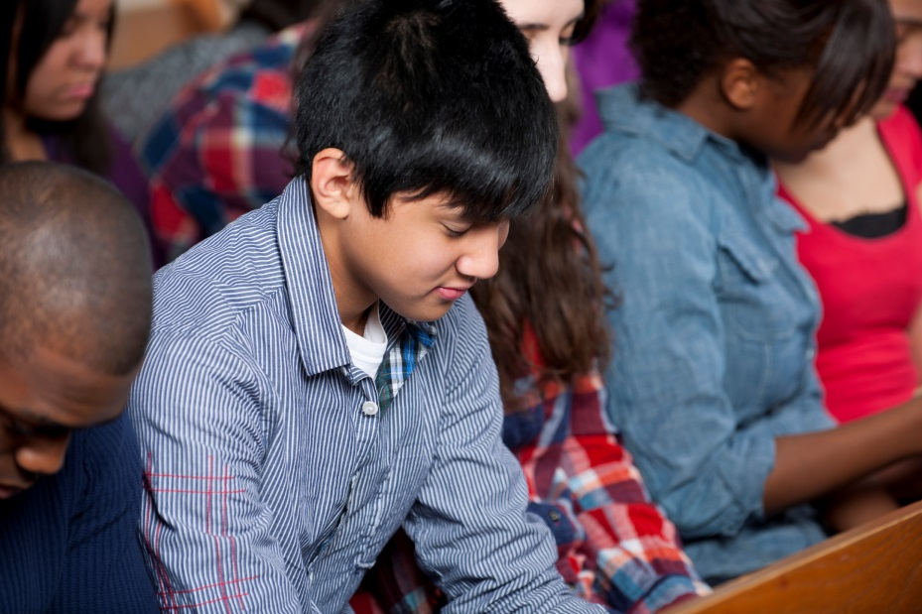
Our Destiny: Union with God
We are created to be united with God forever in Heaven.
In our earthly lives, we experience a degree of union with God . . .
through participation in the Sacraments and efforts to follow a path of holiness.
© Christopher Futcher / iStockphoto.com
Notes:
Read aloud the statement in article 73 of the student book about experiencing a degree of union with God in our earthly life. Share your own answer to the question that concludes this article, “What are some examples of earthly union with God from your life?” Ask volunteers to answer the question, too.
This slide corresponds to content in article 73, “Our Destiny: Union with God,” in the student book.

Slide 3
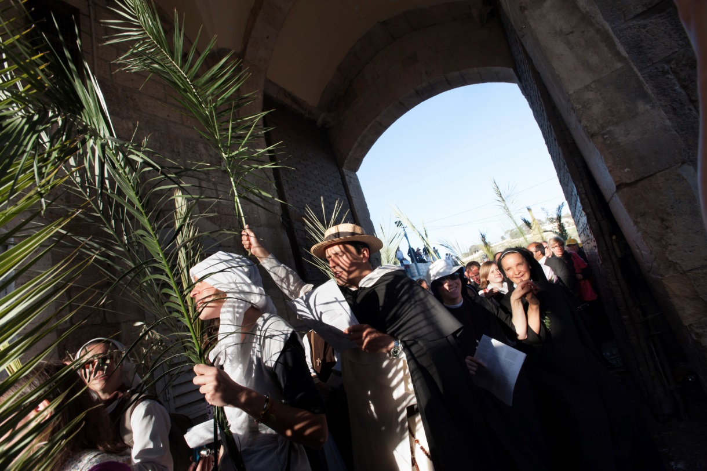
Faith and Our Destiny
Faith in Jesus is our path to eternal life,
assuring us that we will one day enjoy the company of the Blessed Trinity.
The faith of the entire Church calls forth our individual faith . . .
and supports our belief in God.
© rrodrickbeiler / iStockphoto.com
Notes:
Remind students of the priest’s introduction of the Sign of Peace at Mass. Discuss the comfort this phrase offers.
This slide corresponds to content in article 73, “Our Destiny: Union with God,” in the student book.

Slide 4

The Beatific Vision
The Beatific Vision is the encounter with God in the glory of Heaven after we die.
The desire to see God, to know God, is built into us.
Thus the Beatific Vision is the ultimate goal of our lives.
© sebastian-julian / iStockphoto.com
Notes:
Direct the students to read the quotations about the Beatific Vision in article 73 in the student book. Ask which one resonates with them.
This slide corresponds to content in article 73, “Our Destiny: Union with God,” in the student book.

Slide 5
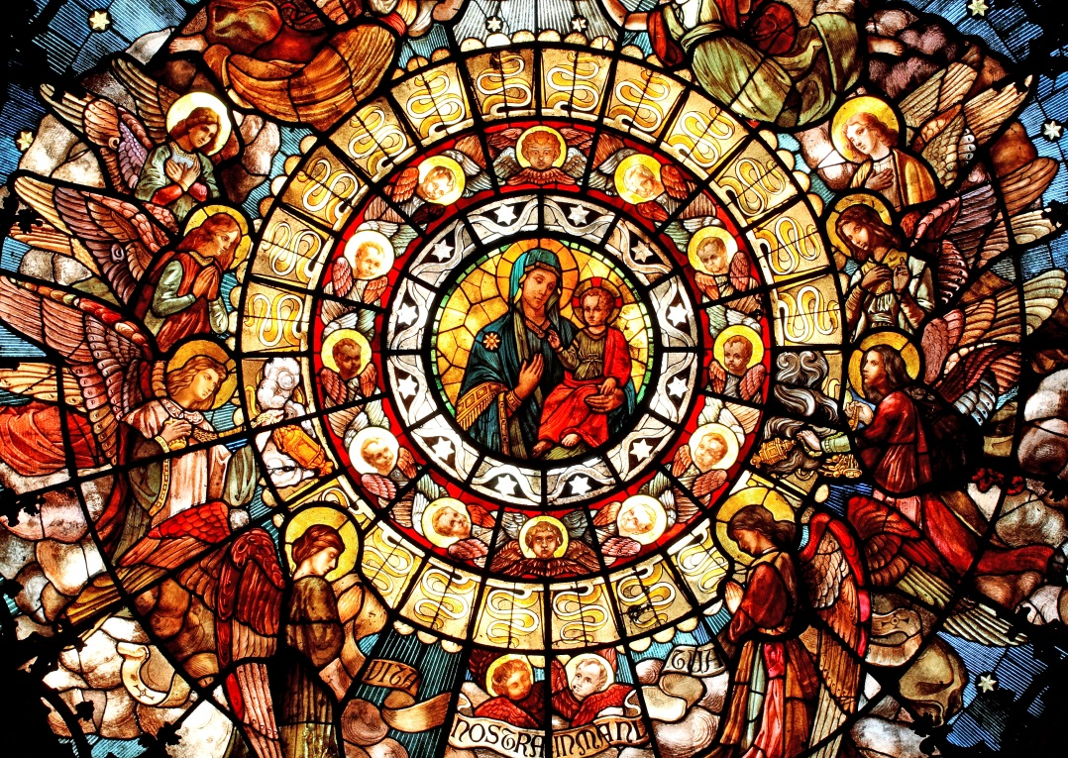
The Mystical Body of Christ
When we are baptized, we become part of a visible, human society and an invisible, divine reality.
All members of the Church are spiritually united as one Body in the divine life of the Blessed Trinity.
© stockbart / iStockphoto.com
Notes:
Point out that Church includes people who are living on earth, being purified in Purgatory, and living in Heaven. Ask what we call this complete community (the Communion of Saints). Explain that a saint is anyone who is trying to live a holy life, with the help of grace.
This slide corresponds to content in article 74, “The Church: Visible and Spiritual,” in the student book.

Slide 6
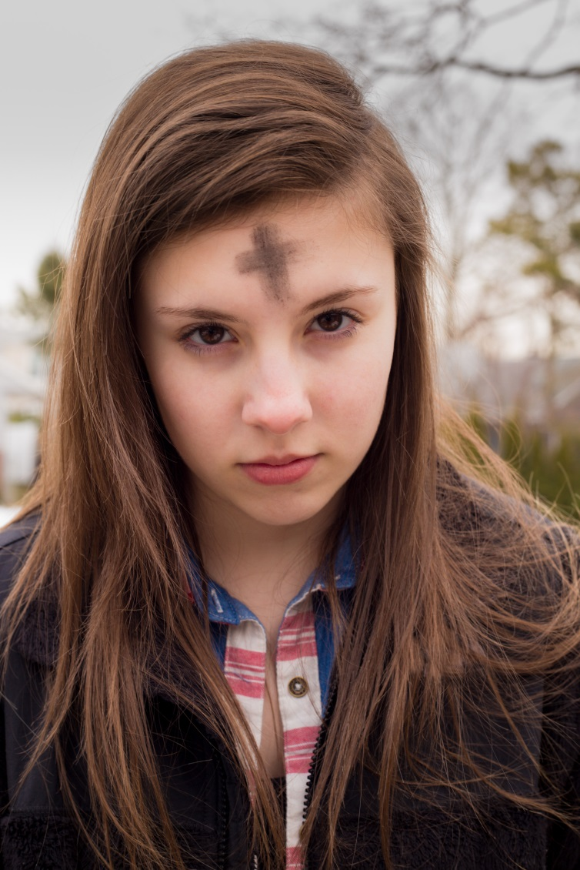
The Resurrection of the Body
After the body dies, the soul separates from the body and goes to meet God.
When Christ comes again in glory, there will be a Final Judgment.
The soul will be reunited with the body in a new and glorified state.
© littleny / Shutterstock.com
Notes:
Direct students to read the Live It! sidebar in article 75 in the student book. Discuss the cultivation of awareness that our true destiny is union with God.
This slide corresponds to content in article 75, “The Christian Understanding of Death,” in the student book.

Slide 7
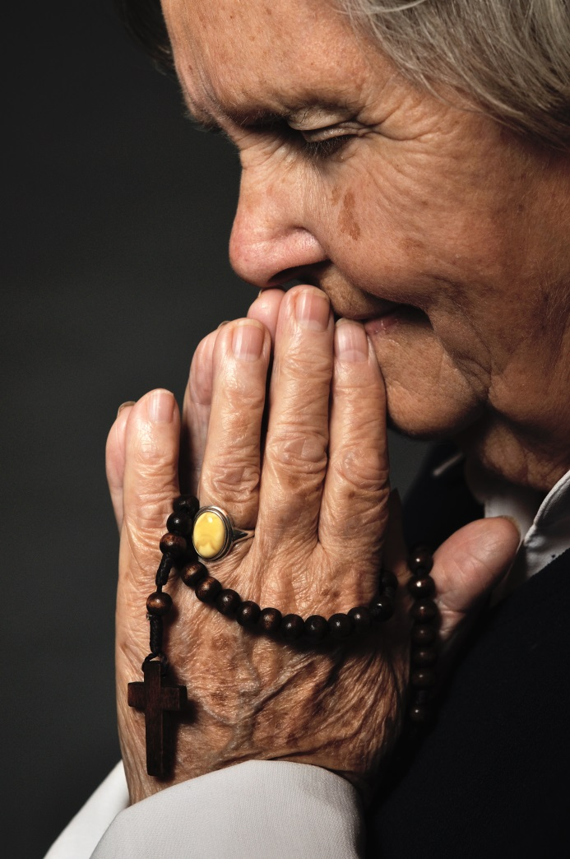
Preparing for Death
Remembering our mortality helps us to know that our time is limited.
It is also a way of growing in faith,
surrendering to God’s divine will,
and trusting that our lives are truly in God’s hands.
© itsmejust / Shutterstock.com
Notes:
Ask the question that concludes article 75 in the student book, “What do you think is meant by the phrase ‘life is changed, not ended’?”
This slide corresponds to content in article 75, “The Christian Understanding of Death,” in the student book.

Slide 8
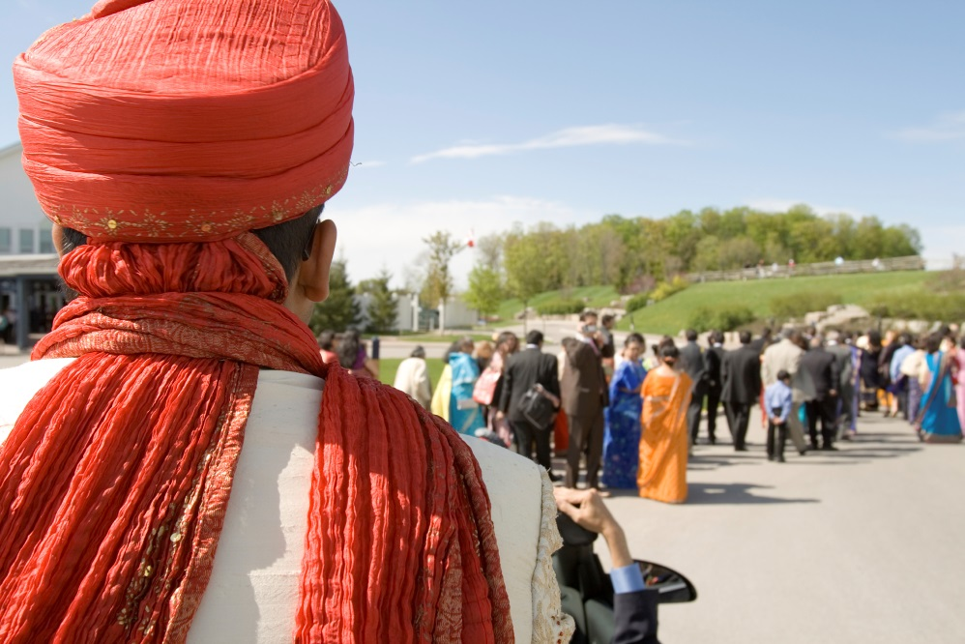
Heaven
At the moment of our death, we will face Christ in the Particular Judgment.
Those who die in God’s grace and friendship go immediately to Heaven.
We cannot really know what Heaven is like until we are there.
© zarinmedia / iStockphoto.com
Notes:
Remind the students of a scriptural metaphor for Heaven: a wedding feast. Brainstorm a list of words that could describe both a wedding feast and life in Heaven.
This slide corresponds to content in article 76, “Heaven, Hell, and Purgatory,” in the student book.

Slide 9
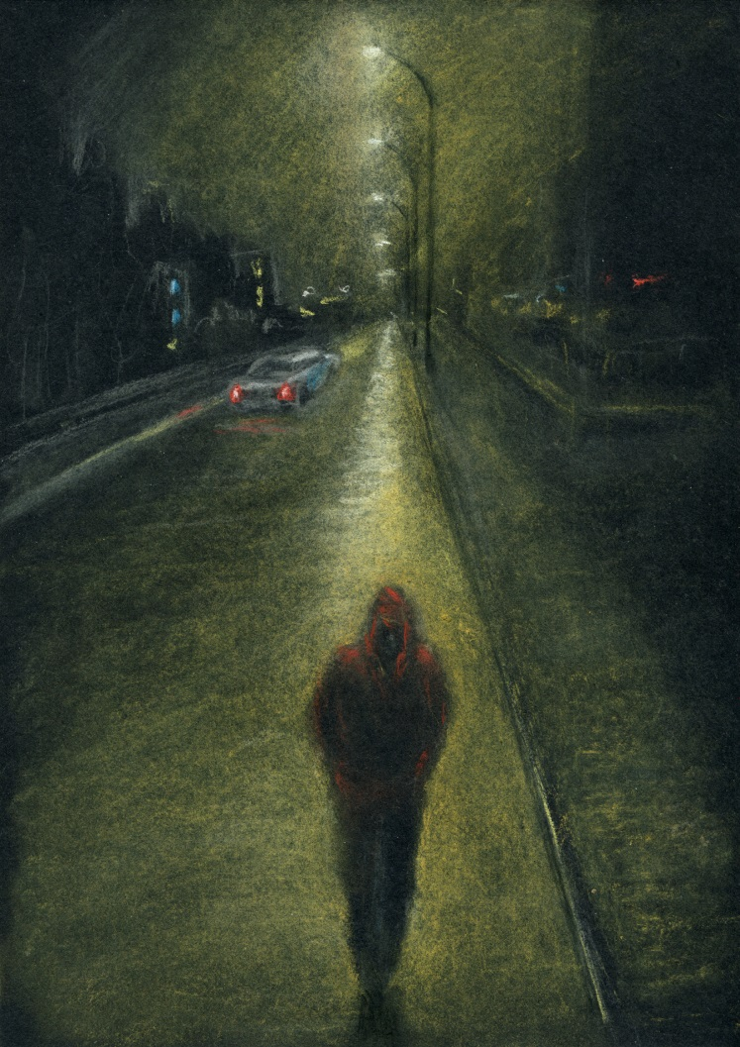
Hell
When we choose evil, we reject the love, grace, and redemption God offers to us.
We choose Hell.
Those in Hell are eternally separated from God.
© g_muradin / iStockphoto.com
Notes:
Read aloud 1 John 4:7–8. Ask, “If Hell is separation from God, and God is love, then what is Hell like?” Brainstorm a list of words that could describe Hell.
This slide corresponds to content in article 76, “Heaven, Hell, and Purgatory,” in the student book.

Slide 10
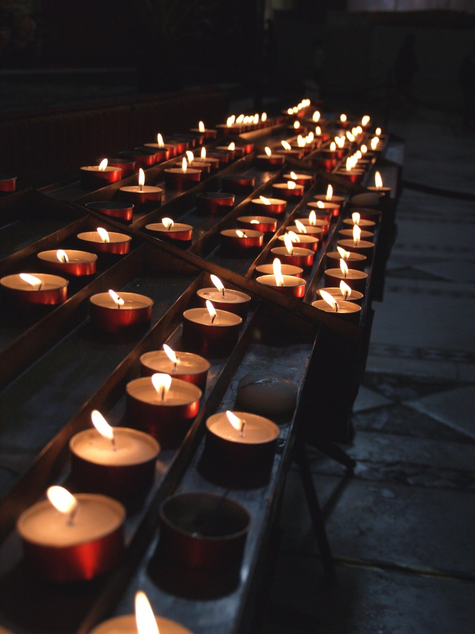
Purgatory
Purgatory is for souls ultimately destined for Heaven but who are not yet pure enough.
Purgatory is a state of final purification or cleansing.
When we pray for the dead, we are interceding for those in Purgatory.
© carbs26 / iStockphoto.com
Notes:
Consider sharing an experience of praying for the dead, either on All Souls Day or throughout the year. Ask for volunteers to share an experience.
This slide corresponds to content in article 76, “Heaven, Hell, and Purgatory,” in the student book.

