Slide 1
Mercy Today
The Paschal Mystery Course
Document # TX001343
Notes:
(Notes: The students will be asked to apply each of the corporal works of mercy to the modern scene. They may work individually or in small groups, listing responses, and then follow up with a class discussion at the end of the presentation. Or, you may wish to lead a class discussion on each slide. Text is drawn from the NAB translation of Matthew 25:37–40.)

Slide 2
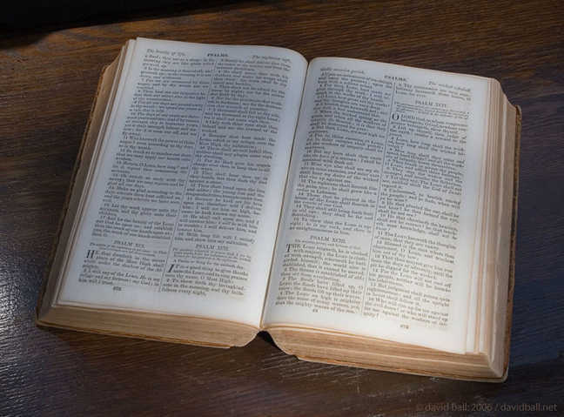
What would the corporal works of mercy look like today?
Image in public domain
Notes:
(Notes: Explain to the students that they will literally decide what the works of mercy “look like” by choosing images to accompany each slide. You may wish to set a number of images per slide, or you can ask for a list.)

Slide 3
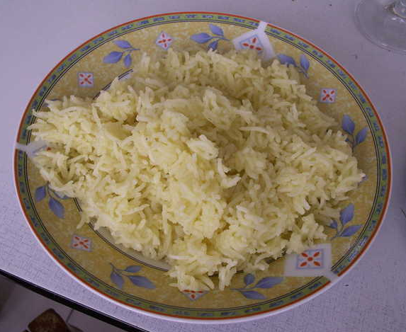
Lord, when did we see you hungry and feed you?
Image in public domain

Slide 4
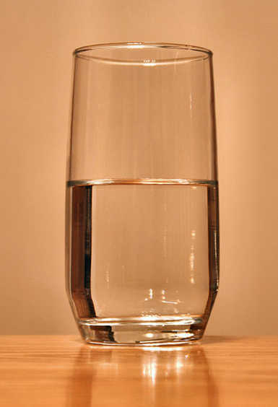
Or thirsty and give you drink?
Image in public domain

Slide 5
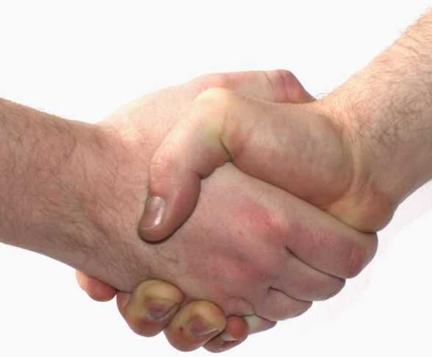
When did we see you a stranger and welcome you?
Image in public domain

Slide 6
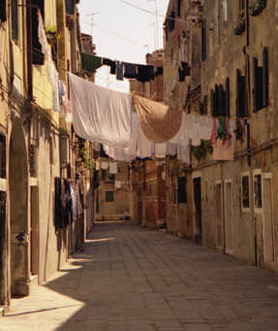
Or naked and clothe you?
Image in public domain

Slide 7
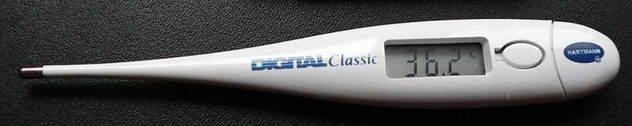
When did we see you ill?
Image in public domain

Slide 8
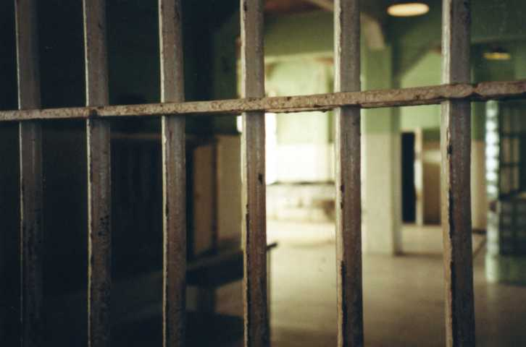
Or in prison, and visit you?
minivannews.com

Slide 9
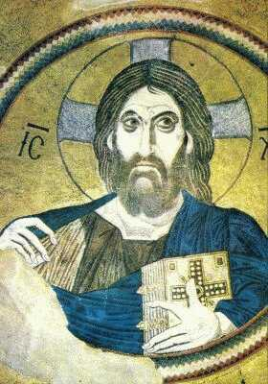
“Amen, I say to you, whatever you did for one of these least brothers of mine, you did for me.”
Image in public domain

