Slide 1
Four Marks of the Church
The Church Course
Document # TX001509

Slide 2
Four Marks
What Are the Four Marks of the Church?
ONE
HOLY
CATHOLIC
APOSTOLIC
Notes:
(Notes: You might ask for input from the students about the four marks before you click for each bullet.)

Slide 3
Nicene Creed
In the Nicene Creed, we profess, “I believe in one, holy, catholic, and apostolic Church.” These are the four marks of the Church.
They are inseparable and intrinsically linked to one another.
Image in public domain

Slide 4
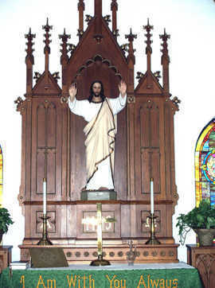
Christ Marked the Church
These characteristics reflect the Church’s essential features and mission.
Through the continued guidance of the Holy Spirit, the Church fulfills these marks.
© flickr.com
Notes:
(Notes: Emphasize that these marks come from Christ, defining both the Church and its mission.)

Slide 5
One
1
How is the Church One?
united in charity
one in the profession of faith
one in the common celebration of worship and Sacraments
one in the Apostolic Succession

Slide 6
One
1
The Church is One because of . . .
its source, the Holy Trinity, a perfect unity of three Divine Persons
its founder, Jesus Christ, who came to reconcile all mankind
its “soul,” the Holy Spirit, who dwells in the souls of the faithful, unites all the faithful into one communion of believers, and guides the Church
Notes:
(Notes: See Catechism of the Catholic Church, 813)

Slide 7
One
1
The “oneness” of the Church is also visible. As Catholics we are united . . .
in our Creed and our other teachings
in the celebration of the Sacraments
in the hierarchical structure based on the Apostolic Succession preserved and handed on through the Sacrament of Holy Orders.

Slide 8
One
1
There is “one body and one Spirit, as you were also called to the one hope of your call; one Lord, one faith, one baptism; one God and Father of all” (Ephesians 4:4–6).
“Because the loaf of bread is one, we, though many, are one body, for we all partake of the one loaf” (1 Corinthians 10:17).
Jesus had promised at the outset that “there will be one flock, one shepherd” (John 10:16).

Slide 9
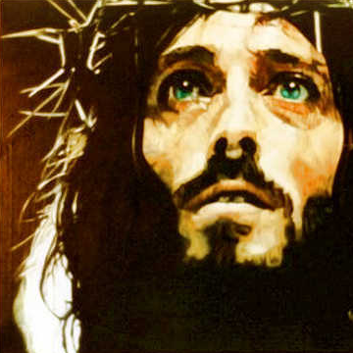
Holy
The Church is Holy because, although Church members sin, the Church as the Body of Christ is sinless.
Image in public domain
Notes:
(Notes: Emphasize this point to the students. We are sinners, but the Church itself remains sinless because it was founded by Christ and, therefore, can never be tarnished or less than perfect.)

Slide 10
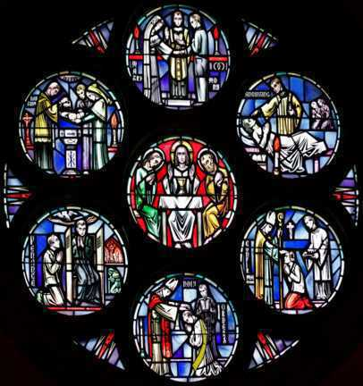
Holy
From the beginning, the Church has been endowed with the sacramental means to help make holy the sinners who are found in the Church.
The Church has been given the Sacraments along with the Word precisely in order to be able to make sinners holy.
© Gene Plaisted

Slide 11
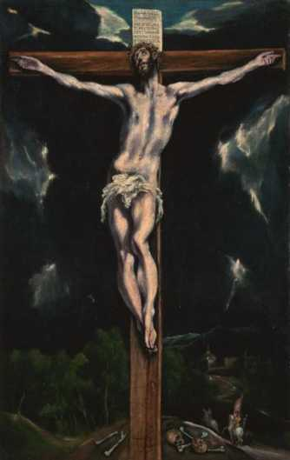
Holy
“Christ loved the Church and handed himself over for her to sanctify her, cleansing her by the bath of water with the word, that he might present to himself the church in splendor, without spot or wrinkle or any such thing, that she might be holy and without blemish” (Ephesians 5:25–27).
Image in public domain
Notes:
(Notes: The holiness of the Church has always had reference to her Divine Founder and to what the Church was founded by him with the power and authority to do, not with the condition of her members.)

Slide 12
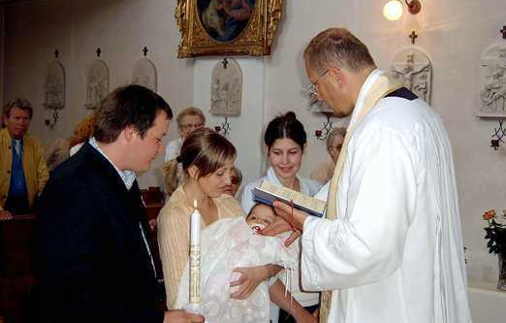
Holy
Each of us as a member of the Church has been called to holiness.
By God’s grace we strive for holiness, through the power of the Holy Spirit.
Image in public domain
Notes:
(Notes: Through Baptism we have been freed from Original Sin; filled with sanctifying grace; plunged into the mystery of our Lord's Passion, death, and Resurrection; and incorporated into the Church, the holy people of God.)

Slide 13
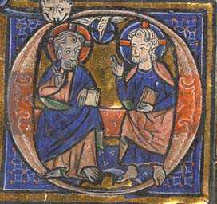
Holy
Our Church has been marked by outstanding examples of holiness in the lives of the saints of every age.
No matter how dark the times may have been for our Church, there have always been those great saints through whom the light of Christ has radiated.
Image in public domain
Notes:
(Notes: You might ask the students for examples of saints who showed the light of Christ during difficult times: Joan of Arc, Saint Benedict, Edith Stein, etc.)

Slide 14
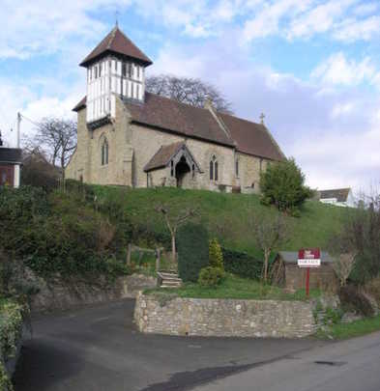
Holy
Even though members of the Church fail and sin, the Church continues to be the sign and instrument of holiness.
Image in public domain

Slide 15
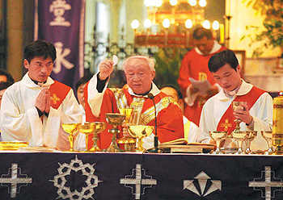
Catholic
When we say the Church is Catholic, we are saying two things:
The Church possesses the fullness of Christ and has received from him the fullness of the means of salvation.
The Church has been sent on a mission by Christ to all people in the world to gather all into the People of God.
© worldpress.com

Slide 16
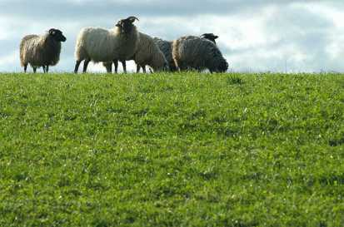
Catholic
The word catholic means “universal.”
At the very beginning, it was difficult to see how the “little flock” (Luke 12:32) in the land of Israel could, by any stretch of the imagination, qualify as universal.
But, through the power of the Holy Spirit, it spread to the ends of the earth.
Image in public domain

Slide 17
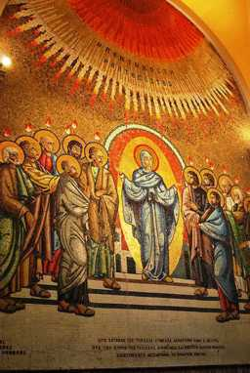
Catholic
The Holy Spirit came down upon the Church at Pentecost at a time when “there were devout Jews from every nation under heaven staying in Jerusalem” (Acts of the Apostles 2:5).
It was to them that the Holy Spirit temporarily enabled the Apostles to speak in the languages of all these various nations—a powerful sign that the Church was destined for all people everywhere.
Image in public domain

Slide 18
Catholic
Many accepted the faith then and there and began carrying “the Catholic Church” back to the four corners of the earth.
“Go, therefore, and make disciples of all nations” (Matthew 28:19).
Image in public domain
Notes:
(Notes: Jesus has commissioned the Church to evangelize the world.)

Slide 19
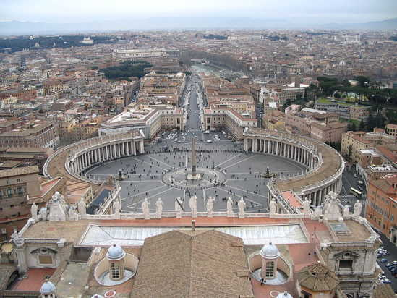
Catholic
The Church is Catholic because it exists for all people and is the means of salvation for all people.
Image in public domain

Slide 20
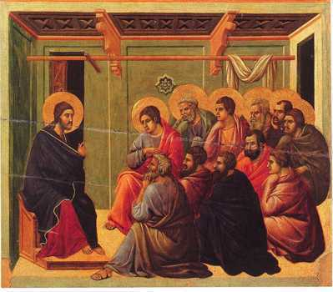
Apostolic
The Church is Apostolic because she is founded on the Apostles.
“Jesus answered them, ‘Did I not choose you twelve?’” (John 6:70).
Jesus sent his Apostles to continue his Father’s mission, and he gave them authority and power.
Image in public domain

Slide 21
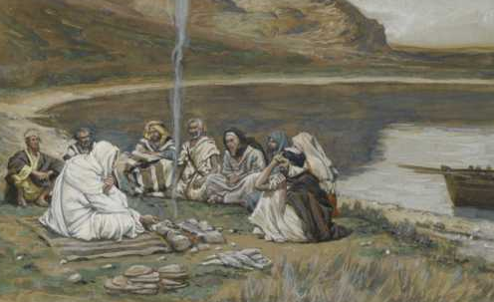
Apostolic
How do we know that the Apostles have the power and authority to pass on to others what they had received from Christ?
“Whoever listens to you listens to me” (Luke 10:16).
Image in public domain
Notes:
(Notes: The Apostles very definitely did have this power and authority; the New Testament evidence is clear about that. With these words, Jesus declared that the Apostles and their successors would speak for him in the serious business of gathering in and sanctifying his People and leading them toward the salvation he offers.)

Slide 22
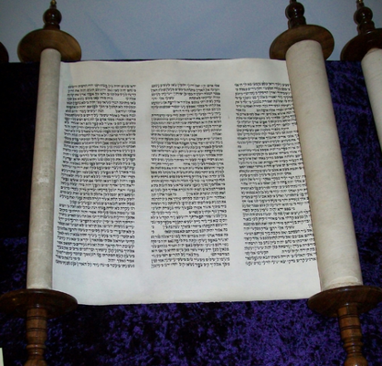
Apostolic
The Church is also Apostolic in that the Deposit of Faith found in both Sacred Scripture and Sacred Tradition was preserved, taught, and handed on by the Apostles.
Image in public domain

Slide 23
Apostolic
Under the guidance of the Holy Spirit, the Spirit of truth, the Magisterium (the teaching authority entrusted to the Apostles and their successors) has the duty to preserve, teach, defend, and hand on this Deposit of Faith.
The Pope and bishops in union with him form the Magisterium, the living, teaching office of the Church.

Slide 24
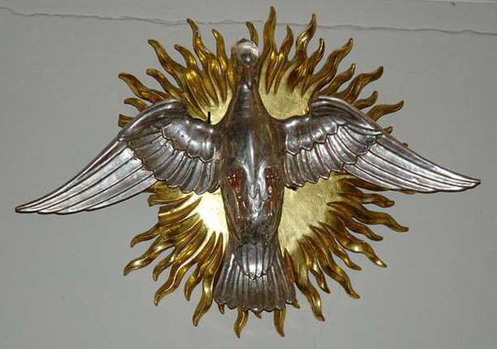
Apostolic
The Holy Spirit protects the Church from error in its teaching authority.
Image in public domain
Notes:
(Notes: This is an important point: the Holy Spirit protects and defends the faith, despite what mankind might try to do to it.)

Slide 25
Apostolic
The Church is Apostolic because she is founded on Jesus’ Apostles in three ways:
She was and is “built upon the foundation of the apostles” (Ephesians 2:20), who lived with and were taught by Jesus.
With the help of the Holy Spirit, the Church preserves and hands on the teaching of the Apostles and their successors.
The Church continues to be taught, made holy, and led by the Magisterium.

Slide 26
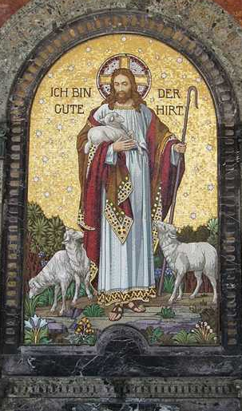
Fullness of Grace
Jesus Christ intended that the fullness of his grace should come to his People in a Church that, from the beginning, was what the Creed still calls it today: “one, holy, catholic, and apostolic.”
Image in public domain

Slide 27
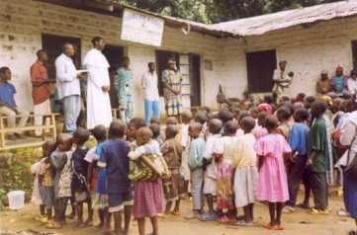
Marks of Mission
Our Lord himself founded the Church and marked it with these characteristics, which reflect its essential features and mission.
Through the guidance of the Holy Spirit, the Church fulfills these marks.
© asodi.org

Slide 28
Our duty, then, as baptized Catholics, is to make these four marks of the Church visible in our daily lives.
Notes:
(Notes: Resources for this presentation include the Catechism of the Catholic Church for use in the United States of America, second edition, number 813. Copyright © 1994 by the United States Catholic Conference, Inc.—Libreria Editrice Vaticana. English translation of the Catechism of the Catholic Church: Modifications from the Editio Typica copyright © 1997 by the United States Catholic Conference, Inc.—Libreria Editrice Vaticana.)

