Slide 1
The Origin of the Church
The Church
Unit 1, Chapter 1
Document #: TX005551
© 2016 Saint Mary’s Press
Living in Christ Series

Slide 2
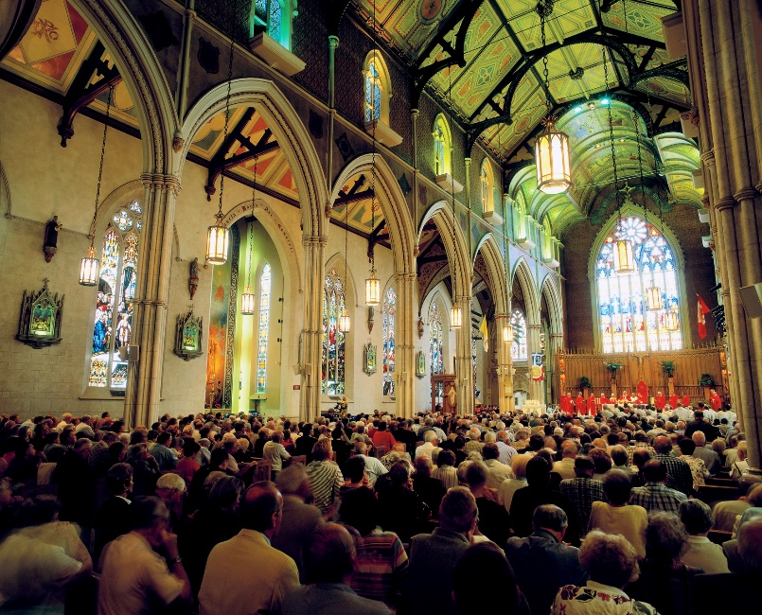
The Meaning of Church:
the entire community of God’s People around the world
the local community, known as a diocese or an archdiocese
the community assembled for liturgy
© Josef Hanus / Shutterstock.com
© 2016 Saint Mary’s Press
Living in Christ Series
Notes:
Notes: Explain the meaning and origin of the Greek word ekklesia, the New Testament term translated church. (See article 1 of the student book.) Ask the students to identify the dioceses they live in and the bishop of each diocese.

Slide 3
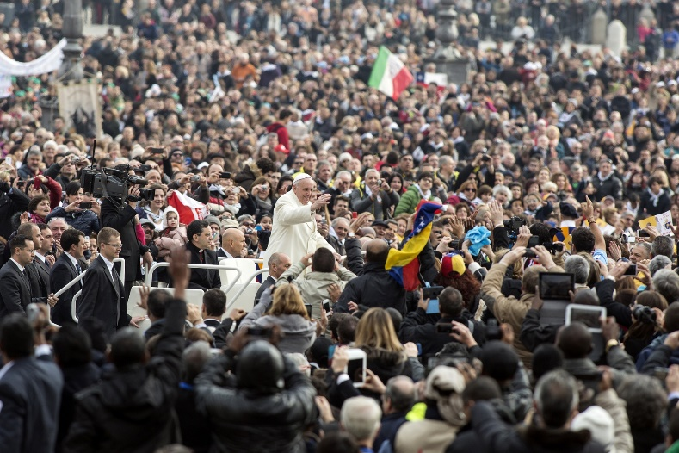
The Father Planned the Church from the Beginning
God gathers us as
his own people in
order to save us.
Christ established
the Church when
he ushered in the
Kingdom of God.
God desires that the whole human race may come together as one Church.
© giulio napolitano / Shutterstock.com
© 2016 Saint Mary’s Press
Living in Christ Series
Notes:
Notes: Review the definition of the Kingdom of God in article 1 of the student book. Ask the question that concludes article 1, “If everyone were to come together as one Church, how might the world be different?”

Slide 4
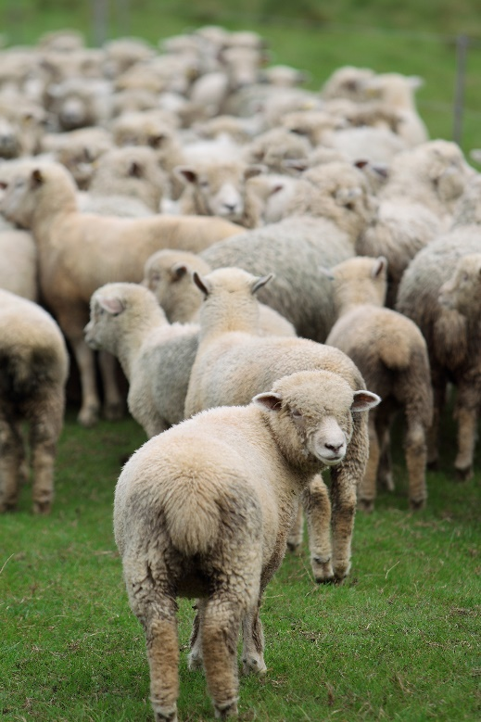
Old Testament Images of the Church
God’s flock of sheep, following him
God’s vineyard, bearing good fruit
a temple, built of living stones
Noah’s ark, saving humankind
© tomocam / Shutterstock.com
© 2016 Saint Mary’s Press
Living in Christ Series
Notes:
Notes: Explain that the Old Testament, together with the New Testament, makes known to us God’s plan of salvation from the beginning of time. Point out that Jesus and early Church leaders drew on Old Testament images to describe the Church.

Slide 5
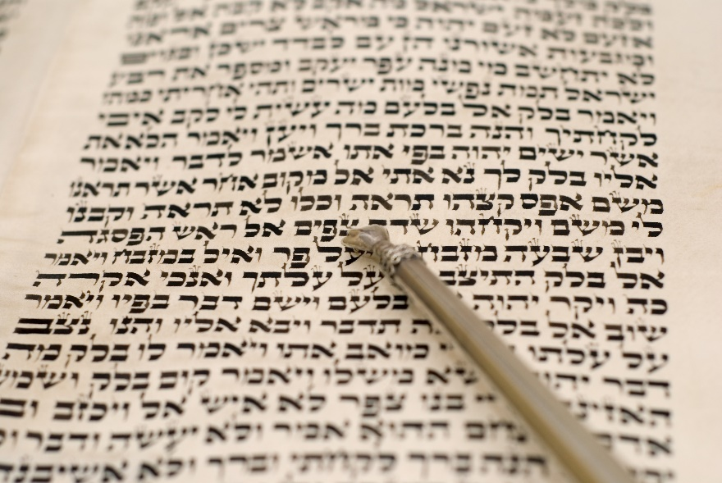
God’s Covenants with Israel
God called Israel as a nation to be his Chosen People as part of his plan of salvation.
Through covenants, God established a relationship with Israel as his Holy People.
© Howard Sandler / Shutterstock.com
© 2016 Saint Mary’s Press
Living in Christ Series
Notes:
Notes: With the students, review the covenants with Abraham and Moses, as in article 2 of the student book.

Slide 6
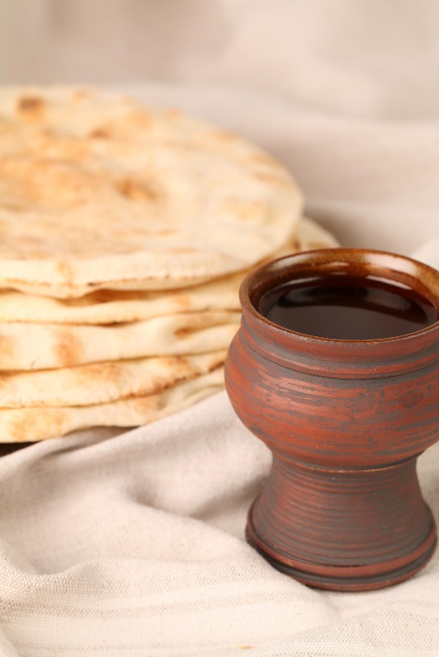
Universal Implications of God’s Call to Israel
God’s special relationship with Israel was not just about Israel.
It foreshadowed the gathering of all into one People of God.
© IngridHS / Shutterstock.com
© 2016 St. Mary’s Press
Living in Christ Series
Notes:
Notes: Point out that the sign of this New Covenant between God and all believers is Jesus’ own Body and Blood.

Slide 7
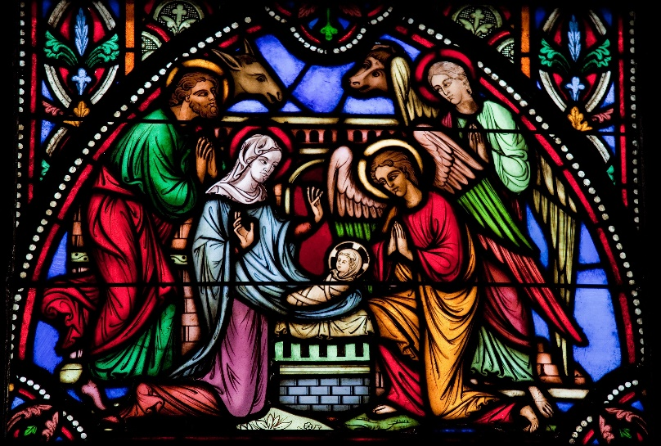
Christ Instituted the Church
Jesus Christ, the
Eternal Word of the
Father, became man
and lived among us.
He took on human
nature without losing
his divine nature.
During his earthly ministry, Jesus inaugurated the Church.
© jorisvo / Shutterstock.com
© 2016 St. Mary’s Press
Living in Christ Series
Notes:
Notes: Review the definition of Incarnation, found in article 3 of the student book. Explain that the following slides explain four different ways Jesus instituted the Church.

Slide 8
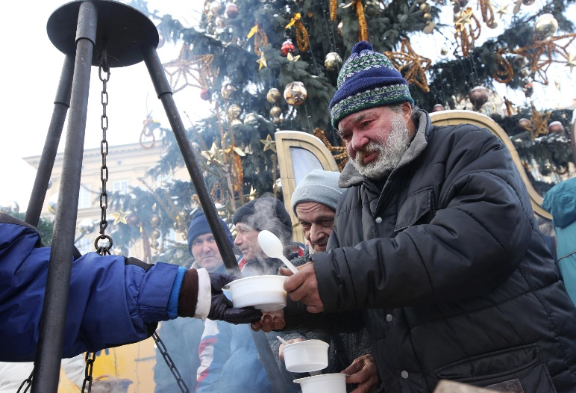
Jesus Preached the Kingdom of God
Jesus drew on the hope announced by the Old Testament prophets.
They had looked
forward to an age
when God’s will
would be done on
earth.
Jesus taught about
the Kingdom in his
actions as well as in his words.
© praszkiewicz / Shutterstock.com
© 2016 St. Mary’s Press
Living in Christ Series
Notes:
Notes: Ask which groups Jesus’ message of hope was especially directed toward (the poor; sinners). Ask what message he directed to the wealthy (take care of the poor).

Slide 9
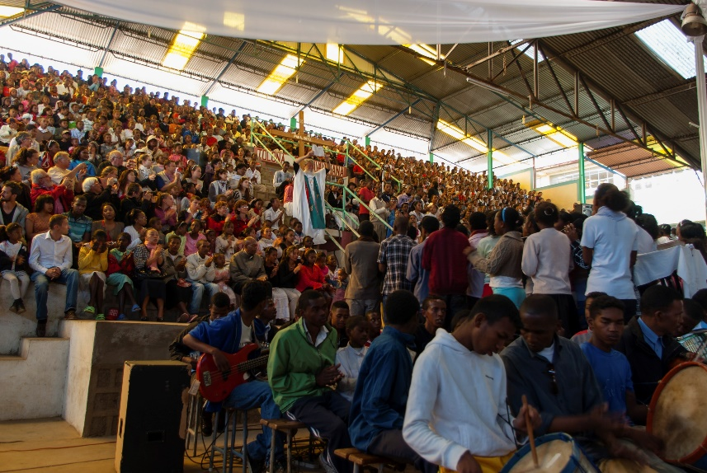
Jesus Sent Disciples
Jesus sent his disciples to preach the Kingdom and to make disciples of all nations.
The disciples became the Church.
The Church is a sign of the Reign of God
mysteriously present in the world.
© Aurelie1 / iStock
© 2016 St. Mary’s Press
Living in Christ Series
Notes:
Notes: Review the definition of the Kingdom of God, found in article 1 of the student book. Discuss how the Church is a sign of the Kingdom, given this definition.

Slide 10
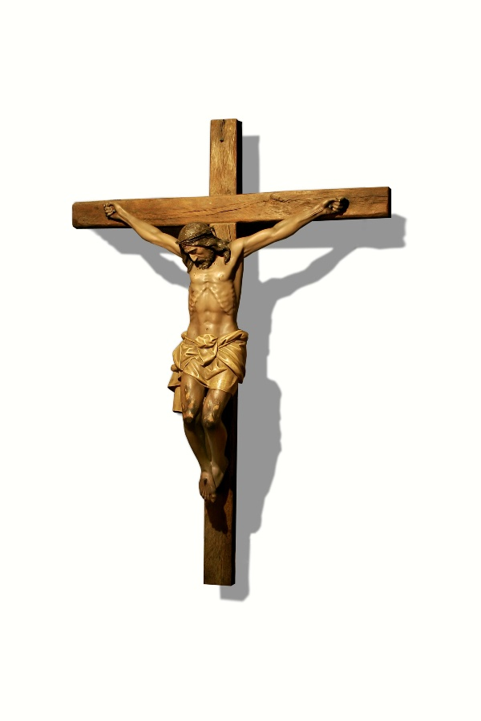
Jesus Gave Himself Fully for the Church
Jesus established the Church
primarily through the saving
gift of himself.
He expressed his complete
self-giving in handing over his
life for the sake of humanity.
© FDS111 / iStock
© 2016 St. Mary’s Press
Living in Christ Series
Notes:
Notes: Discuss the grace and blessings that flow from the Eucharist, as in article 3 of the student book.

Slide 11
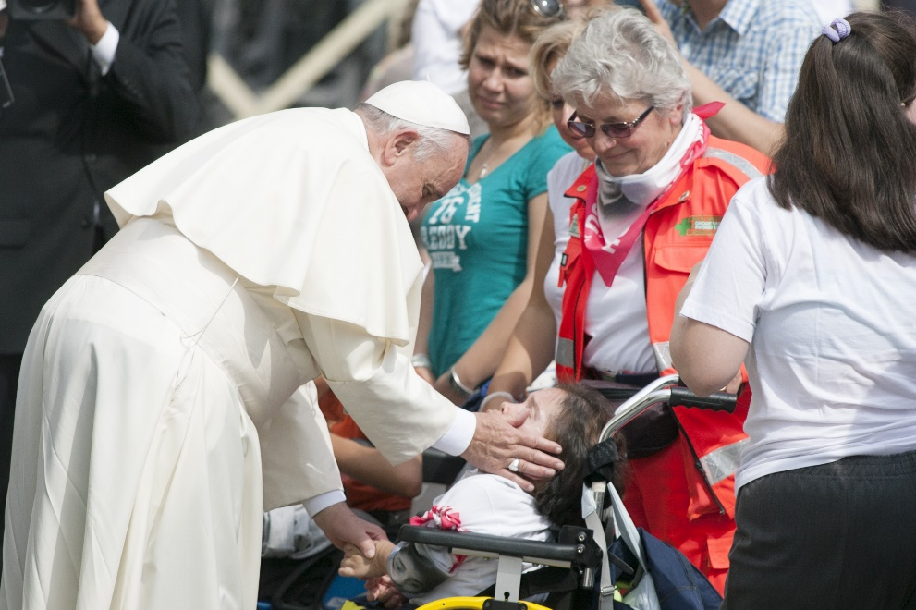
Jesus Created the Structure of the Church
He appointed the Twelve Apostles as leaders of the community.
He gave Peter a special role as the head of the Church.
© 2016 St. Mary’s Press
Living in Christ Series
© giulio napolitano / Shutterstock.com
Notes:
Notes: Point out that Jesus granted these leaders the power and authority to act in his place. Ask the students why Jesus chose twelve apostles. Direct them to read the sidebar “Whom Does Jesus Call?” in article 3 of the student book, and discuss whom Jesus calls.

