Slide 1
Chapter 11: Ancestors of the West
World Religions: A Voyage of Discovery
DOC ID #: TX003948

Slide 2
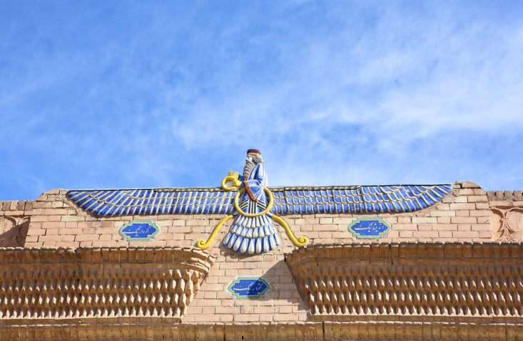
Faravahar
The faravahar is a primary symbol of Zoroastrianism.
It represents Ahura Mazda for some.
Zarathustra worshipped Ahura Mazda as the one true God.
© Vladimir Melnik / www.shutterstock.com
Notes:
Notes: Zoroastrianism is one of the world’s earliest examples of a monotheistic religion. Along with symbolizing Zoroastrian religion, the faravahar has, in the twentieth century, been used as a symbol of Iran.

Slide 3
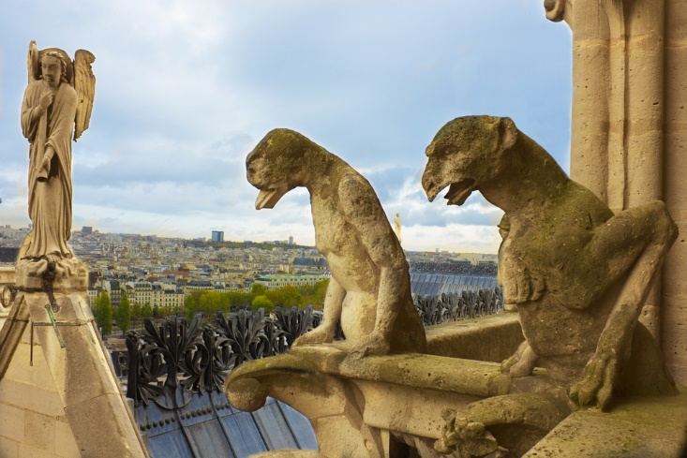
Angels and Demons
Zoroastrianism maintains complex beliefs regarding angels and demons.
Angels and demons, the forces of good and evil, are believed to be at battle.
Zoroastrianism has influenced Judaism, Christianity, and Islam with regard to angels and demons.
© eska2005 / www.shutterstock.com
Notes:
Notes: The angel and gargoyles shown in this slide are on Notre Dame Cathedral, in Paris. Though Jewish belief in angels and demons is not necessarily entirely dependent on Zoroastrianism, Jewish angelology and demonology underwent significant development after the period of Babylonian Exile, during which there was more extensive contact with Zoroastrians.

Slide 4
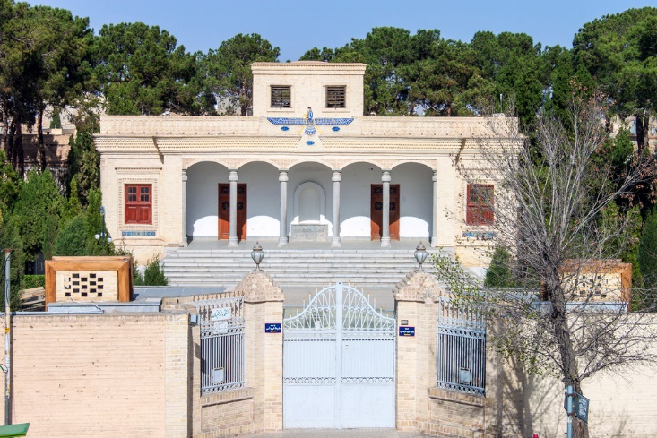
Ateshkadeh Fire Temple
The fire temple is the main place of Zoroastrian worship.
In the fire temples, a sacred fire burns continuously.
Fire is symbolic of purity and of God.
© M R / www.shutterstock.com
Notes:
Notes: The Ateshkadeh Fire Temple in Yazd, in central Iran, is one of many Zoroastrian fire temples. The fire in this temple has been burning for over fifteen hundred years. Fire ritual is also important for Hinduism, and in ancient Rome the Vestal Virgins were responsible for maintaining the sacred fire in the Temple of Vesta. You might explore these comparative phenomena in more detail with the students, or perhaps you might ask the students to comment regarding their perspectives on fire and why it might be popular as a means of religious worship.

Slide 5
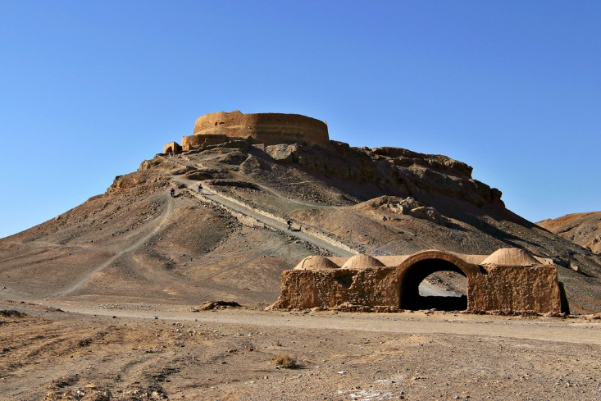
Tower of Silence
Zoroastrian funerary practices involve exposure of the body on a “Tower of Silence.”
The body is left to be consumed by scavengers, typically vultures.
It is believed that a dead body is impure, and that this manner of disposal minimizes further pollution.
© Massimiliano Lamagna / www.shutterstock.com
Notes:
Notes: The Persian term for Tower of Silence is dakhma. For a quick study in the complexities involved in trying to get permission to dispose of the dead in this manner in the United States, consider the case of the Ethician Church in Texas: http://www.towerofsilence.org/.

Slide 6
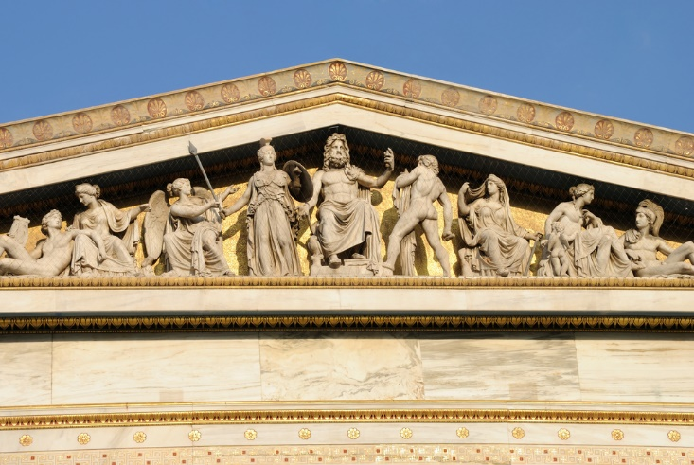
Olympian Pantheon
The Olympians include Zeus and his siblings:
Hera (also his wife)
Poseidon
Hades
Demeter
Hestia (who seldom appears in Greek myth)
Zeus’s children also are Olympians:
Athena
Apollo
Artemis
Ares
Aphrodite
Hermes
Hephaestus
Dionysus
Persephone
© TeoXanthi / www.shutterstock.com
Notes:
Notes: The Olympians are so named because of their home on the lofty peak of Mount Olympus. Ancient lists normally numbered twelve, although the specific set varied. Hades (god of the underworld), Hestia, and Persephone were often left off the list. The (unidentified) temple building on this slide is obviously a modern construction, but the pediment sculptures are not unlike those that originally adorned the Parthenon in Athens.

Slide 7
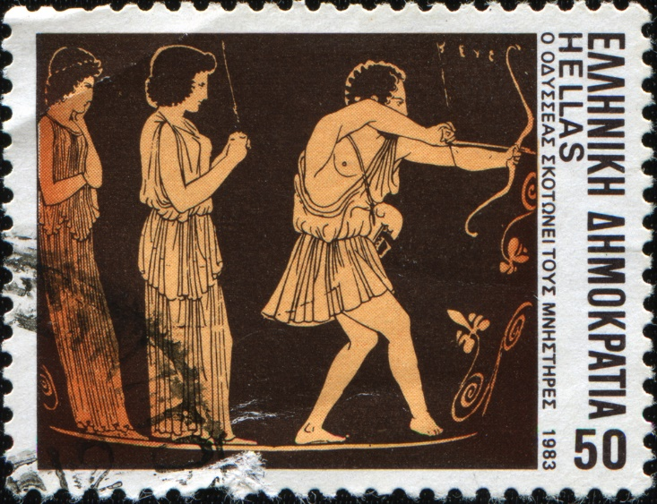
Odysseus Kills the Suitors
Homer’s Odyssey features Odysseus’s return home and his revenge against those who tried to take his wife, Penelope, and his possessions.
Zeus and his daughter Athena support Odysseus’s pursuit of justice.
Homer’s poem therefore sets forth elements of theology.
© IgorGolovniov / www.shutterstock.com
Notes:
Notes: This Greek postage stamp features a scene from an ancient vase painting. One of the primary themes of Homer’s Odyssey involves Odysseus’s revenge against the suitors who, while he was away at the Trojan War and then through ten years of wanderings, ravaged his palace and his possessions. The J. Paul Getty Museum offers a search option on its website; several ancient artworks involving Homeric scenes are accessible: http://www.getty.edu/museum/index.html.

Slide 8
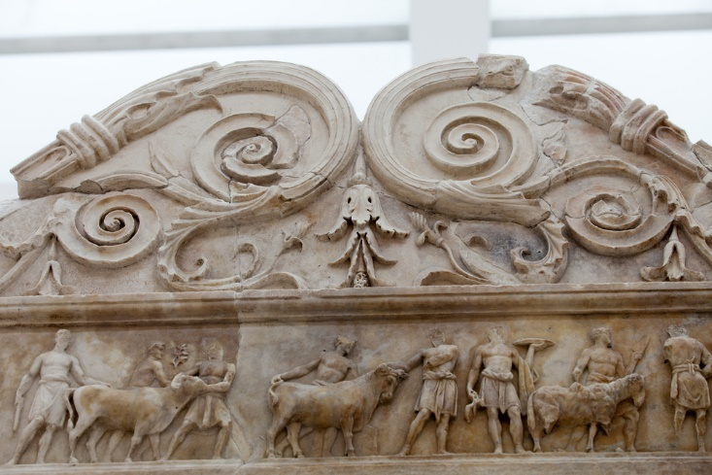
Ara Pacis
The Altar of Augustan Peace is commonly known as the Ara Pacis.
It features reliefs of Roman state religious processionals.
The Romans, like the Greeks, believed that the gods favored receiving sacrifices.
© wjarek / www.shutterstock.com
Notes:
Notes: The sacrificial victims—on this slide a sheep and two bovines—are led to an altar, in front of which the sacrifice will take place, presided over by a priest, often the emperor himself, who also held the office of Pontifex Maximus, chief priest of Roman state religion. Sacrifice was believed to please the gods in order that they might be benevolent toward the people. The website of the Ara Pacis Museum (in which the Ara Pacis is situated) provides extensive and dependable information: http://en.arapacis.it/.

Slide 9
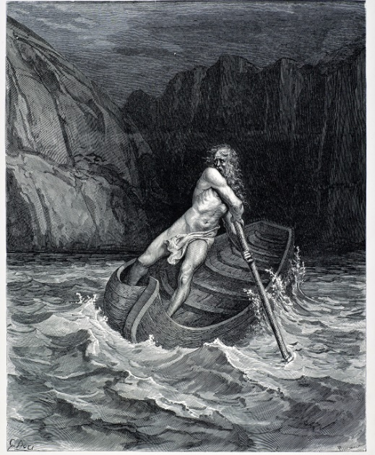
Charon, the Ferryman of Hell
Charon is believed by the Greeks and Romans to ferry dead souls across a river to their permanent home in the underworld.
The Greeks and Romans tended to think of the underworld as an unhappy place where souls had no hope for improvement.
© duncan1890 / www.istockphoto.com
Notes:
Notes: The painting shown on this slide is based on an early scene in Dante’s Inferno, but it could just as well be based on Vergil’s Aeneid, the greatest Roman literary work. Vergil, drawing many of his ideas from Homer, filled his poem the Aeneid with religious ideas and characters. Charon appears in the Aeneid in Book 6, line 229 and following. He also appears in three plays by Aristophanes: Frogs (180f.), Lysistrata (606), and Plutus (278). In the Inferno, Charon is featured in the third canto (82f.).

Slide 10
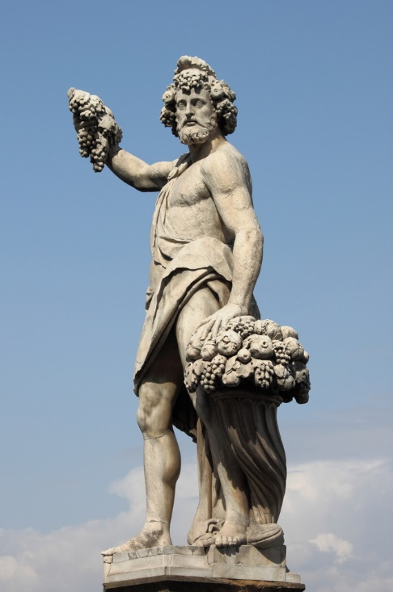
Portrait of Dionysus
Dionysus (or Bacchus) was venerated as god of wine.
He also was god of vegetation and of ecstasy.
Worship of Dionysus led to the invention of drama.
© alessandro0770 / www.shutterstock.com
Notes:
Notes: The so-called mysteries of Dionysus provided worshippers an opportunity for release from the normal bonds of social conformity. It is possible that worshippers anticipated a better afterlife because of their devotion to Dionysus. The other most significant mystery religions of the Greco-Roman world are the Eleusinian mysteries (of Demeter and Persephone), the cult of Cybele (Magna Mater in Rome), the cult of Isis, and the cult of Mithras. (The terms cult and mysteries can be used interchangeably.)

Slide 11
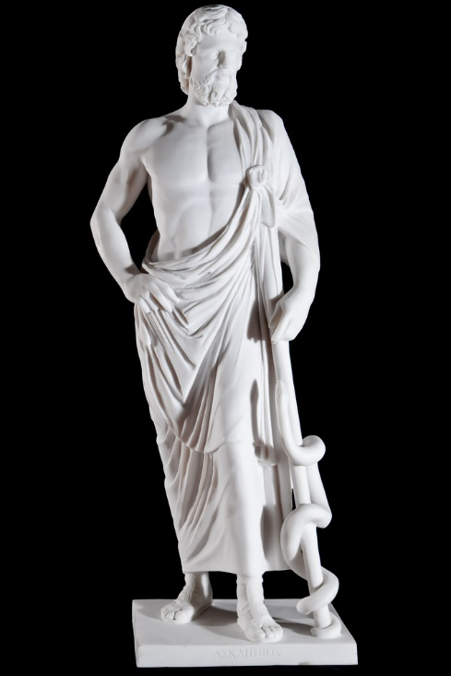
Asclepius
Worship of Asclepius was very popular among those who sought healing.
Asclepius was a son of Apollo and the father of Hygieia (“Health”) and several other children involved in healing.
He was hailed as Soter (“Savior”).
© Denis Kornilov / www.shutterstock.com
Notes:
Notes: Whereas views among the ancient Greeks and Romans regarding prospects for a good afterlife seem to have varied quite widely, almost everyone believed that better health could be secured through worship of the right deities. Some of the practices at the shrines of Asclepius, called Asclepions, involved medical techniques somewhat akin to those of modern times. Other practices were more purely “religious.” The two most important Asclepions were at Epidaurus on the Greek Peloponnesus, and on the island of Kos, home of the famous physician Hippocrates.

