Slide 1
The Fundamentals of Prayer
The Paschal Mystery
Unit 5, Chapter 11
Document #: TX005442

Slide 2
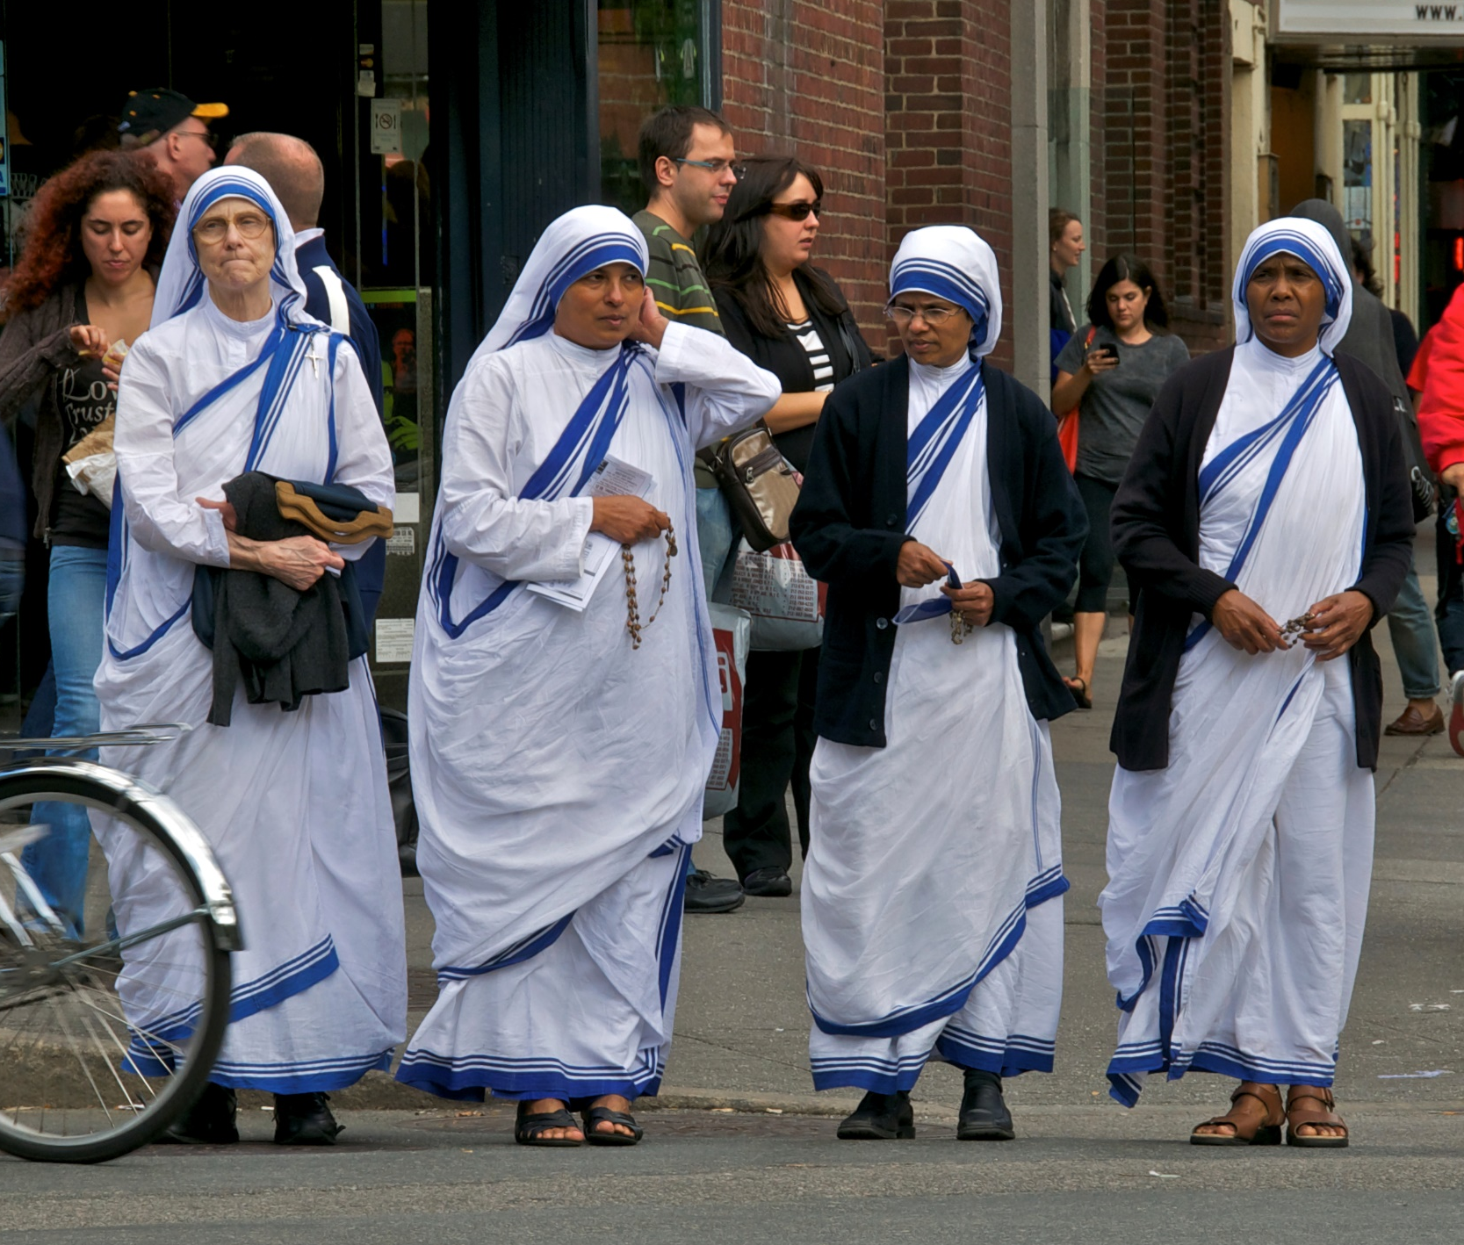
Prayer Defined
“Prayer is the raising of one’s mind and heart to God . . .
“. . . or the requesting of good things from God.”
Prayer is more than words.
It includes insight and affection.
© JayLazarin / istock
Notes:
Notes: Direct the students to read the two quotations in the Primary Sources sidebar, “Being Prayerful Means More Than Saying Prayers,” in article 42 of the student text. Discuss the meaning of these two statements.
This slide corresponds to student text content in article 42.

Slide 3
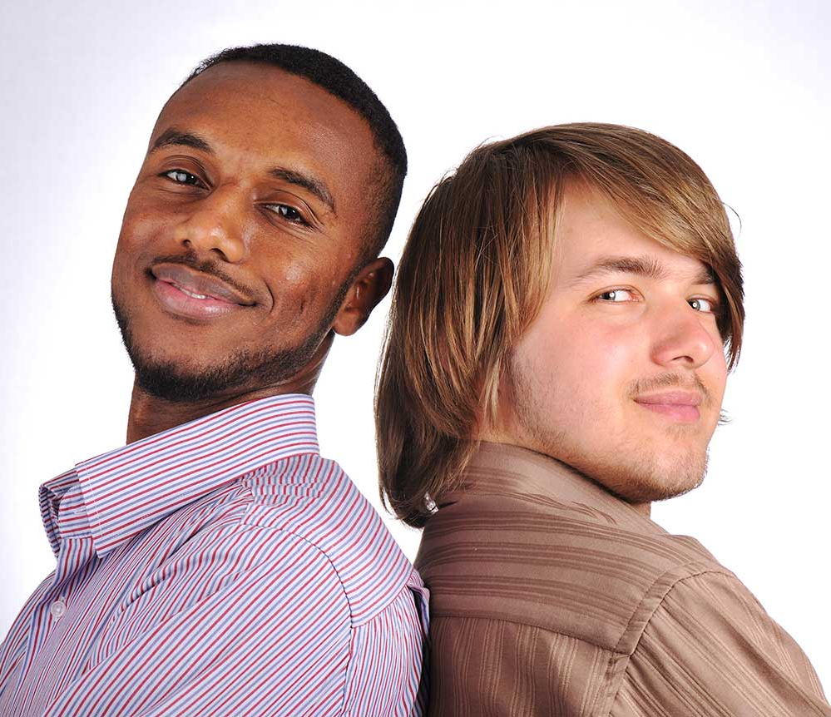
Prayer Forms Us
When we regularly raise our mind to God in prayer, our intellect is shaped by our closeness to him.
Prayer can enable us to give fully of ourselves in our relationships with God and others.
© Zurijeta / Shutterstock
Notes:
Notes: Ask volunteers to explain each bullet point, according to how they’re described in the section “Prayer Defined“ in article 42 of the student text.
This slide corresponds to student text content in article 42.

Slide 4
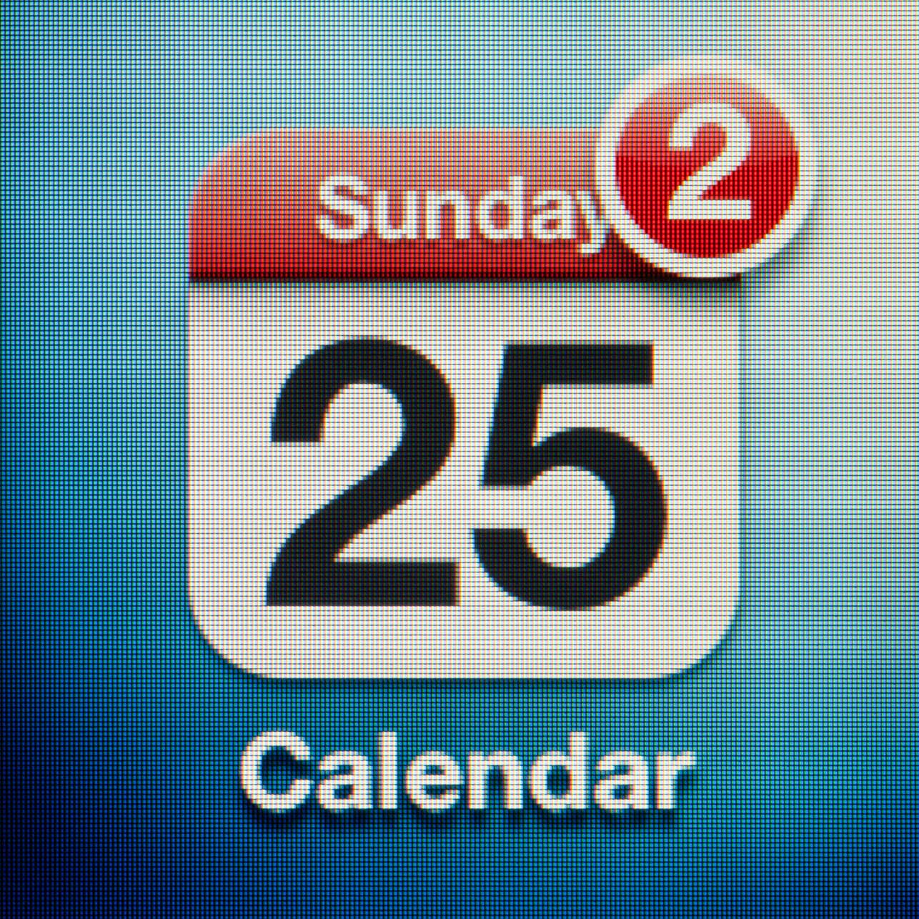
Everyone Is Called to Prayer
All people have an innate desire for God.
Prayer is a response to God, who first calls us to encounter him.
In prayer God reveals himself to us, and we learn about ourselves.
© Roma_ / istock
Notes:
Notes: Point out that the Church offers us many opportunities to pray and to learn about prayer. Ask for examples from the students’ parishes (see the section “Everyone Is Called to Prayer” in article 42 of the student text for examples). Ask for suggestions for making time for regular prayer.
This slide corresponds to student text content in article 42.

Slide 5
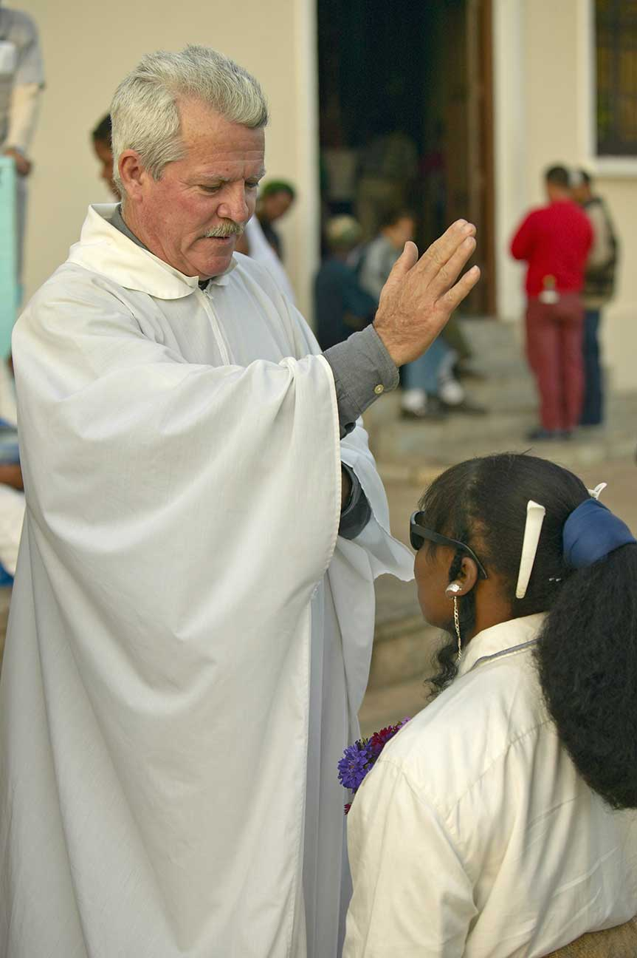
Forms of Prayer
A blessing is a response to God’s many gifts.
Sometimes a blessing invokes God’s power and care over a person, object, place, or event.
Adoration acknowledges that we are creatures before the One who created us.
A petition asks God for something we need.
© Joseph Sohm / Shutterstock
Notes:
Notes: Ask volunteers to share examples of blessings they have received or witnessed (blessings of objects such as class rings, of homes, animals, and so on).
This slide corresponds to student text content in article 43.

Slide 6
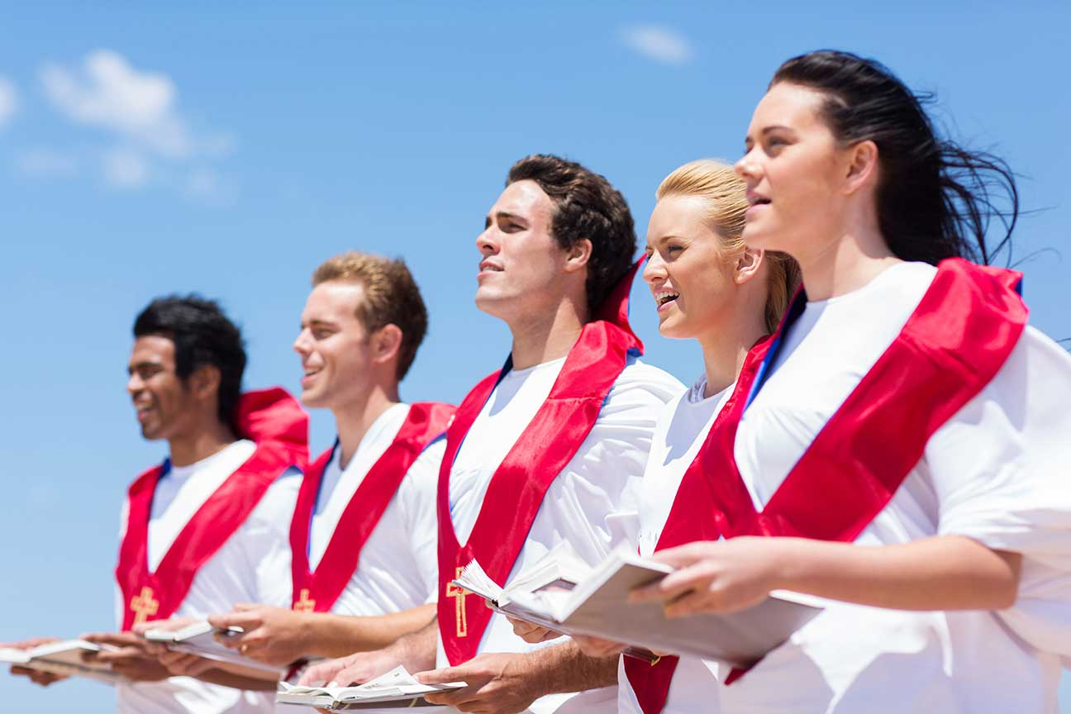
More Forms of Prayer
Intercession is asking God’s help for another person.
Thanksgiving recognizes that all we have comes to us as a gift from God.
Praise expresses our love for God simply because God is.
The Gloria at Mass, a doxology, and the term alleluia all praise God.
© michaeljung / Shutterstock
Notes:
Notes: Explain that the prayer “Glory be to the Father . . .” is often called the doxology, but the term can apply to any short hymn of praise. If the students have Bibles, invite them to find these doxologies: Ephesians 3:20–21; 1 Timothy 1:17; Jude 25; Revelation 7:12.
This slide corresponds to student text content in article 43.

Slide 7
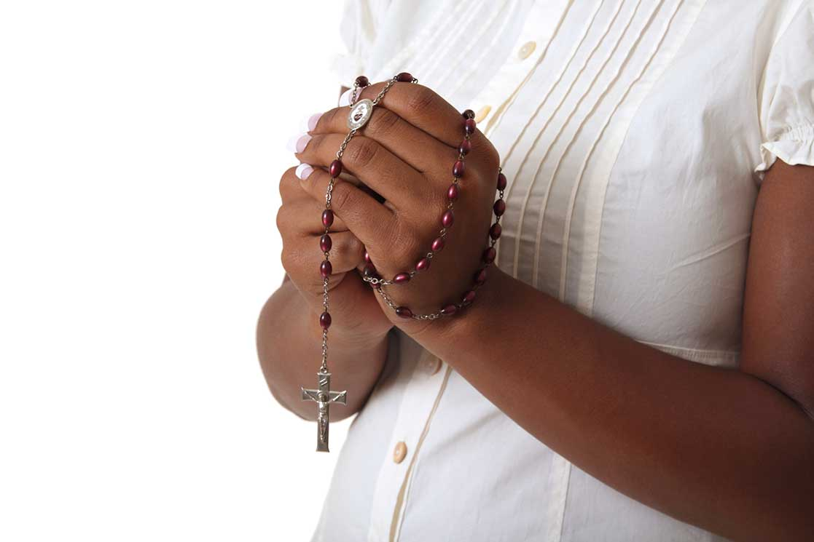
Expressions of Prayer
Vocal prayer uses words either spoken aloud or recited silently.
In meditation, we ponder God’s presence and activity in our life and in the world.
Contemplative prayer involves deep awareness of the presence of God.
© princessdlaf / istock
Notes:
Notes: Discuss some springboards to meditation, as in the section “Meditation” in article 44 of the student text: lectio divina, liturgical texts of the day or season, holy writings, the Rosary, icons, and all creation.
This slide corresponds to student text content in article 44.

Slide 8
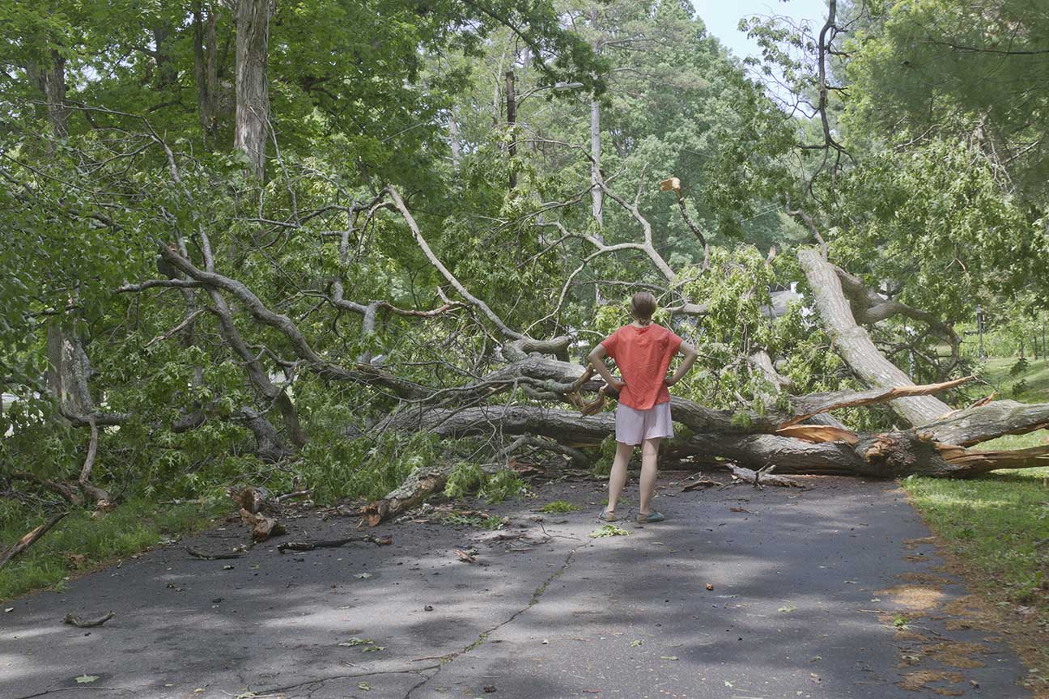
Overcoming Obstacles to Prayer
Developing a consistent and regular prayer life is often challenging.
Those great saints who said that prayer is a battle left us advice.
© J. Bicking / Shutterstock
Notes:
Notes: Discuss why a consistent and regular prayer practice is helpful.
This slide corresponds to student text content in article 45.

Slide 9

Misconceptions about Prayer
Prayer is merely a psychological activity.
It requires us to rattle off memorized words.
It requires expertise.
We should spend every waking moment in prayer.
© pictafolio / istock
Notes:
Notes: Explain that prayer is a sign of our communion with God. Ask why each statement is incorrect, in light of that fact. Highlight the words of Origen in the section “Misconceptions about Prayer,” in article 45, as encouragement in prayer.
This slide corresponds to student text content in article 45.

Slide 10

Difficulties in Prayer: Distraction and Dryness
Distractions reveal our preferences and attachments.
Dryness is feeling separated from God and losing the joy and peace of prayer.
We can turn our focus back to the Lord.
© wragg / istock
Notes:
Notes: Explain the statement that distractions reveal which master we serve. Ask for examples. Encourage the students to think of ways to let distractions go and to turn back to God when they are praying. Consider sharing a method that has worked for you.
This slide corresponds to student text content in article 45.

Slide 11
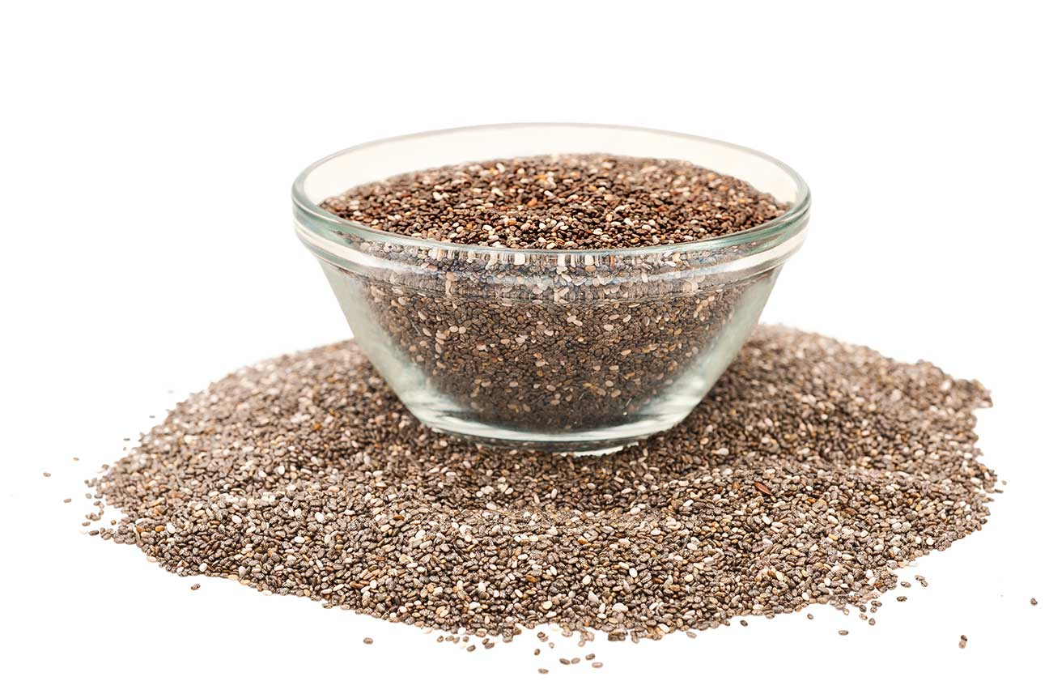
Difficulties in Prayer: Darkness
Spiritual darkness can begin with dryness due to carelessness . . .
. . . or it can be as profound as feeling that we have been abandoned by God.
We can see these moments as times when our love for God is being purified.
© Scisetti Alfio / Shutterstock
Notes:
Notes: Read aloud the modern-day parable at the end of article 45 of the student text. Ask why discouragement is the most effective seed of sin.
This slide corresponds to student text content in article 45.

Slide 12
Ignatian Gospel Meditation
Use your imagination to immerse yourself in a story from the Bible.
Pay careful attention to all you are feeling and thinking.
Respond in prayerful conversation with Jesus.
Notes:
Notes: Explain that imagining yourself as part of a Gospel story can be a very powerful way to hear the voice of God. Invite the students to try this type of prayer using one of the passages listed at the end of the section “The Method,” in article 46 of the student text.
This slide corresponds to student text content in article 46.

