Slide 1
Sacred Scripture and the Life of the Church
The Living Word: The Revelation of God’s Love, Second Edition
Unit 5, Chapter 16
Document#: TX004694

Slide 2

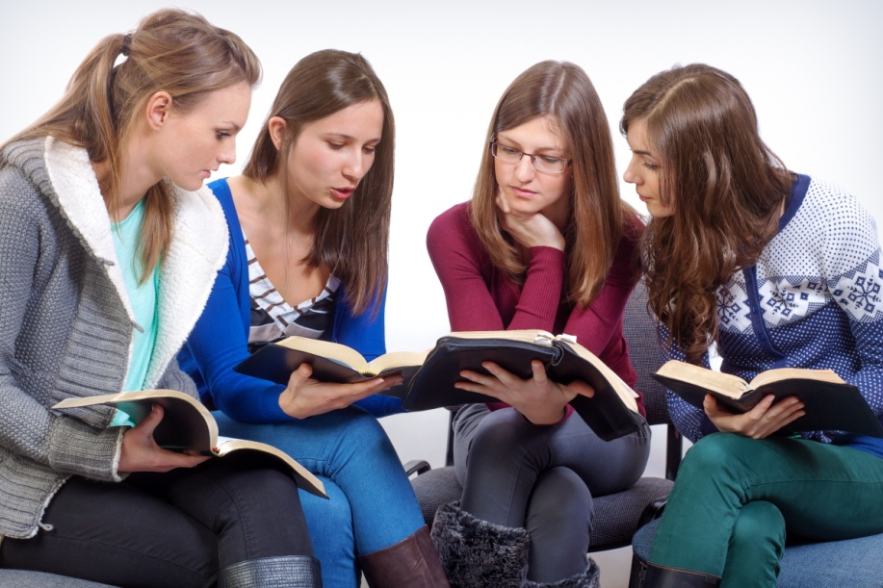
The Study of Sacred Scripture
We must know Sacred Scripture to understand the saving action of God.
The Magisterium has the responsibility of interpreting, teaching, and proclaiming the Word.
© George Muresan / Shutterstock.com
Notes:
Notes: Ask the students to name examples of “life’s big questions.” Brainstorm the ways people look for the answers in the information age; include ways that Catholics can trust.
This slide corresponds to content in article 76, “The Study of Sacred Scripture,” in the student book.

Slide 3
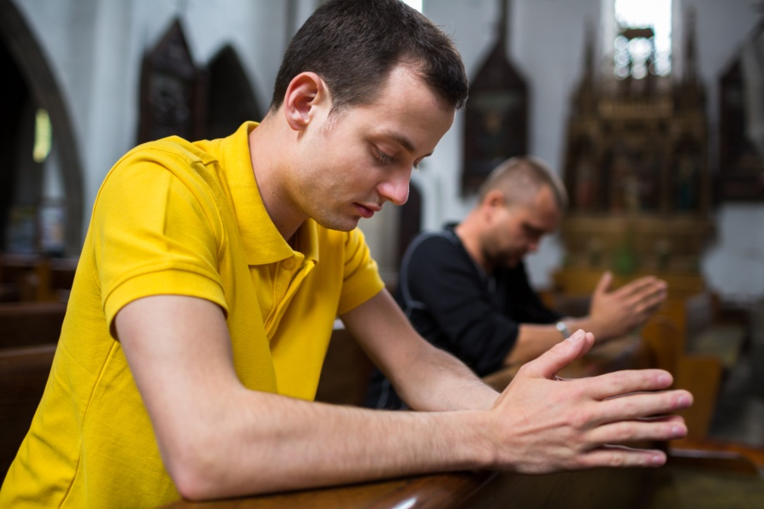
The Heart of the Mass
The Liturgy of the Word contains readings from Scripture.
Scripture is also present in the Liturgy of the Eucharist, as it makes present the saving work of the Paschal Mystery.
© lightpoet / Dollar Photo Club.com
Notes:
Notes: Ask the students to identify the source of the readings included in the Liturgy of the Word on most Sundays (Old Testament, Psalm, New Testament, Gospel).
This slide corresponds to content in article 77, “The Central Place of Sacred Scripture in the Mass and Other Liturgies,” in the student book.

Slide 4
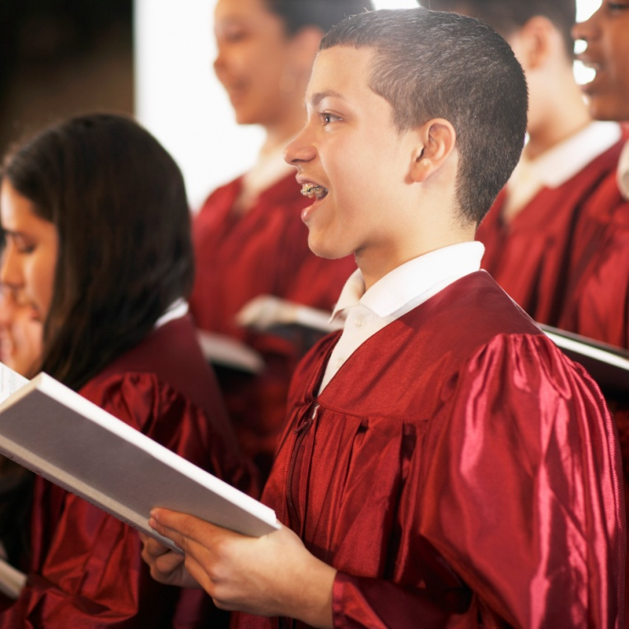
The Heart of All Worship
Scripture provides the foundation for the celebration of all the Sacraments.
Liturgical music is
steeped in Sacred
Scripture.
© Fuse / Thinkstock
Notes:
Notes: One by one, challenge each student to name a hymn (or Christmas carol) that draws on Scripture.
This slide corresponds to content in article 77, “The Central Place of Sacred Scripture in the Mass and Other Liturgies,” in the student book.

Slide 5
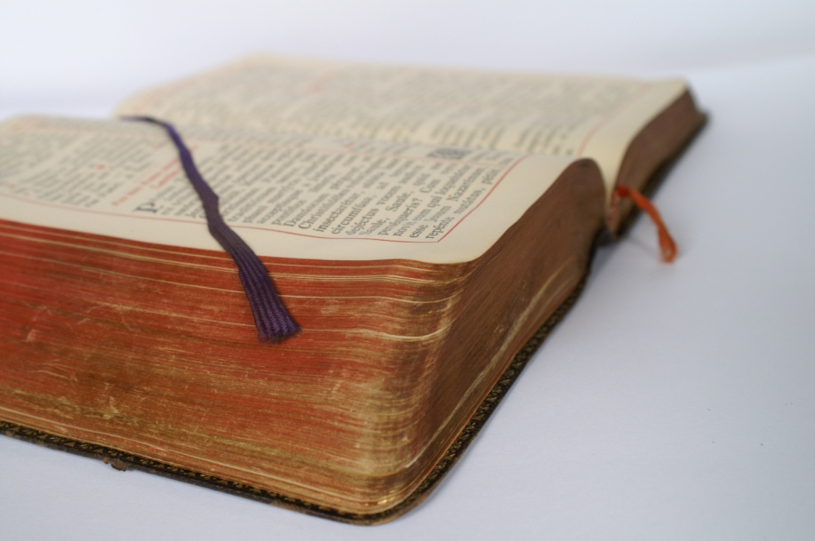
The Liturgy of the Hours
This prayer is the official, public, daily prayer of the Catholic Church.
It is prayed at regular hours throughout the day.
It is also known as the Divine Office.
© Marijus Auruskevicius / Thinkstock
Notes:
Notes: Explain to the students that all priests and deacons commit to praying the Divine Office daily, as do many lay Catholics; it also forms the basis for prayer in many religious communities.
This slide corresponds to content in article 78, “The Liturgy of the Hours: A Window into the Daily Rhythms of Life,” in the student book.

Slide 6
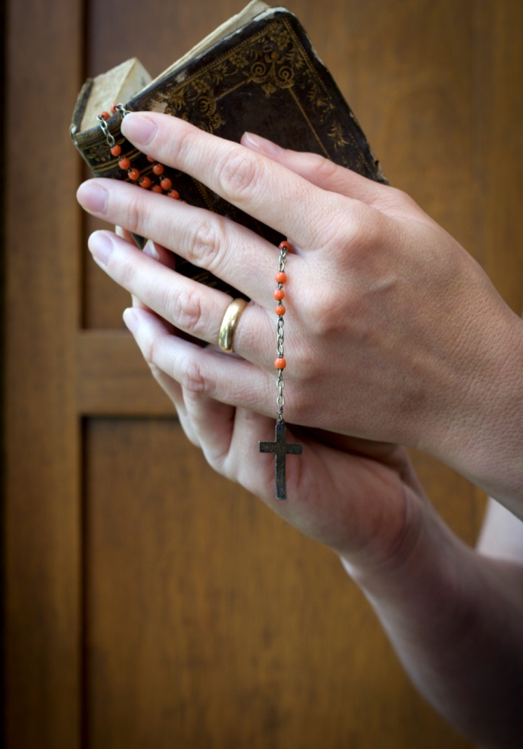
The Word of God at Each Hour
We can pray the Liturgy of the Hours seven times a day.
Many people pray it twice a day, morning and evening.
It follows a four-week cycle.
© PiercarloAbate / iStockphoto.com
Notes:
Notes: Discuss with the students the benefits and challenges of committing to a regular daily prayer practice.
This slide corresponds to content in article 78, “The Liturgy of the Hours: A Window into the Daily Rhythms of Life,” in the student book.

Slide 7
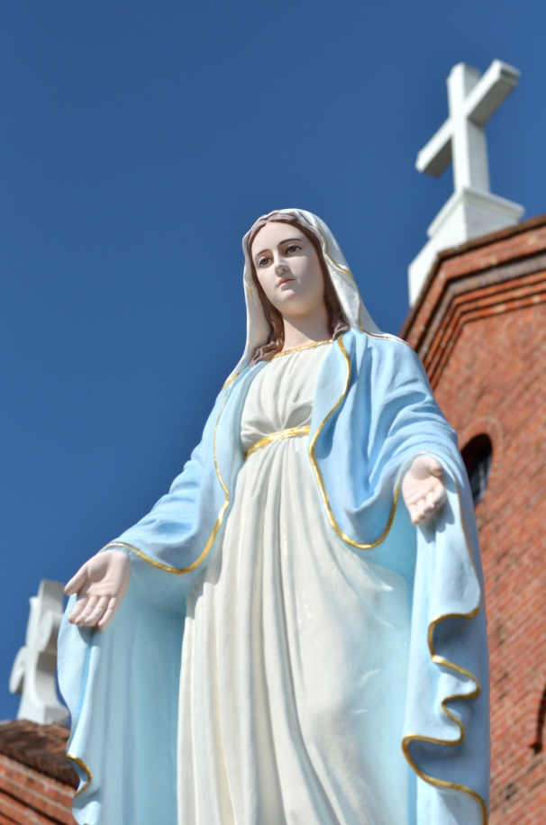
Sacred Scripture in the Divine Office
The Psalms are the heart of the Divine Office.
Psalms help us meditate on God’s saving action in human history.
The Divine Office also includes the Magnificat and the Canticle of Zechariah.
© TOMO / Shutterstock.com
Notes:
Notes: Direct the students to read both canticles in article 78 in the student book. Brainstorm a list of what we learn about God when we pray them.
This slide corresponds to content in article 78, “The Liturgy of the Hours: A Window into the Daily Rhythms of Life,” in the student book.

Slide 8

The Lord’s Prayer
We also call this prayer the Our Father.
We highly esteem the Lord’s Prayer because it came to us directly from Jesus.
When we pray to
the Father, we are
in communion with
him and with his
Son, Jesus Christ.
© Jason Stitt / Shutterstock.com
Notes:
Notes: Ask the students these questions: When did you learn the Lord’s Prayer? How did you learn it? Consider sharing your own answers.
This slide corresponds to content in article 79, “The Lord’s Prayer: The Prayer of the Church,” in the student book.

Slide 9
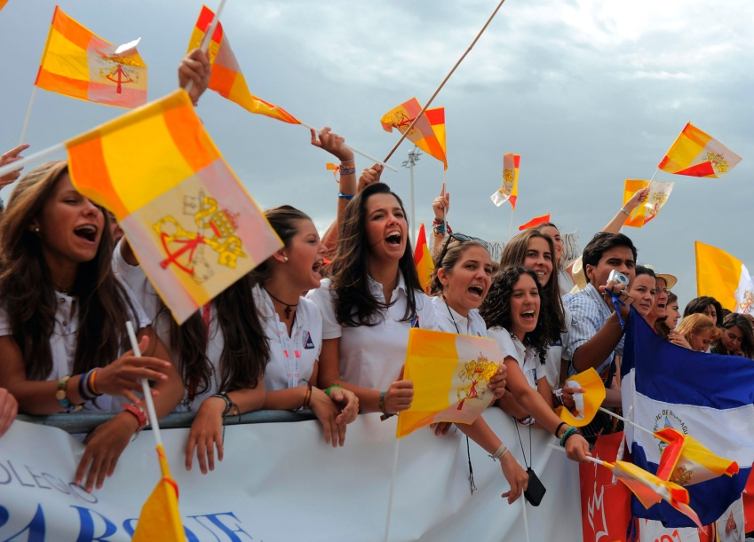
We Pray for God’s Glory
that our words and deeds show respect and reverence for God
that the Lord will fulfill the Reign of God through the Second Coming of Christ
that we may never
stand in the way of
God’s plan of
salvation
© Denis Doyle / Getty Images News / Thinkstock
Notes:
Notes: Ask volunteers to state each of the first three petitions, as described in article 79 in the student book. Ask how the world will be different when these petitions have been granted.
This slide corresponds to content in article 79, “The Lord’s Prayer: The Prayer of the Church,” in the student book.

Slide 10

We Pray for Our Needs
for a greater awareness of our total dependence on God
for the ability to forgive those who harm us
for a wise heart that is able to identify and resist temptation
for good to triumph over evil
© Jaren Jai Wicklund / Shutterstock.com
Notes:
Notes: Ask volunteers to state petitions four through seven, as described in article 79 in the student book. Ask what we can do to help God grant these petitions in our lives.
This slide corresponds to content in article 79, “The Lord’s Prayer: The Prayer of the Church,” in the student book.

Slide 11
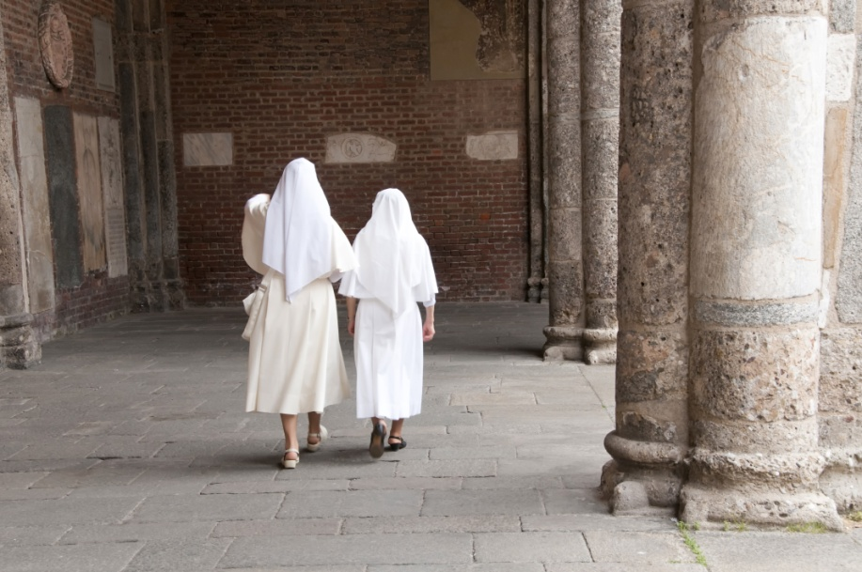
The Rules of the Saints
Saint Augustine drew his emphasis on the importance of community from Acts 4:32.
Saint Benedict developed his vision of hospitality from Matthew 25:35.
Saint Francis based
his dedication to
poverty and
simplicity on
Matthew 10:9–10.
© Stefano Panzeri / Shutterstock.com
Notes:
Notes: Explain to the students that the Rule of Life provides guidelines for life in religious communities. Read each passage mentioned after providing the context. Refer to the Live It! sidebar in article 80 in the student book, which explains that laypeople can also follow these Rules.
This slide corresponds to content in article 80, “Sacred Scripture and the Rules of the Saints,” in the student book.

