Slide 1
Prophets
Document #: TX004709

Slide 2
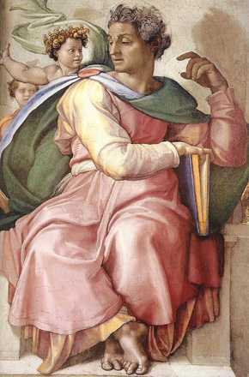
What Is a Prophet?
Prophets have a special connection with God and understand his desire; prophets crafted and proclaimed their exhortations to their community.
Prophets could not necessarily tell the future.
Who would you consider to be a modern example of a prophet?
Public Domain
Notes:
Notes: It is important to begin by noting that a biblical prophet was not necessarily someone who could tell the future, although you may find that definition in many dictionaries. Biblical prophets usually deliver a message of divine direction or consolation for the prophet’s own time. Because some prophetic messages include divine direction, their fulfillment may be in the future.
Biblical prophets are often thought to have delivered God’s message verbatim as a human “amplifier” of the divine broadcast. More likely it was that the prophet had a close, special connection with God, understood God’s desire for his people, saw how the community was falling short of this divine desire―especially in the way the people did not keep the Covenant or practice social justice―and then crafted and proclaimed their exhortations to their community.
Keeping in mind this broader understanding of the experience of the biblical prophets, help the students to see that throughout history there continue to be women and men who follow in this prophetic practice. Some are explicitly Christian, while others participate in other faith traditions. What they have in common is that they know God’s desire for peace, justice, human dignity, respect for creation, liberation from sin and bondage, love of God, neighbor, and self, and much more. They know these truths and call, through their words and actions, their community to live in these ways of God.

Slide 3
God creates or enters into a Covenant and it is good.
Humanity falls into idolatry, resulting in disease, war, and grief.
God sends teachers, kings, prophets, or others who lead the people to repentance.
The people return to following the Covenant.
Peace and God’s healing return to the people.
Public Domain
Prophets and
the Cycle of Redemption

Slide 4
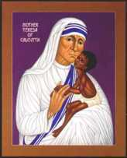
What Do Prophets Have in Common?
They obeyed God.
They knew that God wanted his people to treat all people with justice.
They understood that God wanted his people to come back to him with their whole selves.
They lived good, moral lives themselves.
Public Domain
© www.bridgebuilding.com
Notes:
Notes: God chose prophets who shared the following characteristics:
• They obeyed God. In the Old Testament, the Hebrew word for obedience meant mainly “listening” or “hearing.” An obedient person heard God’s Word and followed it (see Exodus 15:26). To be obedient was simply to align oneself with God’s will.
• They knew that God wanted his people to treat all people with justice. They understood the need for and purpose of divine justice. The Hebrew and Greek words translated as “justice” are also translated as “righteousness” and “judgment.” Divine justice calls for the fair and equitable distribution of life’s necessities. The scriptural idea of justice is based in the truth that all humans have dignity and worth and are children of God. God’s love for all creation is shown in his emphasis on justice, which is love in action.
• They lived good, moral lives themselves. They committed themselves to ethical responsibility. The commandments of God are the fundamental rules of conduct for the Chosen People. The Ten Commandments are about loving God and neighbor.
• They understood that God wanted his people to come back to him with their whole selves. They needed to be able to ask the Jews and Israelites to return to the Covenant in body, mind, and spirit. At this time the Abrahamic and Mosaic Covenants had been entered into and long adhered to by the people. Therefore God no longer looked only for sacrifice to appease him. He sought more. Specifically, God was interested in a full return to the Covenant by his people in body, mind, and spirit. Yet the Israelites were unsure of how to accomplish this goal.
The discussion about how modern prophets have shown these characteristics will depend on the prophets identified on the second slide.

Slide 5
The Prophets
Writing Prophets
Each of the writing prophets has a book of the Bible named after them.
Major Prophets have longer books.
Minor Prophets have shorter books.
Major Prophets
Isaiah
Jeremiah
Ezekiel
Minor Prophets
Micah
Hosea
Amos
Joel
Obadiah
Jonah
Nahum
Habakkuk
Zephaniah
Haggai
Zechariah
Malachi
Notes:
Notes: There are fifteen prophets known as writing prophets because each has a book of the Bible named after them. The major prophets have longer books and the minor prophets have shorter books.
It is important to note that the writing prophets almost certainly did not personally write down the books attributed to them, especially not in the form in which we have these books today. Rather, these prophets preached and taught orally, individuals or communities compiled and wrote down the prophets’ spoken words, and then editors later modified these writings before they entered the fixed biblical canon.

Slide 6
The Prophets
Non-writing Prophets
They do not have books of the Bible named after them.
They are major characters in the stories in the two Books of Samuel and the two Books of Kings.
Other people who lived prior to the monarchy are considered prophets because they also spoke for God. These include Moses, Miriam, and Joshua.
Samuel
Nathan
Elijah
Elisha
Gad
Notes:
Notes: Old Testament prophets are grouped in different ways because there are so many of them.
Samuel, Nathan, Elijah, Elisha, and Gad are important prophets who are major characters in the stories in the two Books of Samuel and the two Books of Kings. These prophets do not have books in the Bible named after them.
Some people consider Moses and his sister, Miriam, to be non-writing prophets due to the ways they communicated God’s message to the people.

