Slide 1
The Acts of the Apostles and Saint Paul
The Bible Course
Document # TX001083

Slide 2
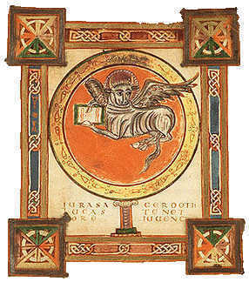
Basic Facts about the Acts of the Apostles
The Book of Acts was written by the same evangelist who wrote the Gospel of Luke.
It was written in approximately
AD 80.
The Acts of the Apostles picks
up where the Gospel of Luke
ends.
It recounts how the early
Church grew under the
guidance of the Holy Spirit.
Image in public domain
Notes:
(Note: The first slide introduces the Book of Acts. If time permits you may want to have students open their Bibles to the end of the Gospel of Luke and read its ending and then read the beginning of the Book of Acts to see the connection. Another thing you might want to point out is how both books are written to Theophilus.)

Slide 3
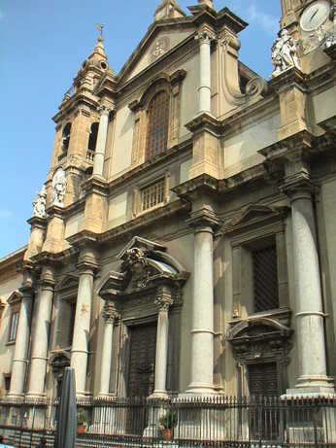
Content in the Acts of the Apostles
In the Acts of the Apostles, we
see the Church grow under the
guidance of the Holy Spirit.
What begins with a group of
frightened disciples in an upper
room ends with a Church
spanning the Roman Empire.
Chapters 1–12 focus on Saint
Peter’s leadership in Jerusalem
and nearby communities.
Chapters 13–28 focus on the
missionary work of Saint Paul
and his companions.
Image in public domain
Notes:
(Note: You may want to assign the reading of Acts, chapter 9, to have the students become more familiar with the biblical account of Saint Paul’s conversion.)

Slide 4
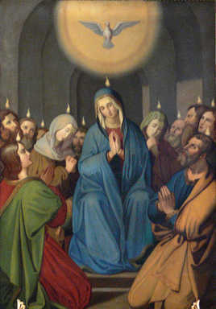
The Pentecost Event
What is the Pentecost event?
The feast of Pentecost celebrates the
fulfillment of Jesus’ promise to send
the Holy Spirit to guide the disciples
and their followers as they proclaim
the truth of salvation in Jerusalem
and beyond.
Is Pentecost still celebrated? If so,
when?
We celebrate Pentecost fifty days after Easter.
Some people call it the birthday of the Church, because the disciples went in confidence to form the first Christian community in Jerusalem.
Image in public domain
Notes:
(Note: Prior to this slide, you can write the word Pentecost on the board and have the students volunteer information as to what they think Pentecost is and what it celebrates.)

Slide 5
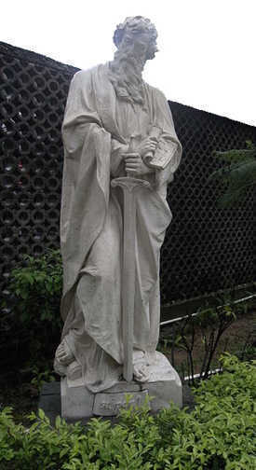
Saint Paul
Saint Paul lived during the early to middle first century AD.
He was born into a Jewish community.
He was a Roman citizen.
He studied under Rabbi Gamaliel and became a Pharisee.
He spent the first part of his life persecuting Christians, and he witnessed the martyrdom of Saint Stephen.
Image in public domain
Notes:
(Note: This slide gives basic information about Saint Paul. To begin presenting the material on this slide, you might consider asking the students what they know about Saint Paul. A good way to do this is to have the students do a KWL [Know\Want to Know\Learned] chart in their notebooks about Saint Paul.)

Slide 6
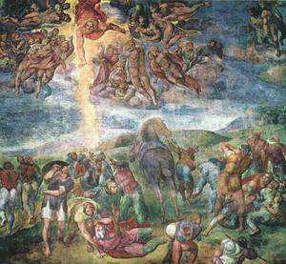
The Conversion of Saint Paul
Saint Paul encountered the risen
Christ on the road to Damascus,
in Syria.
The story of his conversion is
found in Acts, chapter 9.
His conversion led him to
become a true Apostle.
He established many Christian
communities in major Roman cities.
To remain in contact with these communities, he wrote letters offering advice, encouragement, and teaching.
These letters are part of his great contribution to our understanding of the Christian faith.
Image in public domain
Notes:
(Note: Depending on time and on your knowledge of the class, it may benefit the students to ask them what they understand about someone undergoing a conversion.)

Slide 7
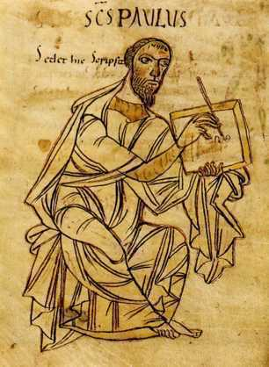
Pauline Letters
What are the Pauline letters?
They are letters written to individuals and Christian communities in the Apostolic Church.
There are twenty-one letters.
Over half of the letters (thirteen) are attributed to Paul or to disciples who wrote in his name.
Paul’s letters follow a specific pattern.
Nine of the Pauline letters are addressed to communities and four to individuals.
Some letters are grouped into two subcategories:
  the captivity letters
  the pastoral letters
Image in public domain
Notes:
(Note: Other information to be mentioned with the information on this slide is that the letters are the oldest Christian documents we have and that they are older that the Gospels. Also, to provide the students with fuller information, the captivity letters are Ephesians, Philippians, Colossians, and Philemon. It is believed that these were written while Saint Paul was in jail. The pastoral letters are First Timothy, Second Timothy, and Titus, and are believed to have been written by him and his companions while on mission.)

Slide 8
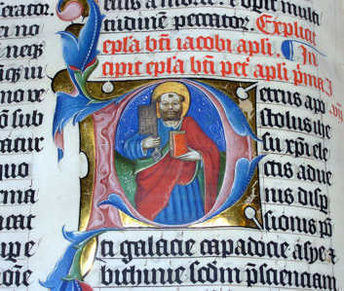
The Catholic Letters
What are the catholic letters?
The word catholic here means
“universal” or “general.”
The catholic letters are
intended for a general
audience or an unnamed
individual.
Seven non-Pauline letters are considered part of the catholic letters.
These letters are named after an Apostle.
Like Paul’s letters they offer advice, encouragement, and teaching about community life and faith in Jesus Christ.
Image in public domain
Notes:
(Note: To fill in information for the students, the Apostles who had seven letters attributed to them are James, Peter, Jude, and John.)

Slide 9
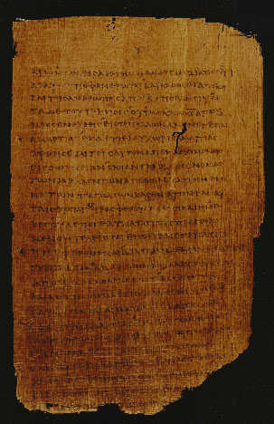
The Letter to the Hebrews
Another non-Pauline letter found in the New Testament is the Letter to the Hebrews.
The author of Hebrews supports and enlivens faith in Jesus Christ.
The Letter to the Hebrews emphasizes the divinity of Christ.
It also emphasizes the redeeming power of Christ’s Death on the cross.
http://www.cbl.ie/getfile/11fc493d-bdbb-4ee7-8a5f-80f8bc105b60/paul6.aspx
Notes:
(Note: Another thing to speak about when talking about the Letter to the Hebrews is how it speaks about the priesthood of Jesus Christ.)

