Slide 1
Acts and Letters
The Living Word: The Revelation of God’s Love, Second Edition
Unit 4, Chapter 15
Document#: TX004693

Slide 2


Acts and Letters
The New Testament includes books that give us insight into the spread of Christianity.
Some books offer words of encouragement to the new Christian communities.
© Dream Perfection / Shutterstock.com
Notes:
Notes: Ask the students why writings for or about the early Church can still support our faith today.
This slide corresponds to content in the chapter 15 introduction in the student book.

Slide 3
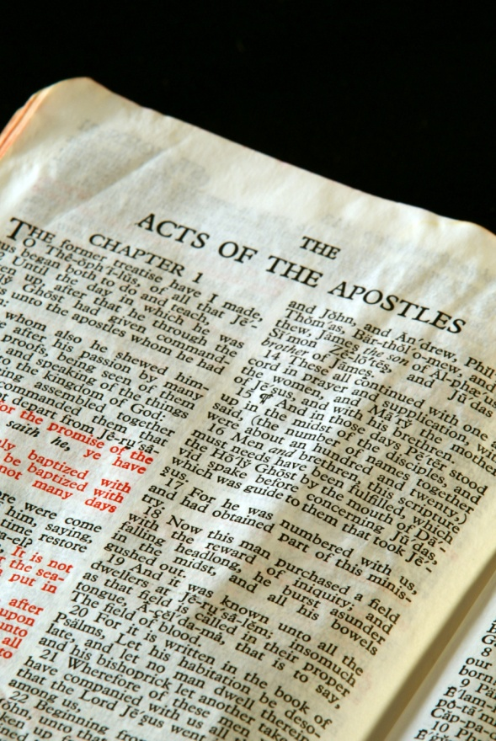
Acts of the Apostles
The Acts of the Apostles picks up where the Gospel of Luke ends.
Acts tells of the Ascension, Pentecost, and the growth of the Church under the guidance of the Holy Spirit.
© Stephen Orsillo / Shutterstock.com
Notes:
Notes: Remind the students that the Acts of the Apostles is part of a two-volume work, Luke-Acts, written around AD 80.
This slide corresponds to content in article 71, “Acts of the Apostles,” in the student book.

Slide 4

Tongues as of Fire
Beginning at Pentecost, the disciples went forth to spread the Good News of Christ.
Pentecost is the fulfillment of Jesus’ promise to send the Holy Spirit to guide the Church.
We commemorate Pentecost fifty days after Easter.
© Olga Nikonova / Shutterstock.com
Notes:
Notes: Read aloud the account of Pentecost found in Acts 2:1–12. Ask the students these questions: What does the image of wind tell you about the Holy Spirit? What does the image of fire tell you?
This slide corresponds to content in article 71, “Acts of the Apostles,” in the student book.

Slide 5
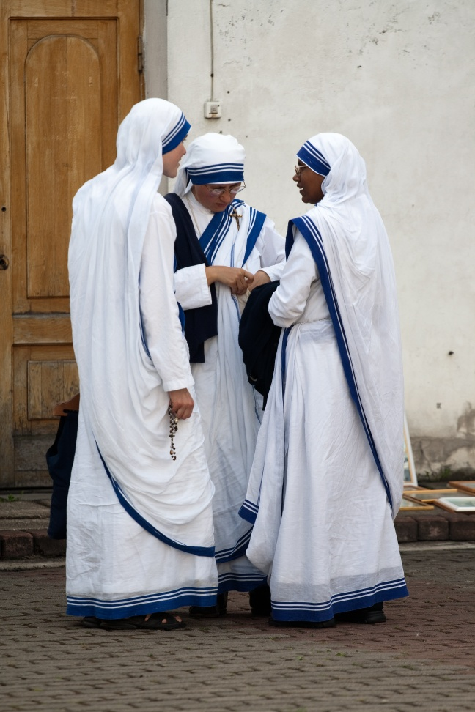
A Missionary Church
Saint Peter preached repentance and forgiveness.
Saint Stephen prophesied about how Jesus’ Death and Resurrection fulfilled the Torah.
Saint Paul set out on missionary journeys to bring the Light of Christ to all.
© Ints Vikmanis / Shutterstock.com
Notes:
Notes: Explain that the stories of these models of faith are found in Acts. Note that all three men were martyred.
This slide corresponds to content in article 71, “Acts of the Apostles,” in the student book.

Slide 6

The Pauline Letters
Paul wrote letters to offer advice, pastoral encouragement, and teaching.
Thirteen letters in the New Testament are attributed to Paul, or to disciples who wrote in his name.
© lithian / Shutterstock.com
Notes:
Notes: Provide the students with background about Saint Paul’s life, and read aloud the account of his conversion in Acts 9:1–6. Explain how he undertook his work as a missionary, as described in article 72 in the student book.
This slide corresponds to content in article 72, “The Pauline Letters,” in the student book.

Slide 7

Jesus Christ Is the Path to Salvation
Paul uses the title “the Son” to point to Jesus as God’s Divine Son.
He uses the title “the Christ” to show that Jesus fulfilled the hope of Israel.
He uses the title “Lord” to express Jesus’ divinity.
© Mark Schwettmann / Shutterstock.com
Notes:
Notes: Ask the students what Paul means when he presents Jesus as the New Adam (see article 72 in the student book).
This slide corresponds to content in article 72, “The Pauline Letters,” in the student book.

Slide 8
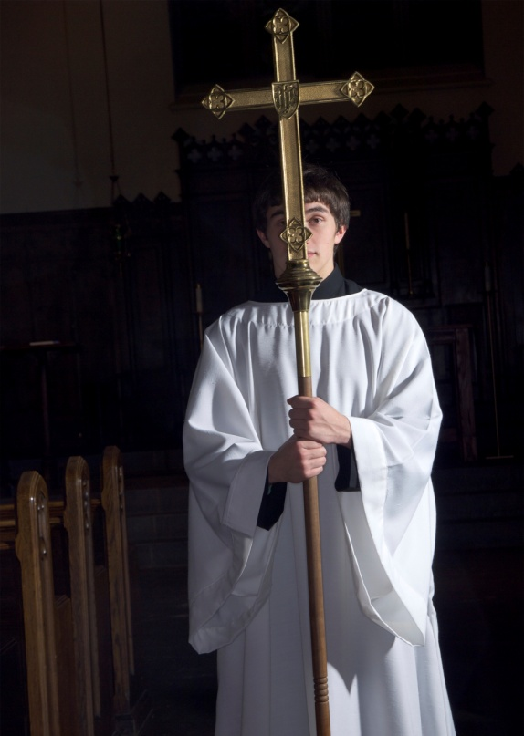
The Church Is the Body of Christ
Paul was writing to communities who sometimes experienced disunity and discord.
Using an analogy of the human body, Paul explains that all people, with varied gifts, are essential in the Body of Christ.
© kokophoto / iStockphoto.com
Notes:
Notes: Explore with the students Paul’s analogy, asking for examples of the diverse gifts needed in parishes and in the universal Church.
This slide corresponds to content in article 72, “The Pauline Letters,” in the student book.

Slide 9

The Non-Pauline Letters
They are called the catholic (or universal) letters.
They were intended for a general audience.
They were written for new believers.
© Ansebach / Shutterstock.com
Notes:
Notes: Lead a discussion with the students about the kinds of information that new Christians might have needed (explanation of beliefs, teaching on morality, encouragement, etc.).
This slide corresponds to content in article 73, “The Catholic (Non-Pauline) Letters,” in the student book.

Slide 10
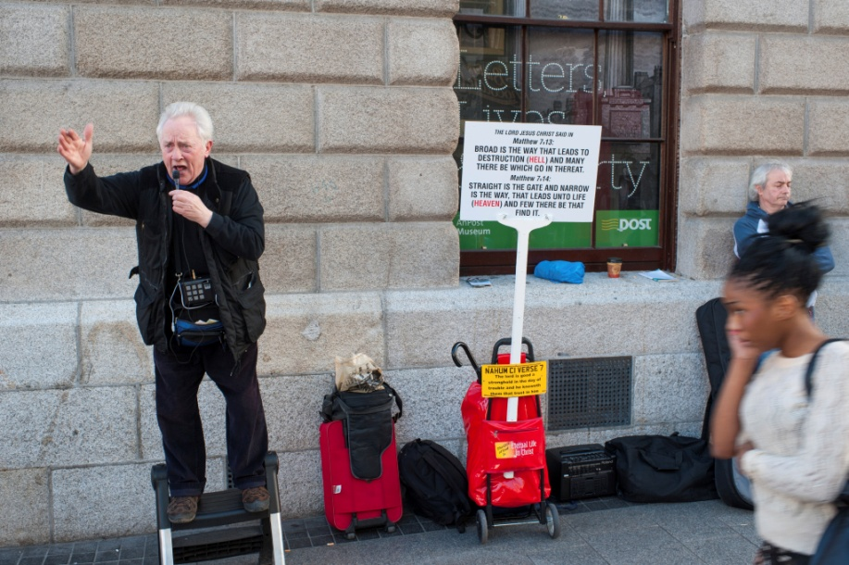
Important Teachings
the importance of both faith and good works for salvation
encouragement not to lose faith
warnings against allowing deceivers to disrupt and destroy the community
© kulicki / iStockphoto.com
Notes:
Notes: Explain to the students that the Christian community was beginning to face a new threat: teachers whose ideas didn’t reflect those handed down by the Apostles.
This slide corresponds to content in article 73, “The Catholic (Non-Pauline) Letters,” in the student book.

Slide 11
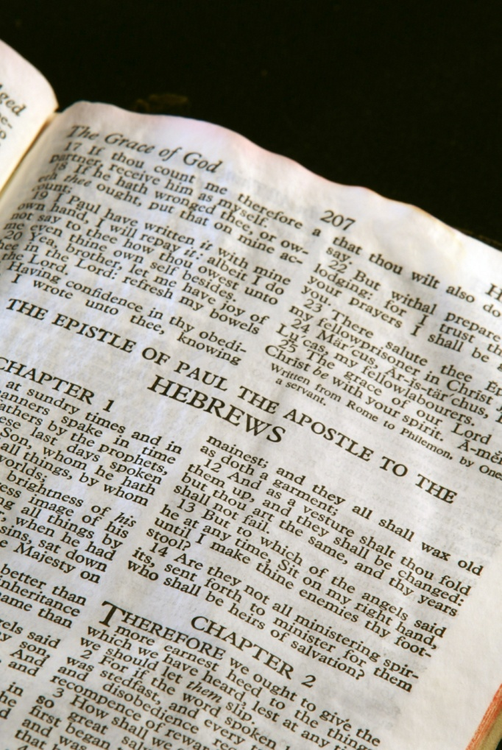
Letter to the Hebrews
It was originally circulated as a Pauline letter.
It is written in the form of a long homily.
It argues that Jesus embodies the New Law.
It emphasizes the divinity of Christ.
© Stephen Orsillo / Shutterstock.com
Notes:
Notes: As a starting point for a discussion about why scholars investigate the authorship of the letters, ask the students the questions at the end of article 74 in the student book: Is it important to know whom the author of the Letter to the Hebrews really was? Why or why not?
This slide corresponds to content in article 74, “What about the Letter to the Hebrews?” in the student book.

Slide 12

The Book of Revelation
It takes a literary form called apocalyptic literature.
This form describes cosmic battles between good and evil; good always wins.
The Book of Revelation also includes symbolic numbers and colors.
© Joe Fallico / Shutterstock.com
Notes:
Notes: Explain to the students that the author of this book uses symbols to communicate a message to his hearers. Point out that many people mistakenly interpret the numbers and colors literally.
This slide corresponds to content in article 75, “The Book of Revelation,” in the student book.

Slide 13
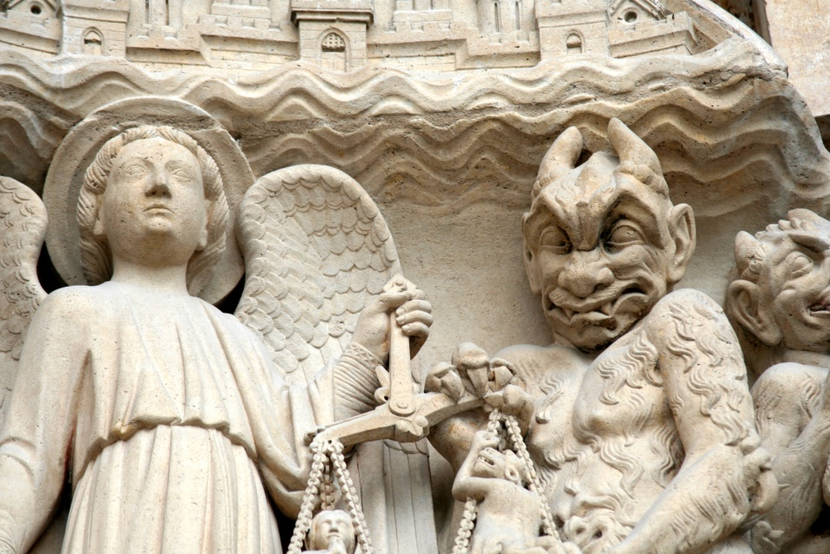
Does Revelation Predict the Future?
The veiled language of apocalyptic literature is a means of secret communication.
It allowed the author to criticize the Roman authorities without putting his audience at risk of further persecution.
© Gautier Willaume / Dollar Photo Club.com
Notes:
Notes: Remind the students that just because Revelation was written with the language of apocalyptic literature, it does not mean its purpose is to predict the end of the world.
This slide corresponds to content in article 75, “The Book of Revelation,” in the student book.

Slide 14
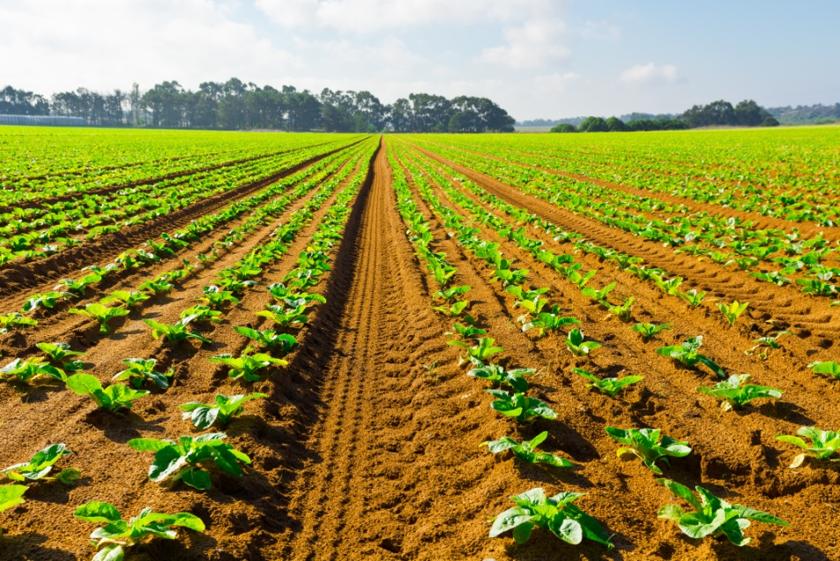
Hope for All Time
John assures the persecuted Christians that God has not abandoned them.
At the end of time, the Kingdom of God will be fully realized.
Those who follow Satan and reject the love of God will be eternally separated from God.
© gkuna / Shutterstock.com
Notes:
Notes: Ask the students the questions at the end of article 75 in the student book: Do you think the original audience found the message of Revelation comforting? Why or why not?
This slide corresponds to content in article 75, “The Book of Revelation,” in the student book.

