Slide 1
Praying the Rosary
Document #: TX004714
Notes:
Notes: This PowerPoint is designed for teachers who would like to provide an explanation and experience of praying the Rosary.
Invite the students to bring a Rosary to class for this experience – perhaps one they received at their First Communion or Confirmation, or one that belonged to a family member. You may choose to provide Rosaries for them or have a few extra in case students do not have one or do not bring a Rosary to class.
You may choose to do the explanation of how to pray the Rosary first, then use the image of the Rosary (Slide #9) as a reminder as you pray a decade of the Rosary together in class.
As you pray the Rosary together in class, you may want to simply light a candle or in some other way create an atmosphere that is conducive to prayer.

Slide 2
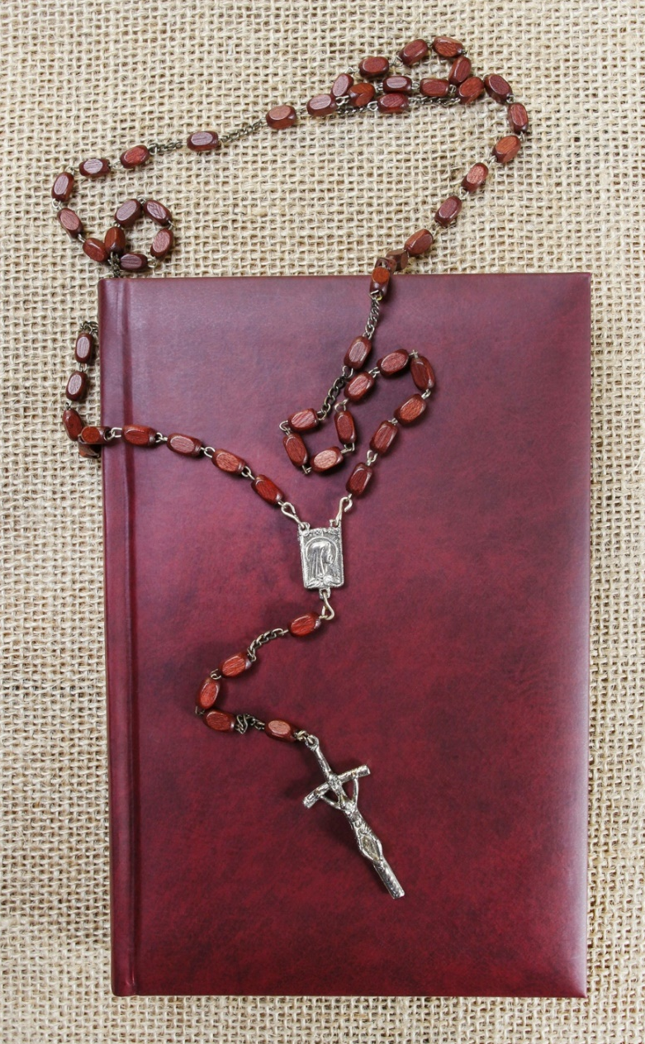
Based in Scripture
The various prayers of the Rosary can be found in Scripture:
The Lord’s Prayer can be found in the Gospels.
The first part of the Hail Mary is the Annunciation and Visitation.
The Mysteries of the Rosary focus on Jesus’ life.
© Agnes Kantaruk/Shutterstock
Notes:
Notes: The Rosary begins with the Apostles’ Creed. Though it is not scripturally based, the Apostles’ Creed does summarize the important mysteries of the Catholic faith. Pope Pius V added the second part of the Hail Mary.

Slide 3
The Rosary as Contemplative Prayer
The repetition in the Rosary allows us to enter more deeply into prayer.
As we repeat the words, we move gently into the silence of our hearts where we encounter the indwelling of God’s spirit.
© Vitaly Maksimchuk/Shutterstock

Slide 4
Mysteries of the Rosary
There are four sets of Mysteries:
Joyful
Sorrowful
Glorious
Luminous
© Blend Images/Shutterstock
Notes:
Notes: The Luminous Mysteries were added by Pope John Paul II in 2002.

Slide 5
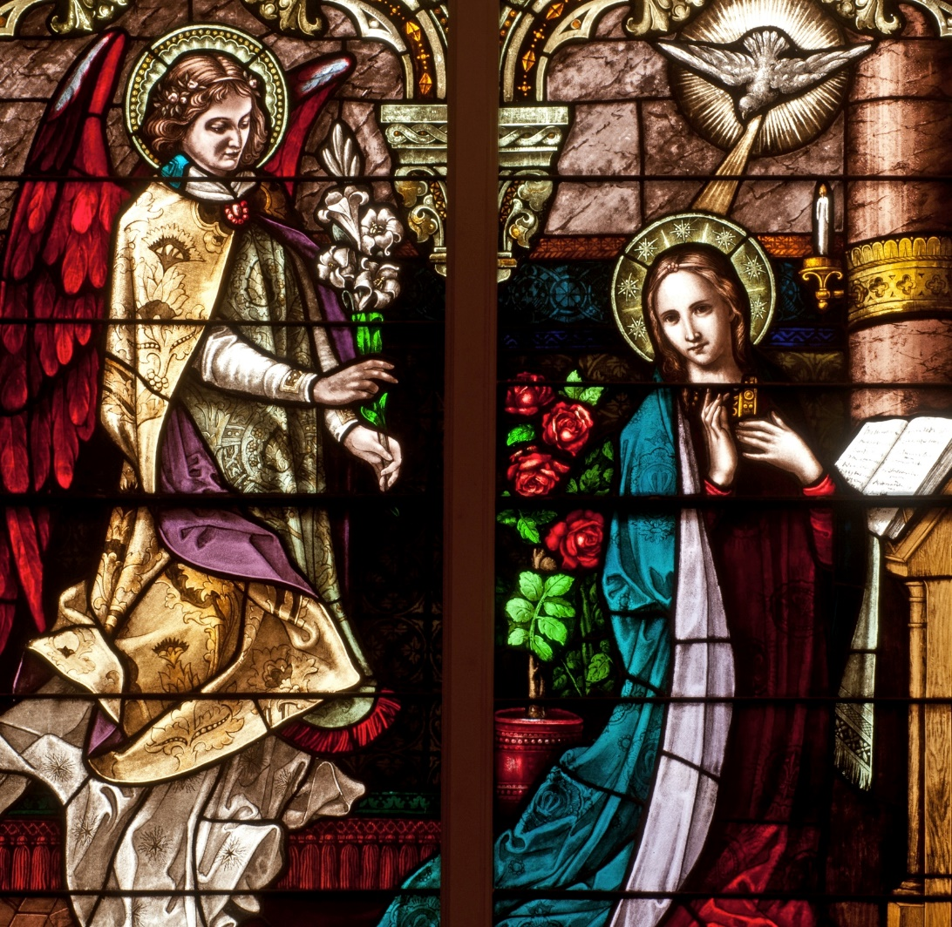
The Joyful Mysteries
The Annunciation
The Visitation
The Nativity
The Presentation in the Temple
The Finding in the Temple
© Nancy Bauer / Shutterstock.com
Notes:
Notes: These mysteries are traditionally prayed on Mondays, Saturdays, and the Sundays of Advent. As an extra learning experience, you may wish to ask the students to conduct a Bible “scavenger hunt” and locate Scripture that corresponds to each of the parts of the different mysteries.

Slide 6
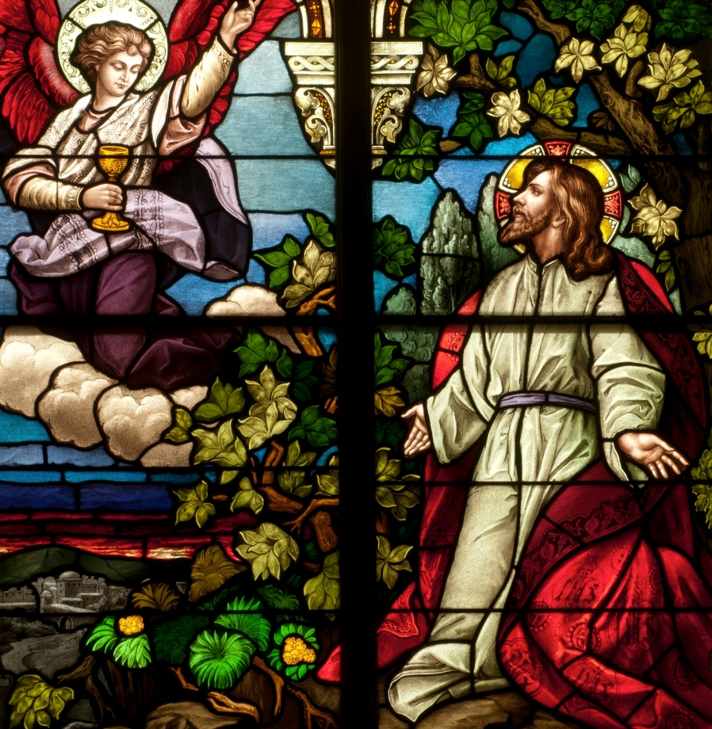
The Sorrowful Mysteries
The Agony in the Garden
The Scourging at the Pillar
The Crowning with Thorns
The Carrying of the Cross
The Crucifixion and Death
© Nancy Bauer / Shutterstock.com
Notes:
Notes: These mysteries are traditionally prayed on Tuesdays, Fridays, and the Sundays of Lent.

Slide 7
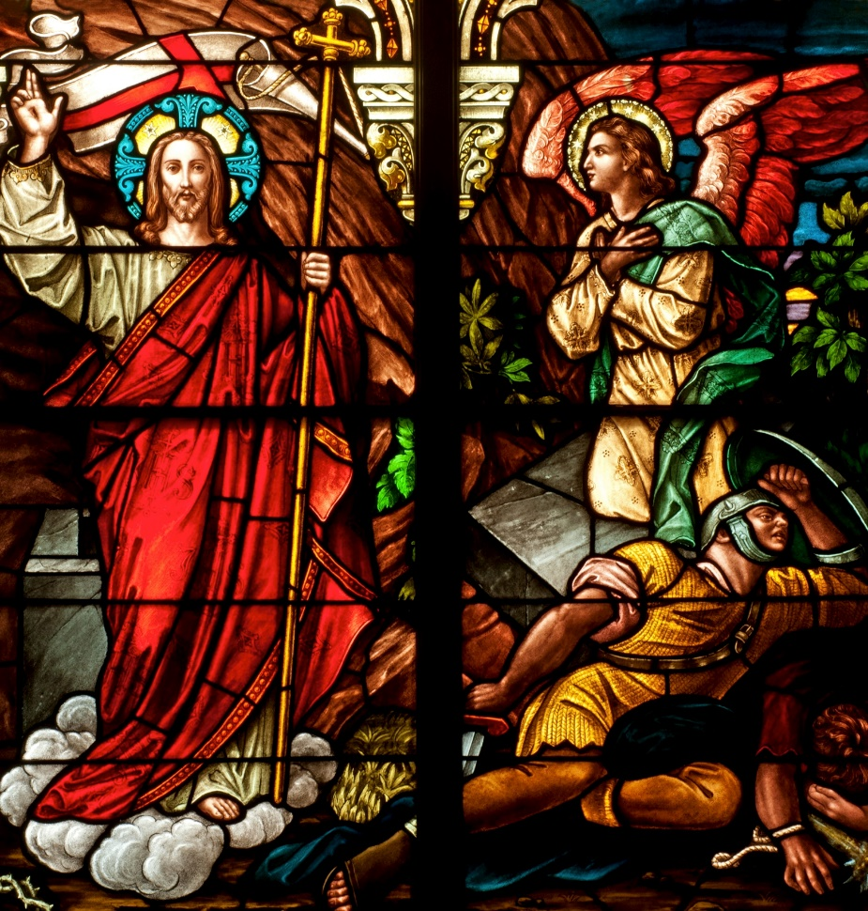
The Glorious Mysteries
The Resurrection
The Ascension
The Descent of the Holy Spirit
The Assumption
The Coronation of Mary
© Nancy Bauer / Shutterstock.com
Notes:
Notes: These mysteries are traditionally prayed on Wednesdays and on Sundays outside of Lent and Advent.

Slide 8
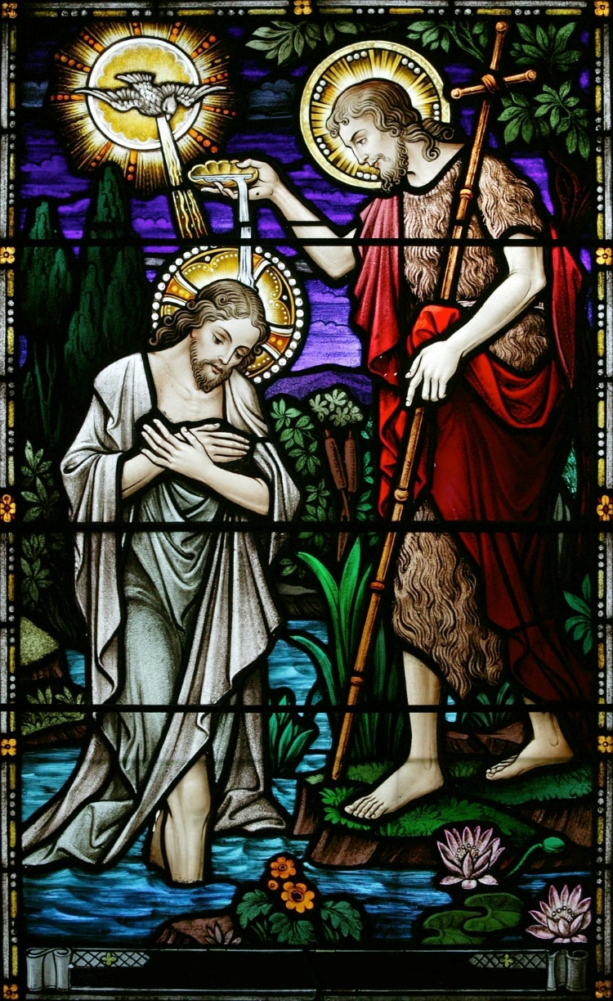
The Luminous Mysteries
The Baptism of Christ in the Jordan
The Wedding Feast at Cana
Jesus’ Proclamation of the Coming of the Kingdom of God
The Transfiguration
The Institution of the Eucharist
© Keith McIntyre / Shutterstock.com
Notes:
Notes: These mysteries are traditionally prayed on Thursdays.

Slide 9
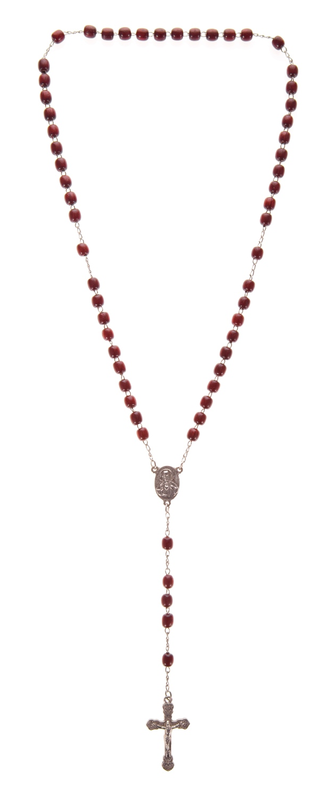
How to Pray the Rosary
© Keith McIntyre / Shutterstock.com
Notes:
Notes: Explain the steps of saying the Rosary, using the following as a guide:
Beginning
Make the Sign of the Cross.
Pray the Apostles' Creed.
On the first bead, pray an Our Father.
On each of the next three beads, pray a Hail Mary.
Pray the Glory Be.
Central Part
For each of the five decades, state the mystery, then pray the Our Father.
Pray one Hail Mary per bead while meditating on the mystery.
At the end of the decade, pray the Glory Be.
End
After all decades, pray the Hail, Holy Queen.

