Slide 1
The Crusades
Church History, Unit 3

Slide 2
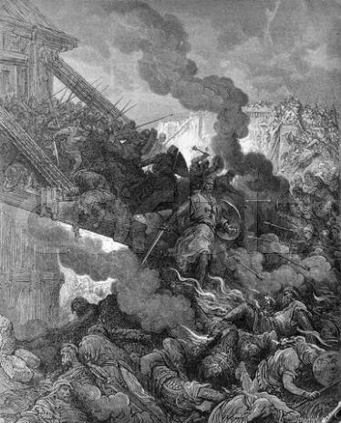
Not long after the 1054 split between the Church in the East and the Church in the West, the Byzantine emperor sent a plea for help to the Church in Rome.
Parts of Asia Minor, formerly under Byzantine control, were being invaded by Turkish Muslims.
Image in public domain

Slide 3
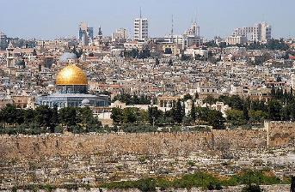
The Latin Church responded swiftly. The Latin Church and Eastern Church shared this common enemy.
The Turks had already attacked Jerusalem and destroyed many churches.
Christians in Jerusalem were being subjugated through travel restrictions and clothing requirements.
Christian pilgrims were
barred from visiting
Jerusalem.
The ongoing assault on
Christians in Jerusalem
was an outrage to the entire Christian world.
Image in public domain

Slide 4
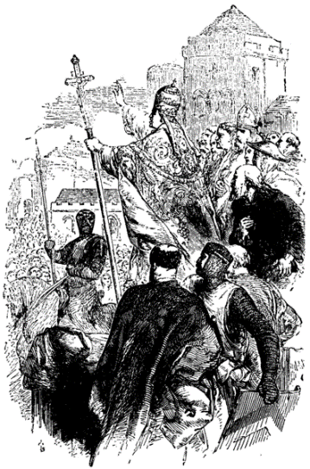
The First Crusade (1095–1099)
The First Crusade was launched when Pope Urban II turned to his native France to recruit soldiers. The forces set off in 1096.
Image in public domain

Slide 5
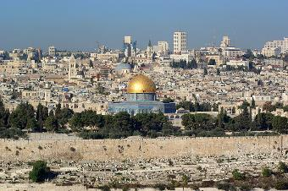
The First Crusade (1095–1099) (continued)
The campaign was a mix of gains and losses, both moral and military.
The Crusaders, blinded by their zeal to regain Jerusalem, massacred Jews and Muslims alike and engaged in other immoral behavior.
The Byzantine Empire recovered some territories from the Turks.
By 1099 Jerusalem was
again under Christian
control.
The returning knights were
hailed as defenders of the
faith.
Image in public domain
Notes:
Image: Jerusalem, Dome of the Rock, in the background the Church of the Holy Sepulchre.

Slide 6
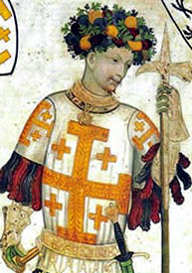
The Second Crusade (1145–1149)
The Second Crusade was launched after the Muslims regained some territories that had been captured by the Christians in the First Crusade.
The Second Crusade was disastrous. The Christians lost Jerusalem again, as well as all the other territories gained in the First Crusade.
Image in public domain
Notes:
Godefrey of Bouillon, pictured in a fresco from the Baronial Hall of the Castello della Manta in Northern Italy, whose frescoes were painted by an anonymous master craftsman and finished shortly after 1420. Based on this, the original author must have been dead for more than 100 years. He wears a Jerusalem or Crusader’s cross.

Slide 7
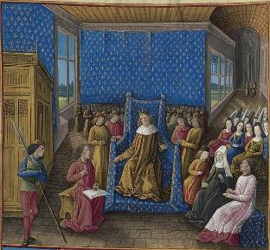
The Third Crusade (1189–1192)
The Third Crusade was jointly launched by the kings of England (Richard the Lion-Hearted), France (Philip II),
and Germany (Frederick Barbarossa).
The Third Crusade failed to regain Jerusalem, but it did secure the right for Christians to visit the city.
Image in public domain

Slide 8
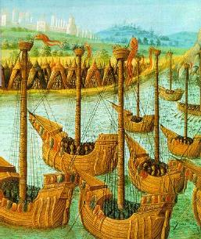
The Fourth Crusade (1202–1204)
The Fourth Crusade was launched
in 1204 to address concerns about
Muslim influence in the Holy Land,
with particular hope for retaking
Jerusalem.
The Crusaders needed financial
support to sustain their undertaking.
They agreed to detour to
Constantinople to help the deposed
Byzantine emperor regain his throne.
They hoped to be compensated well enough to pay for the ships to take them to Jerusalem.
Image in public domain

Slide 9
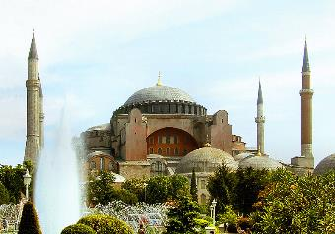
The Fourth Crusade (1202–1204) (continued)
The Crusaders broke through the city walls of Constantinople. They went on a pillaging frenzy: attacking citizens, breaking into churches, and stealing and destroying precious icons and relics.
The most vibrant city in the Christian world was left in ruins.
These actions caused
suffering and sorrow that
further inflamed the tensions
between the Western and
Eastern Churches.
Image in public domain

Slide 10
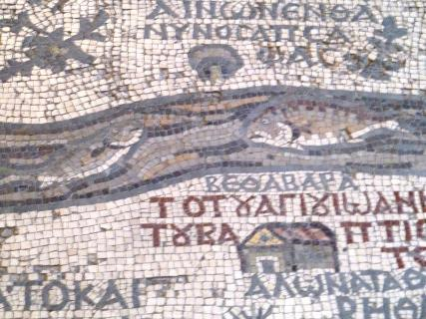
Several smaller crusades were launched in subsequent years, including the so-called Children’s Crusade. All failed to reach their goal.
In 1291 Christians lost the city of Acre (in present-day Israel)—its last stronghold in the Holy Land. This loss ended Christian influence in the region.
Image in public domain

Slide 11
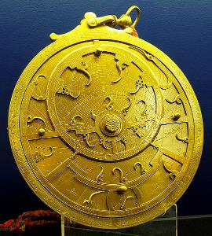
The Crusades did accomplish
some good for the West:
Contact with Muslim scholars
exposed Western Europe to
advances in astronomy,
navigation, mathematics,
and science.
The Crusaders brought back
long-lost works of the Greek philosophers that had been safeguarded and studied in Muslim lands.
These philosophical works in turn influenced Saint Thomas Aquinas and other scholastic theologians.
Image in public domain

Slide 12
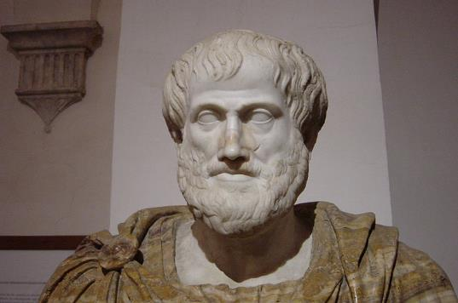
These gains from the Crusades opened the door to profound changes in western Europe, eventually ushering in the Renaissance period.
Image in public domain

