Slide 1
Respecting Human Life and Dignity
Catholic Social Teaching
Document #: TX001994
Notes:
[Music: Introduction music such as “Give Peace a Chance,” “All You Need Is Love,” or “Stand by Me.”]

Slide 2
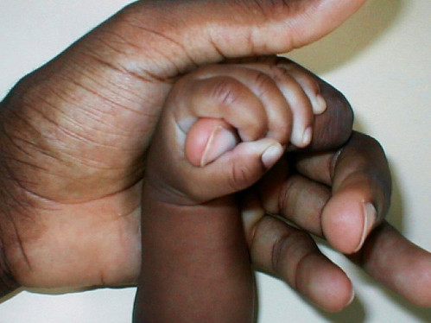
A Culture of Life versus a Culture of Death
Pope Saint John Paul II wrote about the moral shifts occurring in society, specifically abortion and euthanasia.
Abortion and euthanasia are two serious sins against the sanctity of life and are violations of the Fifth Commandment.
By Clarence Goss from USA (Flickr:Got You Daddy) [CC-BY-2.0 (www.creativecommons.org/licenses/by/2.0)], via Wikimedia Commons

Slide 3
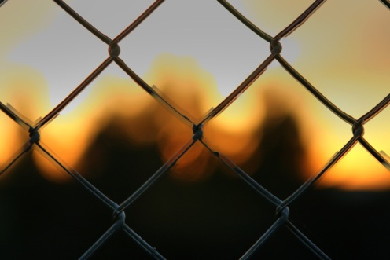
The Culture of Death
In The Gospel of Life, Saint John Paul II identifies two contemporary causes of the culture of death:
adopting a distorted understanding of human freedom
making something other than God the center of our lives
By Shayan Sanyal (Flickr) [CC-BY-2.0 (www.creativecommons.org/licenses/by/2.0)], via Wikimedia Commons

Slide 4
The Culture of Death (continued)
First, people today often adopt a distorted understanding of human freedom.
Some people think that we should have the right to pursue our personal goals and desires without any hindrance.
The Church teaches that human freedom is a gift and not an absolute right.
Image in shutterstock

Slide 5
The Culture of Death (continued)
Second, when God is not the center of our lives, we can become preoccupied with material things at the expense of others, which leads to suffering.
The gift of freedom comes with responsibility:
to choose right over wrong
to choose love over hate
to choose solidarity over self-centeredness
to choose life over death
Image in shutterstock

Slide 6
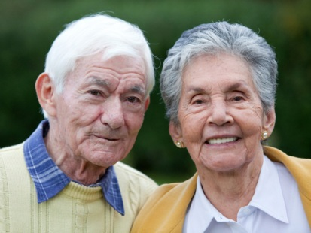
Promoting the Culture of Life
As members of God’s family, we must serve others through works of charity.
Civil leaders have particular responsibility to make courageous choices in support of life.
Families also play a special role in building a culture of life.
Image in shutterstock
Partner Discussion
Turn to a partner and share:
In what ways can civil leaders promote a culture of life?
In what ways can families build a culture of life?

Slide 7
Conscience and the Culture of Death
In its January 22, 1973, Roe v. Wade decision, the U.S. Supreme Court ruled that states cannot limit a woman’s right to an abortion during the first trimester of her pregnancy.
After abortion was legalized, it became more common to believe that unborn children do not have full human rights.
By Clarence Goss from USA (Flickr:Got You Daddy) [CC-BY-2.0 (www.creativecommons.org/licenses/by/2.0)], via Wikimedia Commons
This human rights issue can lead to questions about the dignity of others, especially those who are elderly or infirm.

Slide 8
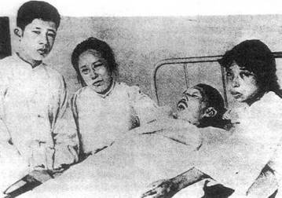
End-of-Life Issues: Euthanasia
Euthanasia, also known as mercy killing, is a serious offense against the Fifth Commandment. Proponents of euthanasia make it an issue of human freedom.
God’s Law makes it clear that intentionally causing the death of a human being is murder, regardless of the motive or circumstances.
According to the teachings of the Catholic Church, euthanasia violates human dignity and the respect we owe to our Creator, the author of human life.
Large-Group Discussion
In what ways is the Catholic Church’s view on euthanasia different from society’s view on euthanasia?
What foundational principles govern the Church’s view?

Slide 9
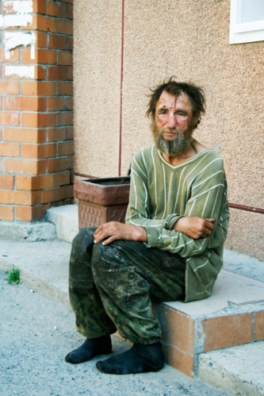
End-of-Life Issues: Suicide
Suicide is a grave offense against the Fifth Commandment.
Suicide is the ultimate rejection of God’s gifts of hope and love.
Although suicide is always wrong, the Church recognizes that serious mental illness or suffering can contribute to the decision to take one’s own life.
Image in shutterstock

Slide 10
End-of-Life Issues: Suicide (continued)
If you know someone who is thinking about suicide, it is essential that you tell someone who can get the person the medical, psychological, or spiritual help she or he needs, even if it breaks a promise of confidentiality.
If you know someone who has committed suicide, do not consider her or him forever lost to the love of God or condemned to Hell. As the Church, we pray for those who have committed suicide, placing them in God’s love and mercy.
Large-Group Discussion
What are some action steps you could take to help yourself or a friend who is considering suicide?

Slide 11
End-of-Life Issues: The Death Penalty
Taking the life of another is an offense against the Fifth Commandment.
Pope Saint John Paul II teaches in The Gospel of Life that the death penalty should be “very rare, if not practically non-existent.”
Image in shutterstock

Slide 12
End-of-Life Issues: The Death Penalty (continued)
The Catholic Church is generally against the death penalty for the
following reasons:
The New Law taught by Jesus emphasized mercy and forgiveness.
Advancements in the criminal justice system allow for imprisonment for a lifetime as well as the capacity to ensure that prisoners in maximum-security prisons have minimal risk for escape.
Conversion of heart and lifestyle through rehabilitation is always possible.

Slide 13
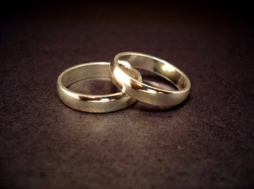
Protecting Dignity: Sexual Exploitation
Men and women are called to acknowledge the dignity of their own sexual identity. Two Commandments remind us that sexual sin has social consequences:
the Sixth Commandment: “You shall not commit adultery.”
the Ninth Commandment: “You shall not covet your neighbor’s wife.”

Slide 14
Protecting Dignity: Sexual Exploitation (continued)
The virtue of chastity helps us to live out our sexuality with integrity. We are called to respect ourselves and others because we are created in the image and likeness of God.
Quick Write
How does the message of media and society regarding chastity affect your view on chastity? Provide concrete examples.
Who influences your personal thinking regarding chastity? God? society and media? Explain your answer.
Notes:
Suggestion: Quick video clip available on YouTube featuring Jason Everett talking about chastity.

Slide 15
Societal Exploitation of Sexuality
The media often exploit the human dignity of sexuality. For example, the pornography industry creates and distributes sexually explicit stories, images, and video.
Pornography is a serious social sin because it objectifies men and women and disrespects the gift of sexuality. This can lead to the sins of premarital sex and adultery.

Slide 16
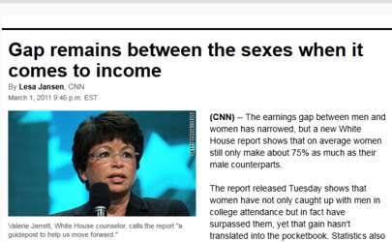
Sexism
Sexism takes many forms, including . . .
not allowing one gender equal rights in society
overlooking verbal, sexual, and physical abuse against one gender
not allowing one gender equal work opportunities or equal pay for equal work

Slide 17
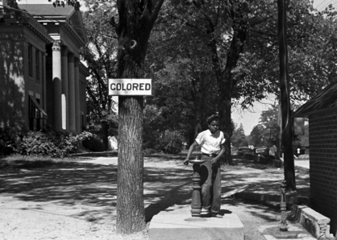
Racism
WikiMiediaCommons
Racism is a sin committed by individuals and also by social structures that perpetuate racist policies and practices.
Once the relationship between two races is marked by humiliation, abuse, or physical violence, the prejudice and distrust can last for years.
This is another consequence of Original Sin.

Slide 18
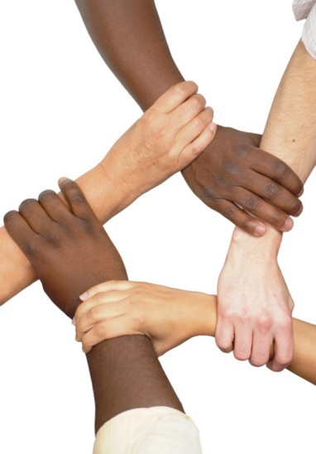
The Church and Racism
The U.S. Catholic bishops speak out against racism in their pastoral letter Brothers and Sisters to Us. They teach that racism is a sin that
divides the human family
violates the fundamental human dignity of those called to be children of the same Father
Image in shutterstock

Slide 19
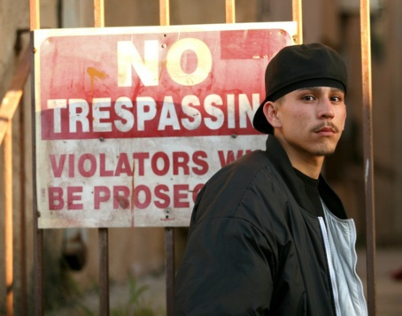
Stereotyping
The way we treat others is based on the way we view them.
Sometimes our assumptions about a person are based on stereotypes.
The problem with stereotypes is that they are often inaccurate or untrue, and they do not respect each individual’s uniqueness.
Image in shutterstock

Slide 20
Prejudice
Prejudice is often displayed as ignorance, fear, or hostility directed toward a specific race or ethnicity, gender, economic class, or ability.
Prejudice is based on a preconceived judgment without knowing all the facts.
Negative prejudicial attitudes harm human dignity.
Image in shutterstock

Slide 21
Discrimination
Prejudice becomes discrimination when people in power are motivated by prejudice to deny members of a particular group their rights.
Discrimination can apply to issues of race or ethnicity, gender, class, or ability.
Overcoming the many faces of discrimination takes a long-term commitment to work for justice.
Image in shutterstock

Slide 22
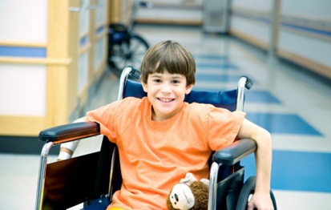
People with Disabilities
People with physical, mental, emotional, or developmental disabilities are also the victims of prejudice and discrimination.
We should remember that Jesus showed great concern for people with disabilities
Image in shutterstock
As the Body of Christ, the Church is committed to ending discrimination against people with disabilities, both within the Church and in society.
Notes:
[

Slide 23
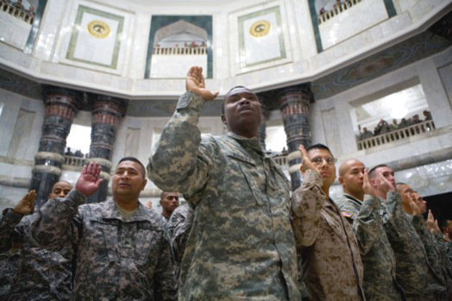
Migration and Immigration
Immigration is a very sensitive issue in our time, both politically and emotionally.
The Church calls for the elimination of the root causes of such migration: poverty, injustice, lack of religious freedom, and war.

Slide 24
Social Justice Principles on Migration and Immigration
The United States bishops teach the following principles related to migration and immigration.
1. People have the right to find opportunities in their homeland.
2. People have the right to migrate to support themselves and their families.
3. Sovereign nations have the right to control their borders.
4. Refugees and asylum seekers should be afforded protection.
5. The human dignity and human rights of undocumented migrants and immigrants should be respected.

Slide 25
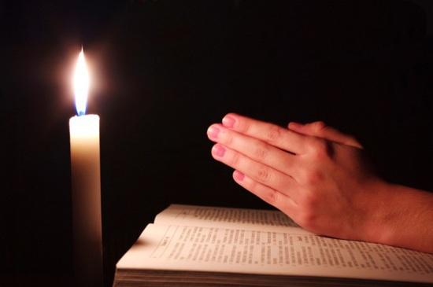
Respecting all human life and dignity is our responsibility and our duty as disciples of Christ.
Quick Write
What can you do to help to promote immigration reform in accordance with the U.S. bishops?
Image in shutterstock

