Slide 1
The Work of the Early Church
The Church
Unit 1, Chapter 3
Document #: TX005553
© 2016 Saint Mary’s Press
Living in Christ Series

Slide 2

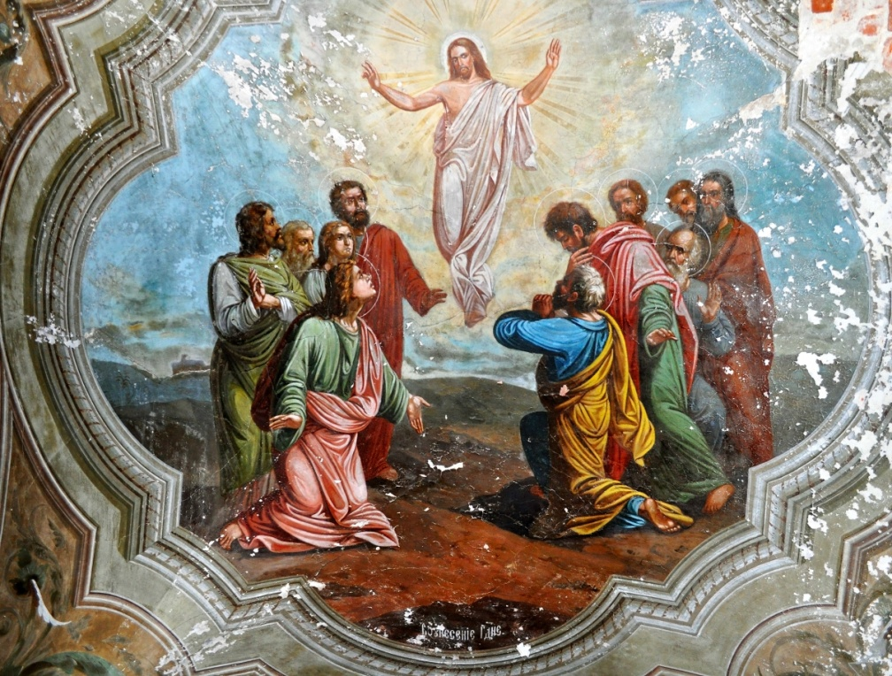
The Mission of the Apostles
Jesus proclaimed the Good News and healed people.
During his earthly ministry, he sent the Apostles out to do the same.
The Risen Christ made it clear that the Apostles’ mission was to everyone.
© Nattesha / Shutterstock.com
© 2016 Saint Mary’s Press
Living in Christ Series
Notes:
Notes: Read aloud Matthew 28:16–20, first explaining that this event happened after Jesus’ Resurrection. Point out that Jesus directed his followers to continue his mission and that the Church continues to do so today. Ask for examples of how the modern Church does this. Ask for examples of how we, as members of the Church, do this.

Slide 3
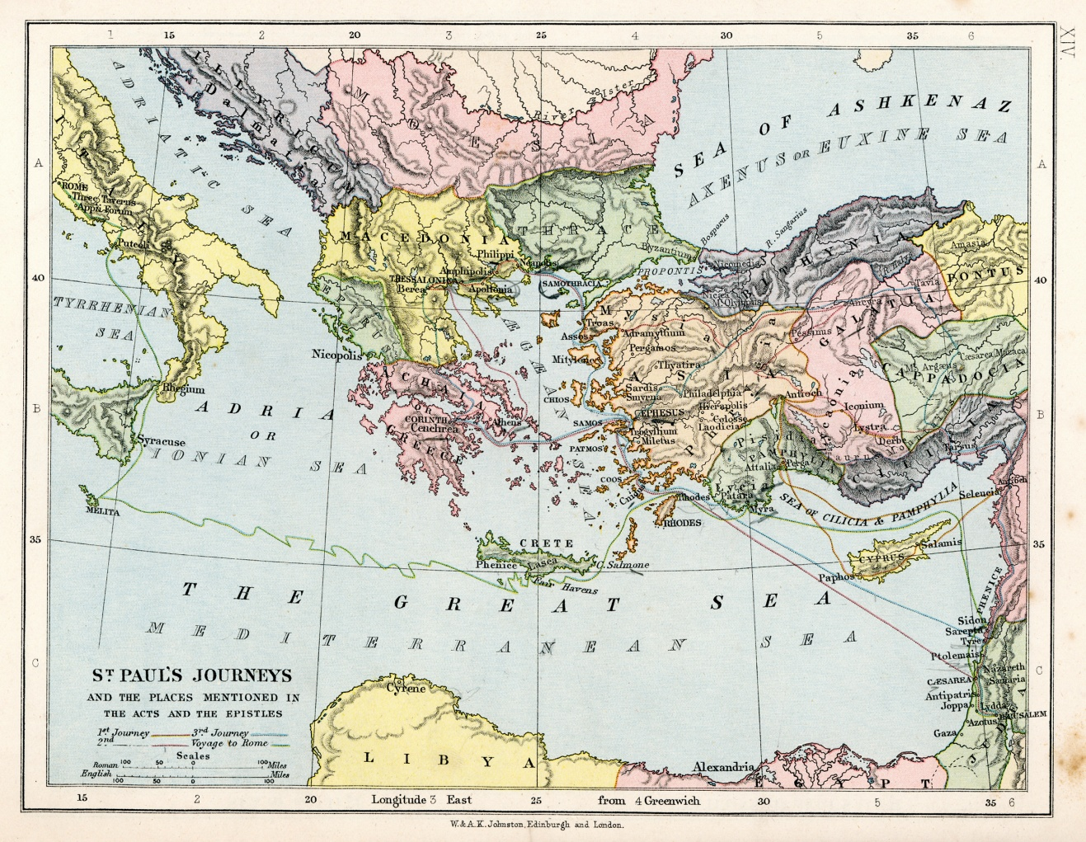
The Spread of Christianity
Within a few years of Jesus’ death, the Church had spread widely.
The love of God motivated and energized the Apostles and disciples.
The Church needed to be missionary so she could share the Good News.
© duncan1890 / iStock
© 2016 Saint Mary’s Press
Living in Christ Series
Notes:
Notes: Using the map in article 11 of the student book, discuss the spread of the Church to the locations noted in that article: from Jerusalem to Samaria, Damascus, Phoenicia, Antioch, Asia Minor, Greece, Rome, Egypt, and Syria. If laptops are in use, ask for distances and discuss first-century modes of travel.

Slide 4
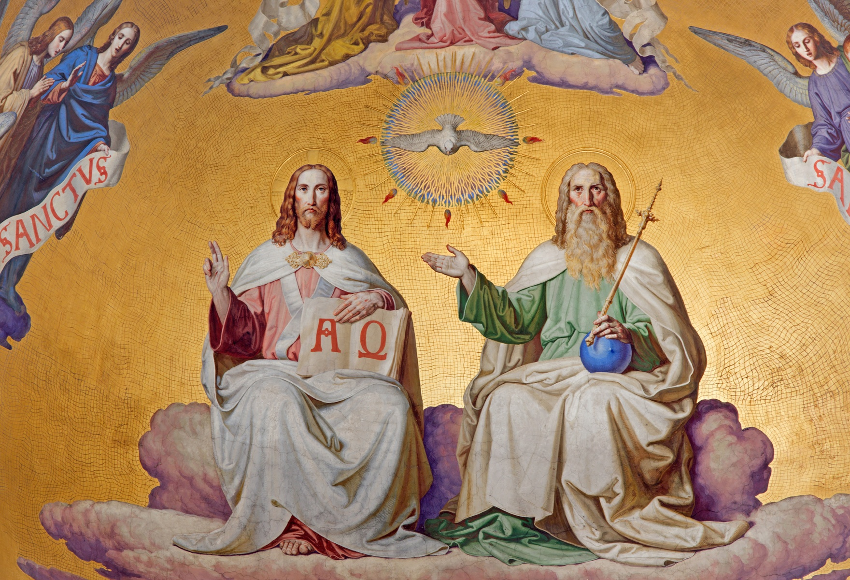
The Holy Spirit and the Apostles’ Mission
The Holy Spirit was involved in every aspect of the spread of Christianity.
The Holy Spirit came to those who were baptized . . .
and helped the Church to make decisions.
© Renata Sedmakova / Shutterstock.com
© 2016 Saint Mary’s Press
Living in Christ Series
Notes:
Notes: Point out that the Church’s mission is Trinitarian: the mission of the Son is the Father’s eternal plan. The Holy Spirit empowers us to carry out that mission.

Slide 5
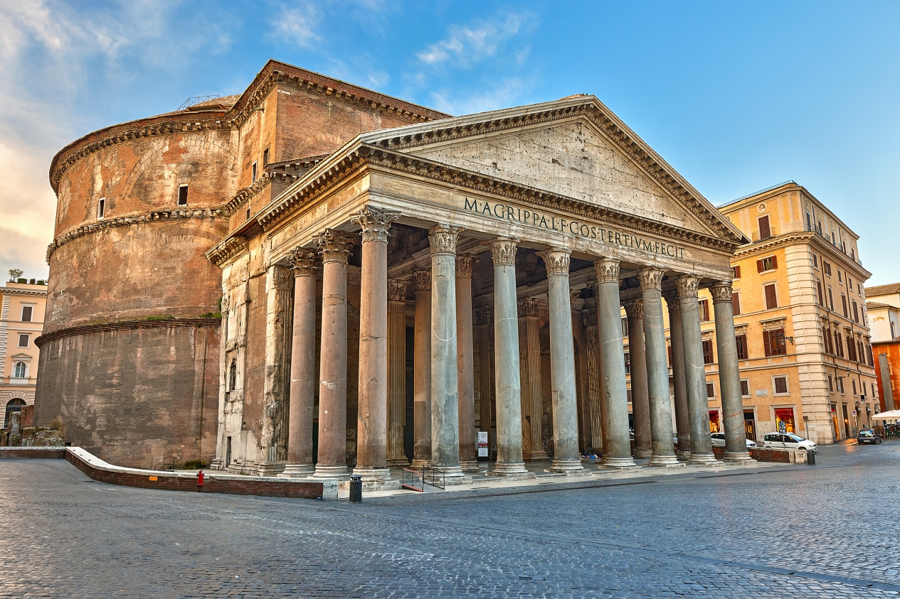
Saint Paul Preached to Both Jews and Gentiles
Saint Paul was a devout Jew, raised in Hellenistic Tarsus.
Preaching to a Jewish audience, Paul applied Old Testament prophecies to Jesus.
Preaching to Gentiles, he related the Gospel to their culture.
© S Borisov / Shutterstock.com
© 2016 Saint Mary’s Press
Living in Christ Series
Notes:
Notes: Explain that the language and culture of the area around the Mediterranean was Greek, although it was ruled by Rome. Ask for examples of Christian contemporary music, such as Christian rock, and discuss how it is a modern example of adapting the Good News to the culture of the audience.

Slide 6
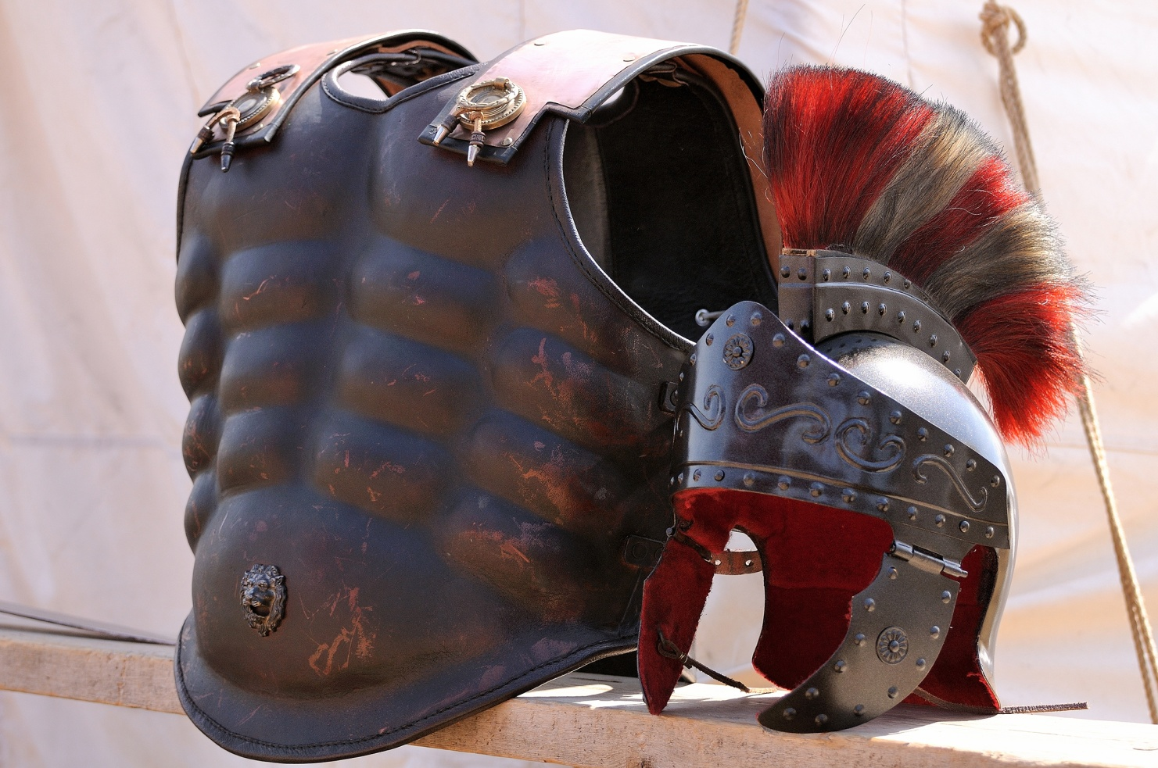
Paul Used Familiar Imagery
Jesus used images familiar to his audience, such as farmers or fishermen at work.
Paul followed Christ’s example.
He spoke of athletes, military armor, musical instruments, temples, and so on.
© 2016 Saint Mary’s Press
Living in Christ Series
© Kissofdeath / Shutterstock.com
Notes:
Notes: If the students have Bibles, assign the following passages, and ask the students what words they would change if they were speaking to a modern audience: 1 Corinthians 9:24–27, Ephesians 6:10–17, 1 Corinthians 13:1, 1 Corinthians 6:19.

Slide 7
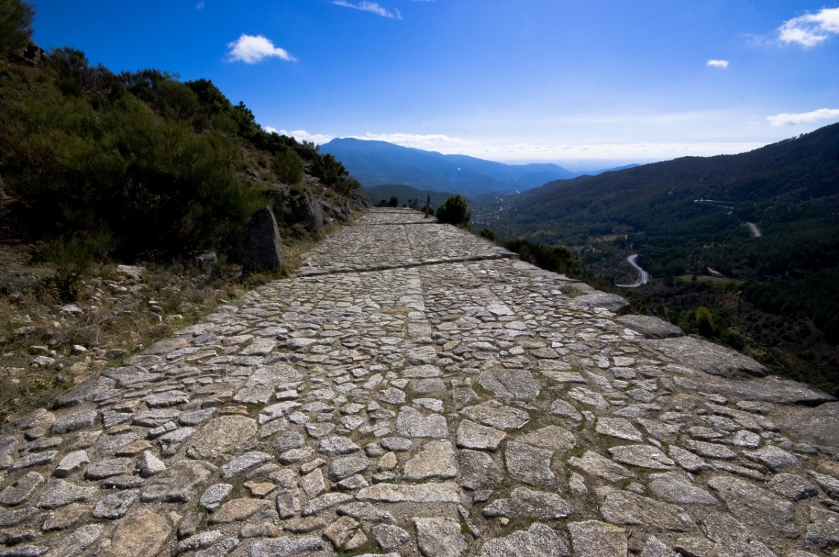
How Did Christianity Spread So Quickly?
The Church was able to reach people from a range of backgrounds.
The Roman Empire had a good system for travel.
Even persecution played a role in helping to spread the Good News.
© Brian Maudsley / Shutterstock.com
© 2016 Saint Mary’s Press
Living in Christ Series
Notes:
Notes: Ask for volunteers to explain the first two bullet points, as in article 12 of the student book. The next slide expands on the last bullet point.

Slide 8
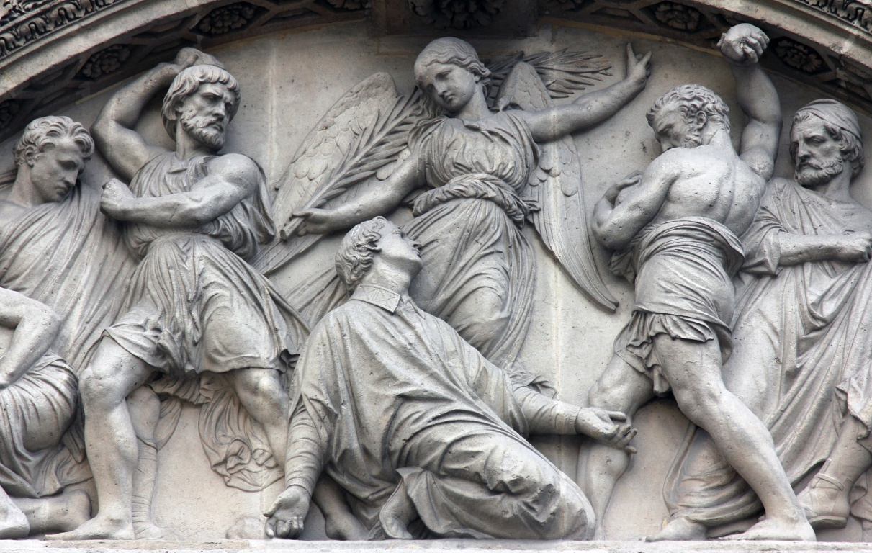
Persecution and Martyrdom
Jewish leaders considered claims of Jesus’ divinity to be blasphemous.
To Roman authorities, a refusal to offer sacrifice to the emperor was a crime.
Despite threats of execution, many Christians refused.
© Zvonimis Atletic / Shutterstock.com
© 2016 Saint Mary’s Press
Living in Christ Series
Notes:
Notes: Explain that both Jewish and Roman authorities persecuted the early Christians.

Slide 9

Martyrs of the Early Church
The highest form of Christian witness is giving up one’s life for Christ.
The followers of Jesus often accepted their suffering with joy.
Persecution produced martyrs whose examples encouraged other Christians.
© nautilus_shell_studios / iStock
© 2016 Saint Mary’s Press
Living in Christ Series
Notes:
Notes: Discuss the willingness of modern Christians to remain faithful in places where they are persecuted today. Discuss the assertion in the student book that faithful teenagers in our culture may face persecution too.

Slide 10
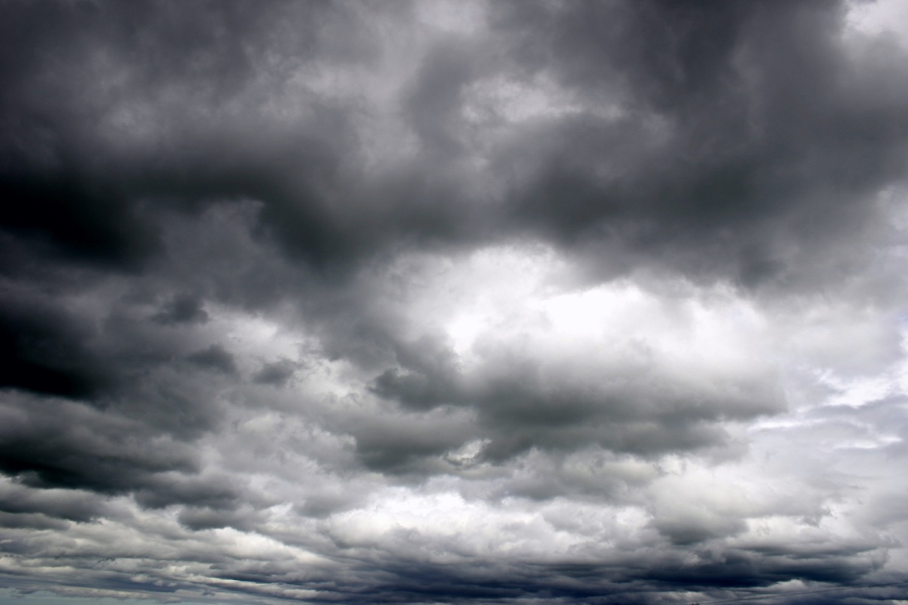
The Church’s Final Trial
In the last days, before Christ’s Second Coming, there will be a final persecution.
One scriptural prediction mentions an antichrist, or false messiah.
Perhaps an earthly power will try to claim the ultimate authority of God.
© STILLFX / Shutterstock.com
© 2016 Saint Mary’s Press
Living in Christ Series
Notes:
Notes: Explain that even in our lifetimes, we may have to stand up to an earthly authority that is claiming God’s authority, as did those who resisted the Nazi regime.

Slide 11
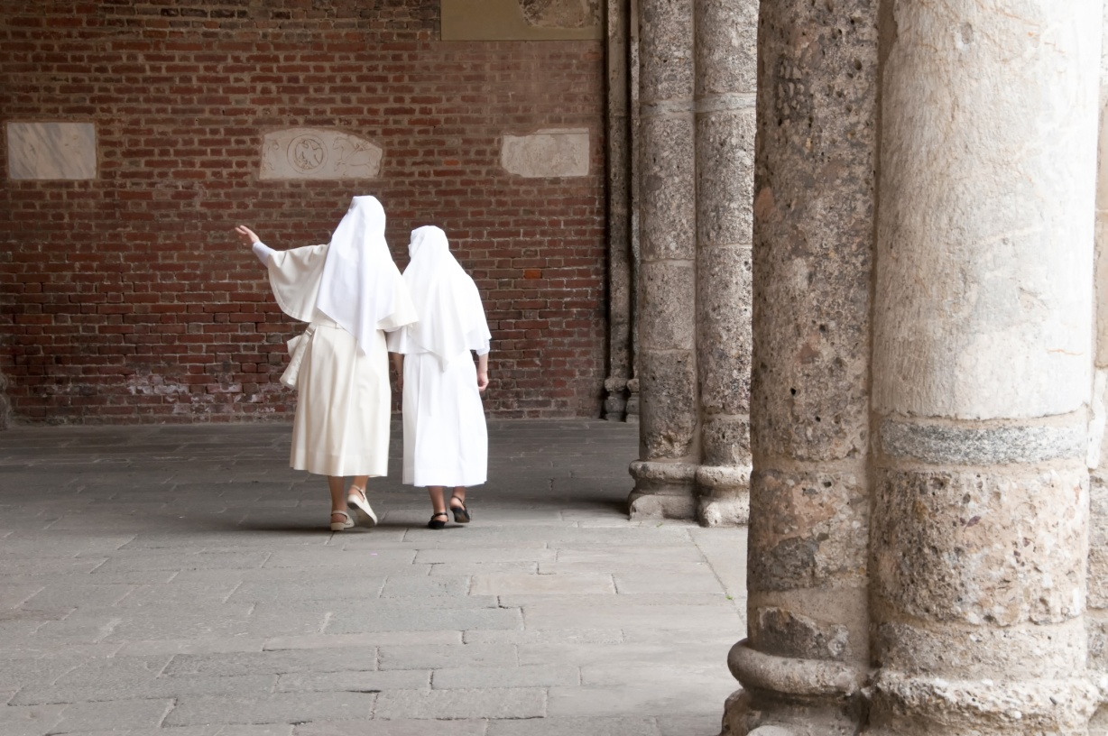
The Church’s Role within History
The Church’s accomplishments throughout history are visible signs of salvation.
They are the outward manifestations of sources of healing, knowledge, and creativity . . .
that lie hidden within the mystery of the Church.
© Stefano Panzeri / Shutterstock.com
© 2016 Saint Mary’s Press
Living in Christ Series
Notes:
Notes: Direct the students to read the sidebar “The Church’s Role within History,” in article 13 of the student book. Discuss how the examples in the sidebar show that the Church has been instrumental in bringing God’s will to life in the world. Ask for modern examples.

